Slide 1
Predicting home prices
Ron Sperber

Slide 2
Motivation
Finding an appropriate price for a home helps a seller get a good price and sell a home quickly
Finding what the appropriate price of a home is helps a buyer make an educated offer on a home

Slide 3
Overview of the process
Obtained data from https://www.kaggle.com/c/house-prices-advanced-regression-techniques/
Did exploratory data analysis and some data cleaning
Created some models to see how well they did at predicting prices
Chose the model that worked best and used that to predict prices on set of houses that didn’t have a price given

Slide 4
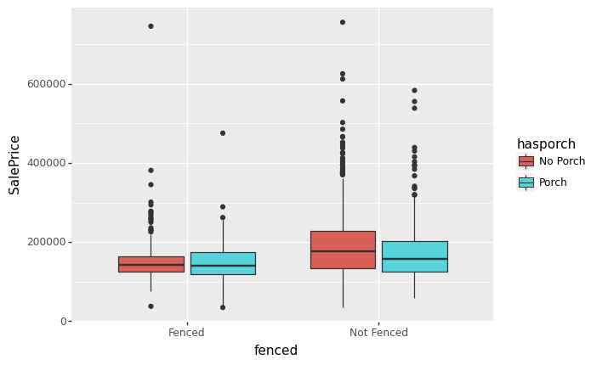
What did we find when we looked at the data?
One unexpected result: We compared homes with fenced in yard to those without and didn’t see a meaningful difference overall

Slide 5
What else did we find?
We looked to see what features might affect the price per square foot.
One of the strongest effects on that was the exterior quality

Slide 6
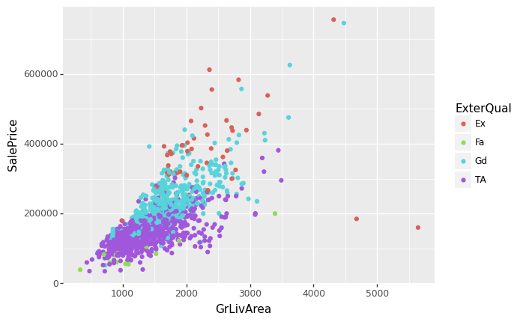
Sale price vs Living area by exterior quality

Slide 7
What was approach?
Initially wanted to see how linear regression would do
Examined all categorical features to see if we needed them or not for regression
Settled on keeping the Exterior quality variabe

Slide 8
Using Linear Regression
We approached using the exterior quality variable in two ways for linear regression
Split the data into the two groups where we saw the split :”Excellent” and “Good” together , and “Fair” and “Typical/Average” together
Turned the Exterior Quality variable into an integer with fair ranked lowest up to “Excellent” at the top

Slide 9
How did regression do?
It didn’t work very well with either approach.
Second approach was slightly better, but not by much.
Quite possibly the fact that several of the features were correlated made it a bad choice.

Slide 10
What next?
After we started with the baseline linear regression we went to the LightGBM model
This is a gradient boosted model based on decision trees
One plus was that it could work with categorical features

Slide 11
How did this model do?
This model actually performed rather well.
After some tuning, we achieved an R² score of about 0.892 on a validation set
This was significantly higher than the R² score we got from regression

Slide 12
Future thoughts and wrap-up
This approach could be used in any area with the data available.
Models probably would need to be re-run over time as the overall market changes
This definitely seems to be a better way to look at prices than a few comparable homes sold.

