Slide 1
UFCFT4-15-3 Cryptography by Rong Yang and Essam Ghadafi rong.yang@uwe.ac.uk room 2P35
3 hours contact time per week:
Lecture – for all
Tutorial – three groups (lecturing + problem solving in class)
Lab – three groups

Slide 2
Coding, Coding Theories some math + some programming a theoretical subject, learn algorithms
What do we mean by coding?
Data → → → → → → Encoded Data
Encoded Data → → → → → → Data
Three areas in coding :
Error correction
Cryptography
Data Compression

Slide 3
Cryptography
Plan
Part 1 - Error Correcting Codes (2-3 weeks)
Part 2 - Cryptography (7-8 weeks)
Part 3 - Data Compression (1 weeks)
Revision (1 week)
~~~~~~~~~~~~~~~~
CW – 75% (hand in Thursday, 14-12-2017)
Exam – 25% (any day between 8-19 January 2018)

Slide 4
References
Books:
A First course in Coding Theory by R. Hill
Codes and Cryptography by D. Welsh
Coding Theory: A First Course by S.Ling, & C. Xing
Cryptography and Network Security by William Stallings (can be shared with the internet security module?)
~~~~~~~~~~~~~~~~~~~~~~
We will try to use maths as little as possible
But at least we need modular arithmetic (this week’s tutorial)

Slide 5
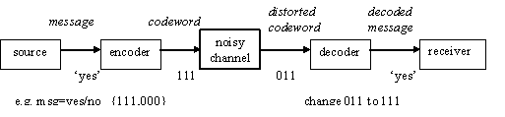
Introduction to Error Correcting Codes
Error correcting codes are used to correct errors when messages are transmitted through a noisy communication channel.
The channel may be: a telephone line, a satellite communication link, or an information storage medium (e.g. cd, magnetic-tape, RAM)
The noise may be human error, lightning, thermal noise, imperfection in equipment, etc.
The object of an error correcting code is to encode the data, by adding a certain amount of ‘redundancy’ to the message, so that the original message can be recovered if errors have occurred.

Slide 6
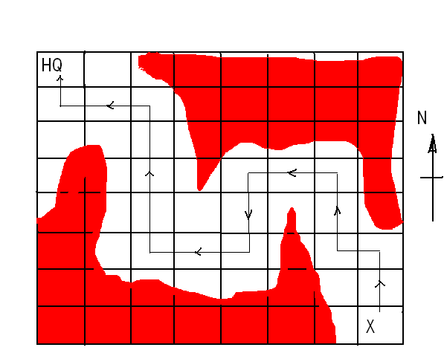
Example 1.1 HQ and X have identical maps girded as shown below, but that only HQ knows the route indicated, avoiding enemy territory, by which X can return safely to HQ.
Source symbols = {N,W,E,S}
Message is a sequence of source symbols: NNWNNWWSSWWNNNNWWN
As there are 4 different symbols, they can be encoded into the following binary codeword:
* shortest code * parity code
00 = N 000 = N
01 = W or 011 = W
10 = E 101 = E
11 = S 110 = S

Slide 7
How is the 3rd digit added in?
s3 = (s1+ s2) mod 2
What is it used for?
to detect single error (let’s assume that multiple errors are very rare in this example)
When single error occurred, we can recognize it because it is NOT a codeword! (all codeword have even number of 1s)
In this example, reliability is far more important than speed of transmission. Thus, it is definitely worth adding an extra digit. When X receive a distorted information, he can ask HQ to return it again until correct information is received.
Question - Is this kind of error detecting good enough? What if X can only receive from HQ but unable to send message back to HQ (one-way channel)?
Examples of One-way channel: playing CD or tape; receiving life pictures from spaceship

Slide 8
We need not only to detect but also correct errors
How to recognize the error and correct it?
A naïve method – e.g. duplicating every bit to 3 copies
00 -> 000 000
01 -> 000 111 with this coding, e.g. a distorted 001 can
10 -> 111 000 be identified and corrected to 000.
11 -> 111 111 but the length of message is increased 3 times!
What if there are two or more errors?
Major Issues :
How to design an efficient code with the minimum redundant digits
What is minimum? How to work out a lower bound?

Slide 9
Definitions – for an important metric
Definition1.1 The Hamming distance between codeword x, y is denoted by d(x,y). It is the number of places in which x and y are differ.
e.g. d(000,010)=1, d(00111,11001)=4, d(an,as)=1
Definition1.2 The minimum distance of a code C, denoted d(C), is the smallest of the distances between distinct codewords in C.
d(C) = min{ d(x,y) | x,y ∊ C, x ≠ y }

Slide 10
Checking codes given so far, can you work out their minimum distances?
C1 = {00,01,10,11}
d(C1) = 1
C2 = {000,011,101,110}
d(C2) = 2
C3 = {000000,000111,111000,111111}
d(C3) = 3

Slide 11
Theorem (what is the limit on detecting error?)
Theorem 1.1 A code C can detect up to s errors in any codeword if d(C) >= s+1.
Proof: Suppose a codeword x is transmitted, and received as y with s or fewer errors (s>=1), Then we recognise that y has been distorted because y is no longer a codeword.
E.g. C = {000,011,101,110}, parity checking code, d(C) = 2
It can detect a single error (i.e. d(C)=2>=s+1, so s=1)
000 -> 010 wrong 101 -> 001 wrong 111 - > 101 wrong
000 -> 000 correct 101 -> 000 wrong, but 2 errors can’t be detected

Slide 12
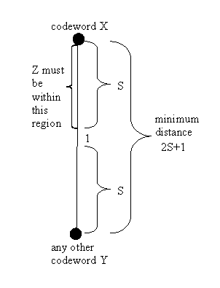
Theorem (what is the limit on correcting error?)
Theorem 1.2 A code C can correct up to s errors in any codeword if d(C) >= 2s+1.
Proof (informal): Suppose a codeword x is transmitted, and received as z with s or fewer errors (s>=1), then d(x,z)=<s. Since d(C)>=2s+1, x to any other codeword y’s distance is greater than or equal to 2s+1. Therefore from z we can find x by looking for the nearest codeword.
(this is called nearest neighbour decoding)

Slide 13
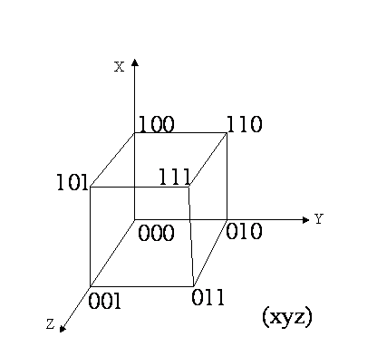
Cont. from the last slide. A simple example, using 3D space to illustrate ….
All possible binary strings with length 3 are
{000,001,010,011,
100,101,110,111}
Let’s have a code
C = {000,111},
d(C) = 3, s=1
It can correct a single error:
000 -> 010 wrong, nearest codeword is 000
111 -> 101 wrong, nearest codeword is 111
000 -> 110 wrong, but 2 errors can’t be corrected

Slide 14
An interesting code example (today’s lab)
Example 1.2 The ISBN code (International Standard Book Number) e.g. 0-19-853287-3. Hyphens positions are ignored. Total 10 digits.
The 1st digit indicates the language (e.g. 0 for English)
The next 2 digits stand for publisher (e.g. 19 for Oxford Uni. Press)
The next 6 digits are assigned by the publisher
The final digit is for error detecting, it is worked out by
d₁₀ = (d₁ + 2d₂ + 3d₃ + …+ 9d₉) mod 11
(Q. what is the difference with binary parity checking code?)
Check the example 0-19-853287-3
0+2+3*9+4*8+5*5+6*3+7*2+8*8+9*7=245
245 mod 11 = 3 (245=11*22+3) d₉ = 3

Slide 15
Note that when mod operation returns 10, the symbol X is used.
To check if a given number is a valid ISBN, we check if
(d₁ + 2d₂ + 3d₃ + …+ 9d₉+10d₁₀) mod 11 = 0
or (Q. why these two do
(d₁ + 2d₂ + 3d₃ + …+ 9d₉) mod 11 = d₁₀ the same check?)
Examples:
Check whether 0-2-33-56131-5 is a valid ISBN:
1*0+2*2+3*3+4*3+5*5+6*6+7*1+8*3+9*1=126
126 mod 11 = 5, so it is a valid ISBN
What if this number is entered wrongly as
0-2-83-56131-5
1*0+2*2+3*8+4*3+5*5+6*6+7*1+8*3+9*1=141
141 mod 11 = 9, so it not an ISBN code.
What if two digits have been transposed, 0-13-165332-5
1*0+2*2+3*3+4*3+5*6+6*5+7*1+8*3+9*1=125
125 mod 4 = 3, so it not an ISBN code.
We can see from the above example that by using a weighted check sum, we can not only detect single error but also detect the transposition of two digits.

Slide 16
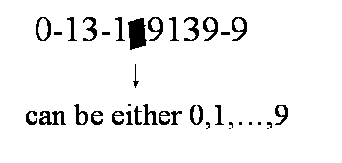
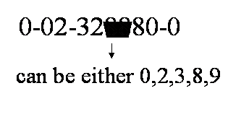
Q. The following ISBNs have been received with smudges. What are the missing digits?
Find x such that
2*1+3*3+4*1+5*x+6*9+7*1+8*3+9*9+
10*9 ≡ 0 mod 11
→ 271+5*x ≡ 0 mod 11
→ 7+5*x ≡ 0 mod 11
→ x = 3
Harder! Find x,y such that
3*2+4*3+5*2+6*x+7*y+8*8 ≡ 0 mod 11
→ 92+6*x+7*y ≡ 0 mod 11
→ 4+6*x+7*y ≡ 0 mod 11
multiple solutions ??
(x=3,y=0)
(x=9,y=9) … ?

Slide 17
Another interesting code example
Example 1.3 How credit card numbers are generated?
total 16 digits,
first 6 digits is known as the issuer identifier number,
next 9 digits in the middle form the account number, and
the last digit is the “check digit”
Similar to ISBN number but not using mod 11, the last number is generated to satisfy a certain condition called the Luhn or Mod 10 check.
Use an example to illustrate Luhn check:
4552 7204 1234 5698 first, double every alternate number
-> 85(10)2 (14)204 2264 (10)6(18)8 if result >=10, take away 9
-> 8512 5204 2264 1698 now use this to do mod 10
Add up all the digits in this new number. If the final total is perfectly divisible by 10, then the credit card number is valid (Luhn check is satisfied), else it is invalid.
In this example, 8+5+1+2+5+2+4+2+2+6+4+1+6+9+8=65, so it’s invalid
Can you work out what the correct check digit should be?

Slide 18
Additional Maths - Modular Arithmetic
Operation x mod y means finding reminder of
x ÷ y. e.g. 13 mod 12 = 1 (a 12 hour clock system)
24 mod 7 = 3 15 mod 3 = 0
-5 mod 12 = 7 -10 mod 60 = 50
34 mod 11 = 56 mod 11 = 1
(a+b) mod c = a mod c + b mod c
(a*b) mod c = (a mod c) * (b mod c)
(17+15) mod 11 = 32 mod 11= 10
= 17 mod 11 + 15 mod 11 = 6+4
(17*15) mod 11 = 255 mod 11= 2
= 17 mod 11 * 15 mod 11 = 6 * 4 = 24 = 2 mod 11

Slide 19
What to remember …
Hamming distance between two codewords
The minimum distance of a code
How to generate/verify ISBN code
How to generate/verify a credit card number
Modular arithmetic

