Slide 1

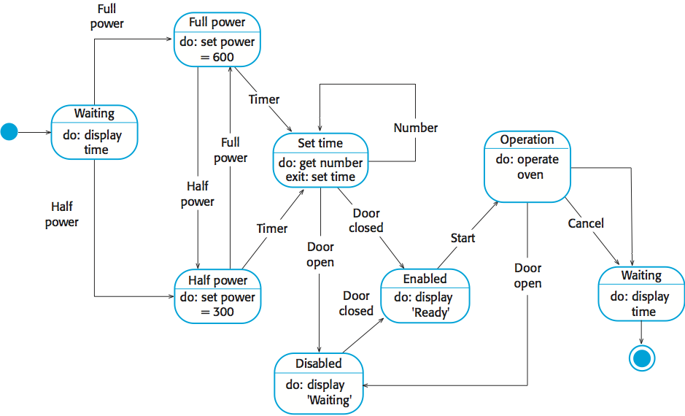
Research: A short summary of your research providing key related works; Be critical. Use appropriate citation.
UFCFXK-30-3: Digital Systems Project
Student name:
Project Title:
Abstract:
The abstract includes a short description of the project. It should not exceed one paragraph. Ideally, it should summarise the key points of your project including the project idea and scope.
Design and implementation
State Diagram
Aims and objectives:
A very short description of the aims of the project and an outline of the objectives.
e.g. The project objectives are:
…
…
…
…
Implementation artefacts (if any)
Can include other diagrams that verify the implementation process (e.g. class diagram etc.)
or
A screenshot of your GUI or ‘code output so far’ or similar
Planning and Management: This section will include your planning and management.
Key requirements:
Provide key requirements with short description if required.
Functional
The tool must blah blah
The tool must blah blah blah
The tool should blah blah blah
The tool should blah blah blah
The tool would blah blah blah
Non-functional
The tool must blah blah blah
The tool must blah blah blah
The tool should blah blah blah
The tool should blah blah blah
The tool would blah blah blah
References: References and citations should be in UWE Harvard style

