Slide 1

SMART TRAVEL PLANNER
2103A51067 Rontala Pooja Reddy
2103A51550 Bathini Shiva Sathvika
2103A51571 Podishetti Nithin
2103A51263 Galib Sai Balaji
2103A51188 Tirumalagiri Hrushikesh
Under the Guidance of
Mr. CH.SANDEEP

Slide 2
Abstract:
The Smart Travel Planner is an AI-powered tool that makes travel planning easy and personalized. It suggests destinations and activities based on your preferences, mood, and budget, whether you want to relax, explore cultures, or seek adventure.
It promotes eco-friendly travel and local experiences, like cooking classes and guided tours. The planner includes helpful features like real-time updates on flights and weather, language assistance, safety tips, and even a service to match travel companions.
Extra tools like wellness plans, a travel journal, and fun challenges add to the experience. Built with advanced technology, it provides 24/7 support and constantly improves to make your trips smooth and enjoyable.

Slide 3
Problem Identification:
Travelers face many problems when using current travel planning tools. Most of these tools do not give personalized suggestions that fit each travelers needs. Instead, they offer general advice that may not be useful.
Information is scattered so travelers need to search different websites to gather details which can be slow and confusing. Often, this information is old or wrong, leading to bad decisions. Managing travel plans like activities, hotels, and flights can be hard, making it easy to miss important things. Its also tough to find the best prices, causing travelers to spend more than they should.
Many tools don’t provide real time updates, like flight delays or changes, leaving travelers unprepared.
Privacy is another worry people are afraid to share their personal information because they don’t trust these platforms. Finally, some tools are not easy for everyone to use.

Slide 4
Introduction:
A Smart Travel Planner makes planning trips easy and enjoyable by using technology to handle all the details in one place. It personalizes recommendations based on your preferences, like activities, or budget, and suggests destinations, accommodations, and activities just for you.
By combining flights, hotels, transport, and tours on a single platform, it saves time and avoids scheduling problems. It also finds the best deals to save money and provides real-time updates to handle changes like flight delays.
With clear schedules, maps, and local tips, the planner ensures a stress-free, fun, and well-organized travel experience for everyone.

Slide 5
Objective of the Problem:
User Experience: Traditional travel planning tools often provide generic suggestions and can be confusing, leading to a frustrating experience.
Data Reliability: Many existing systems rely on outdated or inaccurate data, resulting in poor recommendations and potential travel issues.
Time Efficiency: Users frequently have to navigate multiple websites and apps, making trip planning time-consuming and prone to mistakes.
Budget Management: Finding the best deals and staying within budget can be challenging, leading to overspending or missed opportunities.
Information Organization: Travelers often struggle to keep their itineraries organize which can lead to confusion and missed activities.
Privacy and Security: Users are concerned about the safety of their personal information, especially when using online platforms.
Accessibility: Not all travel tools are user friendly for diverse audiences.

Slide 6
Literature Review:
Smart Tourist Guide System(Chavan,Rahul et.al.)
The Smart Tourist Guide System is a mobile app that provides detailed information about popular tourist spots in Delhi, making it a cost-effective alternative to professional guides.
It uses GPS and Google Maps to help users navigate easily, find restaurants, and get real-time weather updates while allowing them to share their experiences.
ChatGPT as a Travel Itinerary Planner(Katerina Volchek1 and Stanislav Ivanov)
This study compares itineraries created by ChatGPT with those made by travel experts, highlighting that ChatGPT can draft initial travel plans effectively.
While ChatGPT can generate feasible itineraries for popular places, it sometimes lacks details and may provide outdated information, requiring further refinement.
Smart Travel Planner: A Mashup of Travel-Related Web Services(Rabia Jafri)
The Smart Travel Planner is a web-based tool that combines multiple travel services into one platform, allowing users to plan trips easily and customize itineraries.
It integrates various APIs, like Google Maps and Expedia, to provide real-time information and recommendations for hotels, routes, and sightseeing.
AI-Driven Personalized Tourism Recommendation System(Suhaidi Hassan)
This system uses AI and GIS technologies to create personalized travel recommendations based on users' preferences expressed in natural language.
It clusters nearby attractions and suggests travel routes, making planning simpler and more tailored to individual needs.

Slide 7
Literature Review:
Smart Travel Guide Application(Mohana Priya and Vinoth Kiron Sadhasivam)
The Smart Travel Guide Website is a user-friendly platform built with PHP and other technologies to help travelers plan their trips effectively.
It stores user preferences and location information to provide personalized travel recommendations and itineraries.
Smart Travel Planner Using Hybrid Model(Suresh Babu Dasari,V.Vandana and A.Bhharathee)
This project focuses on creating a personalized vacation planning tool that considers users’ unique preferences for routes and attractions.
It uses web scraping and machine learning algorithms to group nearby tourist spots and make customized suggestions for users.
Personal Smart Travel Planner Service(Ki-Beom Kang)
This paper proposes a smart tourism app that helps users create personalized travel itineraries and offers context-aware tour guidance.
The system includes a chatbot feature, allowing users to easily access tourist information and modify their travel plans while on the go.

Slide 8
Literature Review:
Smart Travel Planner for Urban Sustainability (Jacek Malasek)
Making Travel Greener: The Smart Travel Planner helps people find eco-friendly ways to travel, like walking, biking, or using public transport, using live traffic and pollution data.
Rewards and Teamwork: People earn rewards for choosing green options, and the system works with governments and transport companies to keep improving.
Personalized Travel Products for Smart Tour Guidance (J.W. Jwa)
Personalized Plans: The planner creates customized travel routes using smart technologies like big data and cloud systems.
Tourism Features: It helps tourists with route suggestions, updates, and sharing options like bike rentals to make trips fun and eco-friendly.
Integrating Tourist Packages and Attractions (Hsueh-Chan Lu et al.)
Eco-Friendly Travel: The system suggests routes that reduce car use and encourages green travel with rewards.
Better Trips for Tourists: Travelers get detailed plans with maps, guides, and updates for an easy and enjoyable experience.
Active Transport Journey Planner Methodology (Wenqi Hu et al.)
Healthier Travel Options: The planner recommends walking or biking by balancing time, cost, and environmental impact.
Simple Ranking: People can input their needs, and the system ranks the best travel choices for them.

Slide 9
Literature Review:
Navigating Overtourism (Majid Mohammad Shafiee)
Crowd Problems: Popular places get too crowded, causing pollution and ruining the experience for both locals and visitors.
Smart Fixes: Apps and sensors guide tourists to less crowded spots and predict busy times to protect the environment and improve visits.
Smart Travel Survey Experiment (Barry Schouten et al.)
Tracking Travel Habits: Apps are better at collecting travel data but face challenges like tech issues and privacy worries.
Best of Both Worlds: Mixing apps and surveys improves data quality and participation if apps are made easier to use.
Travel Smart, Spend Smart (Ainur Shafiqah Binti Shahrul Nizam)
Budgeting for Travel: Plan for trip expenses and save money ahead of time to avoid financial problems.
Smart Money Tips: Track spending, look for discounts, and use credit cards wisely to stay within your budget.
Smart Travel Service in Intercity Travel (Zhi Dong et al.)
Happier Trips: Smart tools like apps and GPS make travel easier, safer, and better for the environment, especially for frequent users.
Making Tools Better: Add more features for regular users and teach others how to use them to encourage everyone to try them out.

Slide 10
Proposed Plan:
The Smart Travel Planner makes planning trips much easier with several great features. First, it gives you personalized suggestions based on what you like, helping you decide where to go and what to do. You can book flights, hotels, car rentals, and activities all in one place, which saves you time.
It also finds the best deals so you can stick to your budget without losing quality. You’ll get real-time updates about changes, like flight delays, and it will suggest other options. The planner organizes your trip with schedules and maps, making it easy to follow. It also shares local tips for places to eat and things to do. Plus, your personal information is kept safe, and it supports everyone.

Slide 11
Advantages :
1. Personalized Suggestions: It gives you travel recommendations based on your likes and preferences, such as where to go, what to do, and where to stay.
2. All-in-One Tool: You can book flights, hotels, car rentals, and activities all in one place, saving you time and effort.
3. Best Deals: It finds the best prices for flights, hotels, and activities, helping you stick to your budget while getting good quality.
4. Real-Time Updates: It keeps you updated on changes like flight delays or local events and suggests alternatives to keep your plans on track.
5. Easy planning the trips: It organizes your trip into a clear plan with schedules, maps, and reminders, making it easy to follow and enjoy your travel.
6. Local Tips: It offers recommendations for things to do, places to eat, and attractions to visit, helping you find great experiences at your destination.
7. Privacy Protection: Your personal information is kept safe with strong security measures.
8. Multi language Support: It supports different languages and cultures, making it useful for everyone.

Slide 12
Requirements:
Software Requirements :
Frontend: we use React.js, plus HTML, CSS, and JavaScript. For styling,we use Bootstrap or CSS.
Backend: Go with Node.js and Express.js. For the AI part, use Python and some travel APIs like Skyscanner.
Database: You can use MongoDB .
AI/ML Libraries: Use scikit-learn or TensorFlow for AI stuff, plus some NLP tools like spaCy.
Tools: Git for version control, VS Code for coding.
Hardware Requirements:
CPU: Multiple cores (quad-core or higher)
RAM: Minimum 8 GB (16 GB+ recommended for handling concurrent requests)
Storage: SSD with at least 100 GB for application, user data, and logs
Network: High-speed internet connection for real-time API integration and user access

Slide 13
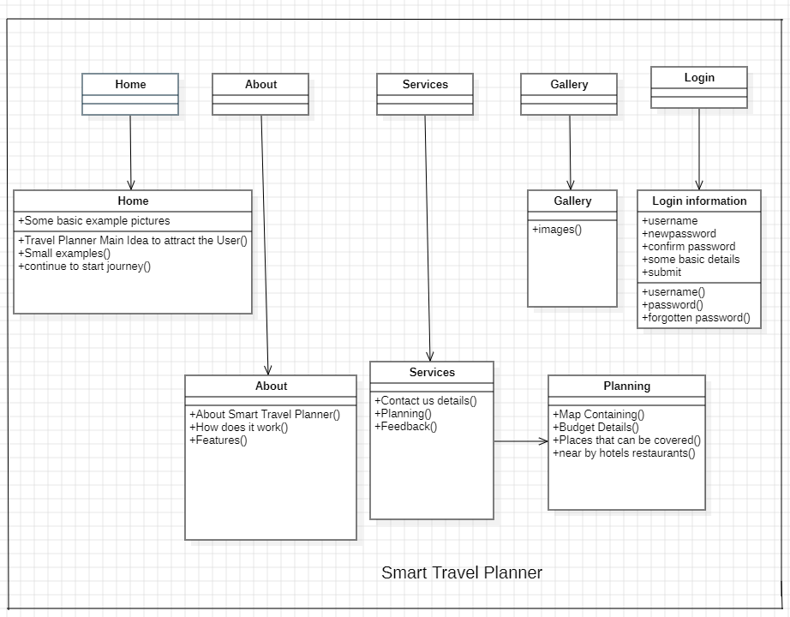
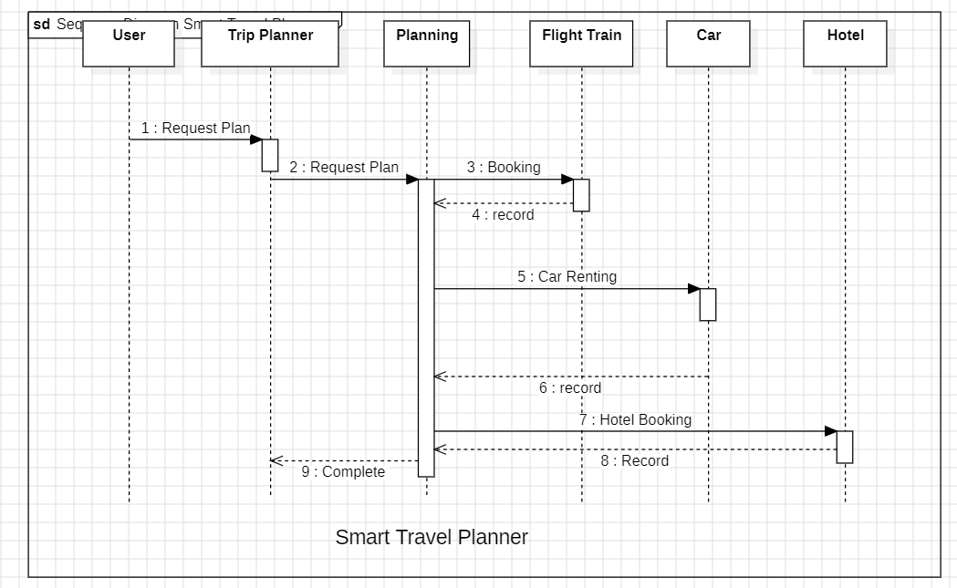
Class Diagram:
Sequence Diagram

Slide 14
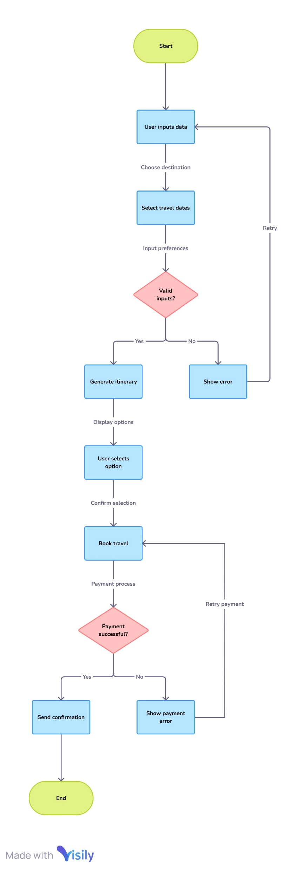
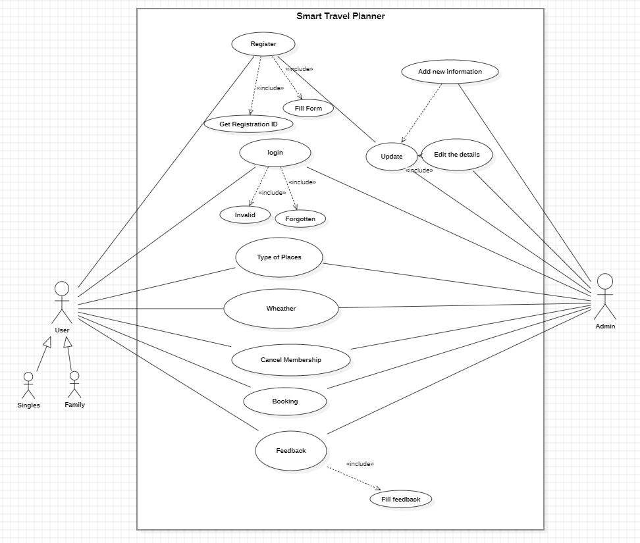
Flow Chart
Use-Case Diagram

Slide 15
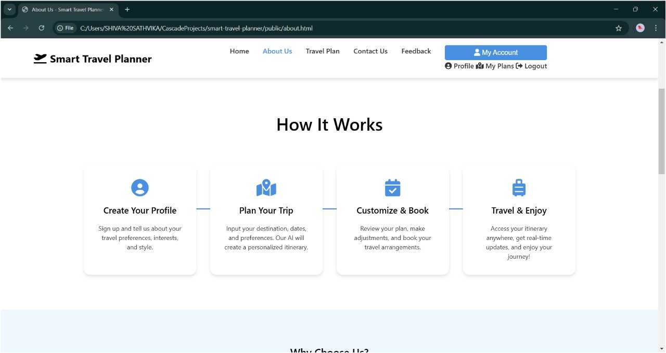
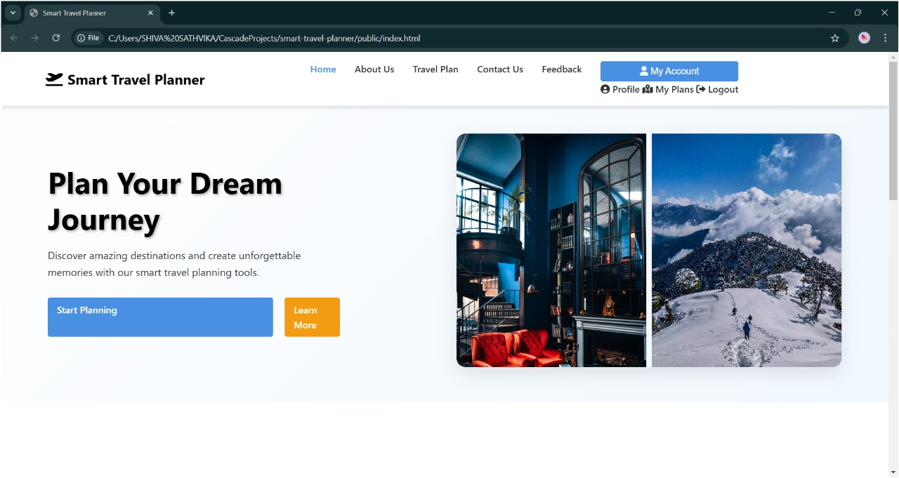
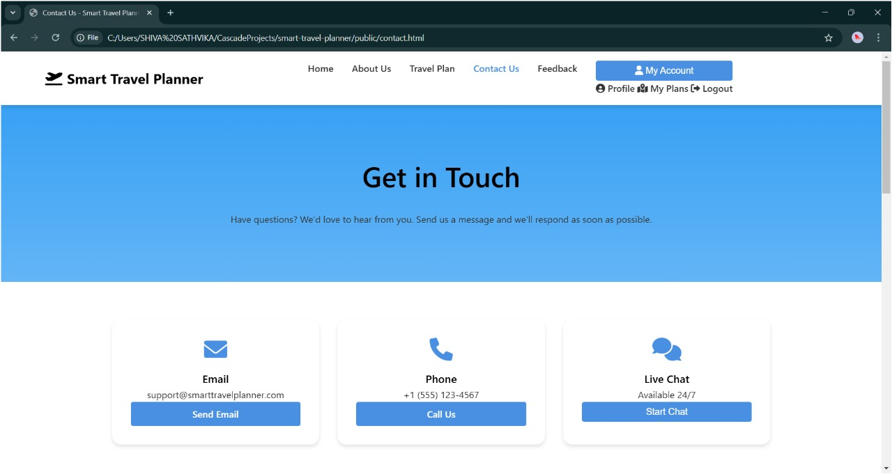
Results:

Slide 16
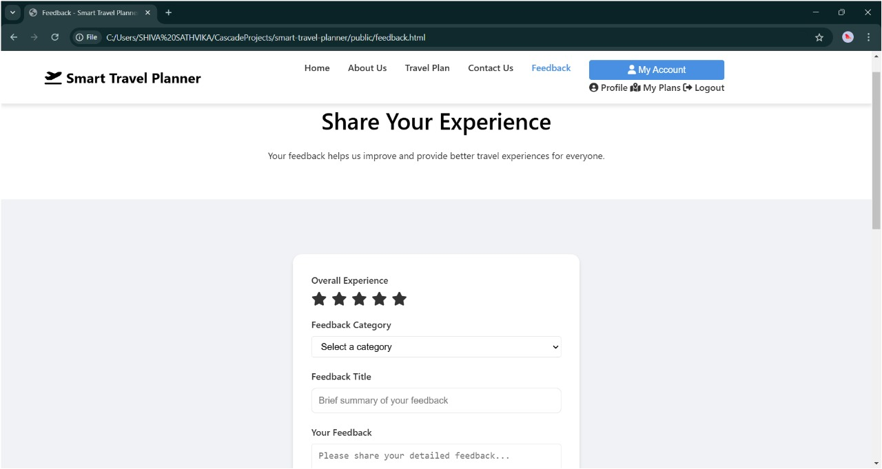
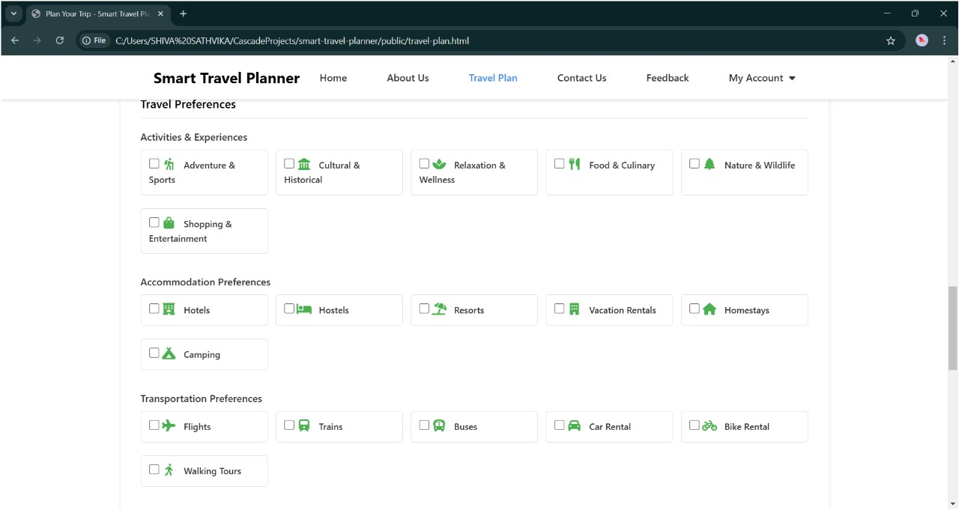
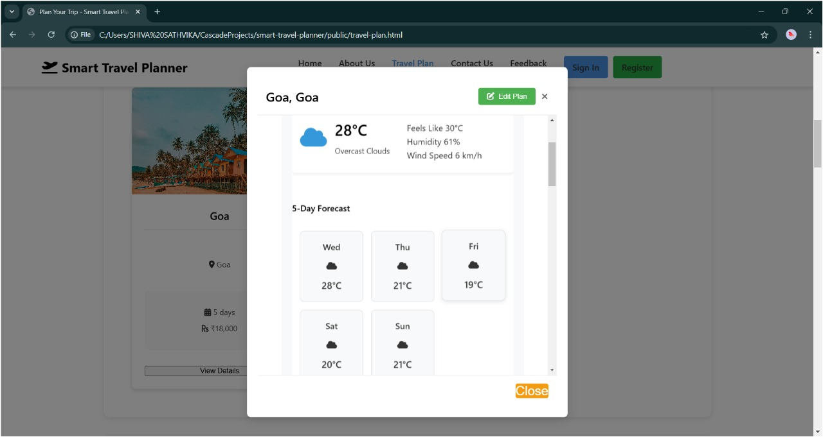

Slide 17
Conclusion:
The implementation of the Smart Travel Planner showcases how technology can simplify and enhance travel planning.
By combining AI, real-time data, and user-friendly design, the planner delivers personalized itineraries and valuable recommendations. It also emphasizes sustainable and culturally sensitive travel practices, addressing modern travelers' diverse needs.
This project fosters essential skills such as teamwork, problem-solving, and adaptability, providing a strong foundation for tackling real-world challenges.

Slide 18
References:
1.Chavan, R., Bhoir, M., Sapkale, G., & Mhatre, A. (n.d.). Smart Tourist Guide System. Datta Meghe College of Engineering, Navi Mumbai, Maharashtra.
2. ChatGPT as a Travel Itinerary Planner", authored by Katerina Volchek and Stanislav Ivanov. It was published in 2024 as part of the proceedings for ENTER 2024. It is licensed under the Creative Commons Attribution 4.0 International License, allowing use and sharing with appropriate credit.
3. R. Jafri, A. S. Alkhunji, G. K. Alhader, H. R. Alrabeiah, N. A. Alhammad and S. K. Alzahrani, "Smart Travel Planner: A mashup of travel-related web services," 2013 International Conference on Current Trends in Information Technology (CTIT), Dubai, United Arab Emirates, 2013, pp. 181-185.
4. AI-Driven Personalized Recommendation System and was presented as part of the Proceedings of Digital Expert Symposium (deXsym) 2023, published by Koperasi Pakar Digital (CodeX) Kedah Berhad. It was authored by Adib Habbal, Farizan Salleh, and Suhaidi Hassan, among others, and published in December 2023.
5."Smart Travel Guide Application," authored by Mohana Priya and Vinoth Kiron Sadhasivam from the Sri Shakthi Institute of Engineering and Technology.

Slide 19
References:
6. S. B. Dasari, V. Vandana and A. Bhharathee, "Smart Travel Planner using Hybrid Model," 2023 International Conference on Intelligent Data Communication Technologies and Internet of Things (IDCIoT), Bengaluru, India, 2023, pp. 647-652.
7. Ki-Beom Kang, Myeong Gyun Kang, Seong-Hyuk Jo, & Jeong-Woo Jwa. (2023). Personal Smart Travel Planner Service. International Journal of Advanced Culture Technology, 11(4), 385-392.
8.Malasek, J. (2015). Smart Travel Planner for Urban Sustainability. Cybernetics and Information Technologies, 15(5), Special Issue on Control in Transportation Systems, 110-120.
9. Jwa, JeongWoo. "Development of Personalized Travel Products for Smart Tour Guidance Services." International Journal of Engineering & Technology, vol. 7, no. 3.33, 2018, pp. 58-61. Available under the Creative Commons Attribution License.
10. Lu, Eric Hsueh-Chan, Shih-Hsin Fang, and Vincent S. Tseng. "Integrating Tourist Packages and Tourist Attractions for Personalized Trip Planning Based on Travel Constraints." GeoInformatica, vol. 20, no. 4, 2016, pp. 741-763.

Slide 20
References:
11. Hu, Wenqi, Russell G. Thompson, and Asif M. Zaman. "Active Transport Journey Planner Methodology." ResearchGate, uploaded on November 12, 2018.
12. Majid Mohammad Shafiee. (2024). Navigating Overtourism Destinations: Leveraging Smart Tourism Solutions for Sustainable Travel Experience. Smart Tourism, 5(2), 2841.
13. "A smart Travel Survey: Results of a push-to-smart field experiment in the Netherlands", authored by Barry Schouten, Daniëlle Remmerswaal, Anne Elevelt, Jelmer de Groot, Jonas Klingwort, Tim Schijvenaars, Marleen Schulte, and Mike Vollebregt.
14. Travel Smart, Spend Smart: The Intersection of Tourism and Financial Planning" by Ainur Shafiqah Binti Shahrul Nizam, affiliated with the School of Economic, Finance & Banking, Universiti Utara Malaysia.
15.Dong, Z., Zhang, J., Gong, X., & Wang, L. (2024). The Role of Smart Travel Service in Intercity Travel Satisfaction: Does Traveler Heterogeneity Matter? Sustainability, 16(7448).

