Slide 1

Exploring the Causes of Upsets in March Madness Tournament
Cody Greene
DSO579 Final Project
07/27/2023

Slide 2
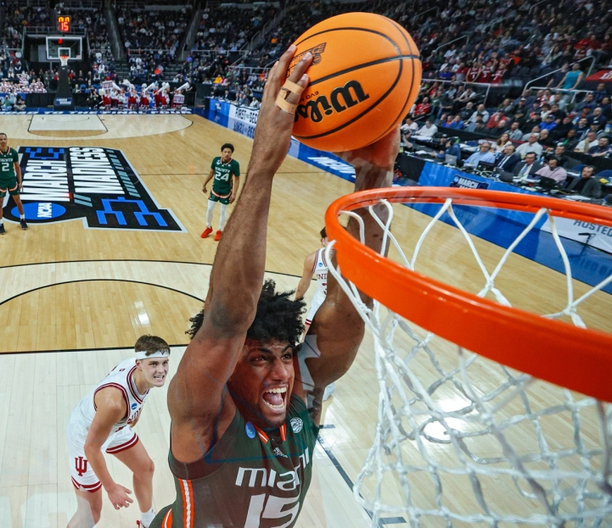
Agenda
What is March Madness?
Data Processing and Cleaning
Defining “Upset”
Upset by Round
Feature Selection
Prediction Models
Logistic Regression
Random Forest
Gradient Boosting
Analysis of Important Features
Limitations
Conclusion

Slide 3
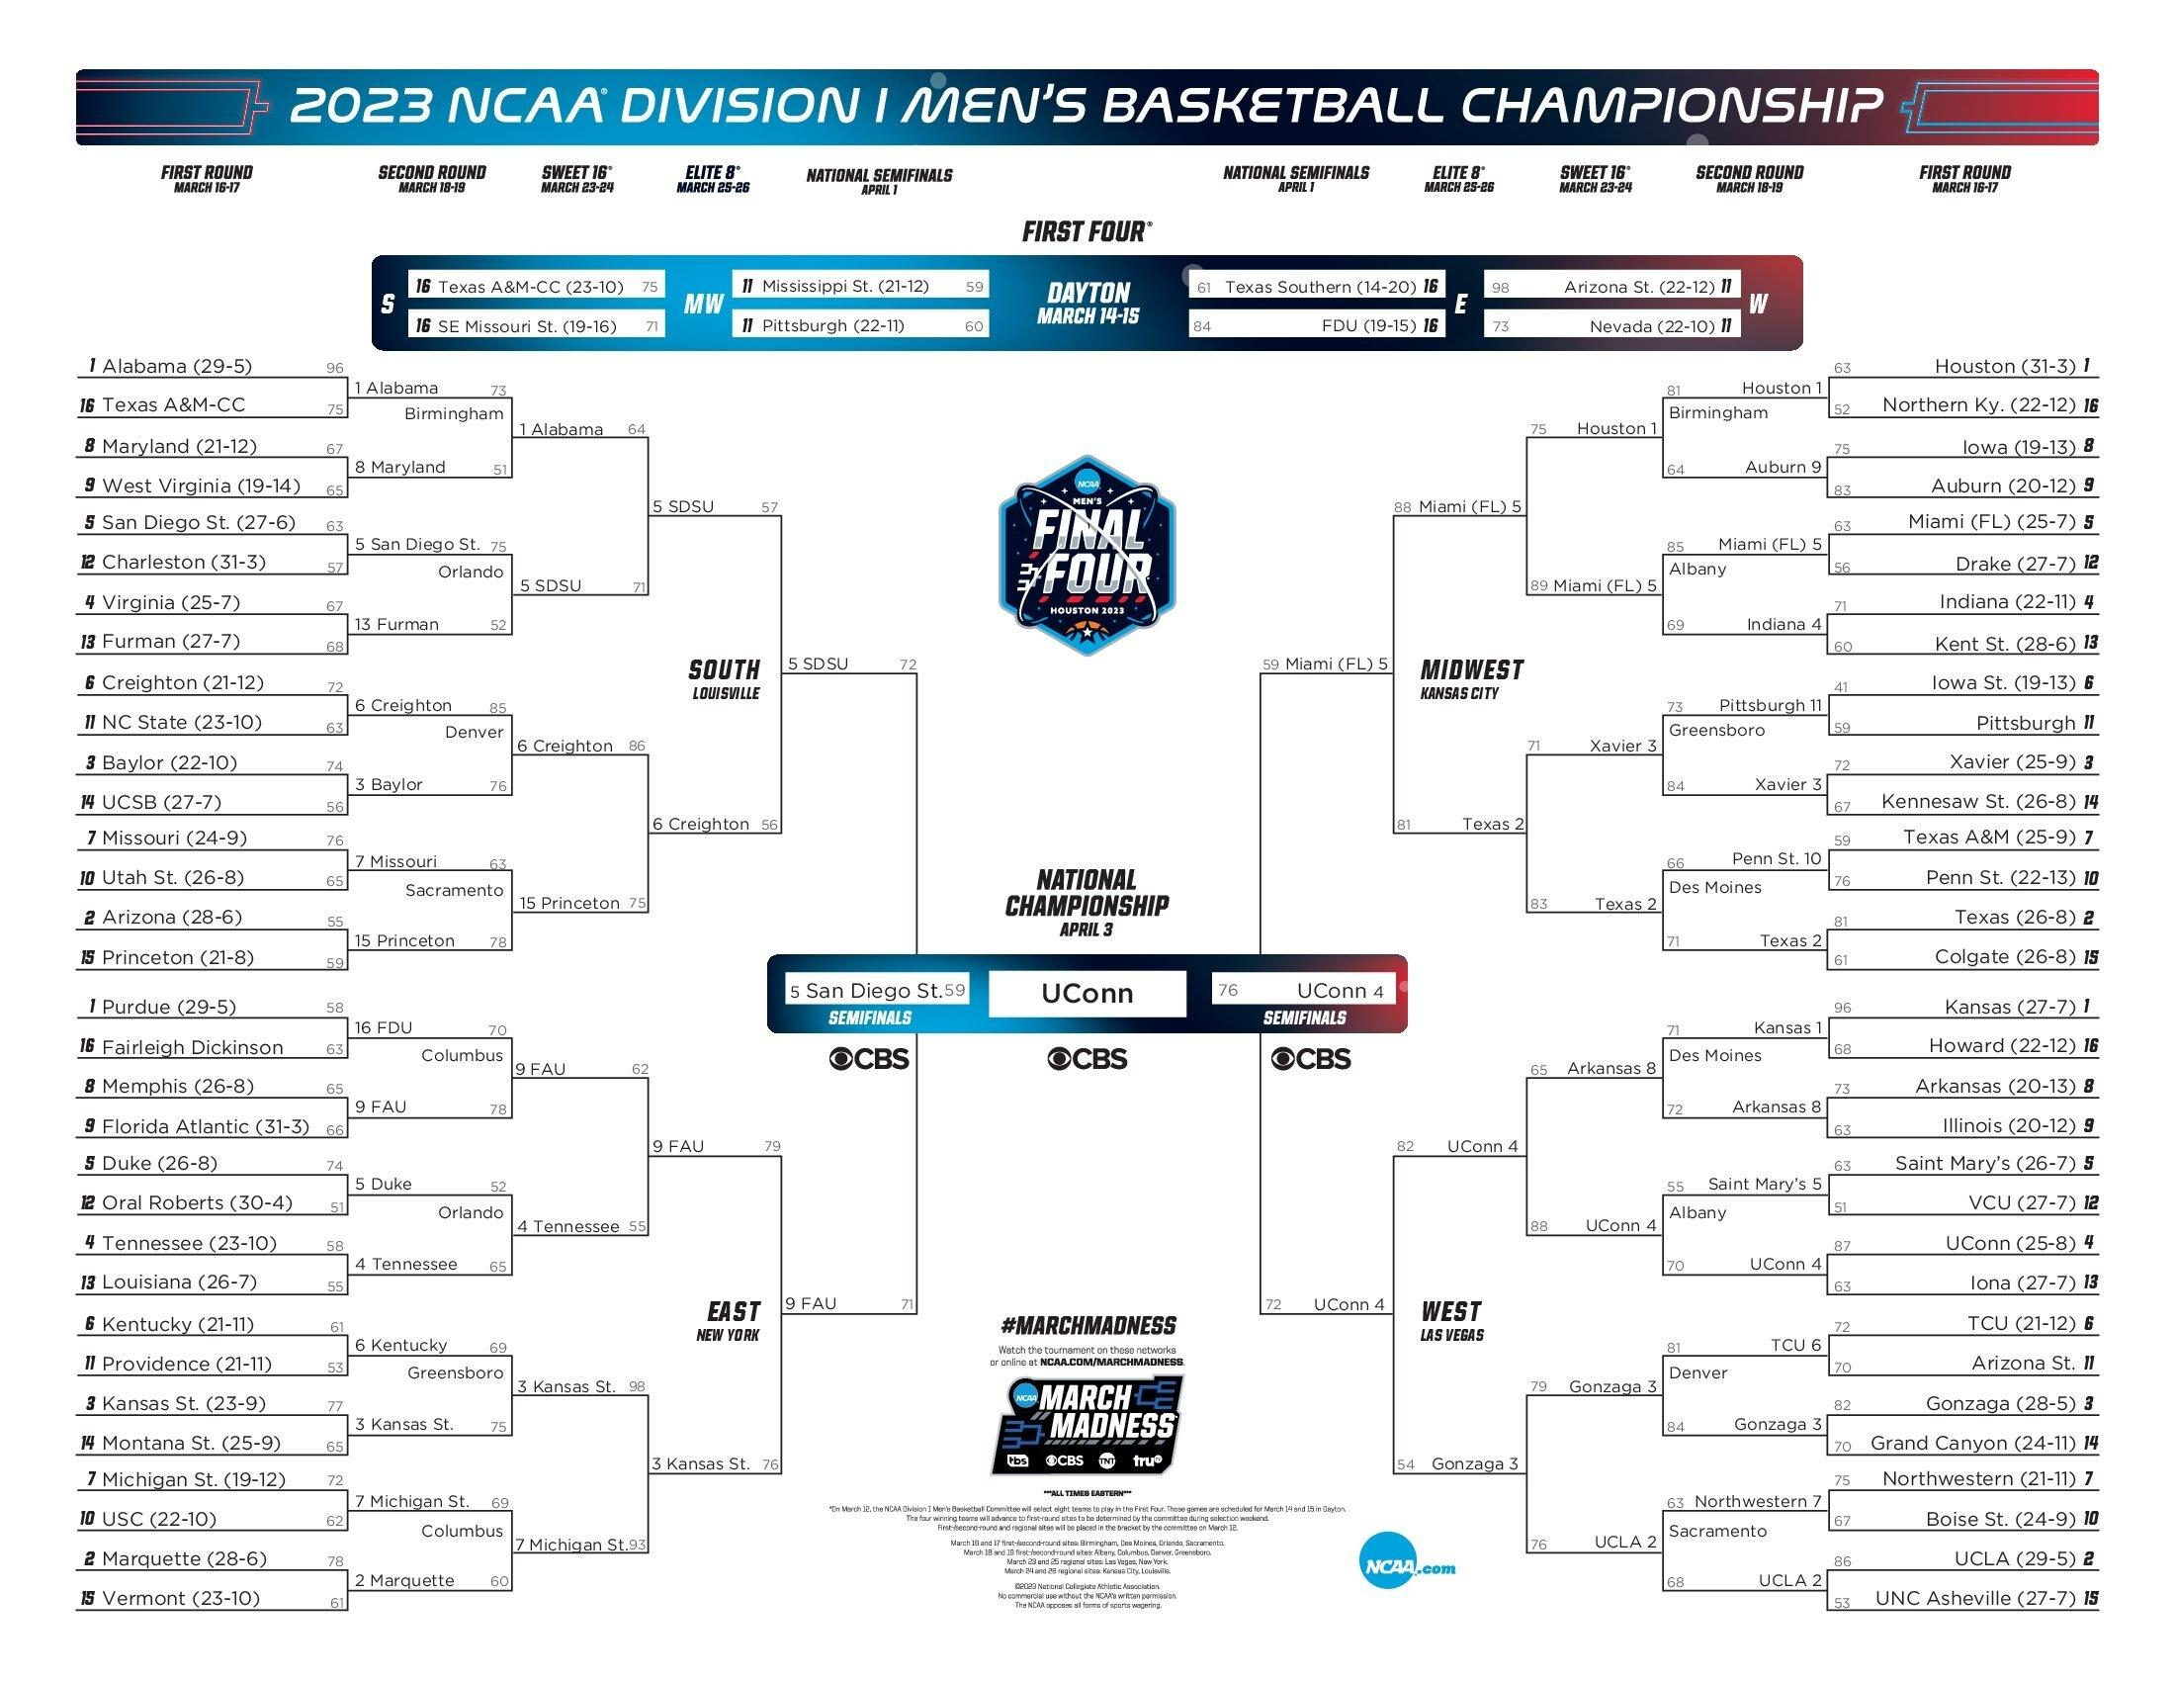
What is March Madness?
March Madness is a NCAA Division I Men’s Basketball Tournament held every March
It features 68 college basketball teams competing in a single-elimination format to determine the national champion
The tournament is known for its unpredictability and intense excitement as underdog teams often pull off upsets, making it one of the country's most popular and widely watched sporting events
Source: https://www.ncaa.com/news/basketball-men/article/2023-04-18/2023-ncaa-bracket-scores-stats-march-madness-mens-tournament

Slide 4
Data Processing and Cleaning
Download csv data from Kaggle
Upload data into python using pd.read_csv
Standardize school names between datasets e.x. USC -> Southern California
Merge datasets Add suffix _F for favorite team data and _U for underdog team
Add a binary value column UPSET
Drop unnecessary columns
Tournament_Scores_1981-2021.csv
Tournament_Team_Data_2008-2022.csv
YEAR | ROUND | WSEED | WTEAM | LSEED | LTEAM | …
2021 | 6 | 1 | Baylor | 1 | Gonzaga | …
2021 | 5 | 1 | Gonzaga | 11 | UCLA | …
YEAR | SEED | TEAM | OF EFF | DF EFF | … | WIN %
2022 | 1 | Kansas | 1.17 | 0.85 | … | 0.760
2022 | 1 | Arizona | 1.16 | 0.86 | … | 0.729
Merge
Merged_Data_2008-2021.csv
YEAR | ROUND | TEAM_F | SEED_F | OF EFF_F | DF EFF_F | … | TEAM_U | SEED_U | OF EFF_U | DF EFF_U | … | UPSET
2021 | 6 | Baylor | 1 | 1.12 | 0.771 |  | UCLA | 11 | 1.05 | 0.910 | … | 0
2021 | 5 | Gonzaga | 1 | 1.19 | 0.698 |  | Houston | 6 | 1.09 | 0.830 | … | 1
Source: https://www.kaggle.com/datasets/nishaanamin/march-madness-data

Slide 5
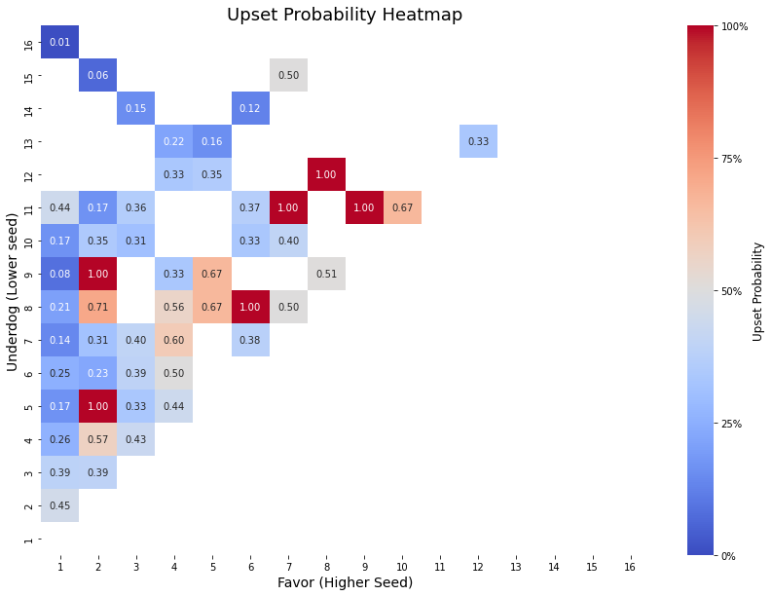
Defining “Upset”
Upset should not be a phenomenon that occurs frequently, and definitions in different studies are inconsistent. Therefore, this study is defining a new definition of upset based on historical probability.
Upset
Not upset
Upset definition in this study:
Higher Seed – Lower Seed >= 5

Slide 6
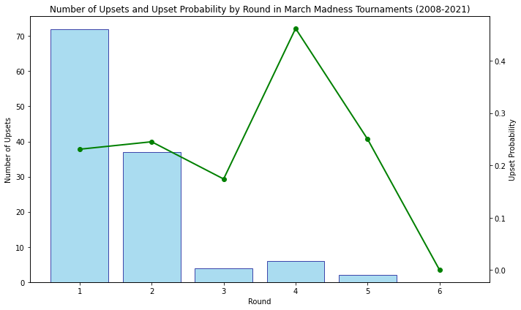
Upset by Round
Most upsets occur in 1st round. However, provability is not as high
Upset probability increases in the 4th round. This indicates that once an underdog makes it to the 3rd round, they have the momentum to advance further
There are no upsets in the championship within the data period. The last championship upset was in 1988, Kansas (6) vs Oklahoma (1)
1 = Round of 64
2 = Round of 32
3 = Sweet 16
4 = Elite 8
5 = Final 4
6 = National Championship
Source: https://championshiphistory.com/ncaahoops.php

Slide 7
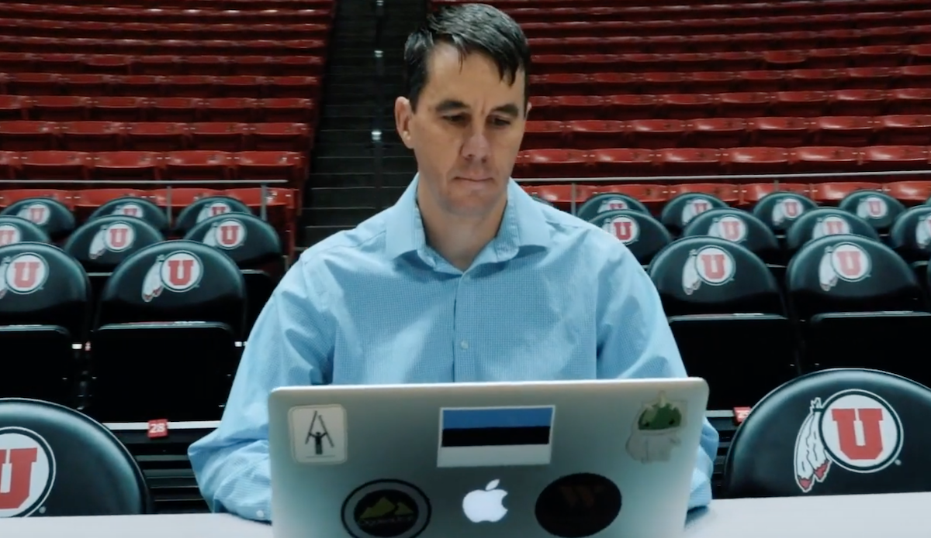
Feature Selection
Performed ANOVA and selected top 30 important features to train models.
 | Feature | F-Score | p-value
10 | BARTHAG_F | 44.735574 | 6.899160e-11
7 | BARTTORVIK ADJUSTED EFFICIENCY_F | 43.040659 | 1.515662e-10
3 | KENPOM ADJUSTED EFFICIENCY_F | 37.841246 | 1.732121e-09
44 | BARTTORVIK ADJUSTED EFFICIENCY_U | 37.252041 | 2.287699e-09
47 | BARTHAG_U | 36.902496 | 2.698781e-09
40 | KENPOM ADJUSTED EFFICIENCY_U | 35.701817 | 4.766732e-09
72 | WINS ABOVE BUBBLE_U | 31.272375 | 3.953434e-08
48 | ELITE SOS_U | 24.470318 | 1.077659e-06
35 | WINS ABOVE BUBBLE_F | 23.860049 | 1.455085e-06
46 | BARTTORVIK ADJUSTED DEFENSE_U | 22.929026 | 2.303543e-06
42 | KENPOM ADJUSTED DEFENSE_U | 22.804567 | 2.449733e-06
2 | SEED_F | 22.348260 | 3.070432e-06
39 | SEED_U | 21.344945 | 5.052015e-06
36 | WIN %_F | 20.246293 | 8.735209e-06
37 | POINTS PER POSSESSION OFFENSE_F | 19.796110 | 1.094031e-05
45 | BARTTORVIK ADJUSTED OFFENSE_U | 18.063276 | 2.612758e-05
4 | KENPOM ADJUSTED OFFENSE_F | 17.800780 | 2.982834e-05
8 | BARTTORVIK ADJUSTED OFFENSE_F | 17.317324 | 3.808664e-05
41 | KENPOM ADJUSTED OFFENSE_U | 15.639963 | 8.933405e-05
38 | POINTS PER POSSESSION DEFENSE_F | 10.979723 | 9.976003e-04
20 | OFFENSIVE REBOUND %_F | 10.533068 | 1.262502e-03
32 | OP D REB %_F | 10.533068 | 1.262502e-03
9 | BARTTORVIK ADJUSTED DEFENSE_F | 8.339414 | 4.071594e-03
13 | 2PT %_F | 7.057030 | 8.183798e-03
5 | KENPOM ADJUSTED DEFENSE_F | 6.199591 | 1.314782e-02
16 | EFG %_F | 5.294752 | 2.185859e-02
57 | OFFENSIVE REBOUND %_U | 5.201907 | 2.304161e-02
69 | OP D REB %_U | 5.201907 | 2.304161e-02
24 | 2PT % DEFENSE_F | 4.818724 | 2.867620e-02
59 | BLOCK %_U | 4.765842 | 2.956005e-02
KemPom Rankings
Developed by Ken Pomeroy in 1999, a meteorologist working for the National Weather Service in Montana
The KenPom system is used as a reference in college basketball by bettors, bookmakers and coaches. It’s very accurate and offers precise predictions most of the time
Website: https://kenpom.com/
BartTorvik Rankings
Run by Bart Torvik who is a lawyer
It was developed by reverse engineering KemPom and it has a similar usage
There is a R package called ‘toRvik’
Website: https://barttorvik.com/#

Slide 8
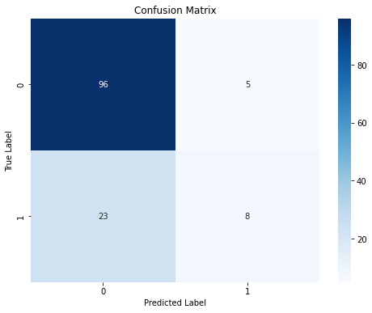
Logistic Regression Model
Reason for choosing this model
Logistic regression model is a simple and widely-used linear classification algorithm that works well for binary classification like predicting the outcome of a sports game
Cross-validation results
[0.81818182, 0.79545455, 0.72727273 0.79545455, 0.75, 0.79545455, 0.72727273, 0.68181818, 0.79545455, 0.77272727]
Average cv accuracy: 0.76590

Slide 9
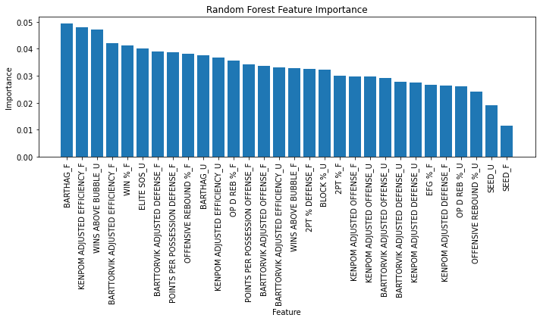
Random Forest Model
Reason for choosing this model
Random forest model is an ensemble model which can provide high accuracy and reduce overfitting
Cross-validation results
[0.75 0.77272727 0.75 0.77272727 0.77272727 0.75 0.68181818 0.70454545 0.77272727 0.72727273]
Average cv accuracy: 0.74545

Slide 10
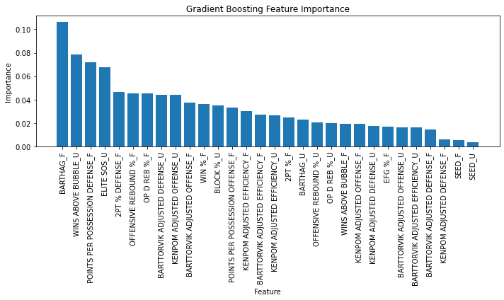
Gradient Boosing Model (GBM)
Reason for choosing this model
A model using GBM won the NCAAW March Madness Kaggle Competition in 2022. Therefore, this model can be applied to predict Men’s Tournament
Source: https://towardsdatascience.com/kaggle-march-madness-silver-medal-for-two-consecutive-years-6207ff63b86c
Cross-validation results
[0.81818182, 0.77272727, 0.79545455, 0.72727273, 0.68181818, 0.77272727, 0.65909091, 0.70454545, 0.79545455, 0.70454545]
Average cv accuracy: 0.74318

Slide 11
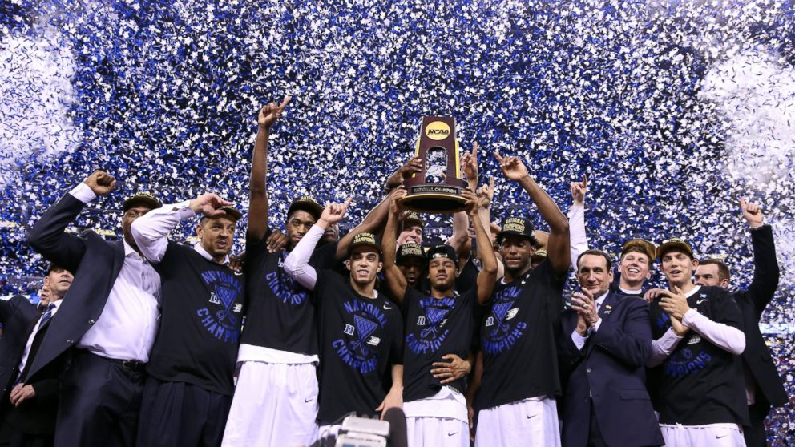
Winner
Logistic Regression Model
Accuracy: 0.76590

Slide 12
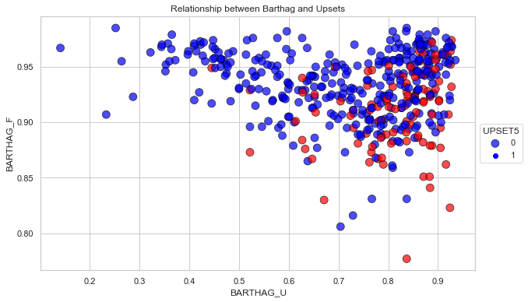
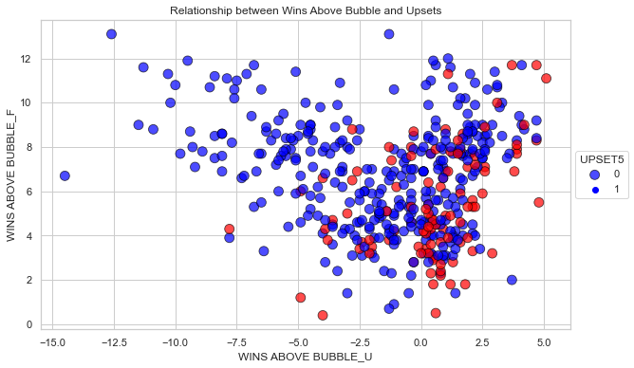
Analysis of Barthag and Wins Above Bubble
Legend:
○ upset
○ non-upset
Barthag: Power Rating (Chance of beating the average Division I basketball team).
A game of favorite team with barthag < 0.95 and underdog with barthag > 0.75 has a higher chance of an upset
Wins Above Bubble (WAB): The expected winning percentage for an average *bubble team in each game of a team's schedule subtracted from the total of the team's actual wins.
A game of favorite team with WAB < 6 and underdog with WAB > 0 has a higher chance of an upset
*The bubble teams for the NCAA tournament are on the cusp of making the field of 68, but an invitation isn’t guaranteed

Slide 13
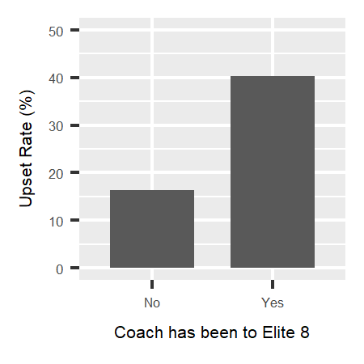
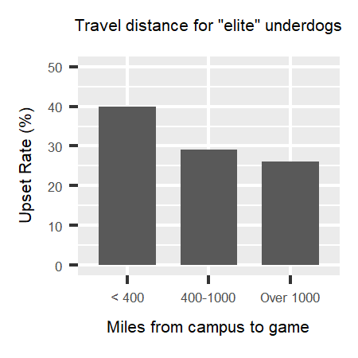
Limitations
Data period
Used 2008-2021 data for this project. March Madness has a long history since 1939
Alternative data
Did not use data outside of team stats. It could produce a model with higher accuracy if able to collect alternative data e.g. coach experience, travel distance
Recency data
No data that takes recency into account. There is something to be said about peaking at the right time in the season
Resource and time
If there were more time and resources it would be interesting to deep dive into the data more by testing additional prediction models or looking into the trends through different rounds
Source: https://towardsdatascience.com/use-my-upset-prediction-model-to-pick-underdogs-in-your-ncaa-tournament-bracket-87c4aa3935f5

Slide 14
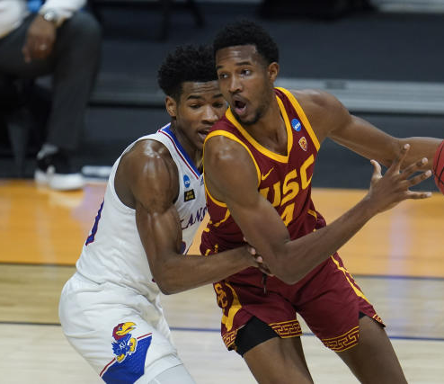
Conclusion
Upsets in March Madness are considered very unusual and unpredictable to the general public but through this study, the created model proved to be able to predict with a fairly high accuracy.
Below are key takeaways:
Upset is defined as an underdog win in game where Higher Seed – Lower Seed >= 5
Round 4 (Elite 8) has the highest probability of upsets
Out of the three tested models (logistic regression, random forest and gradient boosting) logistic regression has the highest accuracy
Barthag and Wins Above Bubble features are important to the random forest and gradient boosting models

Slide 15
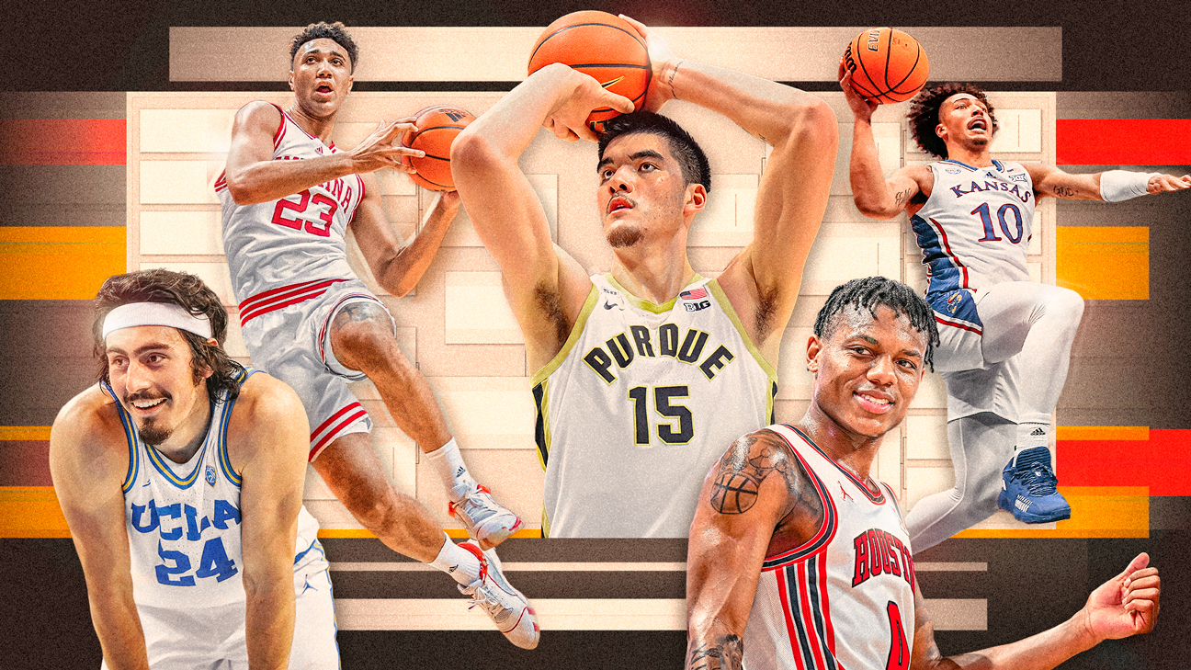
Thank You

Slide 16
References
Worley, M. (2022, March 3). Use my upset prediction model to pick underdogs in your NCAA tournament bracket. Medium. https://towardsdatascience.com/use-my-upset-prediction-model-to-pick-underdogs-in-your-ncaa-tournament-bracket-87c4aa3935f5
T-Rank - Customizable College Basketball Tempo Free Stats - T-Rank. (n.d.). Www.barttorvik.com. Retrieved July 27, 2023, from https://www.barttorvik.com
2021 Pomeroy College Basketball Ratings. (n.d.). Kenpom.com. https://kenpom.com/
Predicting Upsets. (n.d.). Kaggle.com. Retrieved July 27, 2023, from https://www.kaggle.com/code/nishaanamin/predicting-upsets#Upset-Count-Per-Tournament-
Worley, M. (2022, March 3). Predicting Upsets in the NCAA Tournament with Machine Learning. Medium. https://towardsdatascience.com/predicting-upsets-in-the-ncaa-tournament-with-machine-learning-816fecf41f01
Advanced Metrics in College Basketball and How to use them | Hoops Amino. (n.d.). Hoops | Aminoapps.com. Retrieved July 27, 2023, from https://aminoapps.com/c/hoops/page/blog/advanced-metrics-in-college-basketball-and-how-to-use-them/RrNH_wuKmZrxjxL2VY8Ylkkwoo5p4z
C.J. Moore. (2013, March 7). The Ken Pomeroy Effect: How Advanced Metrics Have Revolutionized NCAA Basketball. Bleacher Report; Bleacher Report. https://bleacherreport.com/articles/1556819-the-ken-pomeroy-effect-how-advanced-metrics-have-revolutionized-ncaa-basketball
NCAAM March Madness scores 1985-2021. (n.d.). Www.kaggle.com. Retrieved July 27, 2023, from https://www.kaggle.com/datasets/woodygilbertson/ncaam-march-madness-scores-19852021

