Slide 1


Slide 2
CRIMES IN INDIA
.An action or omission which constitutes an offence and is punishable by law.
'an offence which goes beyond the personal and into the public sphere, breaking prohibitory rules or laws, to which legitimate punishments or sanctions are attached, and which requires the intervention of a public authority. '

Slide 3
ASSIGNMENT QUESTION
What is the major reason people being kidnapped in each and every state?
Offenders relation to the rape victim
Juveniles family background, education and economic setup.
Which state has more crime against children and women?
Age group wise murder victim
Crime by place of occurrence.
Anti corruption cases vs arrests.
Which state has more number of complaints against police?
Which state is the safest for foreigners?

Slide 4
What is the major reason people being kidnapped in each and every state?
ANS. SELECT * from(select Area_Name,Group_Name,sum(Cases_Reported) as total_case from Specific_purpose_of_kidnapping_and_abduction GROUP by Area_Name, Group_Name order by sum(Cases_Reported) DESC) group by Area_Name order by total_case desc;

Slide 5

RESULT

Slide 6
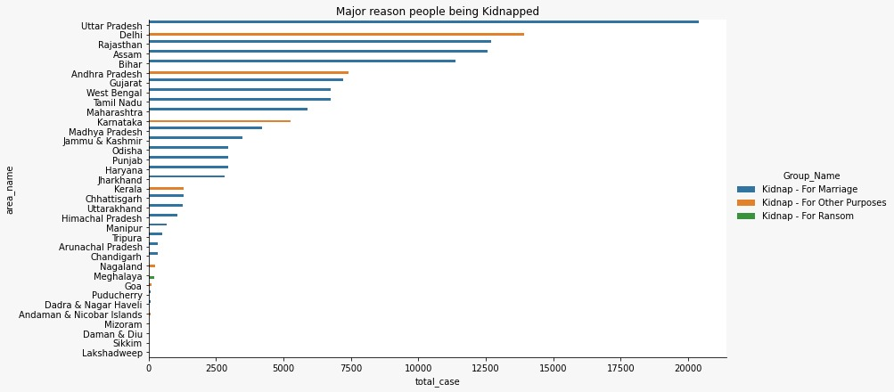
visualization
Conclusion:
1.We can see by this graph ,highest numbers case of kidnapping in Uttar Pradesh.

