Slide 1
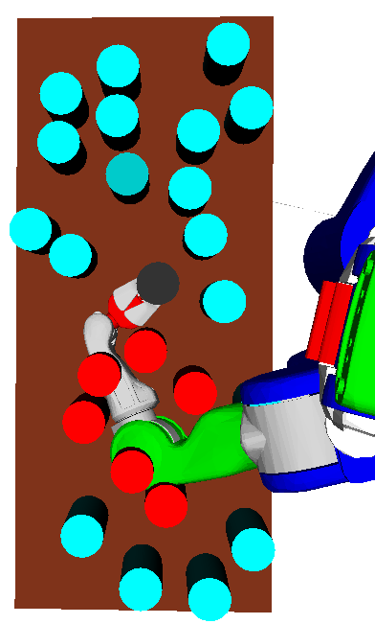
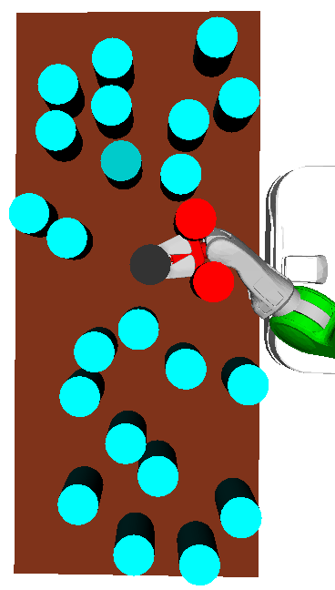
Guided Search for Task and Motion Plans Using Learned Heuristics
Rohan Chitnis¹, Dylan Hadfield-Menell¹, Abhishek Gupta¹, Siddharth Srivastava², Edward Groshev¹, Christopher Lin¹, and Pieter Abbeel¹
¹Electrical Engineering and Computer Sciences, UC Berkeley, USA
²United Technologies Research Center, USA
We formulate task and motion planning as a graph search where nodes correspond to task plans and edges are refinement failures, and we derive a complete algorithm.
We apply reinforcement learning to learn distributions over parameters in a task plan so that plan refinement is efficient.
We learn a heuristic to guide the search over the space of potential task plans, using max-margin IRL from expert demonstrations.
Two potential reasons a task plan is infeasible. The obstructions incorporated determine planning difficulty.

