Slide 1

http://www.bananasit.com
+917859913405
bananasoftinfotech@gmail.com
Instagram id: @bananasoftinfotech

Slide 2


Slide 3




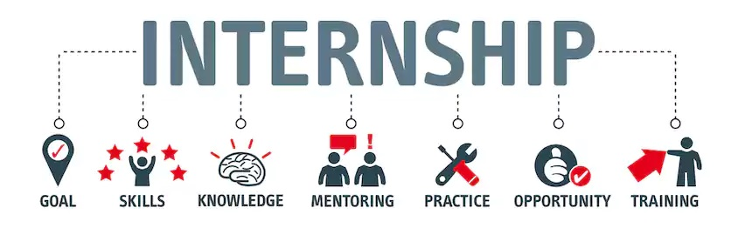

Slide 4

What is Internship?
An internship is a work-based learning experience at a company where you do entry-level work.
It's basically like a job, in the sense that you do real work that professionals might do, but the focus is to learn about the workplace and build skills.

Slide 5
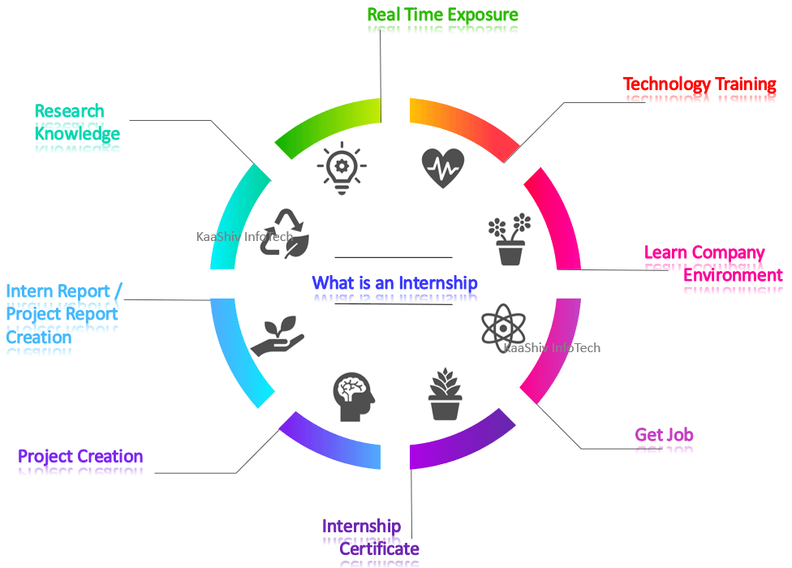

Slide 6
Why Do Companies Offer Internships?
Internships don’t just benefit interns, but the company, too! While a company has to put in the effort to source, hire, and train interns, organizations get entry-level employees who can do basic tasks that more advanced employees might want to spend less time on.
Many companies use their internship programs to source employees for their entry-level positions.
To hire an employee who is already familiar with the organization’s mission, values, and goals, and who already has the skill set to do the job.

Slide 7
Our Internship Technologies
PHP with Core PHP / Wordpress / Laravel
C#.Net web API and Angular
Desktop with C#
Shofipy with Liquid
ReactJS – MERN Stack
Python Django / Flask / FastAPI
Mobile App with Android & Flutter - Dart & React - Native
Data Analysis with Python and R
Data Science – Predication and Recommendation Project
Chatbot App with GenAI(LLM) & Prompt Engineering
Text Analysis, Classification, Summarization using NLP
NoSQL Projects like MongoDB & Graph Database

Slide 8
Project definition with concerned POC
Create a PPT before and after coding
Make a documentation
To attend daily maximum 4 to 5 hours
To maintain your attendance in excel sheet with the format provided
To be in discipline towards yourself and project technology in concern
No internal conflict should take place with any other intern
To carry your own laptop
Weekly presentation and reporting to concern POC
Once internship is successfully done then company will provide certificate & Perk
Internship Rules

Slide 9
INTERNSHIP SELECTION CRITERIA
To prepare proper resume
Basic practical round
[SQL queries with logic program definition]
Interview round [one to one]
[interview will be based on as mention in the resume
OOPs concepts, related to internship
Programming concepts of C/C#/Python / Java / C#
Website concepts of HTML/JAVASCRIPT/CSS/Bootstrap/JQuery
Along with technical practical CRUD operation round
And HR round

Slide 10



http://www.bananasit.com | +917859913405
Software & WebApp Development | IT Computer Training & Internship
શું તમે કોમ્પ્યુટર કોર્ષ કરવા માંગો છો?
શું તમારે લેટેસ્ટ IT કોર્ષ કરવા માંગો છો?
શું તમારે live પ્રોજેક્ટ પર ઇન્ટર્નશિપ કરવી છે?
શું તમારે Website / Mobile App / UI/UX Design બનાવી છે?
કોઈ પણ પ્રકારના ફોર્મ ભરી આપવામાં આવશે.
ધો ૧૦ / ૧૨ માં fail છો તો ચિંતા ના કરો અમારો સંપર્ક કરો.
Industrial Training with Live Project
Basic Computer (CCC)
C/C++/JAVA/Python
HTML / JavaScript
PHP / Laravel / WordPress
C# / VB.NET / ASP.NET / Web API
ReactJS / AngularJS / SQL / NoSQL
AI / Data Science
Graphic Design (UI/UX)
Digital Marketing
Cyber Security & Ethical Hacking
S-247, Above Dominos Pizza, Opp. Avadh Lake City, Baben Gam, Ta: Bardoli, Dist: Surat -394601

Slide 11
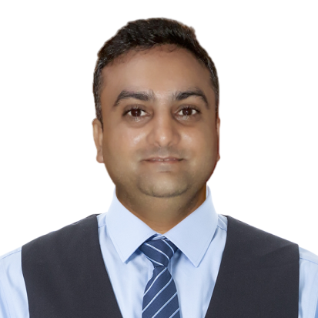
THANK YOU…….
{
“Mobile”: ”+917859913405”,
“Email_id”: “bananasoftinfotech@gmail.com”,
“ website”: http://www.bananasit.com,
“location”: “S-247, Lakeview Point, lakecity, Baben, Bardoli, Dist: Surat - 394601”
}

