Slide 1
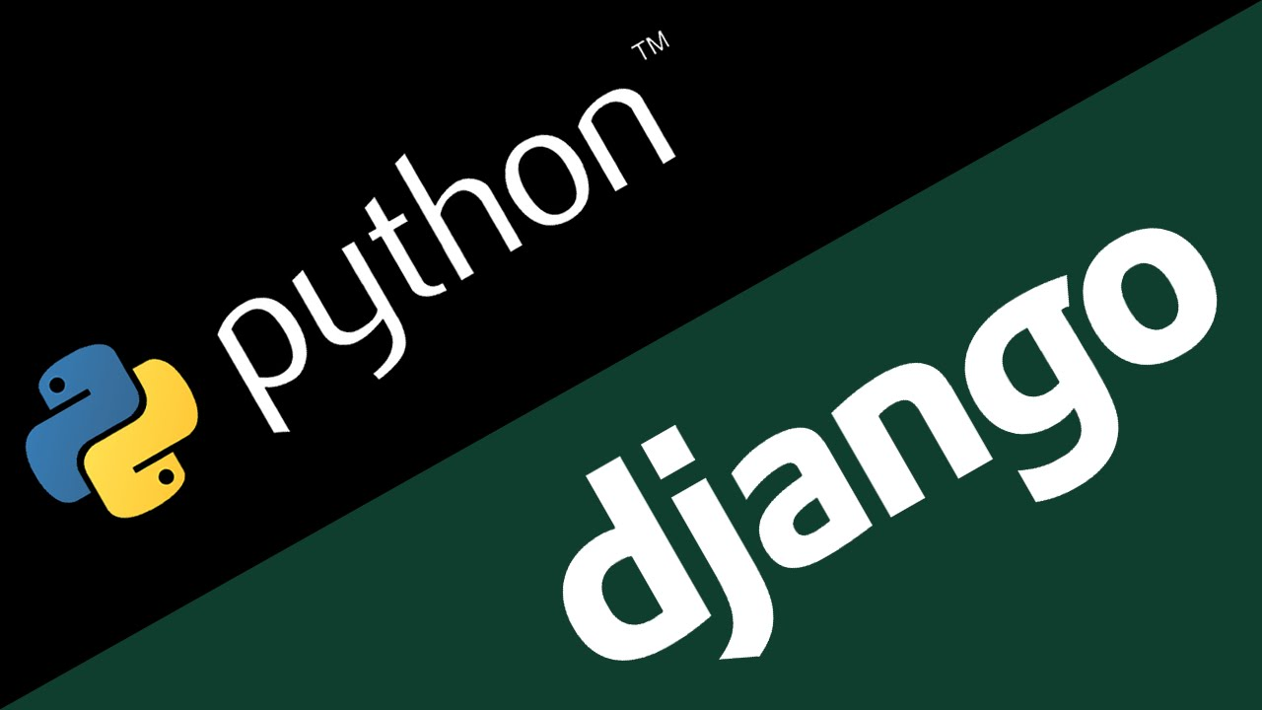
Introduction To Django
Prepared By: Ronak Panchal, VTCMCA
Blog: http://drronakpanchal.wordpress.com

Slide 2
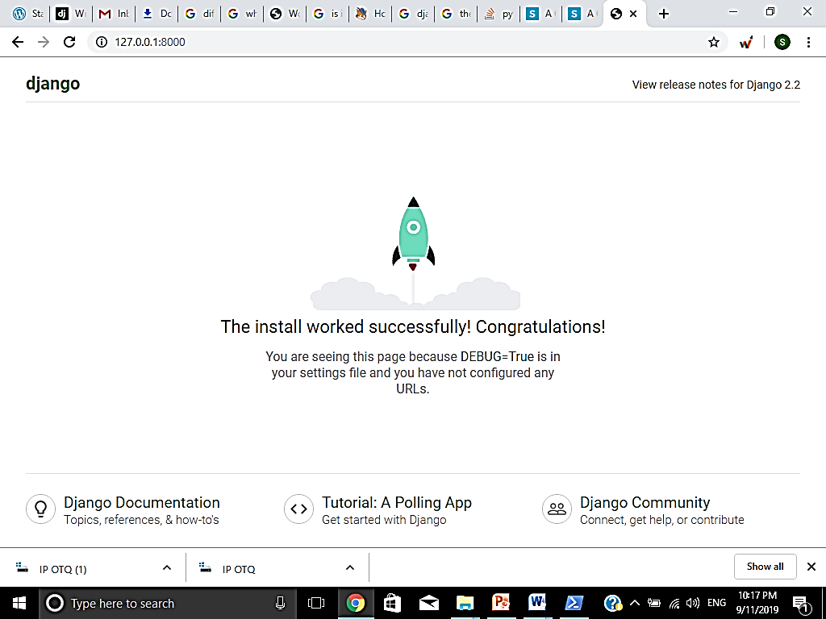
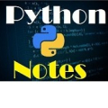

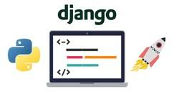
DJANGO
By : Ronak Panchal, VTCMCA

Slide 3
Django is a free and open source web application framework which offers fast and effective dynamic website development.
What is framework?????????
A web framework is a code library that makes web development faster and easier by providing common patterns for building reliable, scalable and maintainable web applications

Slide 4
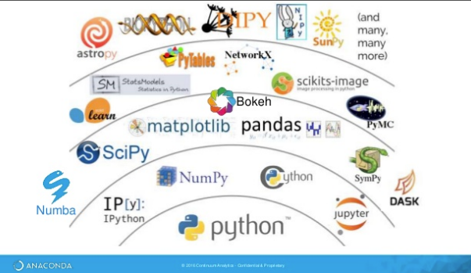
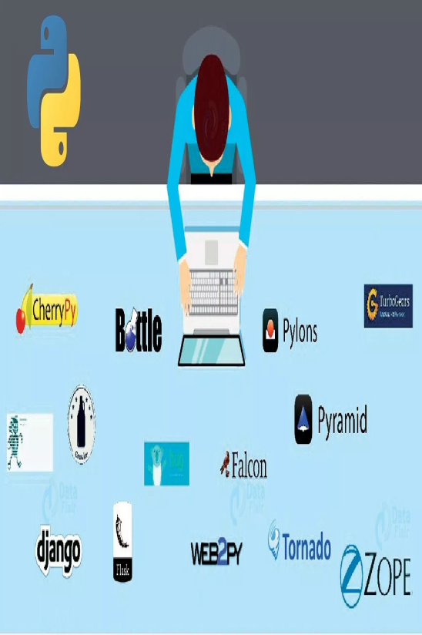
To understand it more clear lets understand the difference between library and framework
=========
=========
=========
=========
=========
=========
=========
=========
=========
Library Called by code
Code Called by Framework
Python Library
Framework
Program Code

Slide 5
Characteristics of Django
Loosely Coupled − Django helps you to make each element of its stack independent of the others.
Less code - Ensures effective development
Not repeated- Everything should be developed in precisely one place instead of repeating it again
Fast development- Django's offers fast and reliable application development.
Consistent design - Django maintains a clean design and makes it easy to follow the best web development practices.

Slide 6
Some of the popular sites that uses Django are :
Pinterest (tool for collecting and organizing your favorite things) ,
Instagram ,
Knight Foundation,
Mozilla,
National Geographic
Open Knowledge Foundation
Disqus (most popular discussion system)
Chess etc

Slide 7
Django MVT (Model –View-Template)
The MVT is a software design pattern which includes three important components Model, View and Template.
The Model helps to handle database. It is a data access layer which handles the data.
The Template is a presentation layer which handles User Interface part completely.
The View is used to execute the business logic and interact with a model to carry data and renders a template.
Although Django follows MVC pattern but maintains it’s own conventions. Here control is handled by the framework itself.

Slide 8

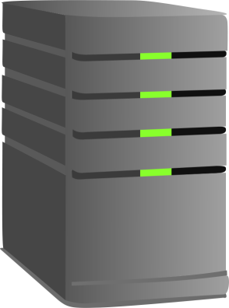
Flow of Control in MODEL-VIEW-TEMPLATE
Sends requests for a resorce
Django
MODEL
USER
Checks availability of resource in URL
VIEW
View interacts with Model & Template. Then renders a template
URL
If url is mapped View is called
TEMPLATE
At last Django responds back to the user and sends a template as a response.

Slide 9
Now our very first step is to create Virtual Envioronment
The virtual environment is an environment which is used by Django to execute an application. It is recommended to create and execute a Django application in a separate environment.

Slide 10

Virtual Environment
WHY?
Its recommended to install Virtualenv before installing Django .
Virtual Environment creates isolated environments to isolates your Python files on a per-project basis.
It ensure that any changes created to your web site won’t have an effect on alternative websites you’re developing.
The attention-grabbing half is that you just will produce virtual environments with completely different python versions, with every environment having its own set of packages.

Slide 11
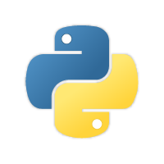
pip
Virtual Envioronment
3.5
2.5
Virtual Env 1
Virtual Env 1
Django 1.6
Django 1.4
3.6
Virtual Env 1
Django 1.0

Slide 12
Virtual Enviornment or wrapper???
What should be Used ….
virtualenv is a tool to create isolated Python environments. The virtualenv creates a folder which contains all the necessary executables to use the packages that a Python project would need.
virtualenvwrapper is a set of extensions to virtualenv tool. The extensions include wrappers for creating and deleting virtual environments and otherwise managing our development workflow, making it easier to work on more than one project at a time without introducing conflicts in their dependencies.

Slide 13
Using virtualenv without virtualenvwrapper is a little bit painful because every time we want to activate a virtual environment, so we have to type long command like this:
myproject/env/activate
But with virtualenvwrapper, we only need to type:
workon myproject

Slide 14
With windows, to install virtualenviornmentwrapper……. type
pip install virtualenvwrapper-win

Slide 15
This is the official website
https://www.djangoproject.com/start/
https://docs.djangoproject.com/en/3.1/intro/tutorial01/

Slide 16
Steps to install virtual environment and Django
Step 1 : Go to Window Power Shell (Admin) /command window
Step 2: Move to desired drive ( C:, D:, F: etc.) by typing driveName : (example → F: ) and move to folder by typing cd <foldername> cd DjangoProj in this case
Step 3: type
F:\>pip install virtualenvwrapper –win
(to install virtaulenvwrapper in F: drive)

Slide 17
Steps to install virtual environment and Django
Step 4 : Create virtual environment under the folder DjangoProj by typing
> mkvirtualenv projenv
Step 5 : now type
>workon projenv
Step 6 : Now install Django by typing
> pip install django
Step 7 : Now we will create Django Project namely LIBRARY
F:\>DjangoProj\MyProj> django- admin startproject Library

Slide 18
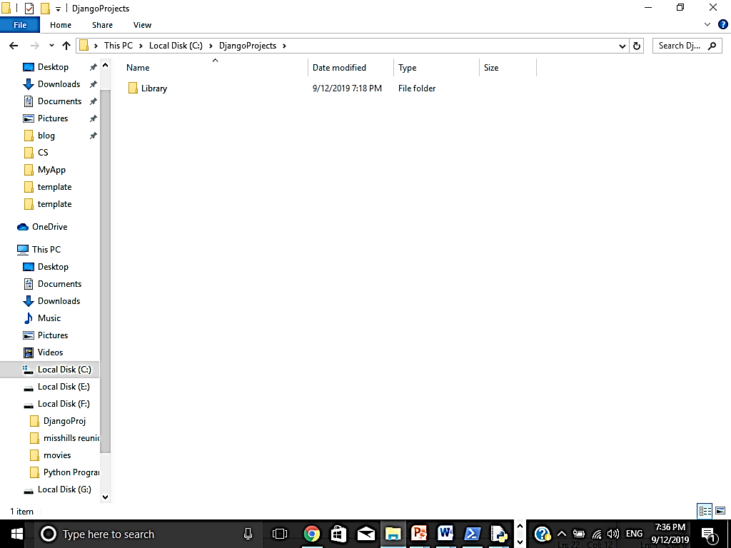
A folder Library will be created under f:\DjangoProj it will look like this :

Slide 19
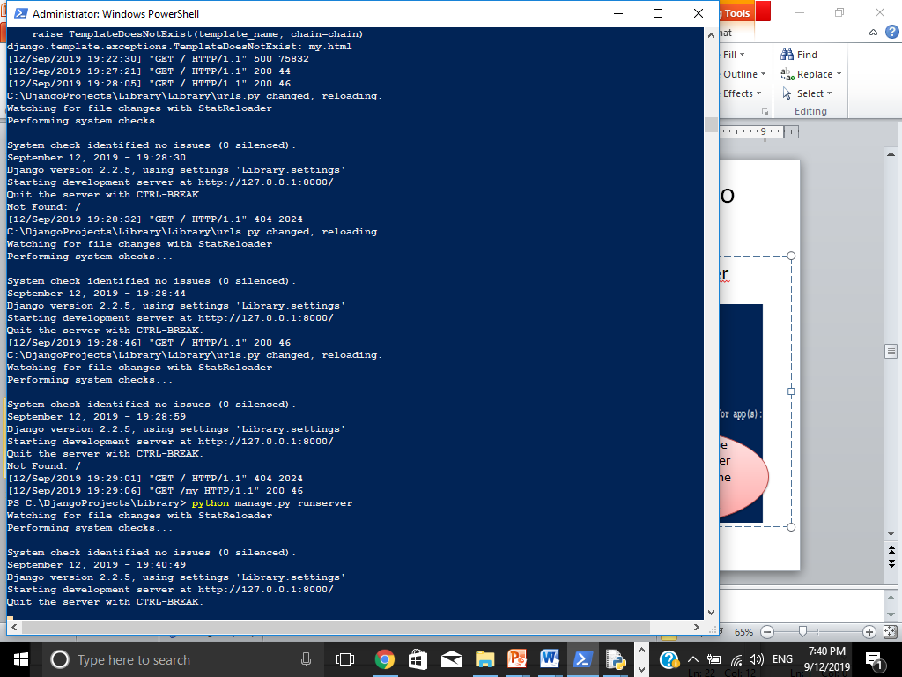
Now to check whether the Django Server is running or not :
F:\DjangoProj\Library > python manage.py runserver
This address will be typed in the browser to check whether the Django server is working properly

Slide 20
If you see this screen, your Django server is running successfully

Slide 21
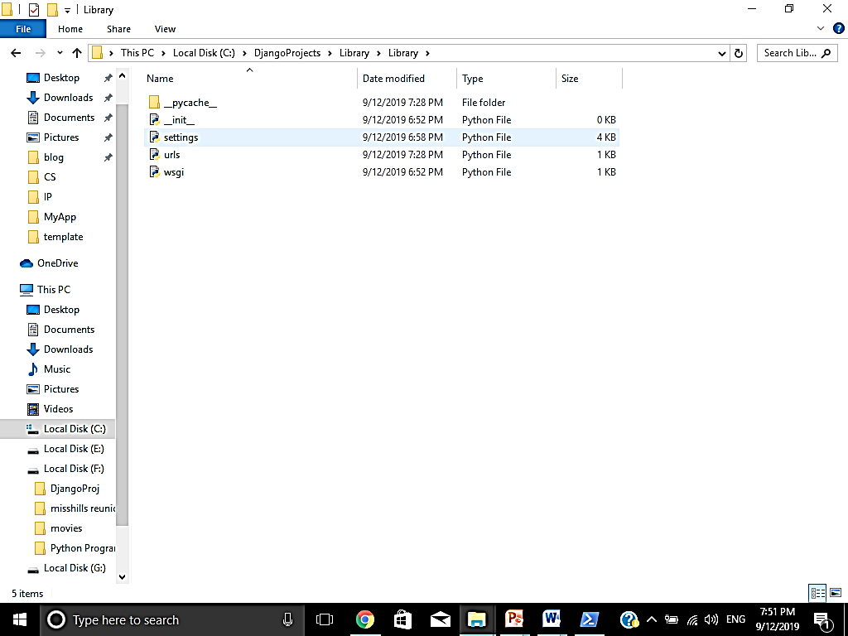
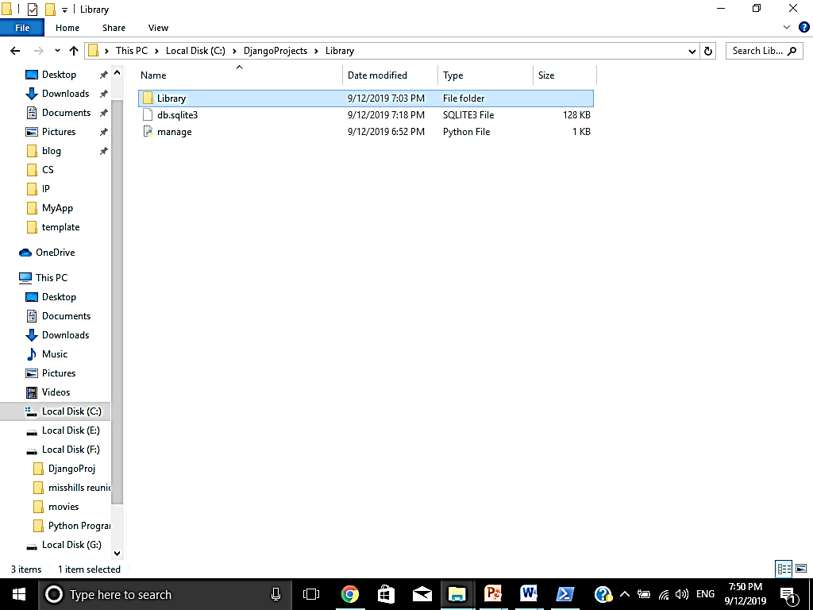
Now you will notice that following Django enviornment will be created ……
Inside the subfolder LIbrary 4 files will __init__.py
settings.py
urls.py
wsgi.py will be created
Inside the main Library folder 1 subfolder with same name and 1 file ‘manage.py’will be created

Slide 22
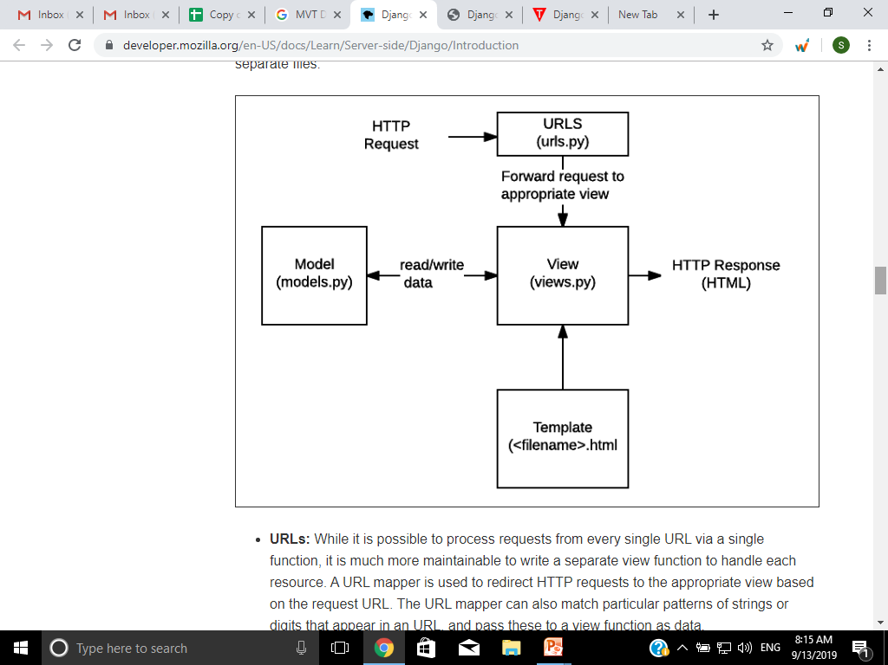
How these files interact each other

Slide 23
Django Project Structure
manage.py: a shortcut to use the django-admin command-line utility. It’s used to run management commands related to our project. We will use it to run the development server, run tests, create migrations and much more.
__init__.py: It is an empty file that indicates that this folder is a Python package.
settings.py: It contains all the project’s configuration.
urls.py: With the help of this file we can map the routes and paths in our project. For example, if you want to show something in the URL /about/, you have to map it here first.
wsgi.py: this file is a simple gateway interface used for deployment. We have nothing to do with it.

Slide 24
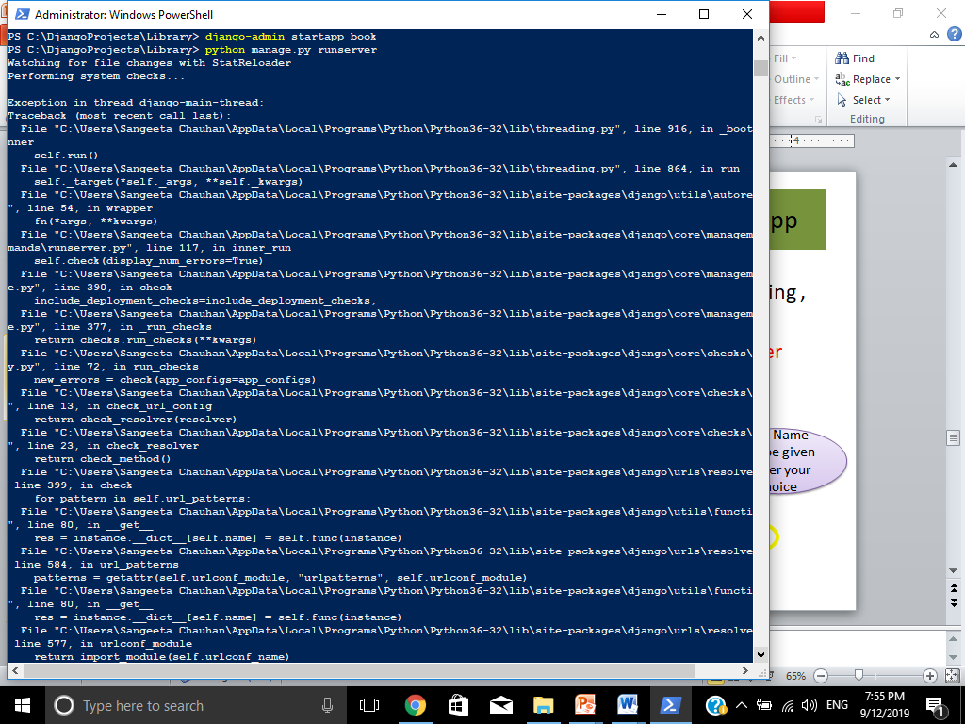
After creating Project lets create Django App
Firstly make sure your Django server is not running , if it is so stop it by pressing ctrl+C
Now again switch to Command window or power shell
Now move to the folder Proj1 (main folder )
Here type
> django-admin startapp book
App Name can be given as per your choice

Slide 25
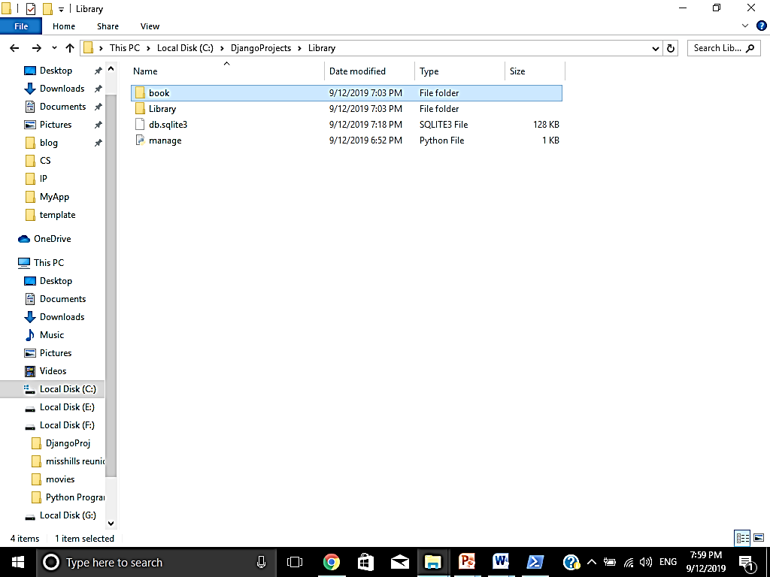
Django App “book” created now

Slide 26
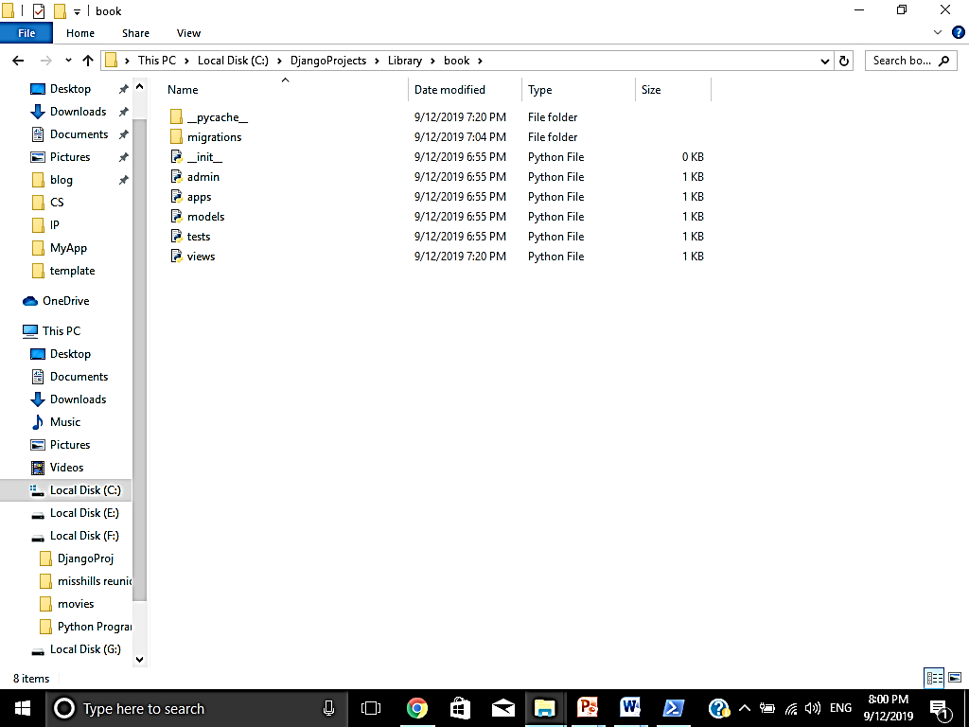
In “book” App following files will be created automatically

Slide 27
Lets understand working of these files
migrations/: This folder stores some files to keep track of the changes done in models.py file, so to keep the database and the models.py updated.
admin.py: It is a configuration file for a built-in Django app called Django Admin.
apps.py: It is a configuration file of the current app.
models.pyThis is the file where we define the entities of our Web application. The models are translated automatically by Django into database tables.
tests.py: used to write unit tests for the app.
views.py: this is the file where we handle the request/response for our Web application.

Slide 28
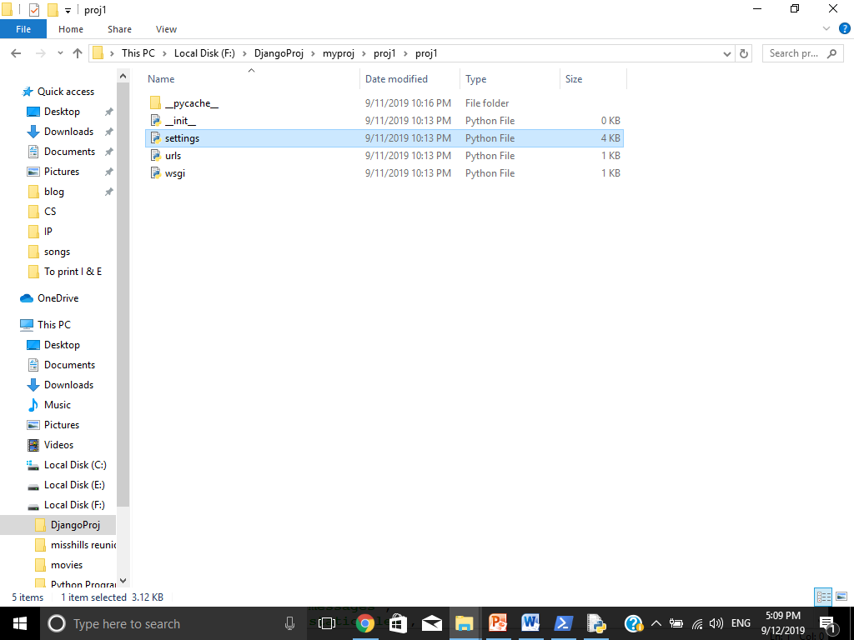
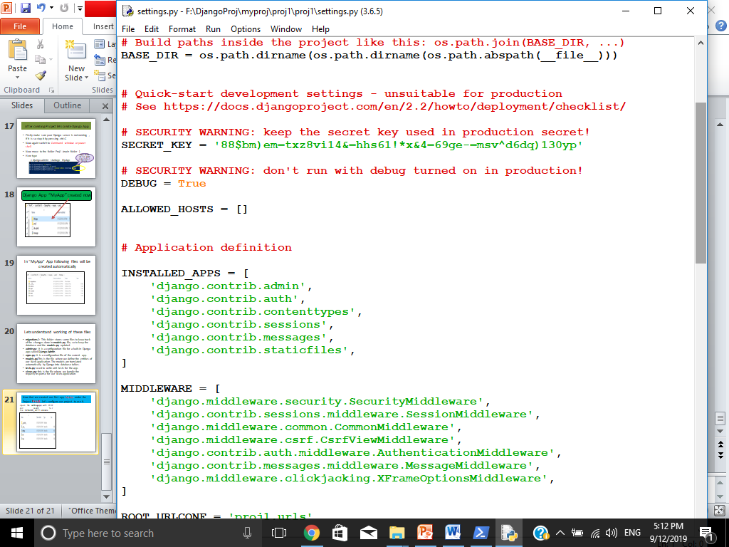
Now that we created our first app book under the Project Library, let’s configure our project to use it.
open the settings.py with IDLE and search for the INSTALLED_APPS variable :
IINSTALLED_APPS VARIABLE

Slide 29
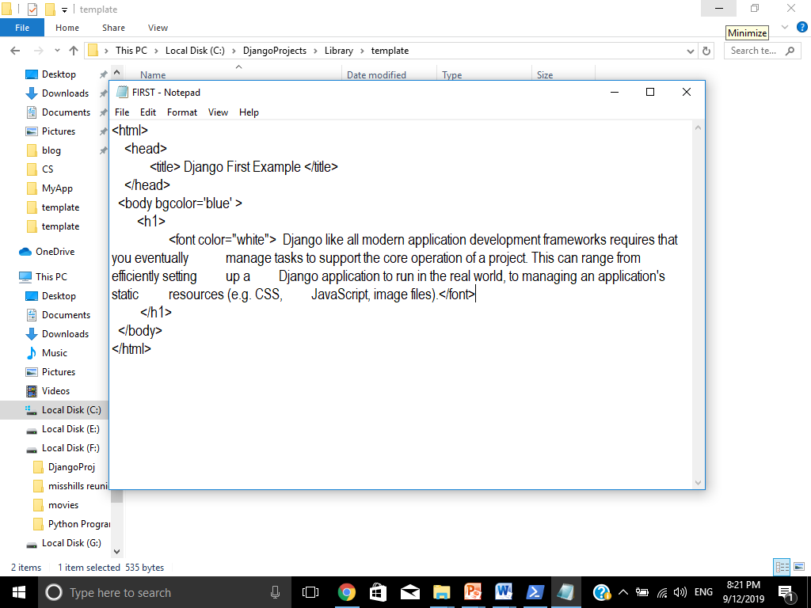
Now create any .html file which you want to show with Django and place it under the new folder ‘template’ under the folder ‘Library’
Here I have created file “First.html”
Now we will add this file to views.py so that we can view it with Django Server

Slide 30
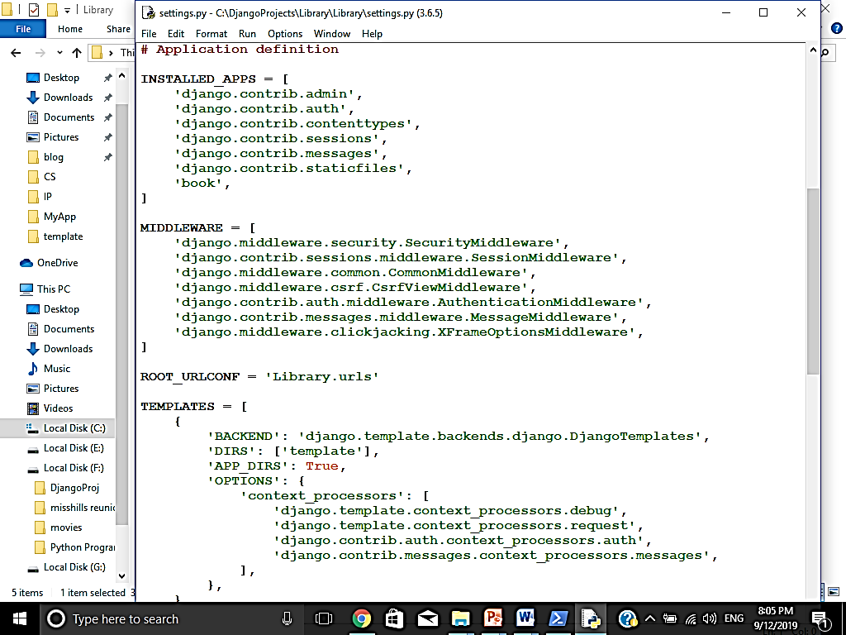
Now Open settings.py with IDLE to register newly created app book in INSTALLED_APPS list and add newly created ‘template’ folder in TEMPLATES list
By including App ‘book ‘ and template folder we are telling the project that template folder includes all pages of app ‘book’ inside it

Slide 31
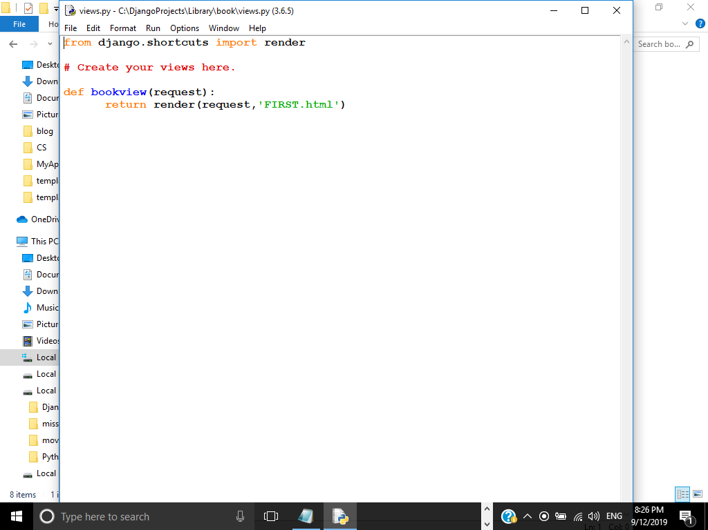
Now write code in views file to call html file
render() is a special Django helper function that creates a shortcut for communicating with a web browser

Slide 32
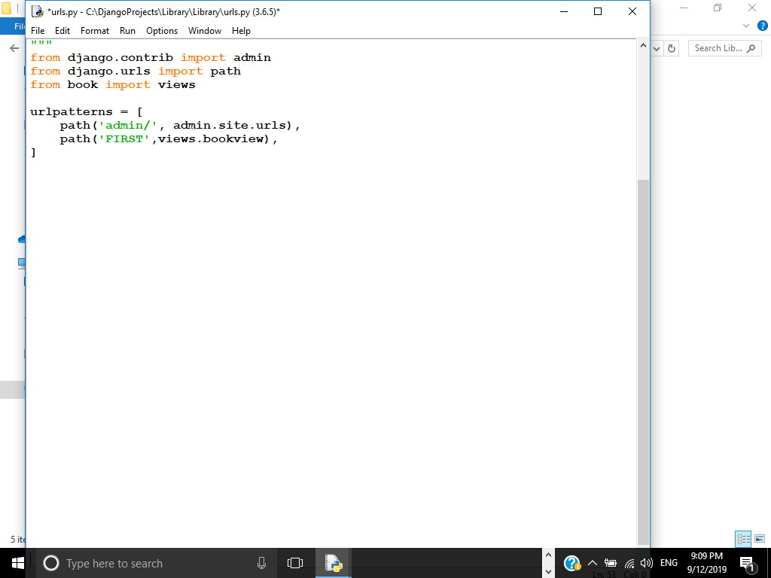
Setting views in url :Now open URL.py file and do the following changes to link files
Write import statement to include views from book
Here we are including name of webpage (FIRST) to be executed with server and function to be called (bookview)

Slide 33
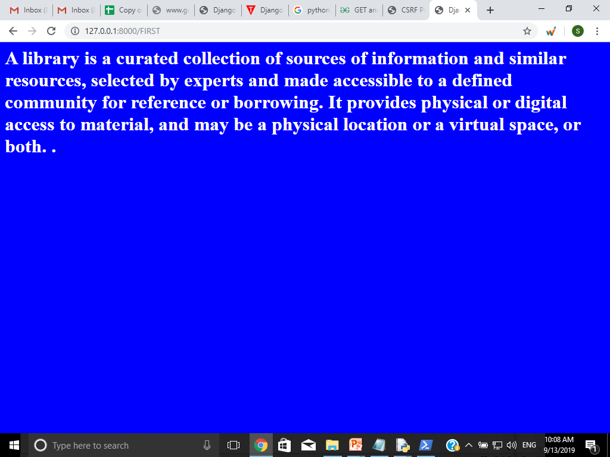
Now we are ready to run our webpage FIRST.html with Django Server
Type in the web browser http://127.0.0.1:8000/FIRST
Then this web page will be displayed

Slide 34


Hurray !!!!! we have developed our first basic WebPage Successfully.
Lets create a webpage which sends Some Data about books through form and we will save it in database
(GET & POST ) Method

Slide 35
Before we start lets understand the basic concepts required to develop such application
What is HTTP? HTTP is a set of protocols designed to enable communication between clients and servers. It works as a request-response protocol between a client and server. A web browser may be the client, and an application on a computer that hosts a web site may be the server.
To request a response from the server, there are mainly two methods:
GET : to request data from the server.
POST : to submit data to be processed to the server.

Slide 36
The post() method is used when you want to send some data to the server.
Syntax
requests.post(url, data={key: value}, json={key: value}, args)

Slide 37
Lets Start to …………..
We are going to continue with previously created project “Library” and App “Book”
Now first step is to create HTML form to input book details..

Slide 38
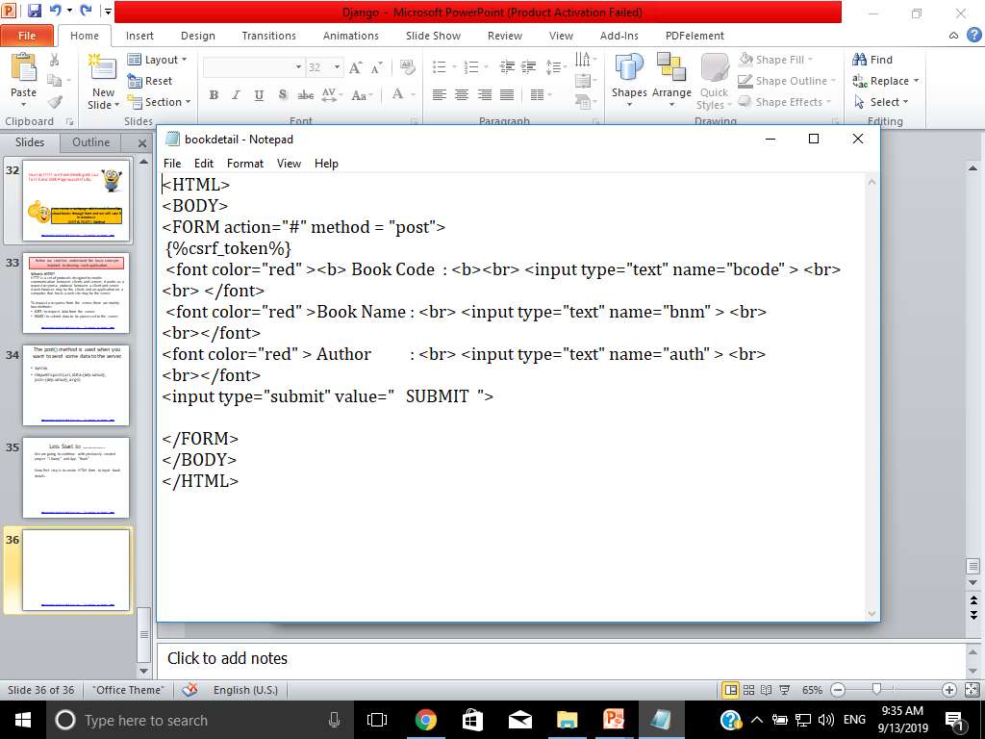
Here we have created a html file under template folder to create 3 text boxes to input book code, book name and author name….you can add more controls to read more data as per your need
File Name : bookdetail.html
Csrf token is used to send requests to the server, in which the token validates them.
Don’t forget to add
action =“#” (to tellthis form will be processed within file/url)
{%csrf_token%} in html file

Slide 39
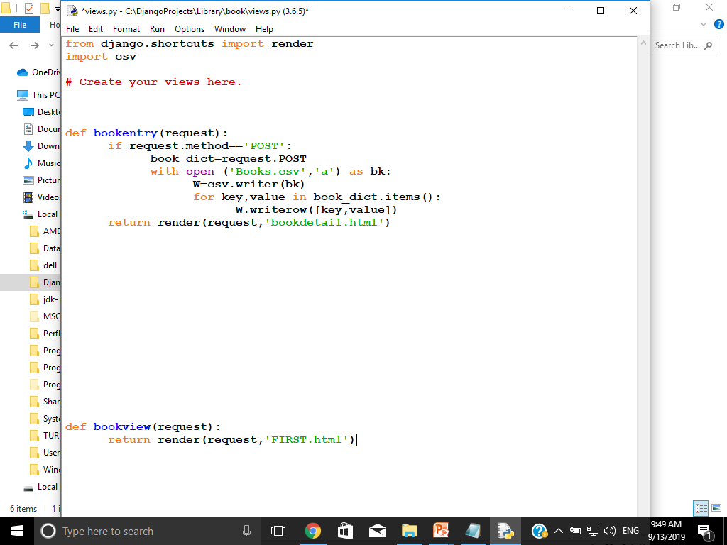
Now create a view : open view.py under the App book and add the following function
Here Bookentry function is created which
store the POSTed data into book_dict dictionary object
creating a csv file books.csv and writing the data into it

Slide 40
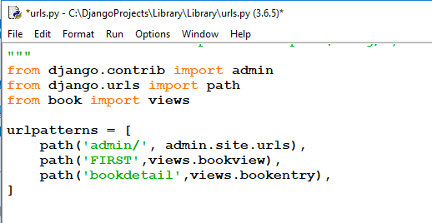
Setting.py : Here we have already done the required changes with previosly created webpage. So now there is no need to do any update
Url.py :
Add this line
Now we are ready to run this application …Open browser and type localhost:8000/bookdetail in address bar

Slide 41
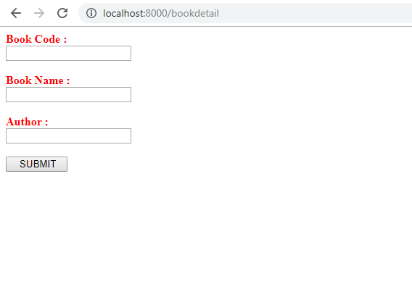
It will show you form you have created using html “bookdetail.html”
fill required data in this form and click on SUBMIT button
Note : You can add as many record as you want using this form

Slide 42
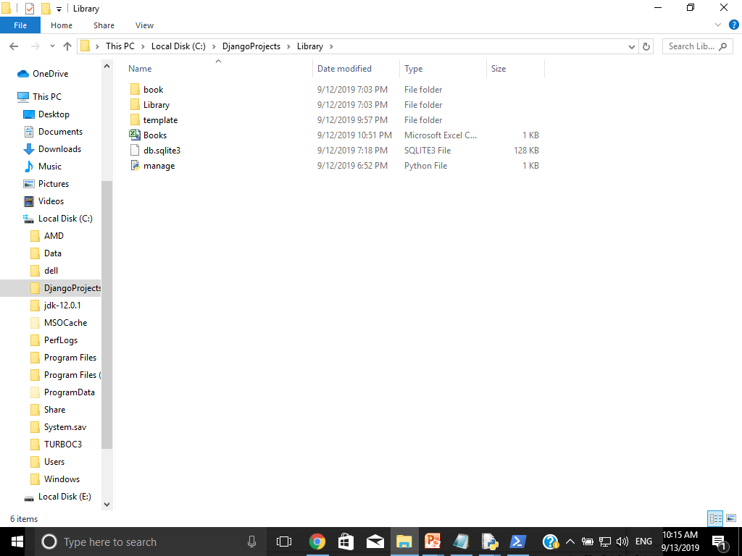
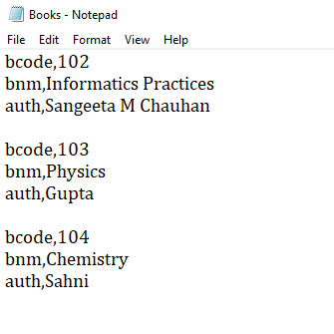
Now you will notice a new file is created under your project
See contents are written in this file
We can open this file with Excel or Notepad

Slide 43


Now its your turn to create similar application

Slide 44
References
www.pythonclassroomdiary.wordpress.com

