Slide 1
Architecture
Noble

Slide 2
Develop a complete granular architecture to develop a knowledge graph system that can 1) Automatically continuously load data from different data formats 2) Do data preprocessing on a continuous basis and with manual intervention as needed 3) Find relationships in data that are already defined and extract new data relationships. 4) Validate the accuracy of the data and relationships for both existing and new data 5) The database should be optimized from a performance and security 6) Create Cypher or Other graph QL to respond to the query with the relevant data based on the query. The architecture should also identify the tools and systems needed to accomplish this. Architecture should be done with consideration for Semantics and Ontology while developing and updating with data.

Slide 3
















AWS Cloud
6
1
5
3
4
2
neo4j
Data Source
AWS Lambda
NLP
Design Semantic Modeling
(Protégé Editor)
VPS EC2 instance for Fuseki
Ontology/OWL RDF graph – Query SPARQL –
Apache Jena Fuseki
Data source connectors
Conversion into csv / json and store
A bucket
Amazon S3
B bucket
Amazon S3
Check Schema Amazon Athena
Python Script
Continue Data Pipeline
Amazon Neptune
SPARQL Endpoint used in Python Flask/Django and get output as API
Points mentioned in slide 2nd.

Slide 4
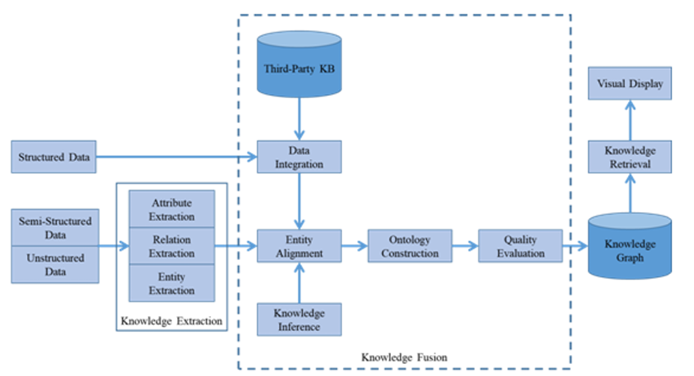
https://acadpubl.eu/jsi/2018-118-19/articles/19b/24.pdf
https://arxiv.org/pdf/2302.05019.pdf

Slide 5
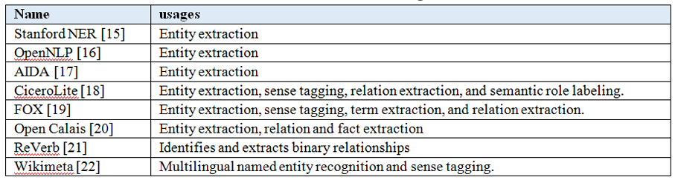
Comparison of Knowledge extraction tools
Knowledge extraction tools and their usages
Ref: https://acadpubl.eu/jsi/2018-118-19/articles/19b/24.pdf

