Slide 1
An introduction to MongoDB
Prepared By: Dr. Ronak Panchal (Ph.D.)
IT Project Manager, Cognizant
Website: http://drronakpanchal.wordpress.com

Slide 2
An introduction to MongoDB
Prepared By: Dr. Ronak Panchal (Ph.D.)
IT Project Manager, Cognizant
Website: http://drronakpanchal.wordpress.com

Slide 3
Agenda
Introduction To MongoDB
Why and What is a mongoDB?
SQL vs mongoDB vs RDBMS
Installation of mongoDB
Datatypes of mongoDB
Insert Document
Update Document
Read Data from collection
Delete Document
Modify the document
Queries with conditional ( Find, And, OR, lt, gt, all, size, slice )

Slide 4
An introduction to MongoDB

Slide 5





Big Data Every Where!
Lots of data is being collected
and warehoused
  Web data, e-commerce
  purchases at department/
  grocery stores
  Bank/Credit Card
  transactions
  Social Network

Slide 6

How much data?
Google processes 20 PB a day (2008)
Wayback Machine has 3 PB + 100 TB/month (3/2009)
Facebook has 2.5 PB of user data + 15 TB/day (4/2009)
eBay has 6.5 PB of user data + 50 TB/day (5/2009)
CERN’s Large Hydron Collider (LHC) generates 15 PB a year
640K ought to be enough for anybody.

Slide 7
Why mongoDB?
https://www.youtube.com/watch?v=CvIr-2lMLsk
2013.02.11.

Slide 8















In Production
http://www.mongodb.org/about/production-deployments/
Notes:
2009: Initial release
At now: version 2.2.3

Slide 9








NoSQL
Key-value
Graph database
Document-oriented
Column family
Notes:
Huge quantity of data => Distributed systems => expensive joins =>
New fields, new demands (graphs) =>
Different data strucutres:
Simplier or more specific

Slide 10
MongoDB Installation
There are 3 ways to install mongoDB
Community Server
Visual Studio Extension
MongoDB Atlas
2013.02.11.

Slide 11
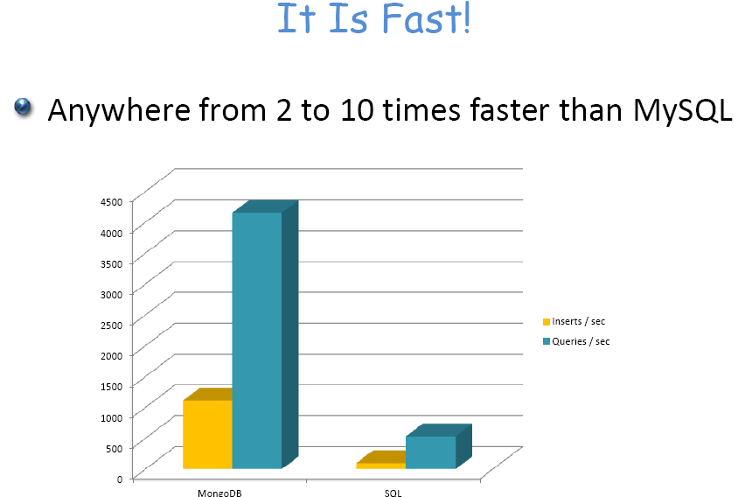

Slide 12
What Is mongoDB?
A document-oriented database
documents encapsulate and encode data (or information) in some standard formats or encodings
NoSQL database
uses BSON format
schema-less
No more configuring database columns with types
No transactions
No joins
MongoDB is an open-source document database and leading NoSQL database.
MongoDB is written in C++.

Slide 13
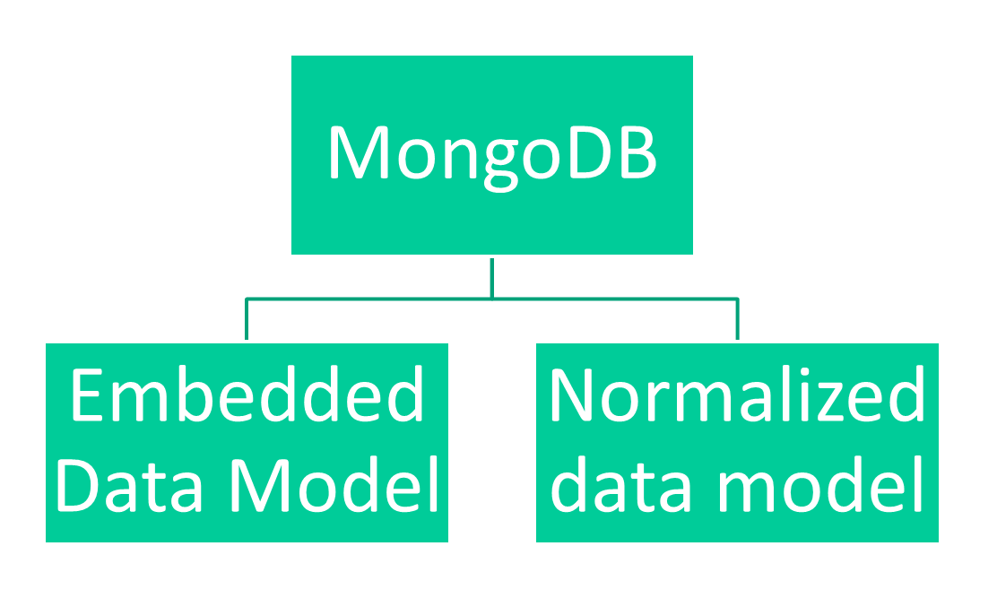
MongoDB provides two types of data models:
2013.02.11.

Slide 14
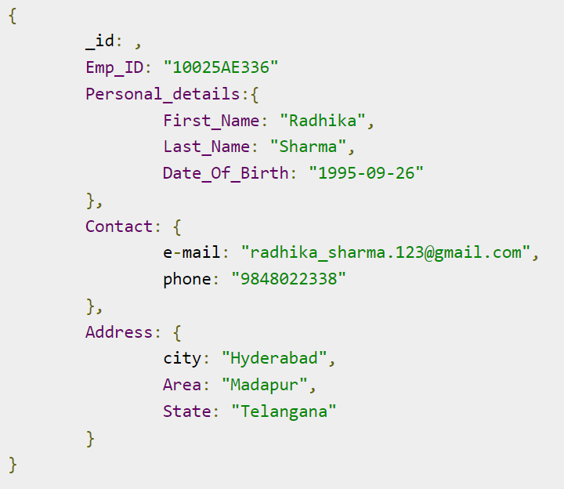
In this model, you can have (embed) all the related data in a single document, it is also known as de-normalized data model.

Slide 15
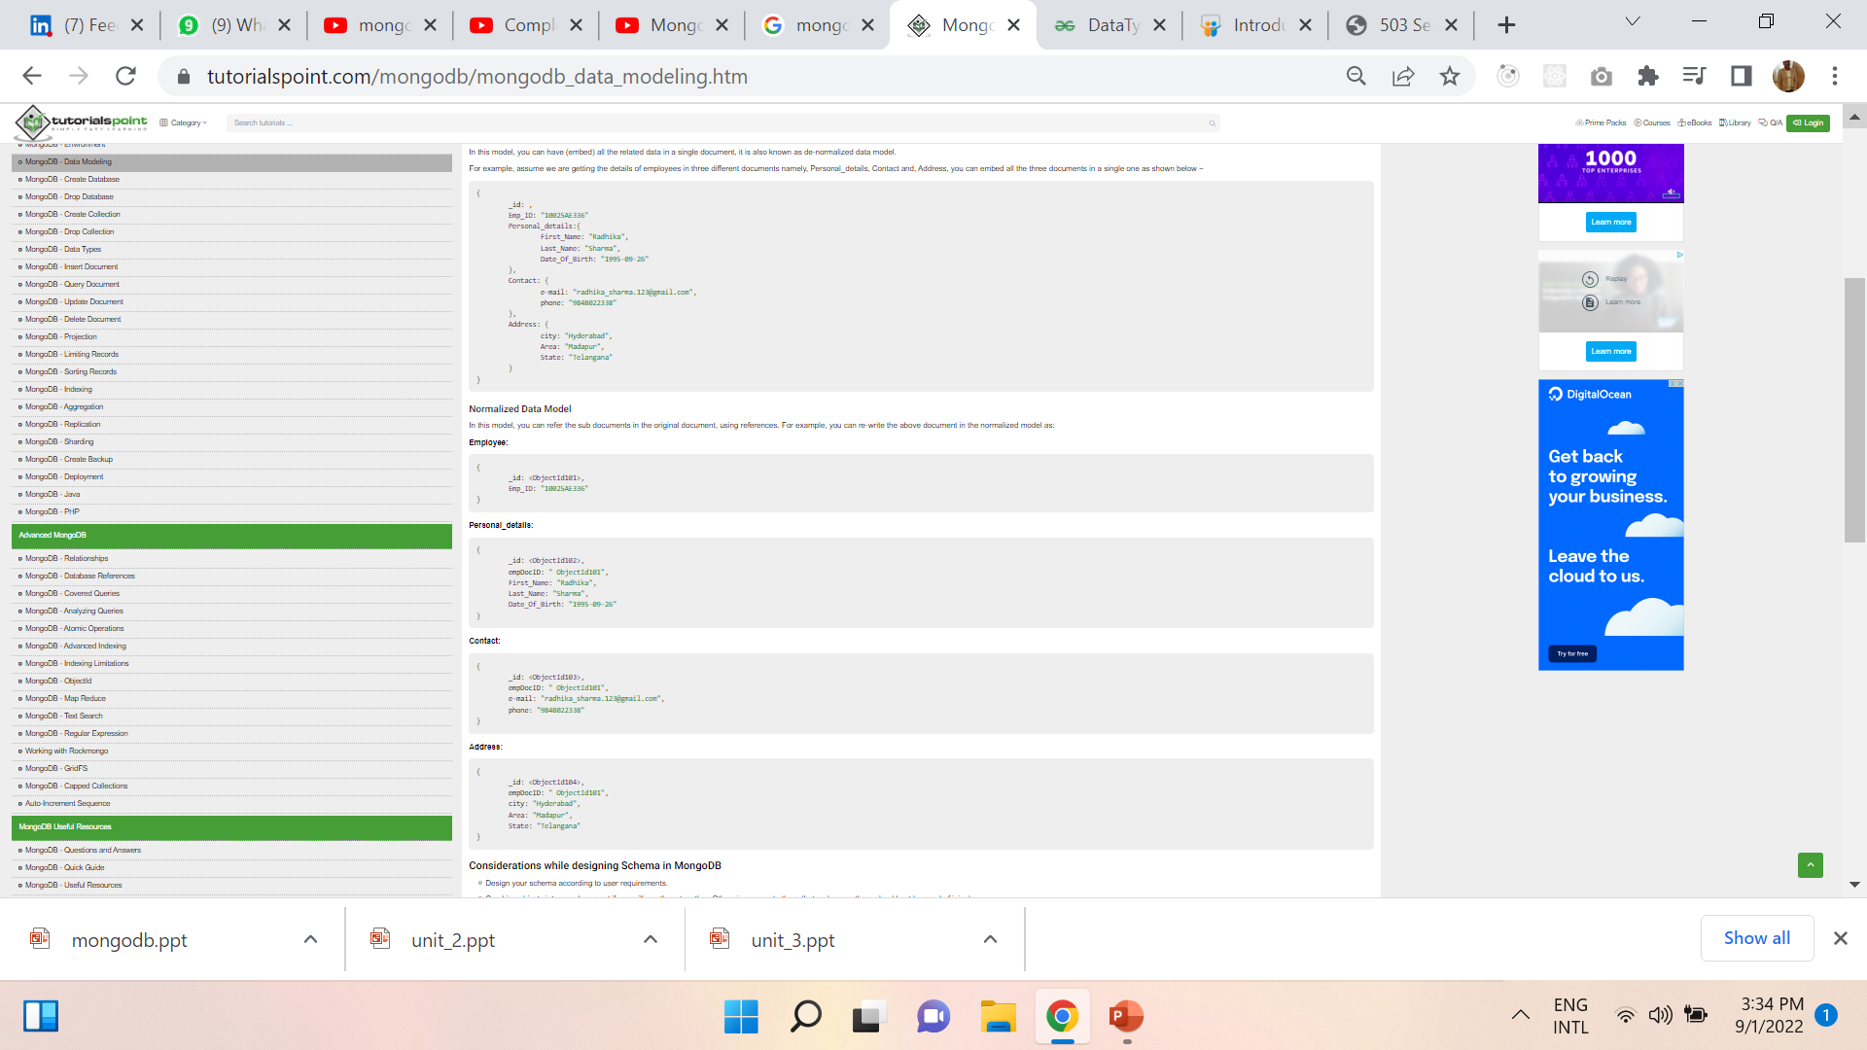
In this model, you can refer the sub documents in the original document, using references. For example, you can re-write the above document in the normalized model as:

Slide 16
MongoDB supports many datatypes
String − This is the most commonly used datatype to store the data. String in MongoDB must be UTF-8 valid.
Integer − This type is used to store a numerical value. Integer can be 32 bit or 64 bit depending upon your server.
Boolean − This type is used to store a boolean (true/ false) value.
Double − This type is used to store floating point values.
Min/ Max keys − This type is used to compare a value against the lowest and highest BSON elements.
Arrays − This type is used to store arrays or list or multiple values into one key.
Timestamp − ctimestamp. This can be handy for recording when a document has been modified or added.
Object − This datatype is used for embedded documents.
Null − This type is used to store a Null value.
Symbol − This datatype is used identically to a string; however, it's generally reserved for languages that use a specific symbol type.
Date − This datatype is used to store the current date or time in UNIX time format. You can specify your own date time by creating object of Date and passing day, month, year into it.
Object ID − This datatype is used to store the document’s ID.
Binary data − This datatype is used to store binary data.
Code − This datatype is used to store JavaScript code into the document.
Regular expression − This datatype is used to store regular expression.

Slide 17
SQL Vs MongoDB
SQL Concepts | MongoDB Concepts
database | database
table | Collection
Row | Document 0r BSON Document
Column | Field
Index | Index
Table Join | Embedded documents & Linking
Primary key | Primary Key
Specify any unique column or column combination as primary key. | In MongoDB, the primary key is automatically set to the _id field.
aggregation (e.g. group by) | aggregation pipeline

Slide 18
Executables
 | Oracle | MySQL | MongoDB
Database Server | oracle | mysqld | mongod
Database Client | sqlplus | mysql | mongo

Slide 19
MongoDB Vs Relational DBMS
Collection vs table
Document vs row
Field vs column
schema-less vs schema-oriented

Slide 20
The Basics
• A MongoDB instance may have zero or more databases
• A database may have zero or more collections.
– Can be thought of as the relation (table) in DBMS, but with many differences.
• A collection may have zero or more documents.
– Docs in the same collection don’t even need to have the same fields
– Docs are the records in RDBMS
– Docs can embed other documents
– Documents are addressed in the database via a unique key
•

Slide 21
Continued..
A document may have one or more fields.
MongoDB Indexes is much like their RDBMS counterparts.
2013.02.11.

Slide 22
Table Creation in Oracle
CREATE TABLE Teacher_Info( Teacher_id Varchar(10), Teacher_Name Varchar(10), Dept_Name Varchar(10), Salary Number(10),Status char(1), PRIMARY KEY (id) );
INSERT INTO TeacherInfo(Teacher_id, Teacher_Name, Dept_Name, Salary, Status) VALUES (“Pic001", “Ravi”, “IT”,30000, “A");
Output: Teacher_Info
Teacher_id | Teacher_Name | Dept_Name, | Salary | Status
Pic001 | Ravi | IT | 30000 | A
Pic002 | Mangesh | IT | 20000 | A
Pic003 | Akshay | Comp | 25000 | N

Slide 23
Example: Mongo Document
Teacher_info = {
Teacher_id: “Pic001",
Teacher_Name: “Ravi",
Dept_Name: “IT”,
Sal:30000,
status: "A"
}

Slide 24
Insert Command:
db.Teacher_info.insert( { Teacher_id: “Pic001", Teacher_Name: “Ravi",Dept_Name: “IT”, Sal:30000, status: "A" } )
db.Teacher_info.insert( { Teacher_id: “Pic002", Teacher_Name: “Ravi",Dept_Name: “IT”, Sal:20000, status: "A" } )
db.Teacher_info.insert( { Teacher_id: “Pic003", Teacher_Name: “Akshay",Dept_Name: “Comp”, Sal:25000, status: “N" } )

Slide 25
Example: Mongo Collection
{ "_id": ObjectId("4efa8d2b7d284dad101e4bc9"),
"Last Name": "DUMONT",
"First Name": "Jean",
"Date of Birth": "01-22-1963" },
{ "_id": ObjectId("4efa8d2b7d284dad101e4bc7"),
"Last Name": "PELLERIN",
"First Name": "Franck",
"Date of Birth": "09-19-1983",
"Address": "1 chemin des Loges",
"City": "VERSAILLES" }

Slide 26
Document store
RDBMS |  | MongoDB
Database |  | Database
Table, View |  | Collection
Row |  | Document (JSON, BSON)
Column |  | Field
Index |  | Index
Join |  | Embedded Document
Foreign Key |  | Reference
Partition |  | Shard
Notes:
Javascript

Slide 27
Document store
RDBMS |  | MongoDB
Database |  | Database
Table, View |  | Collection
Row |  | Document (JSON, BSON)
Column |  | Field
Index |  | Index
Join |  | Embedded Document
Foreign Key |  | Reference
Partition |  | Shard
> db.user.findOne({age:39})
{
"_id" : ObjectId("5114e0bd42…"),
"first" : "John",
"last" : "Doe",
"age" : 39,
"interests" : [
"Reading", Array
"Mountain Biking ]
"favorites": {
"color": "Blue",
"sport": "Soccer"}
}
Embedded document
Notes:
Flexible schema
Javascript

Slide 28
CRUD
Create
  db.collection.insert( <document> )
  db.collection.save( <document> )
  db.collection.update( <query>, <update>, { upsert: true } )
Read
  db.collection.find( <query>, <projection> )
  db.collection.findOne( <query>, <projection> )
Update
  db.collection.update( <query>, <update>, <options> )
Delete
  db.collection.remove( <query>, <justOne> )
Notes:
Create
The field name _id is reserved for use as a primary key; its value must be unique in the collection, is immutable, and may be of any type other than an array.
The field names cannot start with the $ character.
The field names cannot contain the . character.
Create with save
If the <document> argument does not contain the _id field or contains an _id field with a value not in the collection, the save() method performs an insert of the document.
Otherwise, the save() method performs an update.
sds

Slide 29
CRUD example
> db.user.insert({
first: "John",
last : "Doe",
age: 39
})
> db.user.find ()
{
"_id" : ObjectId("51…"),
"first" : "John",
"last" : "Doe",
"age" : 39
}
> db.user.update(
{"_id" : ObjectId("51…")},
{
$set: {
age: 40,
salary: 7000}
}
)
> db.user.remove({
"first": /^J/
})

Slide 30
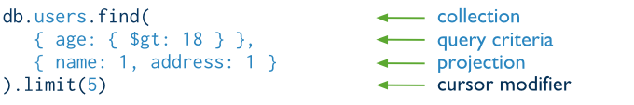
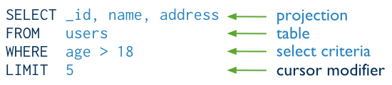
The components of a MongoDB find operation.
The next diagram shows the same query in SQL:

Slide 31
SQL & Mongodb Commands
SQL SELECT Statements | MongoDB find() Statements
SELECT * FROM Teacher_info; | db.Teacher_info.find()
SELECT * FROM Teacher_info WHERE sal = 25000; | db.Teacher_info.find( {sal: 25000})
SELECT Teacher_id FROM Teacher_info WHERE Teacher_id = 1; | db.Teacher_info.find( {Teacher_id: "pic001"})

Slide 32
SQL & Mongodb Commands
SELECT * FROM Teacher_info WHERE status != "A“; | db.Teacher_info.find({status:{$ne:"A"}})
SELECT * FROM Teacher_info WHERE status = "A" AND sal = 20000; | db.Teacher_info.find({status:"A", sal:20000})
SELECT * FROM Teacher_info WHERE status = "A" OR sal = 50000; | > db.Teacher_info.find( { $or: [ { status: "A" } , { sal:50000 } ] } )
SELECT * FROM Teacher_info WHERE sal > 40000 | db. Teacher_info.find( { sal: { $gt: 40000 } } )
SELECT * FROM Teacher_infoWHERE sal < 30000 | db. Teacher_info.find( { sal: { $gt: 30000 } } )

Slide 33
SQL & Mongodb Commands
SELECT * FROM Teacher_info WHERE status = "A" ORDER BY SAL ASC | db. Teacher_info.find( { status: "A" } ).sort( { sal: 1 } )
SELECT * FROM users WHERE status = "A" ORDER BY SAL DESC | db. Teacher_info.find( { status: "A" } ).sort( {sal: -1 } )
SELECT COUNT(*) FROM Teacher_info; | db. Teacher_info.count() or db. Teacher_info.find().count()
SELECT DISTINCT(Dept_name) FROM Teacher_info; | db. Teacher_info.distinct( “Dept_name" )

Slide 34
Update Records
UPDATE Teacher_info SET Dept_name = “ETC" WHERE sal > 250000 | db. Teacher_info.update( { sal: { $gt: 25000 } }, { $set: { Dept_name: “ETC" } }, { multi: true } )
UPDATE Teacher_infoSET sal = sal + 10000 WHERE status = "A" | db. Teacher_info.update( { status: "A" } , { $inc: { sal: 10000 } }, { multi: true } )

Slide 35
Delete Records
DELETE FROM Teacher_info WHERE Teacher_id = “pic001" | db.Teacher_info.remove({Teacher_id: "pic001"});
DELETE FROM Teacher_info; | db. Teacher_info.remove({})

Slide 36
Other Commands..
2013.02.11.

Slide 37

1.Alter Table in Oracle & MongoDb
Oracle:
ALTER TABLE Teacher_info ADD join_date DATETIME
MongoDb:
At the document level, update ()operations can add fields to existing documents using the $set operator.
Ex:
db.Teacher_info.update( { }, { $set: { join_date: new Date() } }, { multi: true} )

Slide 38
2. Drop Command:
Oracle:
DROP TABLE Teacher_info
Mongo:
db.Teacher_info.drop()

Slide 39
3. INSERT A DOCUMENT WITH INSERT() METHOD
The following statement inserts a document with three field
db.inventory.insert( { _id: 10, type: "misc", item: "card", qty: 15 } )

Slide 40
INSERT DOCUMENTS
In MongoDB, the db.collection.insert() method adds new documents into a collection.
In addition, both the db.collection.update() method and the db.collection.save() method can also add new documents through an operation called an upsert.
An upsert is an operation that performs either an update of an existing document or an insert of a new document if the document to modify does not exist.

Slide 41
INSERT A DOCUMENT WITH UPDATE() METHOD
The following example creates a new document if no document in the inventory collection contains { type: "books", item : "journal" }:
db.inventory.update( { type: "book", item : "journal" }, { $set : { qty: 10 } }, { upsert : true } )

Slide 42
INSERT A DOCUMENT WITH SAVE() METHOD
db.inventory.save( { type: "book", item: "notebook", qty: 40 } )
MongoDB adds the _id field and assigns as its value a unique ObjectId.
{ "_id" : ObjectId("51e866e48737f72b32ae4fbc"), "type" : "book", "item" : "notebook", "qty" : 40 }

Slide 43
4. QUERY DOCUMENTS
In MongoDB, the db.collection.find() method retrieves documents from a collection.
The db.collection.find() method returns a cursor to the retrieved documents.
The db.collection.findOne() method also performs a read operation to return a single document.
Internally, the db.collection.findOne() method is the db.collection.find() method with a limit of 1

Slide 44
READ OPERATIONS
Read operations, or queries retrieve data stored in the database.
For query operations, MongoDB provide a db.collection.find() method.
method accepts both the query criteria and projections and returns a cursor.

Slide 45
SELECT ALL DOCUMENTS IN A COLLECTION
An empty query document ({ }) selects all documents in the collection:
db.inventory.find( { } )
OR
db.inventory.find()

Slide 46
Conditional Operators

Slide 47
SPECIFY EQUALITY CONDITION
The following example retrieves from the inventory collection all documents where the type field has the value snacks:
db.inventory.find( { type: "snacks" } )
Specify Conditions Using Query Operators
The following example selects all documents in the inventory collection where the value of the type field is either 'food' or 'snacks':
db.inventory.find( { type: { $in: [ 'food', 'snacks' ] } } )

Slide 48
SPECIFY AND CONDITIONS
In the following example, the query document specifies an equality match on the field type and a less than ($lt) comparison match on the field price:
db.inventory.find( { type: 'food', price: { $lt: 9.95 } } )
Specify OR Conditions
In the following example, the compound query document selects all documents in the collection where the value of the type field is 'food' and either the qty has a value greater than ($gt) 100 or the value of the price field is less than ($lt) 9.95:
db.inventory.find( { type: 'food', $or: [ { qty: { $gt: 100 } }, { price: { $lt: 9.95 } } ] } )

Slide 49
ARRAYS
{ _id: 5, type: "food", item: "aaa", ratings: [ 5, 8, 9 ] }
{ _id: 6, type: "food", item: "bbb", ratings: [ 5, 9 ] }
The following example queries for all documents where the field ratings is an array that holds exactly three elements, 5, 8, and 9, in this order:
db.inventory.find( { ratings: [ 5, 8, 9 ] } )
The operation returns the following document:
{ "_id" : 5, "type" : "food", "item" : "aaa", "ratings" : [ 5, 8, 9 ] }

Slide 50
Example
db.users.find( { age: { $gt: 18 } }, { name: 1, address: 1 } ).limit(5)
This query selects the documents in the users collection that match the condition age is greater than 18.
To specify the greater than condition, query criteria uses the greater than (i.e. $gt) query selection operator.
The query returns at most 5 matching documents (or more precisely, a cursor to those documents). The matching documents will return with only the _id, name and address fields

Slide 51
Querying Arrays
Querying for elements of an array is simple. An array can mostly be treated as though each element is the value of the overall key. For example, if the array is a list of fruits, like this:
> db.food.insert({"fruit" : ["apple", "banana", "peach"]})
the following query:
> db.food.find({"fruit" : "banana"})
will successfully match the document.

Slide 52
$all
If you need to match arrays by more than one element, you can use "$all
> db.food.insert({"_id" : 1, "fruit" : ["apple", "banana", "peach"]})
> db.food.insert({"_id" : 2, "fruit" : ["apple", "kumquat", "orange"]})
db.food.insert({"_id" : 3, "fruit" : ["cherry", "banana", "apple"]})
Then we can find all documents with both "apple" and "banana" elements by querying with "$all":
> db.food.find({fruit : {$all : ["apple", "banana"]}})
Output:-
{"_id" : 1, "fruit" : ["apple", "banana", "peach"]}
{"_id" : 3, "fruit" : ["cherry", "banana", "apple"]}

Slide 53
$size
A useful conditional for querying arrays is "$size", which allows you to query for arrays of a given size. Here’s an example:
> db.food.find({"fruit" : {"$size" : 3}})

Slide 54
$slice
The special "$slice" operator can be used to return a subset of elements for an array key.
For example, suppose we had a blog post document and we wanted to return the first 10 comments:
> db.blog.posts.findOne(criteria, {"comments" : {"$slice" : 10}})

Slide 55
Alternatively, if we wanted the last 10 comments, we could use -10:
db.blog.posts.findOne(criteria, {"comments" : {"$slice" : -10}})
"$slice" can also return pages in the middle of the results by taking an offset and the number of elements to return:
> db.blog.posts.findOne(criteria, {"comments" : {"$slice" : [23, 10]}})
This would skip the first 23 elements and return the 24th through 34th. If there are fewer than 34 elements in the array, it will return as many as possible.

