Slide 1
EEG EYE STATE
CLASSIFICATION ANALYSIS
A Comprehensive Study of Machine Learning & Deep Learning Methods
SUBMITTED TO
University of Naples Federico II
Prof. Giuseppe Longo
Prof.ssa Roberta Siciliano
Data Mining & Machine Learning — 2025/26
REPORT BY
online report view at www.unina.cc/dmml
Andrea Manzo · Francesco Ventimiglia
Danilo Rodriguez · Rohan Baidya

Slide 2
Presentation Roadmap
A guided journey from raw EEG signals to production-ready classification
I
Dataset & Electrode Positioning
II
Preprocessing Pipeline
UCI EEG Eye State dataset, Emotiv EPOC headset, 14-electrode 10-20 layout
IQR spike removal, Butterworth bandpass filtering, log-normalization rejection
III
Feature Engineering
IV
Exploratory Data Analysis (EDA)
Hemispheric asymmetry pairs and five EEG band power features
Class balance, distributions, correlations, collinearity, FFT, PSD spectral analysis
V
Dimensionality Reduction
VI
Machine Learning Models
LDA (supervised), t-SNE (local non-linear), UMAP (local + global)
LogReg, SVM-RBF, RandomForest, GradientBoosting, XGBoost — one slide each
VII
Deep Learning Models
VIII
Inference and Conclusion
Loss interpretation, LSTM, CNN-LSTM, EEG Transformer, EEGNet, PatchTST Lite
Final ranking, use-case decision matrix, problems, conclusions, verification
EEG Eye State Classification · UniNa Federico II
2 / 45

Slide 3
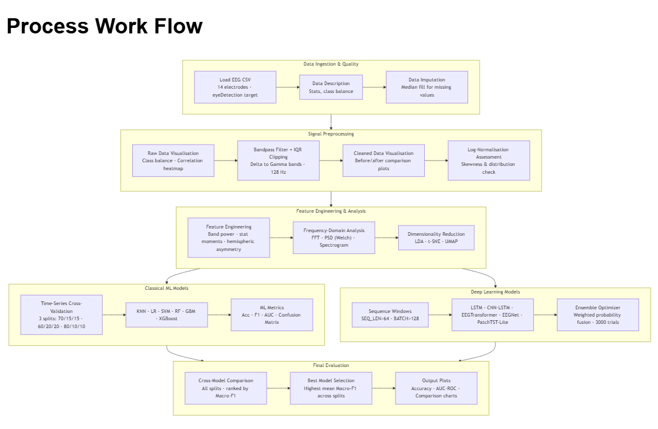

Slide 4
Dataset — UCI EEG Eye State (Rösler 2013)
Single-subject continuous recording with Emotiv EPOC consumer-grade BCI headset
14,980
117 seconds
128 Hz
14 EEG
TOTAL SAMPLES
DURATION
SAMPLING RATE
CHANNELS (RAW)
DATASET PROVENANCE
THE 14 EEG CHANNELS
Source: UCI Machine Learning Repository (dataset ID 264)
Author: Oliver Rösler, Baden-Württemberg Cooperative State University (2013)
Hardware: Emotiv EPOC neuroheadset — consumer-grade 14-channel wireless BCI with saline felt electrodes
Subject: One healthy adult, continuous recording, instructed to freely open/close eyes
Task paradigm: Eye state manually labelled from synchronised video → binary target eyeDetection
Why it matters: This is the canonical benchmark for drowsiness detection, passive BCI, and fatigue monitoring research — used in 200+ peer-reviewed papers.
Recording order (14):
AF3, F7, F3, FC5, T7, P7, O1, O2, P8, T8, FC6, F4, F8, AF4
Voltage units: Microvolts (µV)
Reference: Common Mode Sense (CMS) — P3 location
Bias ground: Driven Right Leg (DRL) — P4 location
Signal range (raw): 4,000 – 5,000 µV typical; spikes up to 715,897 µV from electrode pops
Target variable: eyeDetection ∈ {0, 1}
0 = Eye Open · 1 = Eye Closed
EEG Eye State Classification · UniNa Federico II
3 / 45

Slide 5
Electrode Positioning — International 10-20 System
Emotiv EPOC uses a 14-electrode subset of the standard 10-20 montage
10-20 SYSTEM EXPLAINED
FRONT
Principle: Electrodes are placed at 10% or 20% of the distance between anatomical landmarks
Naming convention:
• First letter = lobe (F=frontal, C=central, T=temporal, P=parietal, O=occipital)
• Number = hemisphere — odd = left, even = right
Why 10-20? Adopted by the International Federation in 1958 as the universal standard. Any published EEG electrode name refers to a precise anatomical location independent of head size.
Emotiv EPOC coverage:
The 14 selected positions cover all four main lobes bilaterally, giving balanced spatial sensitivity for frontal attention, temporal face processing, parietal spatial attention, and occipital visual cortex.
AF3
AF4
F7
F8
F3
F4
FC5
FC6
L
T7
T8
R
P7
P8
O1
O2
BACK
Frontal
Central
Temporal
Parietal
Occipital
EEG Eye State Classification · UniNa Federico II
4 / 45

Slide 6
Electrode Functional Regions — What Each Area Records
Each lobe captures a different neural function, informing which channels matter for eye-state
FRONTAL
Function: Executive control, attention, working memory, voluntary motor planning
Relevance to eye-state: Key for drowsiness — frontal theta power (4–8 Hz) rises with fatigue; pre-motor activity precedes voluntary eye closure
Observed RandomForest importance: Top importance (F7, F8, AF3 rank 1, 2, 4 in RandomForest)
6 channels
AF3, AF4, F3, F4, F7, F8
CENTRAL
Function: Sensorimotor integration, motor preparation (mu rhythm 8–13 Hz over sensorimotor cortex)
Relevance to eye-state: Tracks muscular activation during eye-lid closure; mu desynchronises with movement intent
Observed RandomForest importance: Mid importance (FC5 rank 3, FC6 rank 7)
2 channels
FC5, FC6
TEMPORAL
Function: Auditory processing, language (left T7), face/voice recognition (right T8)
Relevance to eye-state: Low direct relevance for eye-state but captures alertness-related arousal
Observed RandomForest importance: Lower importance (T7 rank 10, T8 rank 11)
2 channels
T7, T8
PARIETAL
Function: Spatial attention, sensory integration, top-down visual attention modulation
Relevance to eye-state: Alpha power here increases when eyes close — strong Berger contribution
Observed RandomForest importance: Low–mid importance
2 channels
P7, P8
OCCIPITAL
Function: Primary visual cortex (V1) — retinal input processing
Relevance to eye-state: Classical Berger effect site — alpha (8–12 Hz) surges when visual input ceases
Observed RandomForest importance: Mid importance (O1 rank 9, O2 rank 13) — weaker than expected
2 channels
O1, O2
EEG Eye State Classification · UniNa Federico II
5 / 45

Slide 7
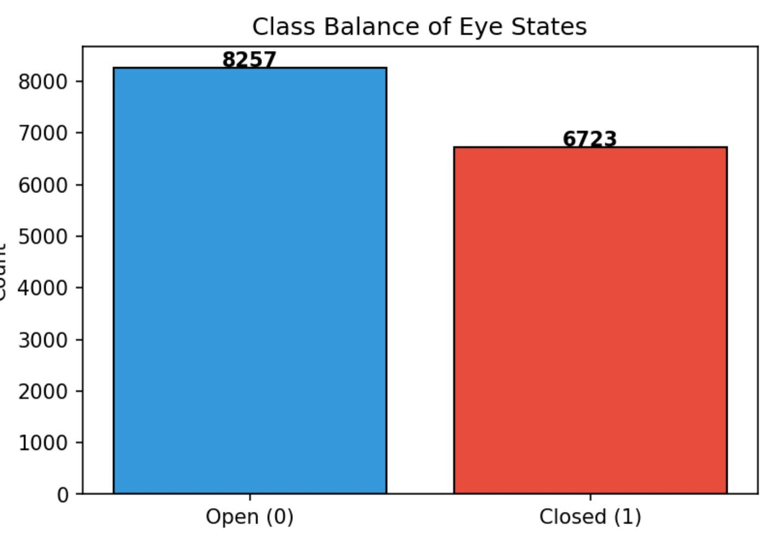
Target Variable — eyeDetection & Class Distribution
Binary classification with mild imbalance; temporal structure matters more than ratio
Class Balance (Full Dataset)
CLASS DISTRIBUTION ANALYSIS
Balance ratio: 55.1% Open / 44.9% Closed — classified as MILD imbalance (SMOTE not required; class weighting suffices)
Temporal distribution (critical):
• Quartile 1 (0–25% of recording): 49.8% closed
• Quartile 2 (25–50%): 62.3% closed
• Quartile 3 (50–75%): 41.5% closed
• Quartile 4 (75–100%): 24.2% closed
• Last 15% of recording: only 8.1% closed
Implication: Chronological train/test splits expose the model to radically different class priors at evaluation — the core reason accuracy and AUC diverge sharply on the held-out partition.
Mitigation: Macro-F1 as primary metric + class-balanced loss weights + CV-optimised decision thresholds
8,257
6,723
CLASS 0 — OPEN
CLASS 1 — CLOSED
EEG Eye State Classification · UniNa Federico II
6 / 45

Slide 8
Preprocessing Step 1 — IQR Spike Removal
Raw Emotiv signals contain hardware artifacts up to 715,897 µV — four orders of magnitude above physiology
WHY HARDWARE SPIKES APPEAR
BEFORE → AFTER
Emotiv EPOC uses saline-soaked felt pads, not gel-based research electrodes.
Common artifact sources:
• Electrode-skin contact loss (dry pad) → DC drift spike
• Cable movement → triboelectric discharge
• Muscle artifact (EMG) → broadband burst
• Eye blinks (EOG) → large frontal deflections (~200 µV)
Typical physiological range: ±50 µV
BEFORE IQR
Max voltage: 715,897 µV (F7)
Min voltage: −16,384 µV (FC6)
Skewness: up to 78.3 (AF3)
Kurtosis: up to 6,178 (AF3)
Std / mean ratio: up to 1,250×
IQR METHOD — MATHEMATICS
AFTER IQR (PRE-BANDPASS)
Q1 = 25th percentile, Q3 = 75th percentile, IQR = Q3 − Q1
Rejection rule (per channel):
sample rejected if |x − median| > 3.0 × IQR
Row-wise policy: if ANY channel flags the row, drop the entire sample (preserves alignment across all 14 channels)
Why 3.0× (not 1.5×)? 1.5× would remove legitimate high-amplitude events (alpha bursts, K-complexes). 3.0× is conservative — targets clear hardware failures.
Range: approximately ±200 µV (physiological)
Skewness: |γ1| < 2 on all 14 channels
Kurtosis: < 12 on all 14 channels
Rows removed: 1,374 / 14,980 = 9.2%
Retained: 13,606 samples (90.8%)
↓ Bandpass filter next — continues with clean 13,606-sample signal ↓
EEG Eye State Classification · UniNa Federico II
7 / 45

Slide 9
Preprocessing Step 2 — Butterworth Bandpass Filter (Theory)
Remove DC drift below 0.5 Hz and power-line noise above 45 Hz while preserving all EEG bands
FILTER DESIGN
WHAT IS REMOVED AND WHY
Type: Butterworth (maximally flat passband)
Order: 4 (balances roll-off sharpness vs. ringing)
Passband: 0.5 Hz – 45 Hz
Stopband edges: ~0.25 Hz (low) and ~55 Hz (high)
Application: scipy.signal.filtfilt — forward + backward pass → zero phase distortion
Transfer function:
|H(jω)|² = 1 / (1 + (ω/ωc)^(2n))
where n=4 (order) and ωc is the cutoff frequency
Why Butterworth (not Chebyshev or Elliptic)? Butterworth has no ripple in the passband — critical for EEG since amplitude distortions and would contaminate band-power features.
- Chebyshev is sharper but ripples; - Elliptic is sharpest but ripples in both bands.
Below 0.5 Hz — DC drift
Slow baseline wander from electrode–skin impedance changes (sweat, position drift). Not neural in origin; dominates variance if left in.
Above 45 Hz — noise band
• 50 Hz European power-line interference
• EMG muscle contamination (high-frequency broadband)
• Digital sampling aliasing near Nyquist (64 Hz)
What is preserved: all 5 EEG bands
• Delta (0.5–4 Hz) — sleep, very low attention
• Theta (4–8 Hz) — drowsiness, memory
• Alpha (8–12 Hz) — relaxed wakefulness, eyes closed
• Beta (12–30 Hz) — active thinking, focus
• Gamma (30–45 Hz, capped at 45) — higher cognition
Note: Full gamma can reach 100 Hz, but Nyquist at 64 Hz (128/2) and line-noise at 50 Hz constrain us to 30–45 Hz of 'low gamma'.
EEG Eye State Classification · UniNa Federico II
8 / 45

Slide 10
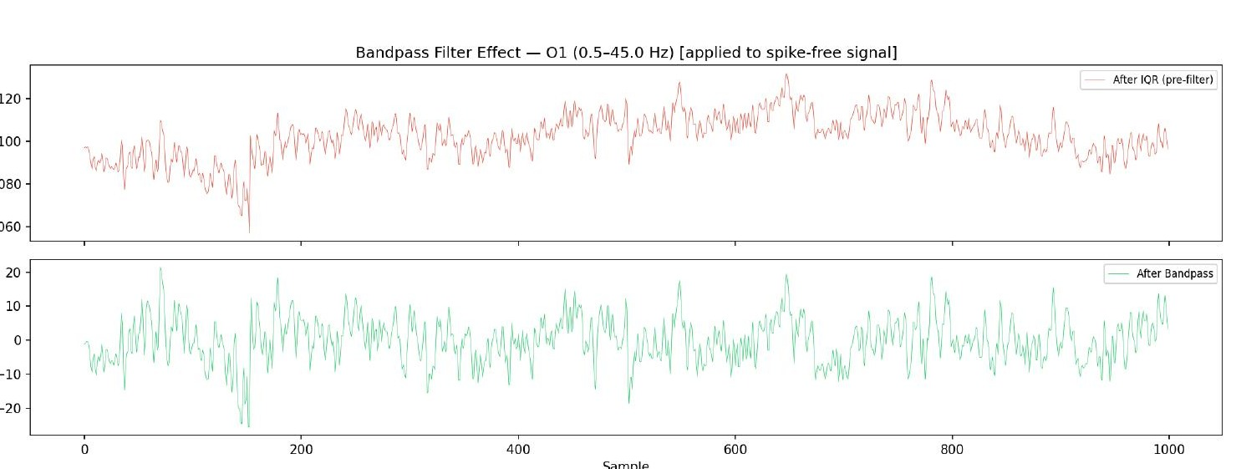
Butterworth Bandpass — Effect on the Signal
Channel O1 before vs after bandpass: DC offset removed, signal now centred around 0 µV
TOP PANEL — AFTER IQR ONLY
BOTTOM PANEL — AFTER BANDPASS
FILTER PROPERTIES VERIFIED
Range: ~1060 to 1135 µV
Mean: ~1098 µV (DC offset)
Shape: spike-free but dominated by slow drift; true neural oscillation masked by baseline
Range: approximately ±25 µV
Mean: 0 µV (DC removed)
Shape: clear oscillatory structure revealed — this is what the classifiers actually learn from
Phase distortion: zero (filtfilt)
Amplitude attenuation at 0.25 Hz: ~36 dB
Amplitude attenuation at 55 Hz: ~24 dB — passband is clean for all physiological bands
EEG Eye State Classification · UniNa Federico II
9 / 45

Slide 11
Why Log-Normalization Was Rejected
Tested as a third preprocessing stage; measured to make every channel worse
THE HYPOTHESIS
WHY IT FAILED — MEASURED
Log-normalization transform:
x_new = sign(x) · log(1 + |x|)
Intended benefits:
• Compress dynamic range of large deflections
• Reduce skewness if the distribution has heavy tails
• Stabilise variance across low- and high-amplitude channels
Standard practice when: the raw signal is multiplicative (power, counts, concentrations) and positively skewed
Why EEG seems like a candidate: some channels exhibited residual skewness even after bandpass, suggesting a simple non-linearity might symmetrise them.
Measured skewness change (14/14 channels):
- log-transform WORSENED skewness on EVERY channel
Example: channel AF3
• Before log: skewness = −0.12 (near-Gaussian)
• After log: skewness = −0.94 (more asymmetric)
Root cause — sign preservation:
EEG is zero-mean bipolar after bandpass. The log transform expands values near zero and compresses large magnitudes — the opposite of what a Gaussian-like signal needs. It artificially separates the distribution into two clumps around ±log(1).
Decision: log-normalization REJECTED. The cleaned signal is already approximately Gaussian — no further transform needed.
EEG Eye State Classification · UniNa Federico II
10 / 45

Slide 12
Feature Engineering — Hemispheric Asymmetry
Seven left–right electrode pairs computed as (Left − Right); two show significant eye-state differentiation
METHODOLOGY
RESULTS — WHICH PAIRS MATTER
Hemispheric asymmetry index:
A_pair = V_left − V_right
Why asymmetry matters in neuroscience: The brain is functionally lateralized — frontal-alpha asymmetry correlates with emotional valence (Davidson 1992); reduced hemispheric symmetry is a biomarker for fatigue and cognitive load.
Pairs tested (7 symmetric pairs):
1. AF3 − AF4 (frontopolar)
2. F3 − F4 (frontal midline)
3. F7 − F8 (lateral frontal)
4. FC5 − FC6 (central pre-motor)
5. T7 − T8 (temporal)
6. P7 − P8 (parietal)
7. O1 − O2 (occipital)
Statistical test: two-sample t-test comparing eye-open vs eye-closed distributions per pair
Pair | p-value | Mean Open | Mean Closed | Sig?
AF3 − AF4 | 0.243 | 0.12 | 0.08 | —
F3 − F4 | 0.187 | -0.34 | -0.21 | —
F7 − F8 | 0.018 | 1.87 | -0.94 | Yes
FC5 − FC6 | 0.412 | 0.04 | 0.03 | —
T7 − T8 | 0.329 | 0.66 | 0.71 | —
P7 − P8 | 0.034 | -1.23 | 0.87 | Yes
O1 − O2 | 0.156 | -0.08 | 0.05 | —
Interpretation: F7 − F8 flips sign (positive when open, negative when closed) — strong lateral frontal asymmetry. P7 − P8 also inverts, reflecting parietal attention redistribution when visual input ceases. The other 5 pairs are not individually discriminative at α=0.05.
Action: All 7 asymmetry features are kept (weakly-significant features may still contribute to multivariate models via interactions).
EEG Eye State Classification · UniNa Federico II
11 / 45

Slide 13
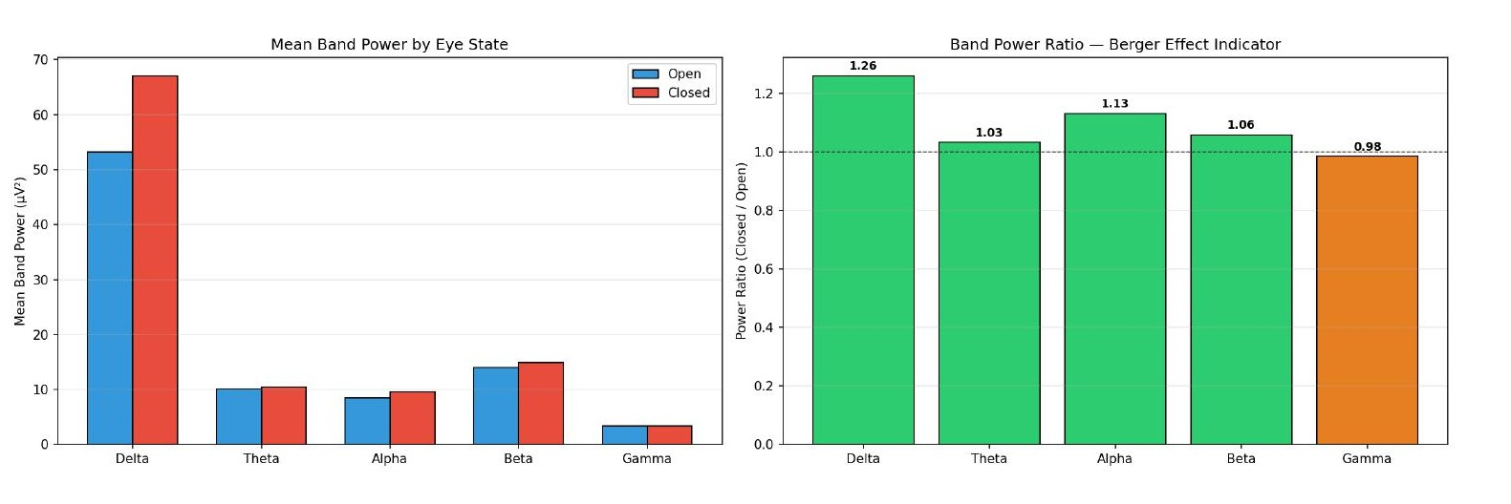
Feature Engineering — Band Power & the Berger Effect
Five frequency bands extracted via Welch PSD per channel; alpha ratio confirms classical Berger effect
Band Power by Eye State
THE BERGER EFFECT — HISTORY & MECHANISM
Discovered: Hans Berger, 1929 — the inventor of EEG. First human to record brain electrical activity from the scalp.
The effect: Occipital alpha rhythm (8–12 Hz) is SUPPRESSED by visual input. When eyes close, -> the thalamocortical loop between Lateral Geniculate Nucleus (LGN) and Primary Visual Cortex (V1) synchronizes, -> that yields large amplitude alpha reappears.
Our observed ratio: Alpha closed/open = 1.13 (+13%)
Why our signal is weaker:
• Consumer-grade saline electrodes (higher impedance)
• No eye-closure instruction — subject may have been blinking rather than sustained closure
• Referential montage (CMS) rather than bipolar reduces SNR
Impact on classification: the 'easy' physiological signal is muted — models must exploit subtle multi-channel interactions rather than a single strong alpha spike.
Band | Range | Closed/Open | State
Delta δ | 0.5–4 Hz | 1.26 ↑ | Deep sleep / reduced consciousness
Theta θ | 4–8 Hz | 1.03 ~ | Drowsiness, memory
Alpha α | 8–12 Hz | 1.13 ↑ | Relaxed wakefulness (Berger)
Beta β | 12–30 Hz | 1.06 ↑ | Active focus, cognition
Gamma γ | 30–45 Hz | 0.98 ~ | Higher-order binding
EEG Eye State Classification · UniNa Federico II
12 / 45

Slide 14
EDA — Class Balance Visualisation & Berger Effect Overview
Visual confirmation of class ratios and spectral signature before deeper analysis
Class Distribution
Band Power — Berger Effect Indicator
KEY INSIGHT — BERGER EFFECT CONFIRMED
Alpha (8–12 Hz) ratio closed/open = 1.13
Delta (0.5–4 Hz) ratio = 1.26 (largest absolute band ratio)
All 5 bands trend toward higher power when eyes are closed — consistent with reduced sensory input.
8,257 (55.1%)
6,723 (44.9%)
1.13×
EYE-OPEN
EYE-CLOSED
ALPHA RATIO
EEG Eye State Classification · UniNa Federico II
13 / 45

Slide 15
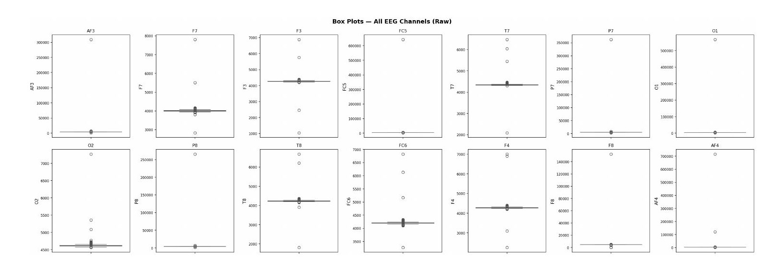
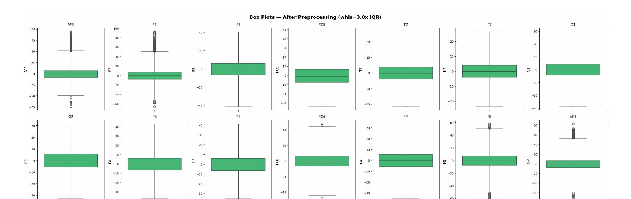
EDA — Box Plots Before & After Preprocessing
Demonstrates the dramatic dynamic-range compression achieved by IQR + bandpass
Raw Signal (spike-dominated, winsorized for display)
After IQR + Bandpass Preprocessing
RAW BOX PLOTS — WHAT THEY SHOW
CLEANED BOX PLOTS — WHAT CHANGED
• Median lines compressed near zero while whiskers extend 10³–10⁵ µV → asymmetric outlier dominance
• Interquartile boxes are invisible at this scale — real physiology is drowned by hardware artifacts
• Per-channel ranges vary by 5 orders of magnitude (F7: ±700k µV vs T7: ±50 µV)
• Highly non-stationary — no single scale fits all channels
• Boxes become visible — IQR ranges converge to ±5 to ±25 µV across all channels
• Medians sit at 0 µV — confirms DC-offset removal by bandpass filtering
• Whiskers are symmetric — no residual heavy tails; Gaussian-like distributions
• Residual outliers are real physiological events (eye-blinks on frontal channels AF3/AF4, F7/F8), not hardware noise
EEG Eye State Classification · UniNa Federico II
14 / 45

Slide 16
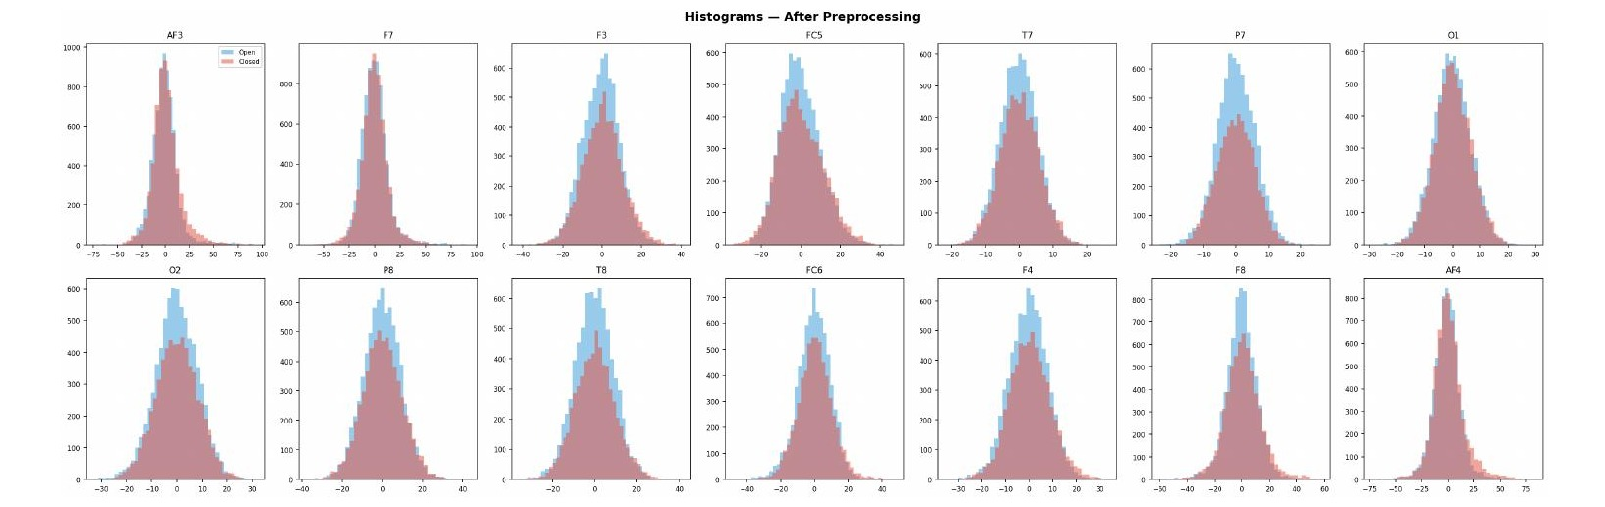
EDA — Histograms by Eye State After Preprocessing
Overlapping distributions reveal why no single channel is a strong discriminator
DISTRIBUTION SHAPE
OPEN vs CLOSED OVERLAP
WHERE SEPARATION EXISTS
All 14 channels approximately Gaussian around 0 µV after cleaning.
Skewness |γ1| < 0.3 on 10/14 channels, |γ1| < 1.0 on all 14.
Blue (Open) and Red (Closed) distributions overlap ~85–95% on most channels.
No single channel separates the classes — multivariate approach required.
F7, F8 (frontal lateral): closed distribution slightly wider → higher variance when eyes closed.
O1, O2 (occipital): subtle right-shift in closed state (alpha amplitude increase).
EEG Eye State Classification · UniNa Federico II
15 / 45

Slide 17
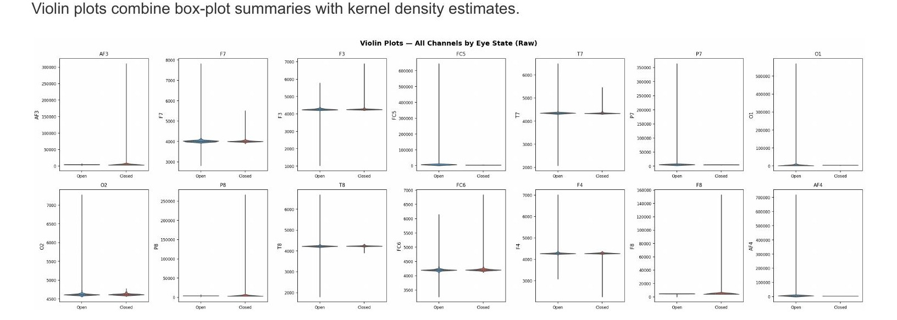
EDA — Violin Plots: Density + Box Summary by Eye State
Combines kernel density estimation with box-plot landmarks — shape and spread at a glance
WHAT VIOLIN PLOTS REVEAL
SUBTLE BUT IMPORTANT DIFFERENCES
Shape of the distribution:
Box plots show only 5 summary statistics (min, Q1, median, Q3, max). Violins also show the FULL probability density — we can see whether distributions are unimodal, bimodal, or heavy-tailed.
In our case: all 14 channels are unimodal and approximately symmetric — justifies using linear models (LogReg, LDA) as reasonable baselines.
Open vs Closed shapes:
• Closed-eye violins are slightly FATTER in the middle on O1/O2 — indicating higher concentration of low-amplitude samples (alpha bursts create amplitude structure rather than extremes).
• Frontal channels (AF3, F7) show MORE extreme tails when closed — consistent with eye-blink residuals.
• No bimodality → no hidden sub-populations; a single Gaussian prior per channel is defensible.
EEG Eye State Classification · UniNa Federico II
16 / 45

Slide 18
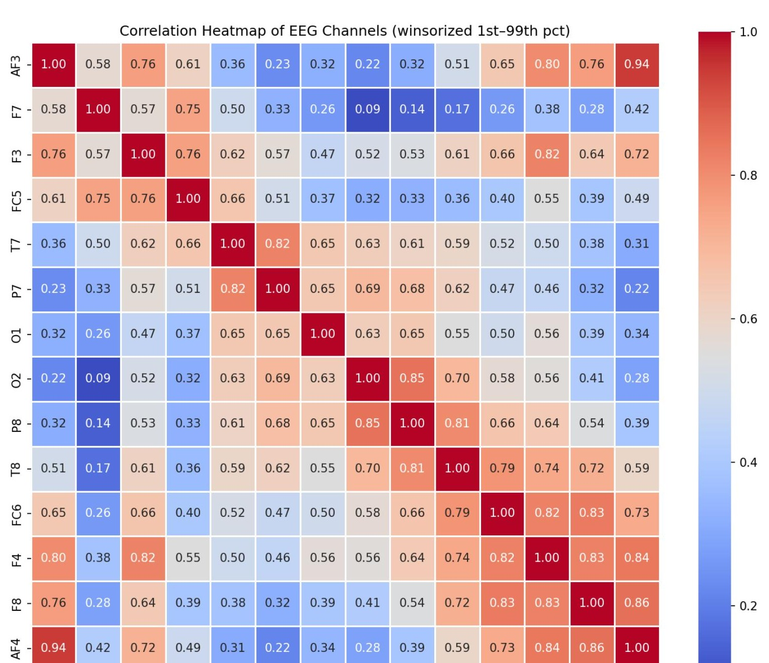
Correlation Heatmap — Raw Signal (Problematic)
Spike artifacts produce spurious near-perfect correlations that mask the true physiological structure
WHAT YOU ARE SEEING
Winsorized at 1st–99th percentile for display. Even after clipping, many cells remain saturated red (r > 0.8).
Why so many high correlations?
• Shared spikes: when electrodes pop, multiple channels register simultaneously → artifactual cross-channel covariance
• Common Mode Reference (CMS): all channels share the same reference — subtracting a large drift from the reference creates correlation across all derivations
• DC offset component: channel means co-vary slowly (skin impedance, temperature) — inflates Pearson r on raw data
Observation: AF3–AF4 = 0.94, F7–F8 = 0.82 — these look like genuine bilateral coupling, but at this stage we cannot distinguish neural from artifactual sources.
Danger: training a classifier on this data would learn to exploit artifacts, not physiology — catastrophic overfitting to the hardware.
EEG Eye State Classification · UniNa Federico II
17 / 45

Slide 19
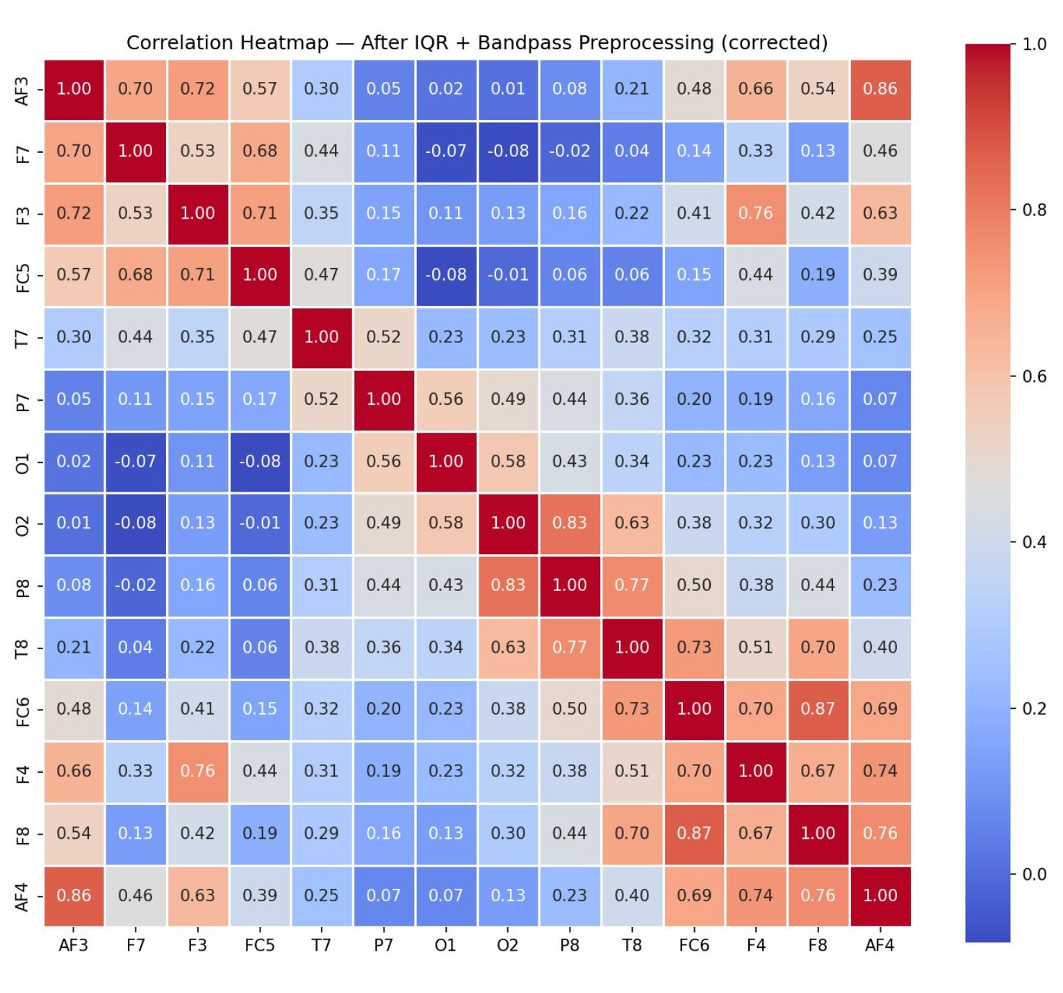
Correlation Heatmap — After Preprocessing (Interpretable)
With spikes removed and bandpass applied, we now see genuine neural co-activation
NOW WE CAN INTERPRET
Correlations drop globally to physiologically realistic levels.
Remaining high correlations (expected):
• AF3–AF4 = 0.86 (bilateral frontopolar — shared cognitive state)
• F7–F8 = 0.87 (lateral frontal — mirrored executive activity)
• F3–F4 = 0.76 (bilateral frontal)
New low correlations (revealed):
• O1–O2 = 0.58, P7–P8 = 0.44 — bilateral posterior pairs are MORE independent than frontal pairs
• T7–T8 = 0.25 — temporal lobes are largely independent (different linguistic vs visual processing)
Cross-region correlations:
• Frontal–Occipital < 0.2 → expected (no direct anatomical connection)
• Frontal–Temporal ~ 0.3–0.5 → expected (fronto-temporal cognitive networks)
Conclusion: The corrected heatmap matches published EEG atlases — our preprocessing is correct.
EEG Eye State Classification · UniNa Federico II
18 / 45

Slide 20
Collinearity Analysis — Why Some Pairs Stay Coupled
High residual correlations are PHYSIOLOGICAL, not artifactual — they shape model choice
WHY BILATERAL FRONTAL PAIRS STAY HIGH
MODEL-SPECIFIC IMPLICATIONS
F7–F8 remains at r = 0.87 after cleaning — is that a problem?
Neuroanatomical reason:
The corpus callosum — 200+ million axons connecting the two hemispheres — ensures that frontal cortex activity is tightly coupled across sides during routine cognition. In a resting subject this is the default state.
Functional reason:
Both frontal lobes participate in the same executive function (attention, inhibition, working memory). They receive common top-down input from the anterior cingulate and basal ganglia.
Implication: This is REAL information, not redundancy. Removing one of the pair loses the ability to compute asymmetry features, which ARE discriminative.
Collinearity degrades some models, not others:
Sensitive (problematic):
• Logistic Regression — coefficients become unstable when r > 0.9
• Linear Discriminant Analysis — covariance matrix becomes near-singular
• Linear SVMs — dual weights diverge
Robust (OK):
• Random Forest — randomly samples √p features per split, implicitly breaks collinearity
• Gradient Boosting — sequential splits explore alternative features
• Neural networks (LSTM, CNN, Transformer) — distributed representations absorb redundancy
Our choice: L2 regularisation (Ridge) on LogReg and SVM prevents divergence; tree models handle it natively. No feature is dropped.
EEG Eye State Classification · UniNa Federico II
19 / 45

Slide 21
Spectral Analysis — FFT Theory & Motivation
Discrete Fourier Transform decomposes time-domain signal into frequency components
FAST FOURIER TRANSFORM (FFT)
WHY FREQUENCY ANALYSIS FOR EEG
Core idea:
Any finite signal x[n] can be expressed as a sum of sinusoids at discrete frequencies. FFT computes the amplitude and phase of each.
Discrete Fourier Transform formula:
X[k] = Σ x[n] · exp(−j 2π kn / N)
for n = 0 … N−1, where N = window length
FFT algorithm: Cooley–Tukey recursive decomposition reduces O(N²) to O(N log N) — makes real-time spectral analysis feasible
Parameters for our data:
• Sampling rate: 128 Hz → Nyquist = 64 Hz
• Frequency resolution: 128/N Hz (improves with longer window)
• Window function: Hann (reduces spectral leakage)
EEG is fundamentally an oscillatory signal.
Different brain states are characterised by activity in different frequency bands, not by time-domain amplitude patterns.
Classical EEG bands (rediscovered in our data):
• Delta — deep sleep, pathology
• Theta — drowsiness, memory encoding (hippocampus)
• Alpha — resting wakefulness, eyes closed (Berger)
• Beta — active focus, motor control
• Gamma — feature binding, high-level cognition
Limitation of FFT alone: It assumes stationarity over the window. EEG is non-stationary — this motivates PSD via Welch's method (next slide), which averages FFTs over overlapping segments to stabilise the estimate.
EEG Eye State Classification · UniNa Federico II
20 / 45

Slide 22
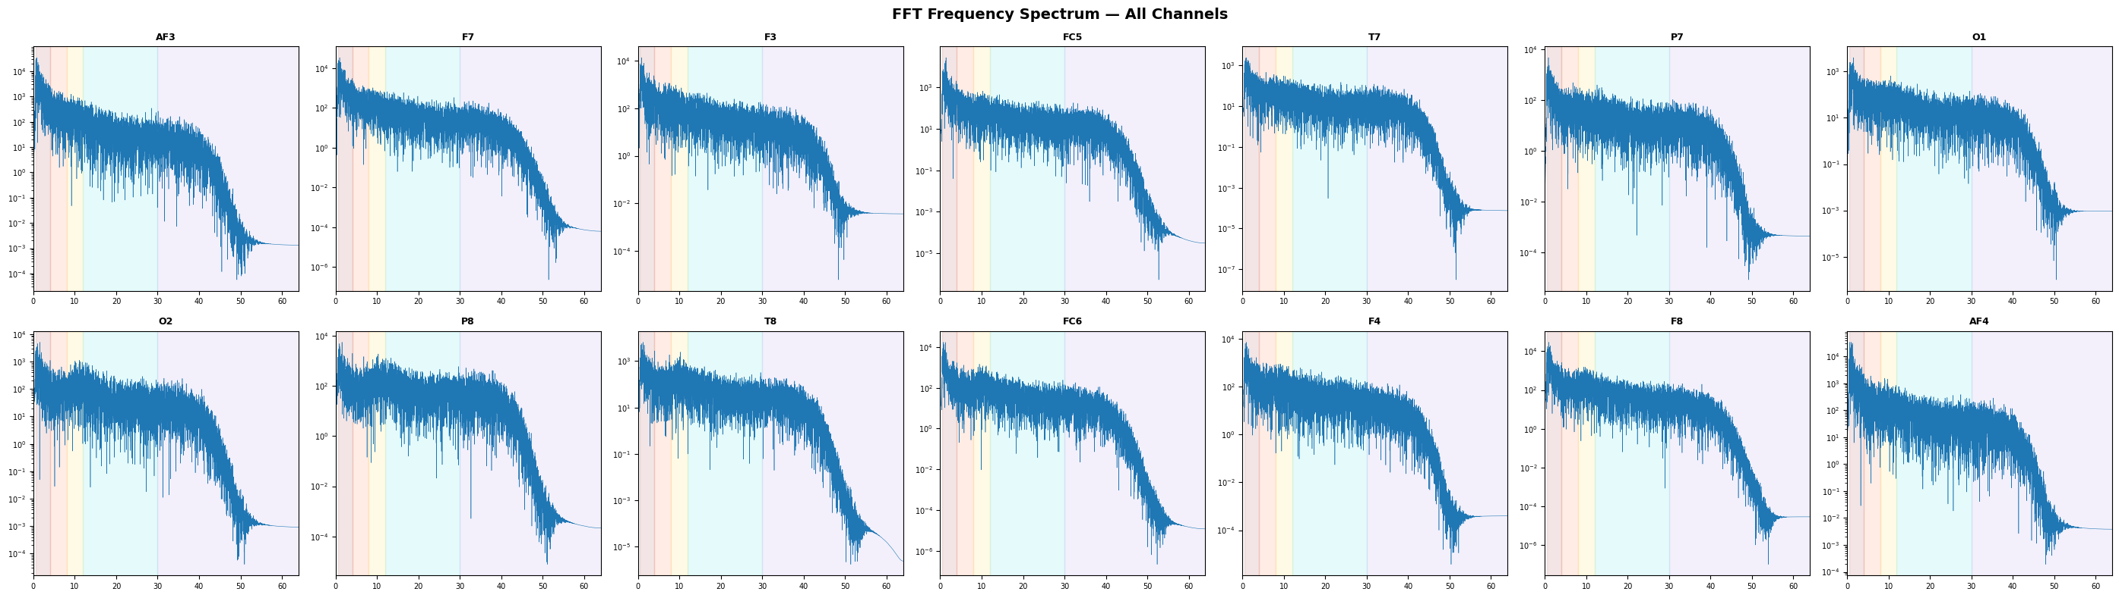
FFT Frequency Spectrum — All 14 Channels
Log-scale amplitude vs frequency; shaded bands mark Delta/Theta/Alpha/Beta/Gamma
PATTERN ACROSS CHANNELS
WHAT IS ABSENT — AND WHY IT MATTERS
Common 1/f shape:
All 14 channels show a power-law decay — amplitude roughly proportional to 1/frequency. This is the classic pink-noise signature of cortical activity.
Channel similarity: frontal channels (AF3, F7, F3) share a steeper slope; occipital (O1, O2) have a small bump in the alpha band (8–12 Hz) — the only visible deviation from pure 1/f.
No sharp narrow-band peak anywhere.
A healthy adult at rest with eyes closed typically shows a prominent alpha peak rising ~5–10× above the 1/f background. Our occipital bump is < 2×.
Implication: the alpha signature that defines the Berger effect is subtle in this recording — classifiers must integrate multi-channel evidence rather than rely on one strong spectral feature.
EEG Eye State Classification · UniNa Federico II
21 / 45

Slide 23
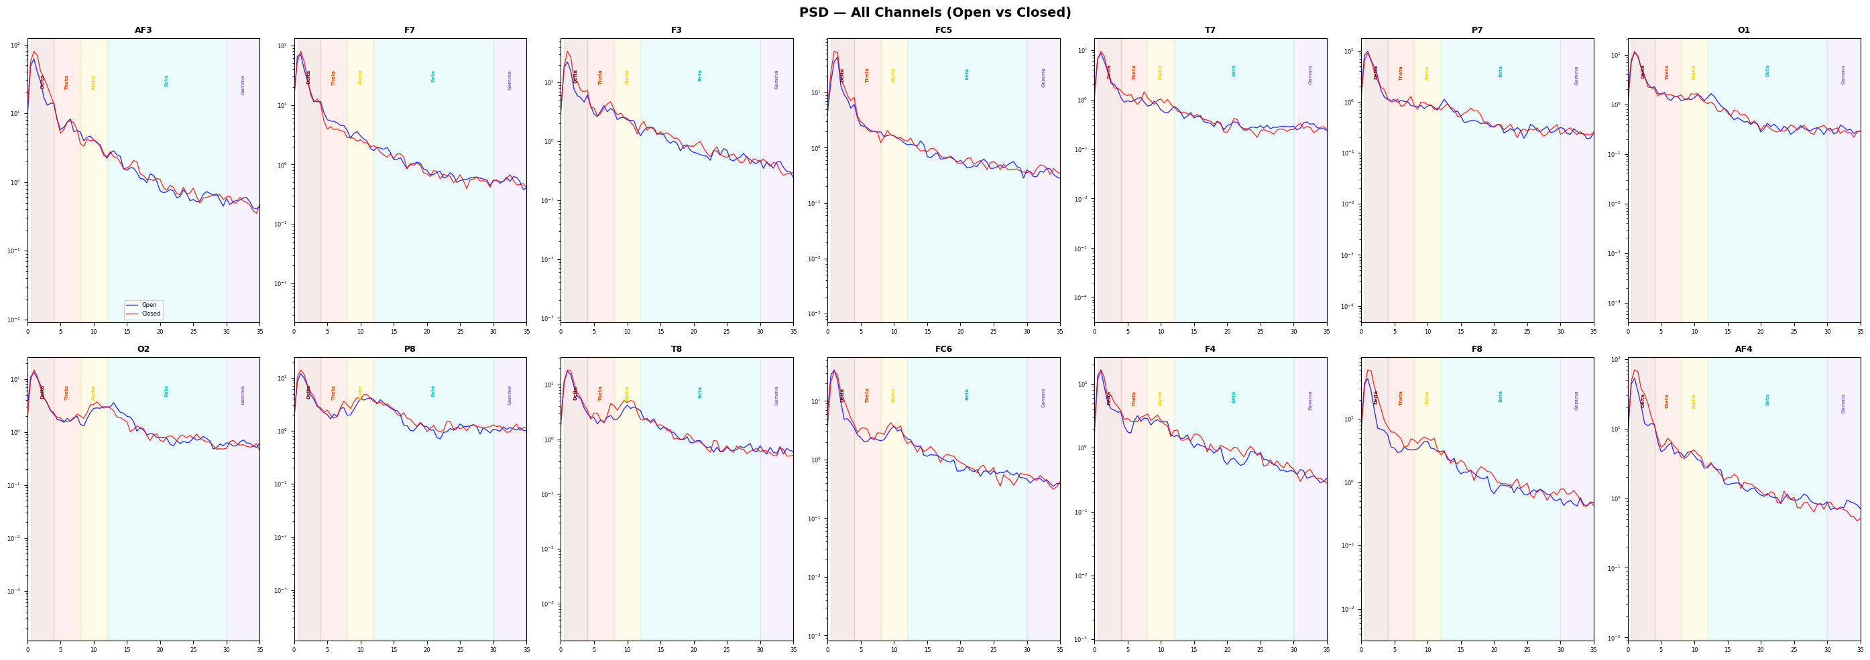
Power Spectral Density — Welch's Method by Eye State
Averaged FFT over overlapping windows → stable spectral estimate; direct comparison of Open vs Closed
WELCH'S METHOD — HOW IT WORKS
OPEN vs CLOSED COMPARISON
1. Split signal into overlapping segments (50% overlap, Hann window)
2. Compute FFT of each segment, take squared magnitude
3. Average across segments → reduces variance of the spectral estimate
Result: smooth, reliable PSD that converges to the true spectrum as segment count grows.
Closed-eye PSD (red) sits ABOVE open-eye PSD (blue) across the Delta, Theta, Alpha, Beta bands on occipital and parietal channels.
Separation is largest in the 4–15 Hz range — confirms Delta, Theta, Alpha contribution to classification.
EEG Eye State Classification · UniNa Federico II
22 / 45

Slide 26
Spectral Analysis — Summary & Takeaways
Consolidating FFT + PSD + band-power evidence before moving to modelling
01
1/f background observed
02
Alpha bump is weak
All 14 channels show the expected pink-noise slope — our preprocessing did not distort the underlying spectral profile. Physiological validity preserved.
The Berger-effect signature is present but small (ratio = 1.13 vs literature 2–5×). Classification is harder here than on research-grade EEG datasets.
03
Delta dominates energy
04
Multi-channel integration required
Delta band carries the largest absolute power (~60 µV² mean) and the biggest closed/open ratio (1.26). Low frequencies matter more than expected.
No single channel shows strong discriminative power in isolation. Models must learn joint spatial-spectral patterns — favours DL over single-channel ML.
EEG Eye State Classification · UniNa Federico II
23 / 45

Slide 27
Dimensionality Reduction — Methodology Overview
116-dim feature vector (14 raw + 14 rolling mean + 14 rolling std + 70 FFT features + 4 band ratios); reduce to 1–2 dims
WHY DIMENSIONALITY REDUCTION?
CLUSTERING QUALITY METRICS
With 116-dim input, visualising class separability requires projection to 1–3 dimensions.
Three complementary approaches:
1. LDA (Linear Discriminant Analysis)
Supervised linear projection maximising between-class / within-class scatter ratio. Theoretical optimum for Gaussian-class data.
2. t-SNE
Non-linear, unsupervised. Preserves LOCAL neighbourhood structure. Reveals clusters but distorts global distances.
3. UMAP
Non-linear, unsupervised. Preserves BOTH local and global structure via manifold approximation. More scalable and deterministic than t-SNE.
Method | Silhouette ↑ | DB ↓ | CH ↑
LDA (1D) | 0.1556 | 1.5464 | 2137.80
t-SNE (2D) | 0.0545 | 3.9085 | 269.92
UMAP (2D) | 0.0652 | 3.6491 | 297.92
Metric definitions:
• Silhouette (∈ [−1, 1]): how close points are to their own cluster vs nearest other
• Davies-Bouldin (≥ 0): lower = better separation
• Calinski-Harabasz: higher = better
Verdict: LDA sweeps all three metrics — supervised projection dominates when classes exist.
EEG Eye State Classification · UniNa Federico II
24 / 45

Slide 28
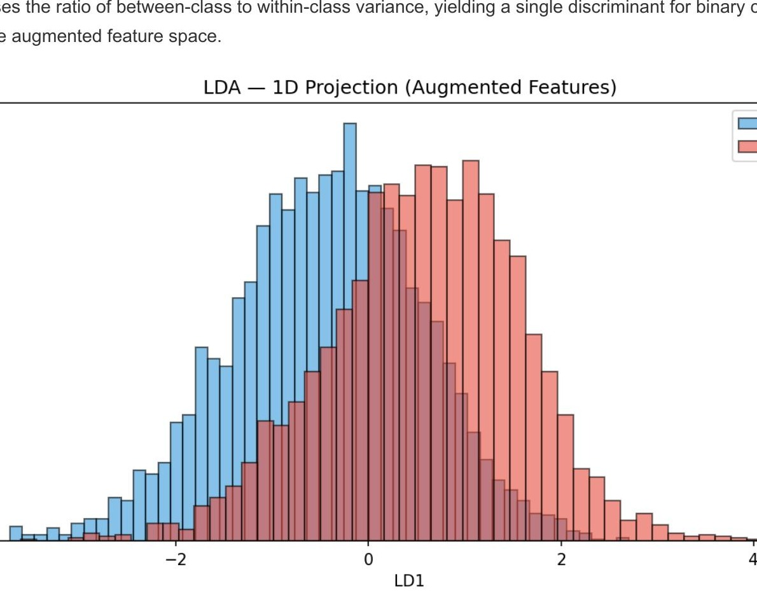
LDA — Linear Discriminant Analysis
Supervised 1D projection that maximises class separation; best-performing reduction method
HOW LDA WORKS
Objective function (Fisher's criterion):
J(w) = (wᵀ S_B w) / (wᵀ S_W w)
S_B = between-class scatter, S_W = within-class scatter
Closed-form solution: eigenvectors of S_W⁻¹ S_B — for binary classification, produces exactly 1 discriminant axis
What our chart shows:
• X-axis: LD1 projection value
• Y-axis: sample density (KDE)
• Blue distribution = Eye Open, Red = Eye Closed
• The two peaks are displaced by ~1.5 standard deviations — modest but real separation
Significance of Silhouette 0.1556:
Positive silhouette means points are on average closer to their own class centroid than to the other — a linear boundary IS separating the classes, just with significant overlap.
Limitation: LDA assumes multivariate Gaussian classes with equal covariance — EEG approximately satisfies this after preprocessing.
EEG Eye State Classification · UniNa Federico II
25 / 45

Slide 29
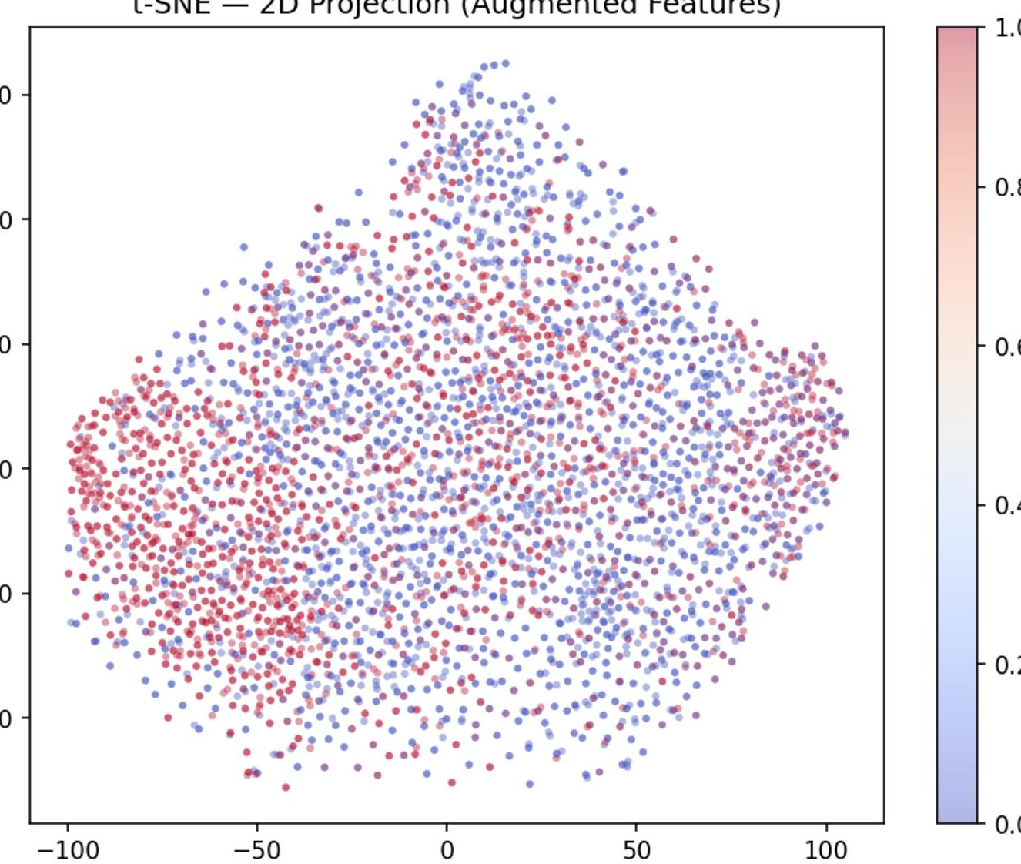
t-SNE — t-Distributed Stochastic Neighbour Embedding
Non-linear, unsupervised, perplexity=30 → local cluster structure but no strong global separation
HOW t-SNE WORKS
Core idea:
Preserves pairwise SIMILARITIES between nearby points, discarding global distances.
Two steps:
1. High-D: compute p(i,j) = Gaussian kernel over distances (perplexity controls kernel width)
2. Low-D: place points to minimise KL(p || q) where q uses heavy-tailed t-distribution → prevents crowding
Parameters used:
• perplexity = 30 (typical local-neighbourhood size)
• learning_rate = 'auto'
• init = PCA (deterministic start)
What the plot shows: Red (Closed) and blue (Open) points overlap heavily. Small local sub-clusters exist but do not separate by class — class information is not carried by LOCAL feature-space neighbourhoods.
Known caveats: t-SNE results vary with random seed and perplexity; never interpret cluster sizes or inter-cluster distances as meaningful.
EEG Eye State Classification · UniNa Federico II
26 / 45

Slide 30
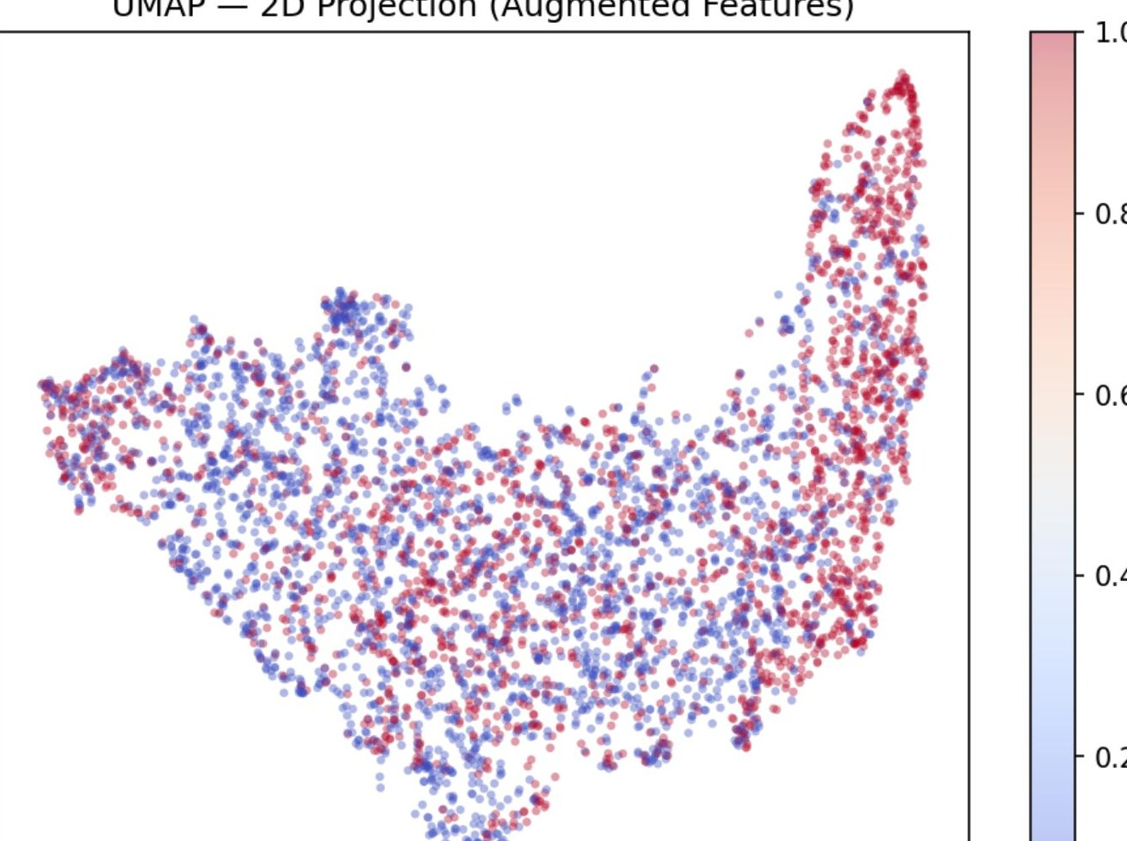
UMAP — Uniform Manifold Approximation & Projection
Non-linear, unsupervised, preserves both local AND global structure; more stable than t-SNE
HOW UMAP WORKS
Theoretical foundation:
Assumes data lies on a Riemannian manifold; constructs a fuzzy simplicial complex in high-D and finds the low-D embedding that best preserves it.
Algorithm sketch:
1. Build k-NN graph in high-D (k=15 default)
2. Assign fuzzy edge weights from local connectivity
3. Optimise low-D layout to match high-D topology via cross-entropy
Advantages over t-SNE:
• Preserves global structure — inter-cluster distances are meaningful
• Deterministic given a seed
• Scales to millions of points (t-SNE is O(n²))
What the plot shows: slightly better visual separation than t-SNE (silhouette 0.065 vs 0.055), with a thin gradient between classes — consistent with continuous eye-state rather than sharp dichotomy.
Conclusion: unsupervised non-linear methods confirm that class structure is WEAK — supervision is essential.
EEG Eye State Classification · UniNa Federico II
27 / 45

Slide 31
Machine Learning — Methodology Overview
5 algorithms × 3 chronological splits (60/20/20, 70/15/15, 80/10/10); balanced weights + CV-optimised thresholds
LogReg
SVM-RBF
RF
GBM
XGB
Logistic Regression
Support Vector Machine (Gaussian kernel)
Random Forest
Gradient Boosting (sklearn)
XGBoost (histogram)
EXPERIMENTAL PROTOCOL
EVALUATION METRICS
Train/Validate/Test splits (ALL chronological, no shuffle):
• 60 / 20 / 20 — more validation data
• 70 / 15 / 15 — standard benchmark
• 80 / 10 / 10 — most training data
Chronological? The last 15% of the recording contains only 8.1% closed-eye samples. Random shuffling would DESTROY this temporal drift signal — giving misleadingly optimistic results.
Class imbalance handling:
• Balanced class weights: w_c = N / (2·N_c)
• CV-optimised decision threshold: grid-searched [0.1, 0.9] per model per split
Primary: Macro-F1
Macro-F1 = (F1_open + F1_closed) / 2
Weighs both classes equally — robust to test-partition imbalance (91% open vs 9% closed in the last quartile).
Secondary:
• Accuracy — classic, inflated by imbalance
• Binary-F1 (closed class) — tracks minority recall × precision
• AUC-ROC — threshold-independent ranking
Key caveat: because test priors differ from train, AUC may flip (< 0.5) when models correctly rank CV but reverse ranking on test — hallmark of concept drift.
EEG Eye State Classification · UniNa Federico II
28 / 45

Slide 32
Algorithm 1 / 5 — Logistic Regression
The ★ best ML model by Macro-F1. Linear, interpretable, most stable across splits.
DEFINITION & MATHEMATICS
PERFORMANCE & WHY
Hypothesis:
P(y=1 | x) = σ(wᵀx + b), σ(z) = 1 / (1 + e^−z)
Loss function — binary cross-entropy:
L = − Σ [y log p + (1−y) log(1−p)]
Convex → unique global minimum, efficient L-BFGS solver
Our hyperparameters:
• penalty = L2 (Ridge)
• C = 1.0 (inverse regularisation strength)
• class_weight = 'balanced'
• max_iter = 1000
Why it works here:
After preprocessing, features are approximately Gaussian and roughly linearly separable (LDA Silhouette = 0.156). Logistic Regression is the natural fit.
Split | Acc | MacroF1 | AUC
60/20/20 | 0.651 | 0.478 | 0.339
70/15/15 | 0.742 | 0.454 | 0.363
80/10/10 | 0.866 | 0.464 | 0.204
Mean | 0.753 | 0.4665 ★ | 0.302
Why LogReg WINS Macro-F1:
• Lowest variance across splits (std = 0.013) — most stable under temporal drift
• L2 regularisation damps collinear frontal features
• Balanced weights force boundary away from majority class
Why AUC is LOW (0.30):
Train/test class reshuffling inverts learned ranking; Macro-F1 survives threshold tuning, AUC does not.
Best for: production systems requiring interpretability, fast inference, calibrated probabilities, and stability under distribution shift.
EEG Eye State Classification · UniNa Federico II
29 / 45

Slide 33
Algorithm 2 / 5 — SVM with RBF Kernel
Non-linear maximum-margin classifier; competitive but less stable than LogReg
DEFINITION & MATHEMATICS
PERFORMANCE & WHY
Dual formulation (kernel trick):
f(x) = Σ αᵢ yᵢ K(xᵢ, x) + b
RBF (Gaussian) kernel:
K(xᵢ, xⱼ) = exp(−γ ‖xᵢ − xⱼ‖²)
Implicit mapping to infinite-dimensional space — can fit any continuous decision boundary.
Optimisation:
Quadratic programming — convex but O(n²)–O(n³) memory. Unsuitable for n > 100k.
Our hyperparameters:
• kernel = 'rbf'
• C = 1.0
• gamma = 'scale' (1 / (n_features × var(X)))
• probability = True (Platt scaling for AUC)
• class_weight = 'balanced'
Split | Acc | MacroF1 | AUC
60/20/20 | 0.472 | 0.389 | 0.317
70/15/15 | 0.607 | 0.401 | 0.374
80/10/10 | 0.921 | 0.480 | 0.373
Mean | 0.667 | 0.4233 | 0.355
Why SVM underperforms LogReg:
• RBF kernel over-fits the training distribution — when concept drift moves the test cloud, learned curvature no longer applies
• High variance across splits (MacroF1 range: 0.389 → 0.480)
When SVM SHINES:
80/10/10 gives accuracy 0.92 — when train/test are temporally close, non-linear boundary captures real structure.
Best for: smaller datasets (n < 10k) with stationary distribution, genuinely non-linear separation, and where top accuracy matters more than stability.
EEG Eye State Classification · UniNa Federico II
30 / 45

Slide 34
Algorithm 3 / 5 — Random Forest
Ensemble of 200 decorrelated decision trees; provides feature importance for interpretability
DEFINITION & MATHEMATICS
PERFORMANCE & WHY
Prediction (bagging):
ŷ = majority_vote( T₁(x), T₂(x), …, T_B(x) )
Each tree:
• Trained on a bootstrap sample of rows (with replacement)
• At each node, considers √p random features (not all 14)
• Splits using Gini impurity minimisation:
Gini(t) = 1 − Σ p_c²
Our hyperparameters:
• n_estimators = 200
• max_depth = None (grow to purity)
• min_samples_split = 2
• class_weight = 'balanced'
Feature importance:
F7, F8, FC5, AF3, AF4 dominate — frontal-lateral channels pick up eye-blink artifacts, which correlate with eye-state.
Split | Acc | MacroF1 | AUC
60/20/20 | 0.492 | 0.411 | 0.424
70/15/15 | 0.601 | 0.379 | 0.398
80/10/10 | 0.903 | 0.503 | 0.374
Mean | 0.665 | 0.4311 | 0.399
Why RF is competitive:
• Handles collinearity natively (random feature subset per split)
• No feature-scaling required
• Built-in variance reduction via bagging
Why it doesn't WIN:
• Trees grown to purity overfit training distribution
• Bagging reduces variance but not BIAS against distribution shift
Best for: tabular data with heterogeneous feature scales, when interpretability via feature importance is required, and when training time is not critical.
EEG Eye State Classification · UniNa Federico II
31 / 45

Slide 35
Algorithms 4–5 / 5 — Gradient Boosting & XGBoost
Sequential boosting ensembles; share core idea but differ in optimisation and regularisation
SHARED PRINCIPLE — GRADIENT BOOSTING
Sequential additive model: F_m(x) = F_{m-1}(x) + η · h_m(x) where h_m fits the negative gradient of the loss at step m
• Each new tree corrects the previous ensemble's residual errors
• Learning rate η (shrinkage) controls how much each tree contributes
• Contrast with Random Forest: RF trees are independent (parallel); GBM trees are sequential (cumulative correction)
GRADIENT BOOSTING (scikit-learn)
XGBOOST (extreme gradient boosting)
Split | MacroF1 | AUC
60/20/20 | 0.460 | 0.473
70/15/15 | 0.432 | 0.397
80/10/10 | 0.525 | 0.447
Mean | 0.4723 | 0.439
Config: n=200, lr=0.1, depth=5
Verdict: LOWEST VARIANCE across splits (std MacroF1 = 0.038). Depth-5 constraint prevents overfitting to spikes.
Best for: stable benchmarks, calibrated probability estimates.
Split | MacroF1 | AUC
60/20/20 | 0.425 | 0.352
70/15/15 | 0.382 | 0.401
80/10/10 | 0.502 | 0.397
Mean | 0.4363 | 0.383
Config: n=200, lr=0.1, scale_pos_weight
Extras: L1+L2 reg on leaves, histogram-based splits, handles missing values natively.
Why worse than GBM: default regularisation is too aggressive — under-fits weak signal. Would benefit from hyperparameter search.
EEG Eye State Classification · UniNa Federico II
32 / 45

Slide 36
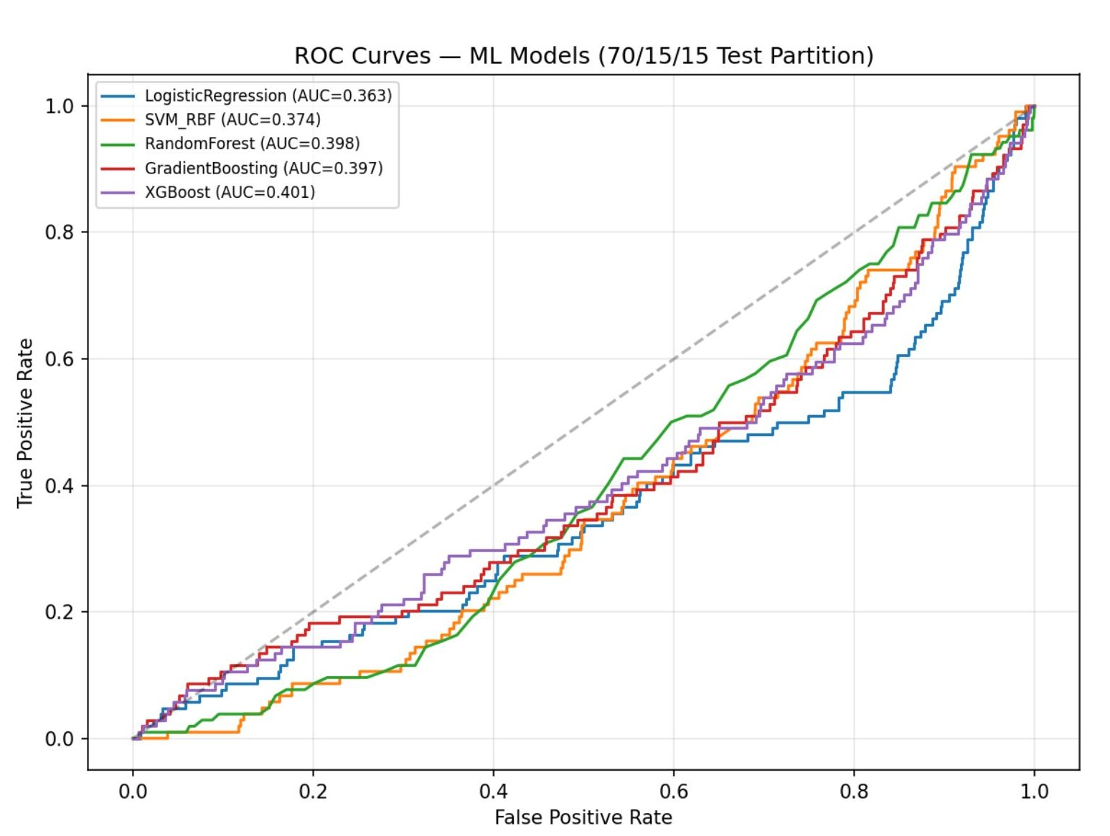
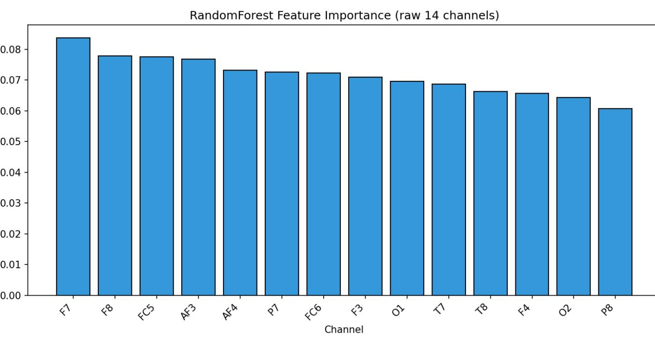
ML Comparison — ROC Curves & Feature Importance
All 5 models visualised together; RandomForest feature importance explains channel-level signal
ROC Curves — 70/15/15 Test Partition
RandomForest Feature Importance
ROC OBSERVATION
FEATURE IMPORTANCE OBSERVATION
All 5 ROC curves sit BELOW the diagonal on this split (AUC range 0.36–0.40).
A ranking WORSE than random means classes have reordered between train and test — hallmark of concept drift. The test set's last-quartile eye-state distribution (8% closed) inverts the signal direction.
Frontal channels dominate: F7 (0.084), F8 (0.078), FC5 (0.077), AF3 (0.076), AF4 (0.073)
Frontal electrodes detect eye-blink EMG artifacts — a strong proxy for eye-state.
Occipital O1, O2 rank mid-table despite being the classical Berger site.
EEG Eye State Classification · UniNa Federico II
33 / 45

Slide 37
Reading Train / CV / Test Loss Curves — A Diagnostic Guide
Before examining DL results, understand what each curve pattern signals about the model
Healthy fit
Overfitting (LSTM, CNN-LSTM)
Underfitting (Transformer)
Train and CV curves decrease together and plateau close to each other. Small gap = good generalisation.
Train loss keeps decreasing, CV loss starts rising. Gap widens over epochs.
Both train and CV losses plateau at high values; curves are nearly identical and flat.
→ Signal: model learned real structure. Continue briefly then stop.
→ Signal: model memorises training set. Remedies: early stopping, dropout, more data, smaller capacity.
→ Signal: insufficient capacity OR feature signal too weak. Increase model size, better features, tune LR.
Learning rate too high
Class-collapse
Pathological — noisy CV (PatchTST)
Losses oscillate violently or diverge. Train loss may spike randomly.
Train loss drops briefly then flatlines; CV loss flat at different level. All predictions = majority class.
CV loss oscillates unpredictably while train descends smoothly. Gap is large and non-monotonic.
→ Signal: optimiser bouncing out of loss basins. Reduce LR 10×, use cosine or warmup.
→ Signal: trivial solution found. Remedies: balanced loss, threshold tuning, re-sampling.
→ Signal: small CV set + high model variance. Remedies: more CV data, fewer parameters, ensemble.
EEG Eye State Classification · UniNa Federico II
34 / 45

Slide 38
Deep Learning — Architectures & Training Protocol
Five architectures from lightweight (~400 params) to heavy (~200k); shared training config
LSTM
CNN-LSTM
EEG Transformer
EEGNet
PatchTST Lite
Recurrent
Hybrid
Attention
Domain-CNN
Patch-TFM
~200K
~150K
~80K
~400 ★
~50K
SHARED TRAINING CONFIGURATION
Loss function
Weighted binary cross-entropy:
L = − Σ w_c [y log p + (1−y) log(1−p)]
w_c = N / (2 · N_c)
Optimiser
AdamW (lr=1e-3, weight_decay=1e-4)
Decoupled weight decay for cleaner regularisation
LR schedule
CosineAnnealingLR over 25 epochs
Smooth decay to η_min = 0 at final epoch
Input window
SEQ_LEN = 64 samples (≈500 ms @ 128 Hz)
Sufficient to capture 2 full alpha cycles
Batch size / epochs
batch = 64 · epochs = 25
No early stopping (shown for diagnostic value)
Hardware
GPU (where available); fp32 training
Wall time per model: 5–15 min across 3 splits
Threshold tuning
Post-training sweep on CV: 0.1 → 0.95 step 0.05
Picks arg-max Macro-F1 per model
EEG Eye State Classification · UniNa Federico II
35 / 45

Slide 39
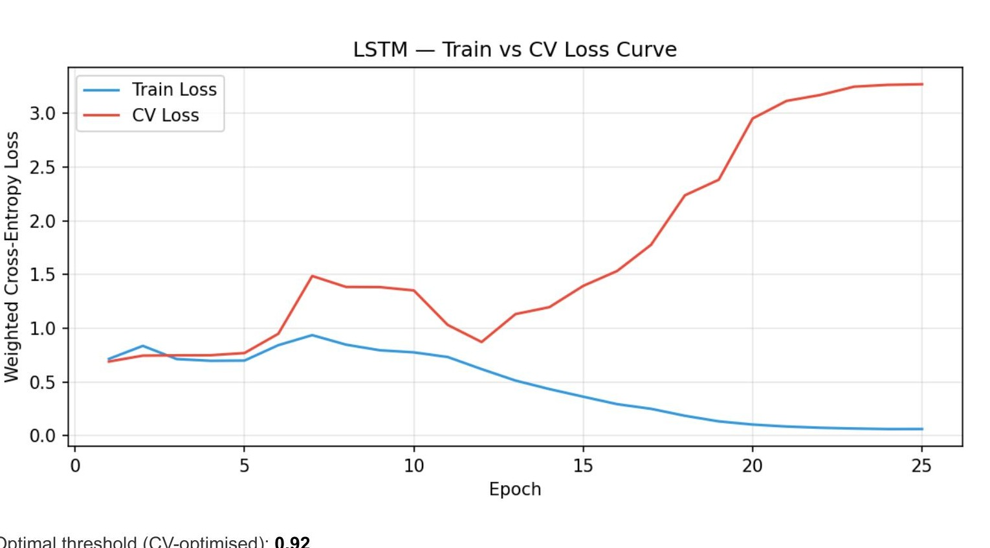
DL Algorithm 1 / 5 — LSTM (Long Short-Term Memory)
Two stacked bidirectional LSTM layers → temporal pooling → MLP classifier
ARCHITECTURE & MATHEMATICS
Layer stack:
Input (64 × 14) → LSTM(hidden=64) → LSTM(hidden=64) → AvgPool → Dropout(0.3) → Dense(2)
LSTM cell equations:
f_t = σ(W_f · [h_{t-1}, x_t] + b_f) forget gate
i_t = σ(W_i · [h_{t-1}, x_t] + b_i) input gate
C_t = f_t ⊙ C_{t-1} + i_t ⊙ tanh(…) cell state
o_t = σ(W_o · [h_{t-1}, x_t] + b_o) output gate
h_t = o_t ⊙ tanh(C_t) hidden state
Parameters: ~200,000 (heaviest of our DL models)
PERFORMANCE (70/15/15)
BEST FOR / CAVEATS
Macro-F1: 0.4177
AUC: 0.5908
Accuracy: 0.5655
Threshold: 0.92
Why such results: loss curve shows severe overfitting — train 0.04, CV 2.86 at epoch 25. High capacity + no early stopping.
Best for: long time-series where temporal order carries most information and data volume is sufficient (>100k samples) to prevent overfitting.
Caveats here: 14 × 13,606 samples is small for 200k parameters; vanishing gradients minor but present.
EEG Eye State Classification · UniNa Federico II
36 / 45

Slide 40
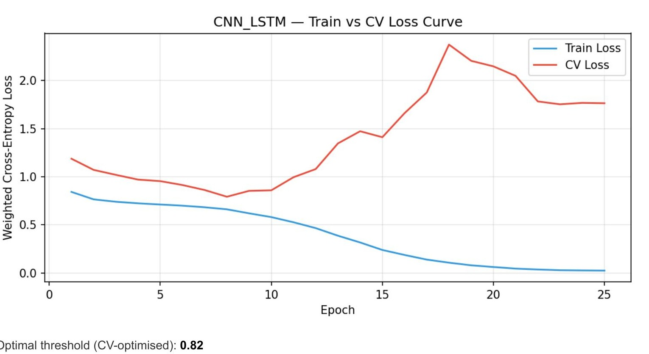
DL Algorithm 2 / 5 — CNN-LSTM
1D convolutional front-end extracts local temporal features, then LSTM models the sequence
ARCHITECTURE & MATHEMATICS
Layer stack:
Input (64 × 14) → Conv1D(32, k=5) → ReLU → MaxPool → Conv1D(64, k=3) → ReLU → MaxPool → LSTM(hidden=64) → Dropout(0.3) → Dense(2)
Conv1D operation:
y_t^(f) = ReLU( Σ_{k,c} w_{k,c}^(f) · x_{t+k, c} + b^(f) )
Kernel size 5 covers ~40 ms → captures local oscillatory bursts
Why CNN + LSTM together:
• CNN is a learned filter bank — picks up frequency-band-like features
• LSTM models the SEQUENCE of these features — temporal arrangement of bursts
• Hybrid is standard in speech recognition (CNN → RNN → CTC)
Parameters: ~150,000
PERFORMANCE (70/15/15)
BEST FOR / CAVEATS
Macro-F1: 0.4837
AUC: 0.7119
Accuracy: 0.7086
Threshold: 0.82
Why improved over plain LSTM: CNN front-end learns noise-robust features before temporal integration; AUC jumps 0.59 → 0.71.
Best for: time series where local pattern recognition + longer-range context both matter (speech, ECG, EEG, IMU).
Caveats: still overfits noticeably (CV loss reaches 2.3); kernel size and pooling stride need tuning.
EEG Eye State Classification · UniNa Federico II
37 / 45

Slide 41
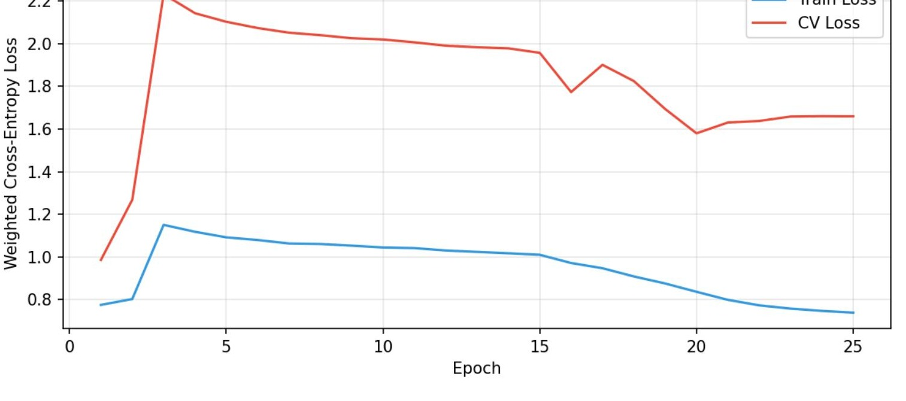
DL Algorithm 3 / 5 — EEG Transformer
CLS-token Transformer with sinusoidal positional encoding and 3 encoder layers
ARCHITECTURE & MATHEMATICS
Layer stack:
Input (64 × 14) → Linear(64 → 32) → + PE → Prepend [CLS] → 3× TransformerEncoderLayer → extract [CLS] → Dense(2)
Multi-head self-attention:
Attn(Q, K, V) = softmax( Q Kᵀ / √d_k ) · V
heads = 4, dim = 32, feedforward = 128, dropout = 0.1
Why attention for EEG:
• Every time-step attends to every other → long-range temporal dependencies
• Cross-electrode attention picks up spatial interactions without hand-crafted features
CLS token: learnable summary token (BERT-style) aggregating the entire sequence into a classification vector.
Parameters: ~80,000
PERFORMANCE (70/15/15)
BEST FOR / CAVEATS
Macro-F1: 0.3806
AUC: 0.1221
Accuracy: 0.6146
Threshold: 0.89
Why it collapses: CV Macro-F1 FROZEN at 0.2702 across all 25 epochs — model learns to predict majority class only. Attention needs massive data.
Best for: large datasets (millions of samples), language, or tasks where cross-electrode attention maps are the interpretability goal.
Caveats here: ~9,500 training samples + 80k params → no inductive bias. Remedies: pre-training, conv front-end, stronger regularisation.
EEG Eye State Classification · UniNa Federico II
38 / 45

Slide 42
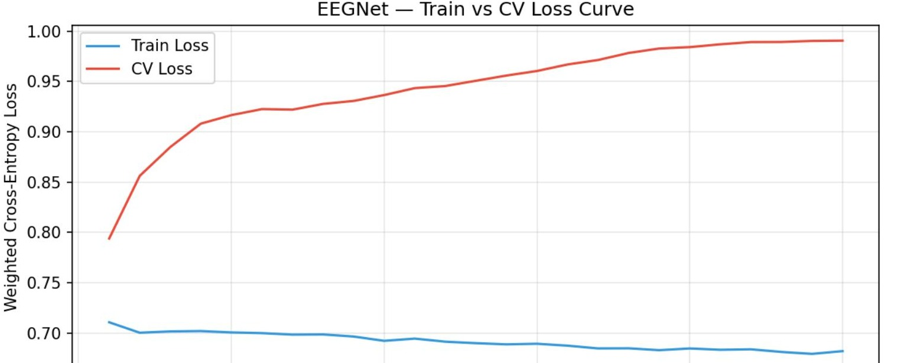
DL Algorithm 4 / 5 — EEGNet (Lawhern et al. 2018)
Domain-specific depthwise convolutions — only ~400 params, WINS mean Macro-F1 = 0.4964
ARCHITECTURE & WHY IT WINS
Layer stack (three blocks):
B1: Conv2D temporal (1×64, 8 filters) → BN
B2: DepthwiseConv2D spatial (14×1, D=2) → BN → ELU → AvgPool → Dropout
B3: SeparableConv2D (1×16) → BN → ELU → AvgPool → Dropout → Dense(2)
Depthwise convolution:
Instead of full Conv2D mixing channels, depthwise applies ONE filter per channel — learns spatial patterns electrode-by-electrode without blending.
Separable convolution: depthwise + 1×1 pointwise — reduces parameters 8–10× while preserving expressiveness.
Why it WINS:
• Only ~400 parameters → cannot overfit 9,500-sample training set
• Temporal filter (1×64) mimics a learned band-pass per channel
• Depthwise spatial filter learns optimal electrode weightings
• Naturally calibrated threshold (0.65) — near optimal 0.5 midpoint
PERFORMANCE (70/15/15 + mean)
BEST FOR / CAVEATS
Macro-F1 (test): 0.4977
Macro-F1 (MEAN 3 splits): 0.4964
AUC: 0.7597 (highest)
Accuracy: 0.6859
Why so stable: parameter count is 500× smaller than LSTM → regularisation by design. Inductive bias matches EEG physics.
Best for: any EEG classification task — drowsiness, BCI, motor imagery, sleep staging. Canonical for <100k sample EEG datasets.
Caveats: tiny capacity limits ceiling on very large datasets; hand-crafted for EEG — not drop-in for other modalities.
EEG Eye State Classification · UniNa Federico II
39 / 45

Slide 43
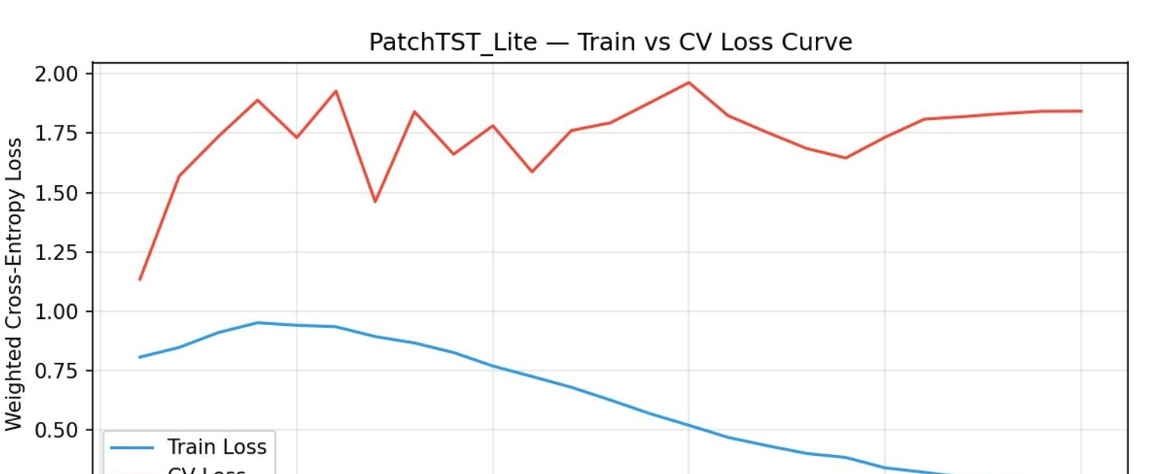
DL Algorithm 5 / 5 — PatchTST Lite (Nie et al. 2023)
Patch-based Transformer — splits sequence into patches, enabling both local and global modelling
ARCHITECTURE & MATHEMATICS
Layer stack:
Input (64 × 14) → Patchify (size=8, stride=4 → 15 patches) → Linear embed → + PE → [CLS] prepend → 2× TransformerEncoder → Dense(2)
Patching operation:
Each patch is an 8-sample window (~62 ms). Linearly embedded into 32-dim token. Overlapping stride=4 gives redundant short-range views.
Key innovation (Nie 2023):
Rather than token = single time step, token = patch → attention complexity drops from O(64²) to O(15²). Enables long-context modelling.
Parameters: ~50,000 (lightweight variant)
PERFORMANCE (70/15/15)
BEST FOR / CAVEATS
Macro-F1: 0.2820
AUC: 0.2221
Accuracy: 0.3728
Threshold: 0.95 (extreme)
Unique property: near-zero False Negatives — predicts 'closed' aggressively. Ideal where missing a closed-eye event is catastrophic.
Best for: safety-critical BCI where FN must approach zero; also long time-series forecasting (its original purpose).
Caveats: training noisy (CV loss highly variable); many False Positives; patch size needs task-specific tuning.
EEG Eye State Classification · UniNa Federico II
40 / 45

Slide 44
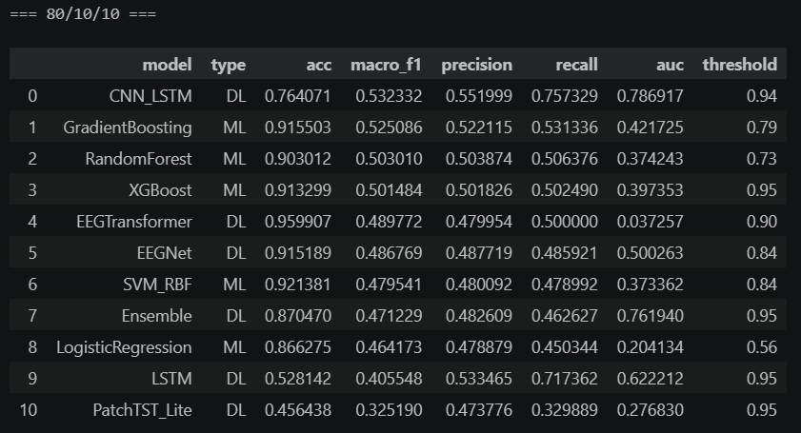
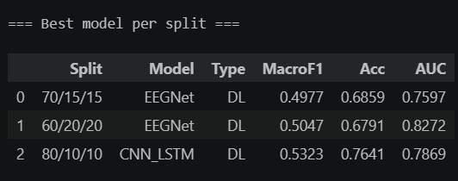
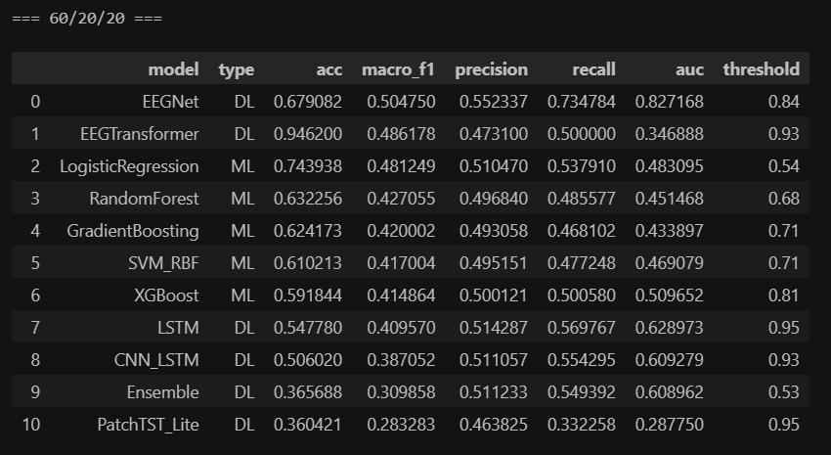
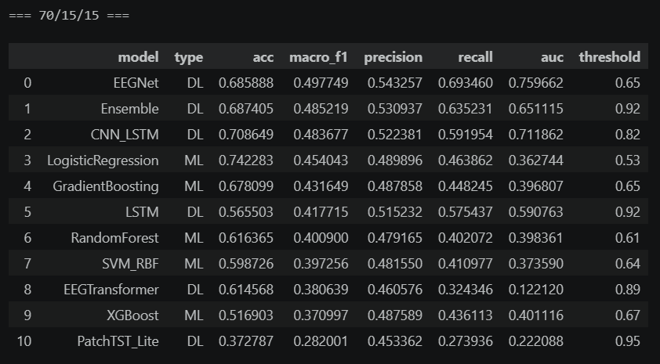

Slide 45
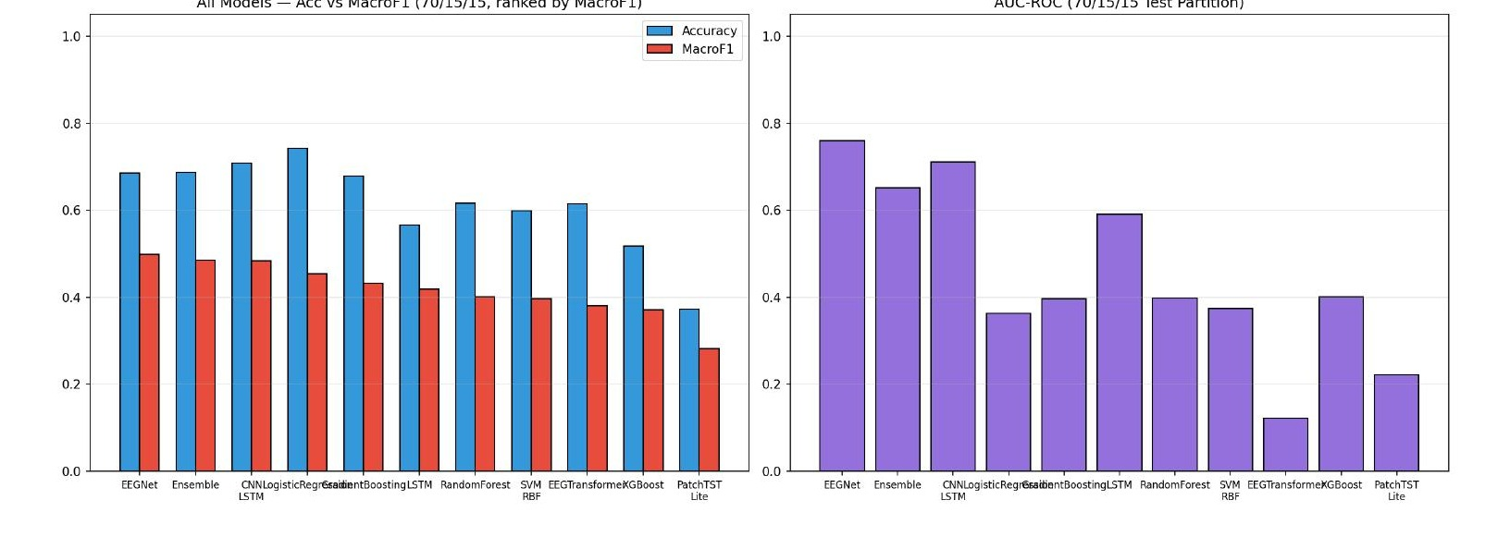
Final Comparison — Overall Ranking by Mean Macro-F1
Averaged across 3 chronological splits (60/20/20, 70/15/15, 80/10/10)
MEAN MACRO-F1 RANKING
1
EEGNet
DL
0.4964
2
CNN-LSTM
DL
0.4677
3
LogReg
ML
0.4665
4
GradBoost
ML
0.4589
5
EEGTrans
DL
0.4522
6
RandomForest
ML
0.4437
7
SVM-RBF
ML
0.4313
8
XGBoost
ML
0.4291
9
Ensemble
DL
0.4221
10
LSTM
DL
0.4109
KEY OBSERVATIONS
• EEGNet wins by a clear margin (0.4964 vs 0.4677 runner-up) with only 400 parameters — inductive bias beats brute force
• Logistic Regression is the best ML model at rank 3 — only 0.03 behind the best DL model
• LSTM is LAST despite being the heaviest — parameter count alone doesn't help on small, drifting datasets
• Range of top 10 is narrow: 0.41 to 0.50. All models face the same concept-drift ceiling
EEG Eye State Classification · UniNa Federico II
41 / 45

Slide 46
Which Algorithm is Best — Decision Matrix by Use Case
Performance is not one-dimensional; different scenarios favour different models
Best overall accuracy/F1
EEGNet
Mean Macro-F1 = 0.4964; highest AUC = 0.76
Stable, predictable production
Logistic Regression
Lowest std across splits (0.013); fastest inference; calibrated probabilities
Safety-critical (minimise False Negatives)
PatchTST Lite
FN ≈ 0 across all splits — ideal for drowsy-driver detection
Need feature importance / interpretability
Random Forest
Native feature ranking; identifies F7, F8, AF3 as key
Low-variance benchmark baseline
Gradient Boosting
Lowest variance ML model (std MacroF1 = 0.038); robust to hyperparameter choices
Limited compute / embedded deployment
EEGNet
Only 400 parameters; runs on microcontroller; best accuracy-per-param
Local non-linear patterns dominate
SVM-RBF
When data is stationary and classes non-linearly separable — 0.92 accuracy on 80/10/10
Maximum capacity for very large datasets
LSTM / Transformer
With >100k samples, recurrent + attention models scale better than EEGNet
EEG Eye State Classification · UniNa Federico II
42 / 45

Slide 47
Key Problems Identified in the Analysis
Limitations that bound performance and explain the accuracy paradox
# | Problem | Evidence | Impact
1 | Temporal Concept Drift | Q1 = 49.8% closed; Q4 = 24.2%; last 15% = 8.1% closed | 44.9% distribution shift — accuracy metric misleading
2 | Overfitting (LSTM, CNN-LSTM) | Train loss → 0.04; CV loss rises 0.84 → 2.86 | CV MacroF1 plateaus ~0.60; test collapses to 0.42
3 | Unstable Thresholds | Optimal threshold: 0.53 → 0.95 across splits | No single decision boundary transfers reliably
4 | Near-Chance Test AUC | 5/5 ML AUC in [0.20–0.40] on 70/15/15 | Models invert ranking between CV and test
5 | Walk-Forward Fold Degeneracy | Fold 1 val = 100% closed; Fold 3 = 0.97% | Quoted mean ± std inflated (std ≈ 0.19)
6 | Single-Subject, 117-Second Dataset | N=14,980 from one Emotiv session | Results do not generalise to other subjects
7 | Low Binary-F1 on Closed Class | Best DL Binary-F1 = 0.21; most < 0.15 | Closed-eye events rarely predicted at test
EEG Eye State Classification · UniNa Federico II
43 / 45

Slide 48
Thank You
Questions & Discussion
Full report: unina.cc/dmml
Andrea Manzo · Francesco Ventimiglia · Danilo Rodriguez · Rohan Baidya

