Slide 1
MID-TERM EMPIRICAL STUDY
LAMBADA & MMLU Benchmark Evaluation of Small Language Models
Evaluating small language models on long-range word prediction (LAMBADA) and multi-subject knowledge & reasoning (MMLU) — architecture, fine-tuning parameters, metrics, and results explained in full.
SUBMITTED TO
Prof. Anna Corazza
TEAM WORK — SUBMITTED BY
Francesco Ventimiglia · Danilo Rodriguez · Rohan Baidya
github.com/ronvoy/gen-ai · unina.cc/gen-ai

Slide 2
Research Question
Among three small language models built with different compression strategies and attention mechanisms, which one best balances accuracy, reasoning quality, and latency — on long-range context prediction (LAMBADA) and broad knowledge & reasoning (MMLU)?
In particular: does a larger, non-distilled model (Ministral-8B) outperform smaller distilled/pruned models (Gemma-3-4B, Llama-3.2-3B) across both benchmarks — or does compression cost more in one dimension (accuracy, reasoning, speed) than another?
LAMBADA & MMLU Benchmark Evaluation
2

Slide 3
Experimental Protocol
DATASET
PREPROCESSING
— LAMBADA: 5,153-passage test split from BookCorpus (English, ACL 2016).
— MMLU: 57 subjects × 5 questions/subject = 285 questions per model, fetched from the free HF datasets-server API and cached locally.
— LAMBADA: predictions normalized (lowercase, punctuation stripped) before exact-match comparison.
— MMLU: chain-of-thought prompt with one worked example enforcing a strict Reasoning: / Answer: <letter> format.
DECODING SETUP (NO TRAINING)
EVALUATION STRATEGY
— No model weights are changed — only decoding parameters (temperature, top-p, max tokens, few-shot count) vary.
— Shared presets — Optimal, Normal, Best Performance — apply identically to both benchmarks and all three models for a like-for-like comparison.
— All models queried through the OpenRouter API for a hardware-neutral comparison.
— Deterministic sampling — fixed subject/question order, no randomness — for reproducible runs.
— Metrics captured live in one shared web app: terminal streaming, run history, charts.
LAMBADA & MMLU Benchmark Evaluation
3

Slide 4
Benchmark
BASELINE TASK
— LAMBADA: predict the single next word of a passage, guessable only from full context. MMLU: choose the correct option (A–D) after writing short step-by-step reasoning. No fine-tuning either way — every model is evaluated purely on its pretrained + instruction-tuned weights.
REFERENCE CRITERIA — LAMBADA
REFERENCE CRITERIA — MMLU
Metric | Better
Exact-match accuracy | Higher
Average response time | Lower
Error rate | Lower
Throughput | Higher
Metric | Definition
Accuracy | Correct letters / total (exact match)
Category accuracy | Per STEM / Human. / Social / Other
Reasoning consistency | Reasoning supports the chosen option
Composite score | 0.70·acc + 0.15·reasoning + 0.15·speed
Ground truth for both benchmarks comes directly from the source datasets (the target word / the official answer key) — never inferred.
LAMBADA & MMLU Benchmark Evaluation
4

Slide 5
Involved approaches
# | Model | Developer | Params | Key Technique
1 | Gemma-3-4B | Google | 4B | Knowledge distillation + local/global attention
2 | Llama-3.2-3B | Meta | 3B | Compact dense transformer
3 | Ministral-8B | Mistral AI | 8B | Sliding Window Attention + GQA
— Gemma-3-4B: dense decoder-only transformer with interleaved local/global attention, distilled from a larger teacher, 128k-token context.
— Llama-3.2-3B: standard dense transformer recipe — RoPE, Grouped Query Attention, SwiGLU — pruned and distilled from larger Llama 3.1 models.
— Ministral-8B: sliding window attention + GQA for efficient long-context inference at the edge — trained at its native 8B size, not distilled down from a larger checkpoint.
LAMBADA & MMLU Benchmark Evaluation
5

Slide 6
CONSIDERED MODEL(S)
Gemma-3-4B
Google
4B parameters
WORKING TECHNIQUE
Knowledge distillation + local/global attention interleaving
— 4B instruction-tuned dense decoder-only transformer from Google, sharing research lineage with Gemini.
— Core idea: alternate between cheap LOCAL attention (each token only looks at a nearby sliding window — fast, low-memory) and occasional expensive GLOBAL attention (one layer in every five lets every token see the entire context) — a 5:1 ratio.
— Why interleave rather than use global attention everywhere: full attention cost grows quadratically with context length; interleaving keeps memory roughly linear while information still reaches every token by the time it passes a global layer.
— Trained via knowledge distillation: the small model learns to match a larger teacher model's output probability distribution, rather than training from raw text alone — this tends to transfer more of the teacher's knowledge per parameter.
— Also uses Grouped Query Attention with QK-norm for training stability, and supports up to a 128k-token context window.
KEY PROPERTIES
• Dense decoder-only transformer, no expert routing
• 5:1 interleaving of local sliding-window and global attention layers
• Grouped Query Attention with QK-norm; 128k-token context window
• Distilled from larger Gemma / Gemini-family teacher models
Evaluated with identical decoding parameters across all three models — see “Parameter set used in this evaluation.”
LAMBADA & MMLU Benchmark Evaluation
6

Slide 7
CONSIDERED MODEL(S)
Gemma-3-4B — inference flow
Input tokens
NOTE
• Local sliding-window attention ×5: cheap, restricted to nearby tokens.
• Global attention ×1: the one layer per block where every token can see the full passage — this is how long-range context (LAMBADA's whole point) actually gets used.
• GeGLU feed forward: a gated variant of the MLP block used after attention.
Token embedding + RoPE
Local sliding-window attention ×5
Global attention ×1
GeGLU feed forward
RMSNorm + residual (×N layers)
Final RMSNorm → LM head
Softmax → next token
LAMBADA & MMLU Benchmark Evaluation
7

Slide 8
CONSIDERED MODEL(S)
Llama-3.2-3B
Meta
3B parameters
WORKING TECHNIQUE
Compact dense transformer
— 3B instruction-tuned model from Meta, explicitly aimed at on-device and low-cost deployment.
— Core idea: no architectural novelty — the standard, well-proven dense transformer recipe used across the Llama family, simply shrunk to 3B parameters, rather than a smaller model with new efficiency tricks.
— Built by pruning and distilling from larger Llama 3.1 checkpoints: structured pruning removes less-important weights/layers from a bigger trained model, then distillation fine-tunes the pruned model to match the bigger one's behavior — 'compress an expert' rather than 'train a novice from scratch'.
— Uses RoPE (rotary position embeddings — encodes token position by rotating vectors, generalizing well to lengths not seen in training), Grouped Query Attention, and SwiGLU-gated feed-forward layers.
— Net effect: predictable, well-understood behavior, easy to serve on modest hardware — at some cost to raw capacity relative to a natively-trained model of similar size (see Ministral-8B).
KEY PROPERTIES
• Dense decoder-only transformer
• RoPE position embeddings for length generalisation
• Grouped Query Attention and SwiGLU feed-forward layers
• Predictable and easy to serve on modest hardware
Evaluated with identical decoding parameters across all three models — see “Parameter set used in this evaluation.”
LAMBADA & MMLU Benchmark Evaluation
8

Slide 9
CONSIDERED MODEL(S)
Llama-3.2-3B — inference flow
Input tokens
NOTE
• Multi-head attention (GQA): full attention over the whole context, but with grouped key/value heads to shrink the KV cache.
• SwiGLU feed forward: a gated MLP block, used in place of a plain ReLU/GeLU MLP.
• No local/global split, no sliding window — the simplest of the three designs.
Token embedding + RoPE
Multi-head attention (GQA)
SwiGLU feed forward
RMSNorm + residual (×N layers)
Final RMSNorm → LM head
Softmax → next token
LAMBADA & MMLU Benchmark Evaluation
9

Slide 10
CONSIDERED MODEL(S)
Ministral-8B
Mistral AI
8B parameters
WORKING TECHNIQUE
Sliding Window Attention + GQA
— 8B model from Mistral AI, part of the Ministral family built specifically for edge deployment.
— Core idea: sliding window attention — each layer only attends to a fixed local window of recent tokens rather than the full context, capping the per-layer attention cost regardless of passage length.
— Stacking many such layers lets information still propagate across the whole passage (a later layer's window can see information an earlier layer already gathered from tokens further back), without ever paying the full quadratic cost in a single layer.
— Combined with Grouped Query Attention to further shrink the key-value cache, keeping memory low even on long documents.
— Unlike the other two models in this study, Ministral-8B is not described as distilled or pruned from a larger checkpoint — it is trained at its native 8B size, very likely the single biggest reason it leads both benchmarks.
KEY PROPERTIES
• Sliding window attention for local context
• Grouped Query Attention for a smaller KV cache
• Efficient long-context inference at the edge
Evaluated with identical decoding parameters across all three models — see “Parameter set used in this evaluation.”
LAMBADA & MMLU Benchmark Evaluation
10

Slide 11
CONSIDERED MODEL(S)
Ministral-8B — inference flow
Input tokens
NOTE
• Sliding window attention: local context only, per layer — same trick Gemma uses for its 'local' layers, but used on every layer here, not just 4 in 5.
• Grouped Query Attention: shrinks the KV cache for fast decoding on long passages.
• No global-attention layer at all — depth (stacking many windowed layers) substitutes for it.
Token embedding + RoPE
Sliding window attention
Grouped Query Attention
SwiGLU feed forward
RMSNorm + residual (×N layers)
Final RMSNorm → LM head
Softmax → next token
LAMBADA & MMLU Benchmark Evaluation
11

Slide 12
COMMENTS AND DISCUSSION BEFORE RESULTS
Fine-tuning parameter: Temperature
WHAT IT DOES
GREEDY vs SAMPLED
Scales the logits before the softmax that turns the model's raw output scores into a probability distribution over the vocabulary — the next token is then sampled from that distribution. The Fine Tune panel exposes six such decoding parameters, shared by both benchmarks; none of them change model weights.
Temperature 0.0 → Greedy / deterministic
Temperature > 0 → Sampled / varied
RANGE
USED IN THIS EVALUATION
— Greedy decoding is the right call whenever the target is an exact match, not open-ended prose.
— This is why every model in this study — regardless of size or architecture — was run at temperature 0.0.
0.0 – 2.0
0.0
WHY THIS VALUE
— At 0.0 the distribution collapses to argmax — the single highest-probability token is always chosen (greedy decoding): fully deterministic, same input always gives the same output.
— Higher values flatten the distribution, letting lower-probability tokens get picked sometimes
— This allows more variety, but more risk of drifting off the one correct word or letter.
— Both LAMBADA (one correct word) and MMLU (one correct letter) have exactly one right answer — no reward for creative variation, only downside risk.
LAMBADA & MMLU Benchmark Evaluation
12

Slide 13
COMMENTS AND DISCUSSION BEFORE RESULTS
Fine-tuning parameter: Top-p (nucleus sampling)
WHAT IT DOES
WHY THIS VALUE
Restricts sampling to the smallest set of tokens whose cumulative probability reaches p — the 'nucleus'. Anything outside that set is discarded before a token is sampled, so the model can never pick a wildly unlikely continuation.
— At 1.0 the nucleus includes the entire distribution — no tokens are excluded.
— Combined with temperature 0.0, top-p has no practical effect here: greedy decoding already picks one token deterministically regardless of how large the candidate pool is.
— Lower values would only matter at temperature > 0, where they'd narrow sampling to the most confident tokens.
— Set to its neutral value here rather than doing any real work in this evaluation.
RANGE
USED IN THIS EVALUATION
0.0 – 1.0
1.0
LAMBADA & MMLU Benchmark Evaluation
13

Slide 14
COMMENTS AND DISCUSSION BEFORE RESULTS
Fine-tuning parameter: Max Tokens
WHAT IT DOES
A hard cap on how many tokens the model is allowed to generate before the API cuts it off. Every output token is one more sequential decoding step, so this parameter is also a direct lever on latency, not just on answer length.
WHY THIS VALUE
— LAMBADA needs only a single word plus a little slack for stray punctuation or formatting — 32 tokens is generous headroom.
— MMLU needs far more: the model must write a full chain-of-thought explanation before its final 'Answer: <letter>' line.
— Setting it too low truncates the model mid-reasoning before it reaches the answer line — recorded as a 'no-answer' verdict, not a wrong answer.
— This budget difference is a major reason MMLU latency (0.6–2.5s) runs systematically higher than LAMBADA latency (0.6–1.2s) for the same models.
RANGE
USED IN THIS EVALUATION
1 – 128 (LAMBADA panel)
32 (LAMBADA)
384 (MMLU)
LAMBADA & MMLU Benchmark Evaluation
14

Slide 15
COMMENTS AND DISCUSSION BEFORE RESULTS
Fine-tuning parameter: Few-shot Examples
WHAT IT DOES
Prepends worked (context → answer) examples from a fixed pool before the real passage, showing the model the exact input/output format expected — a prompting technique, not a change to the model's weights.
WHY THIS VALUE
— Instruction-tuned models sometimes answer in full sentences ('The next word is likely...') unless shown the expected bare-word format.
— A few worked examples anchor that format without touching the model's weights.
— MMLU instead uses one fixed worked example baked into the prompt template, rather than a tunable count.
— Trade-off: each example adds prompt tokens, so more few-shot examples cost a little extra latency per call, even though the model's own output doesn't get any longer.
RANGE
USED IN THIS EVALUATION
0 – 5 (LAMBADA)
3 worked examples
LAMBADA & MMLU Benchmark Evaluation
15

Slide 16
COMMENTS AND DISCUSSION BEFORE RESULTS
Fine-tuning parameters: Frequency & Presence Penalty
FREQUENCY PENALTY — WHAT IT DOES
PRESENCE PENALTY — WHAT IT DOES
— Subtracts a penalty proportional to how many times a token has already appeared in the output so far — the more it repeats, the less likely it is to repeat again.
— Range: -2.0 to 2.0.
— Applies a flat penalty to any token the moment it appears at least once, regardless of count — encourages introducing new words/topics rather than staying on the same ones.
— Range: -2.0 to 2.0.
USED IN THIS EVALUATION
WHY THEY'RE IRRELEVANT HERE
— Both set to 0.0 (neutral / off) for every model, on both benchmarks.
— Both tasks produce a single short answer — one word, or one letter plus brief reasoning.
— There's no room for the kind of repetitive looping these penalties are designed to prevent in long-form, open-ended generation.
LAMBADA & MMLU Benchmark Evaluation
16

Slide 17
COMMENTS AND DISCUSSION BEFORE RESULTS
Parameter set used in this evaluation
LAMBADA — actual run configuration
MMLU — actual run configuration
Parameter | Value
Temperature | 0.0
Top-p | 1.0
Max tokens | 32
Frequency penalty | 0.0
Presence penalty | 0.0
Few-shot examples | 3
Parameter | Value
Temperature | 0.0
Top-p | 1.0
Max tokens | 384
Note: this is a hand-set configuration close to, but not identical to, any single named preset (it mixes Optimal's greedy decoding with a different max-token / few-shot budget).
— Applied identically to Gemma-3-4B, Llama-3.2-3B, and Ministral-8B — none of the three received special treatment, such as a larger reasoning-token budget.
— config.py reserves a separate MAX_TOKENS_REASONING = 8096 budget for models flagged in REASONING_MODELS — that list is empty for this study, so none of the three models used it.
— Any differences in the results come from the models themselves, not from unequal evaluation conditions.
LAMBADA & MMLU Benchmark Evaluation
17

Slide 18
COMMENTS AND DISCUSSION BEFORE RESULTS
Presets — LAMBADA
Preset | Temp | Top-p | Max tok | Few-shot | Intent
Optimal | 0.0 | 1.0 | 16 | 5 | Most reliable accuracy
Normal | 0.3 | 0.9 | 32 | 3 | Balanced default
Best Performance | 0.0 | 1.0 | 8 | 2 | Fastest, cheapest runs
— Optimal is theoretically the strongest preset for LAMBADA specifically: the task has exactly one correct token, so greedy decoding removes sampling risk entirely, and more worked examples further anchor the one-word output format.
— Normal reintroduces randomness (temp 0.3, top-p 0.9) — useful for exploring variability, but with no upside on an exact-match task like this one.
— Best Performance trims both the token cap and the example budget for the cheapest, fastest runs, at some risk of losing the format anchor.
— The actual saved runs used a nearby but distinct hand-set configuration — 3 few-shot examples, 32 max tokens — rather than one of these three presets exactly.
LAMBADA & MMLU Benchmark Evaluation
18

Slide 19
COMMENTS AND DISCUSSION BEFORE RESULTS
Presets — MMLU
Preset | Temp | Top-p | Max tok | Intent
Optimal | 0.0 | 1.0 | 512 | Most reasoning room — most reliable accuracy
Normal | 0.2 | 0.95 | 384 | Matches the defaults
Best Performance | 0.0 | 1.0 | 192 | Caps the reasoning budget for faster runs
— Optimal gives the most room (512 tokens) for multi-step reasoning before the model commits to a letter — useful for subjects needing longer derivations (e.g. formal_logic, college_mathematics).
— Best Performance risks truncating longer reasoning chains before the model reaches its 'Answer:' line, which would surface as a 'no-answer' verdict.
— The actual saved runs used 384 tokens — matching Normal's budget — with greedy decoding (temperature 0.0, top-p 1.0) borrowed from Optimal.
LAMBADA & MMLU Benchmark Evaluation
19

Slide 20
COMMENTS AND DISCUSSION BEFORE RESULTS
Metrics explained — LAMBADA
EXACT-MATCH ACCURACY
AVERAGE RESPONSE TIME
— correct / total, after lowercasing and stripping punctuation from both the prediction and the true target word.
— Example: target "Zane." vs. prediction "zane" — different strings, but identical after normalization → counted correct.
— Mean wall-clock seconds per API call, start to finish — not just model compute time.
— Includes network round-trip and OpenRouter's provider routing/queueing, which is why it can spike heavily under provider congestion.
ERROR RATE
THROUGHPUT
— errors / total — API calls that failed outright (timeouts, malformed responses) even after retries were exhausted.
— All three models finished at 0 errors in the saved runs — every request eventually succeeded, even ones needing multiple retries.
— total / total wall-clock time — samples graded per second.
— Requests are sent one at a time here (no batching), so throughput is essentially the reciprocal of latency: Llama ≈1.73/s, Ministral ≈1.37/s, Gemma ≈0.84/s.
LAMBADA & MMLU Benchmark Evaluation
20

Slide 21
COMMENTS AND DISCUSSION BEFORE RESULTS
Metrics explained — MMLU (1/2)
ACCURACY
CATEGORY ACCURACY
— Correct letters / total questions (exact match) — judges only the final answer, not the reasoning behind it.
— The same accuracy computed separately per STEM / Humanities / Social Sciences / Other.
— Reveals blind spots the headline number hides — e.g. Llama-3.2-3B: 43.3% STEM vs. 63.3% Social Sciences, a 20-point spread.
REASONING RATE
REASONING CONSISTENCY & AVG. WORDS
— Share of answers with a non-trivial explanation (≥5 words).
— All three models wrote substantive reasoning on effectively every question (≈100% reasoning rate) — the differentiator is never whether they explained, but whether the explanation held up.
— Consistency = share of answers whose reasoning text actually supports the chosen letter.
— Ministral-8B writes the shortest reasoning (54.1 words) yet the highest consistency (69.1%); Llama-3.2-3B writes the most (61.8 words) yet is least consistent (59.7%) — length and quality of explanation are not the same thing.
LAMBADA & MMLU Benchmark Evaluation
21

Slide 22
COMMENTS AND DISCUSSION BEFORE RESULTS
Metrics explained — MMLU composite score (2/2)
Composite = 0.70 × accuracy + 0.15 × reasoning consistency + 0.15 × relative speed
Relative speed = fastest model's avg time ÷ this model's avg time (so the fastest model always scores 1.0 on this term).
Model | Accuracy term (0.70×) | Reasoning term (0.15×) | Speed term (0.15×) | Composite
Ministral-8B | 0.789 × 0.70 = 0.552 | 0.691 × 0.15 = 0.104 | 0.500 × 0.15 = 0.075 | 0.731
Llama-3.2-3B | 0.558 × 0.70 = 0.391 | 0.597 × 0.15 = 0.090 | 1.000 × 0.15 = 0.150 | 0.630
Gemma-3-4B | 0.639 × 0.70 = 0.447 | 0.646 × 0.15 = 0.097 | 0.307 × 0.15 = 0.046 | 0.590
— Speed term uses Llama-3.2-3B's 0.768s as the fastest reference time: Ministral 0.768/1.537=0.500, Llama 0.768/0.768=1.000, Gemma 0.768/2.502=0.307.
— These figures reconcile exactly with the composite scores reported earlier — verified independently for this deck.
— Accuracy dominates the weighting (70%), so Ministral's large accuracy lead carries it to #1 even though it is not the fastest model.
LAMBADA & MMLU Benchmark Evaluation
22

Slide 23
COMMENTS AND DISCUSSION BEFORE RESULTS
LAMBADA: dataset, properties & scoring flow
DATASET
SCORING FLOW
— Drawn from the BookCorpus (unpublished novels), English.
— Each passage is chosen so the final word is predictable from the full passage but not from the last sentence alone.
— Test split: 5,153 passages · first published ACL 2016 (Paperno et al.).
Passage
Remove last word
Build prompt (few-shot examples)
PROPERTIES
OpenRouter API call
Property | Value
Source corpus | BookCorpus (unpublished novels)
Task type | Word prediction
Curation criterion | Target guessable from full context only
Parse predicted word
Normalize (lowercase, strip punctuation)
Compare to target
See Benchmark (earlier) for the full accuracy / latency / error-rate / throughput criteria.
→ Correct / Incorrect → Accuracy & latency
LAMBADA & MMLU Benchmark Evaluation
23

Slide 24
COMMENTS AND DISCUSSION BEFORE RESULTS
LAMBADA: dataset splits
Split | File | Passages | Purpose
Test | lambada_test_plain_text.txt | 5,153 | Primary evaluation
Development | lambada_development_plain_text.txt | 4,869 | Validation and tuning
Control Test | lambada_control_test_data_plain_text.txt | 5,000 | Baseline, unfiltered
Rejected | rejected_plain_text.txt | 11,941 | Passages cut during curation
Training Novels | train-novels/ (16 genres) | 2,662 novels | Pre-training material
Vocabulary | lambada-vocab-2.txt | 112,746 entries | Reference vocabulary
This evaluation uses only the Test split (5,153 passages, sampled down to 1,000 for the saved runs) — the other splits exist in the released dataset but aren't used for scoring here.
LAMBADA & MMLU Benchmark Evaluation
24

Slide 25
COMMENTS AND DISCUSSION BEFORE RESULTS
LAMBADA: scoring flow, in detail
KEY STEP
Passage
NOTE
— Normalization is what makes exact-match accuracy fair — without it, capitalization or a trailing period would wrongly count a correct guess as wrong.
— Latency is recorded for every call — correct, incorrect, or (after retries) failed — so the average reflects real-world response time, not just successful guesses.
Remove last word
Build prompt with few-shot examples
OpenRouter API call (temperature 0.0, greedy)
Parse predicted word
Normalize: lowercase + strip punctuation
Equals target?
Correct → tally accuracy
Incorrect → tally accuracy
Record latency for every call, right or wrong
LAMBADA & MMLU Benchmark Evaluation
25

Slide 26
COMMENTS AND DISCUSSION BEFORE RESULTS
MMLU: how a run works
For every question the model first writes short step-by-step reasoning, then commits to one of four options (A–D); both the letter and the reasoning text are parsed and evaluated.
1. Set parameters: subjects, questions/subject, models, decoding
5. Build chain-of-thought prompt (worked example + Reasoning/Answer format)
9. Compare to correct letter → correct / incorrect
2. Trigger run: web UI, run_mmlu.sh, or evaluate_slm_mmlu.py
6. Query model via OpenRouter
10. Aggregate: overall / per-subject / per-category accuracy
3. Resolve subjects (all / group preset / explicit list)
7. Parse answer letter + reasoning text
11. Rank models: accuracy, speed, reasoning, composite score
4. Fetch & cache questions from the free HF datasets-server API
8. Analyze reasoning: length, consistency, verdict
12. Save results JSON, append to history, render in web app
LAMBADA & MMLU Benchmark Evaluation
26

Slide 27
COMMENTS AND DISCUSSION BEFORE RESULTS
MMLU: components
Component | File / Function | Role
Run parameters | evaluate_slm_mmlu.py, run_mmlu.sh | Subject selection, questions/subject, models, decoding params
Subject catalogue | MMLU_SUBJECTS, SUBJECT_GROUPS | 57 subjects mapped to their official categories
Dataset fetcher | fetch_subject_questions, _download_subject | Free HF datasets-server client + local JSON cache
Task loader | load_mmlu_tasks | Flattens subjects × questions into one ordered task list
Prompt builder | build_mmlu_prompt, WORKED_EXAMPLE | Chain-of-thought prompt with a worked example
Model client | query_model_mmlu | OpenRouter call with timing + error capture
Response parser | parse_mmlu_response | Splits a raw response into (answer letter, reasoning)
Reasoning analyzer | analyze_reasoning | Presence, word count, consistency, verdict
Evaluator | evaluate_model_mmlu | Runs all tasks for one model; aggregates accuracy + reasoning
Ranker | build_mmlu_summary | Per-dimension ranks + composite score across models
CLI runner | run_mmlu_evaluation, run_mmlu.sh | One-shot terminal pipeline: setup, install, run, print ranking
Web routes | passenger_wsgi.py | Online runs, live progress feed, ranking JSON, detail feed
Web page | templates/mmlu.html | Subject picker, terminal, ranking table, charts, Q/A viewer
LAMBADA & MMLU Benchmark Evaluation
27

Slide 28
COMMENTS AND DISCUSSION BEFORE RESULTS
MMLU: reasoning verdicts
Every answer is assigned one of six verdicts, scoring not just whether the letter was correct but whether the reasoning actually supports it.
sound
flawed-reasoning
Correct answer, reasoning clearly supports it
Reasoned its way to a wrong answer
right-weak-link
blind-guess
Correct answer, reasoning doesn't clearly support it
Wrong answer and no reasoning
lucky-guess
no-answer
Correct answer with no real reasoning
No A–D letter could be parsed
See Benchmark (earlier) for accuracy, reasoning-rate, and composite-score definitions.
LAMBADA & MMLU Benchmark Evaluation
28

Slide 29
COMMENTS AND DISCUSSION BEFORE RESULTS
Project workflow — end to end
Load configuration (models, decoding params, dataset paths)
Load LAMBADA dataset / fetch MMLU subjects
Sample N passages, or N questions per subject
Run each model via OpenRouter, one at a time: Gemma-3-4B → Llama-3.2-3B → Ministral-8B
Collect predictions + stream progress to the live terminal
Compute metrics and rankings (accuracy, latency, reasoning, composite score)
Save results JSON and append to run history
Render charts, report, and presentation
LAMBADA & MMLU Benchmark Evaluation
29

Slide 30
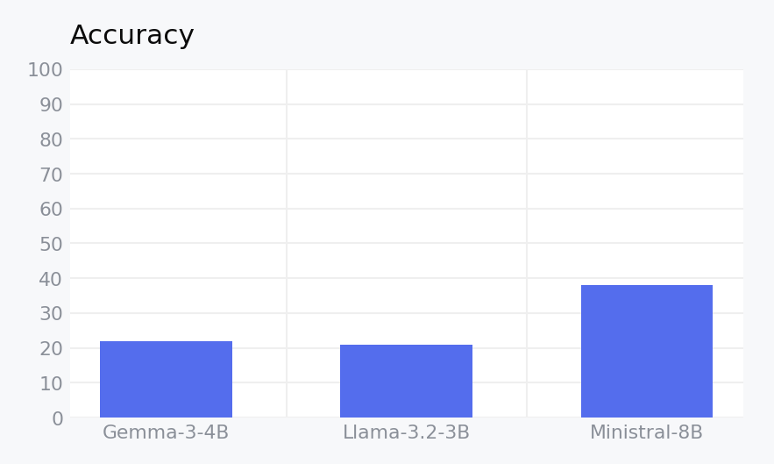
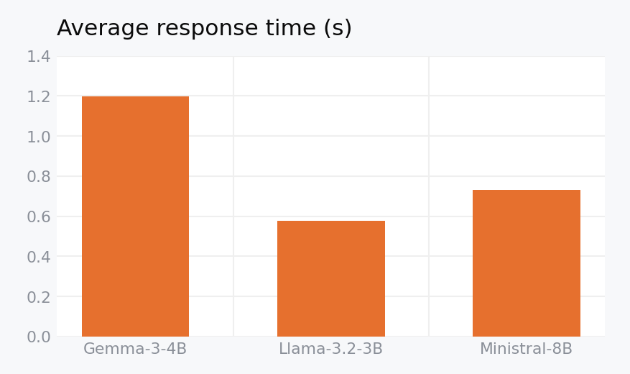
RESULTS
LAMBADA — results (test split)
Model | Accuracy (%) | Correct / Total | Avg Latency (s) | Errors
Gemma-3-4B | 21.9 | 219 / 1000 | 1.198 | 0
Llama-3.2-3B | 20.8 | 208 / 1000 | 0.577 | 0
Ministral-8B | 38.1 | 381 / 1000 | 0.731 | 0
Best accuracy: Ministral-8B at 38.1%. Fastest: Llama-3.2-3B at 0.577 s/query. Gemma-3-4B holds 21.9% on the full 1,000-sample split (matching its earlier 50-sample estimate) but is now clearly the slowest model at 1.198 s/query.
LAMBADA & MMLU Benchmark Evaluation
30

Slide 31
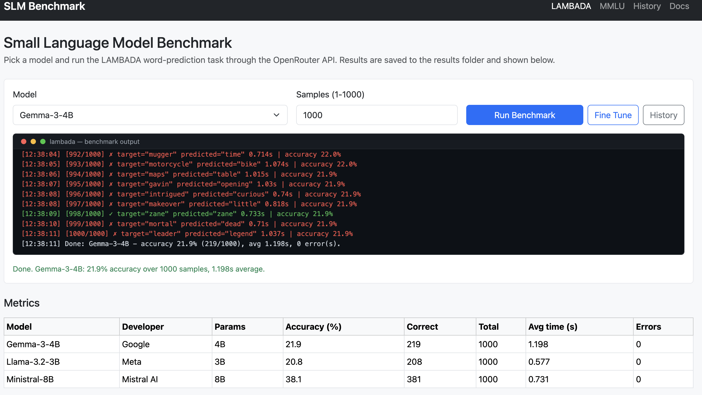
RESULTS
LAMBADA — SLM web app run panel
Model and sample-count inputs, Run Benchmark and Fine Tune (presets) buttons, live terminal streaming per-sample output (green = correct, red = wrong), and the metrics table with the latest saved results for all three models.
LAMBADA & MMLU Benchmark Evaluation
31

Slide 32
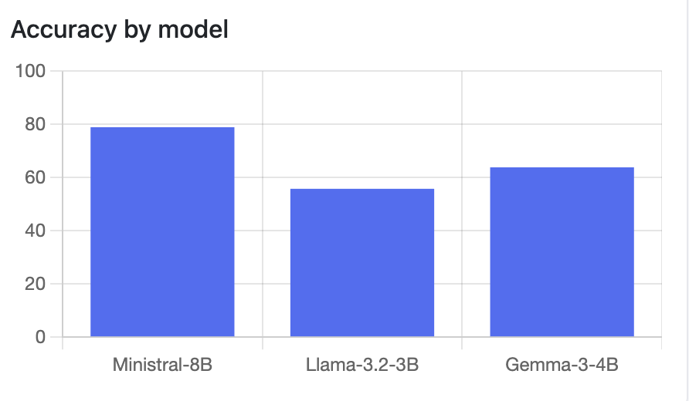
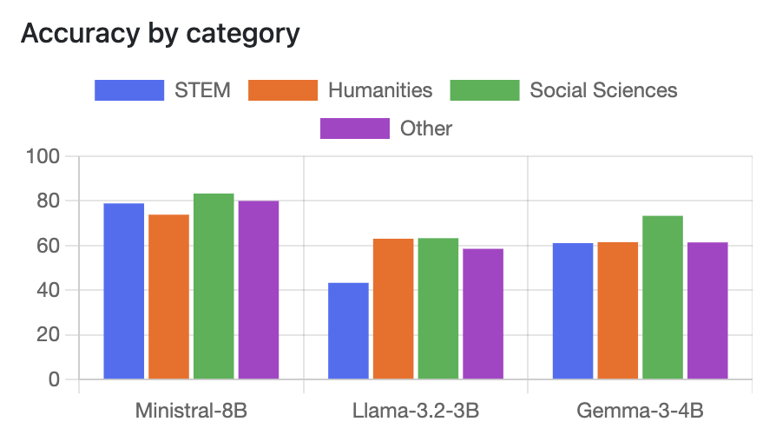
RESULTS
MMLU — results (57 subjects × 5 questions = 285/model)
Rank | Model | Acc. (%) | STEM | Human. | Social | Other | Reason. (%) | Avg s | Composite
1 | Ministral-8B | 78.9 | 78.9 | 73.9 | 83.3 | 80.0 | 69.1 | 1.537 | 0.731
2 | Llama-3.2-3B | 55.8 | 43.3 | 63.1 | 63.3 | 58.6 | 59.7 | 0.768 | 0.630
3 | Gemma-3-4B | 63.9 | 61.1 | 61.5 | 73.3 | 61.4 | 64.6 | 2.502 | 0.590
— Ministral-8B leads every category and the composite score.
— Gemma-3-4B is second on accuracy and reasoning consistency, but its 2.5 s average latency drops it below the faster Llama-3.2-3B on the composite ranking.
— Accuracy dominates the composite (70%); reasoning quality and latency (15% each) break ties — mirroring how small models are picked in practice: quality first, then cost and latency.
LAMBADA & MMLU Benchmark Evaluation
32

Slide 33
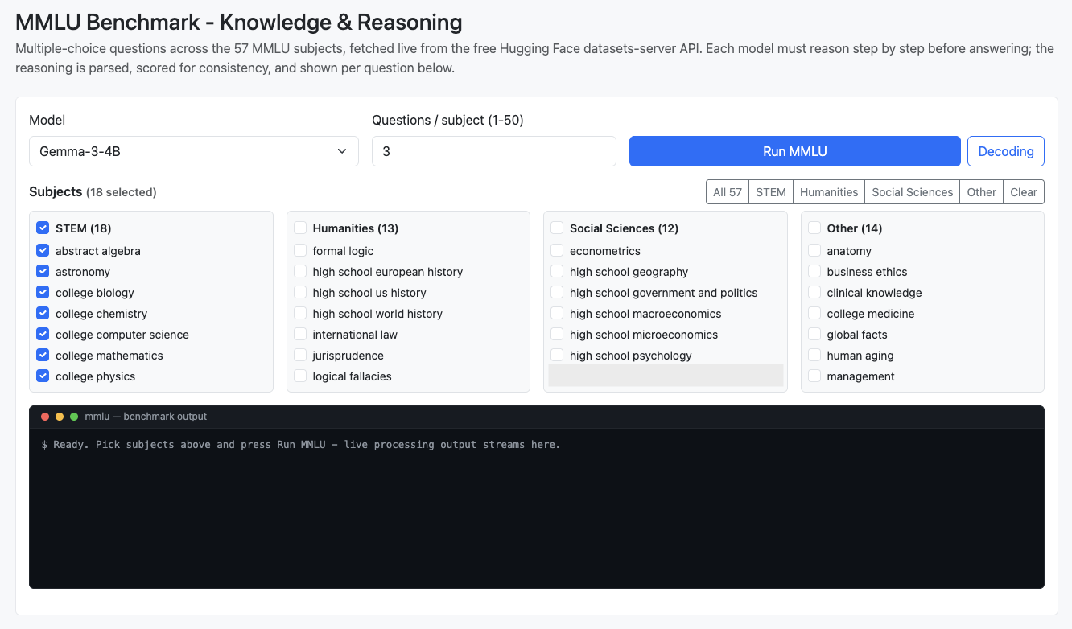
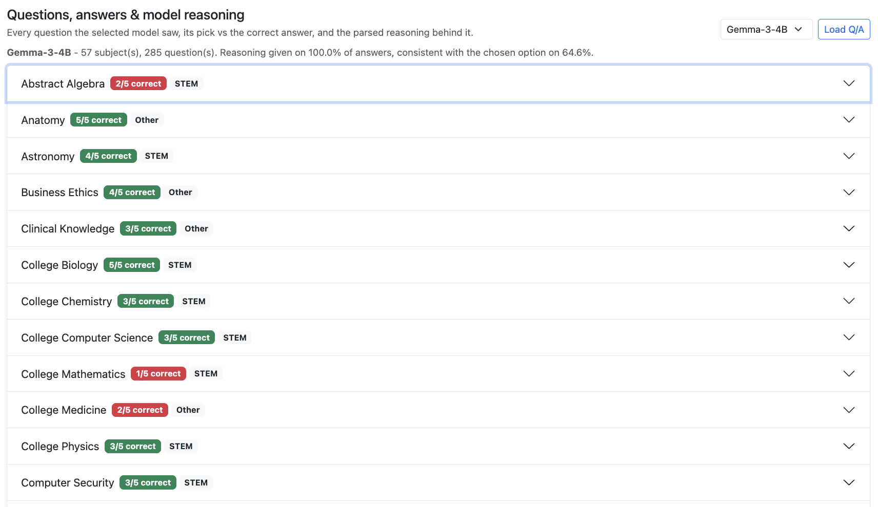
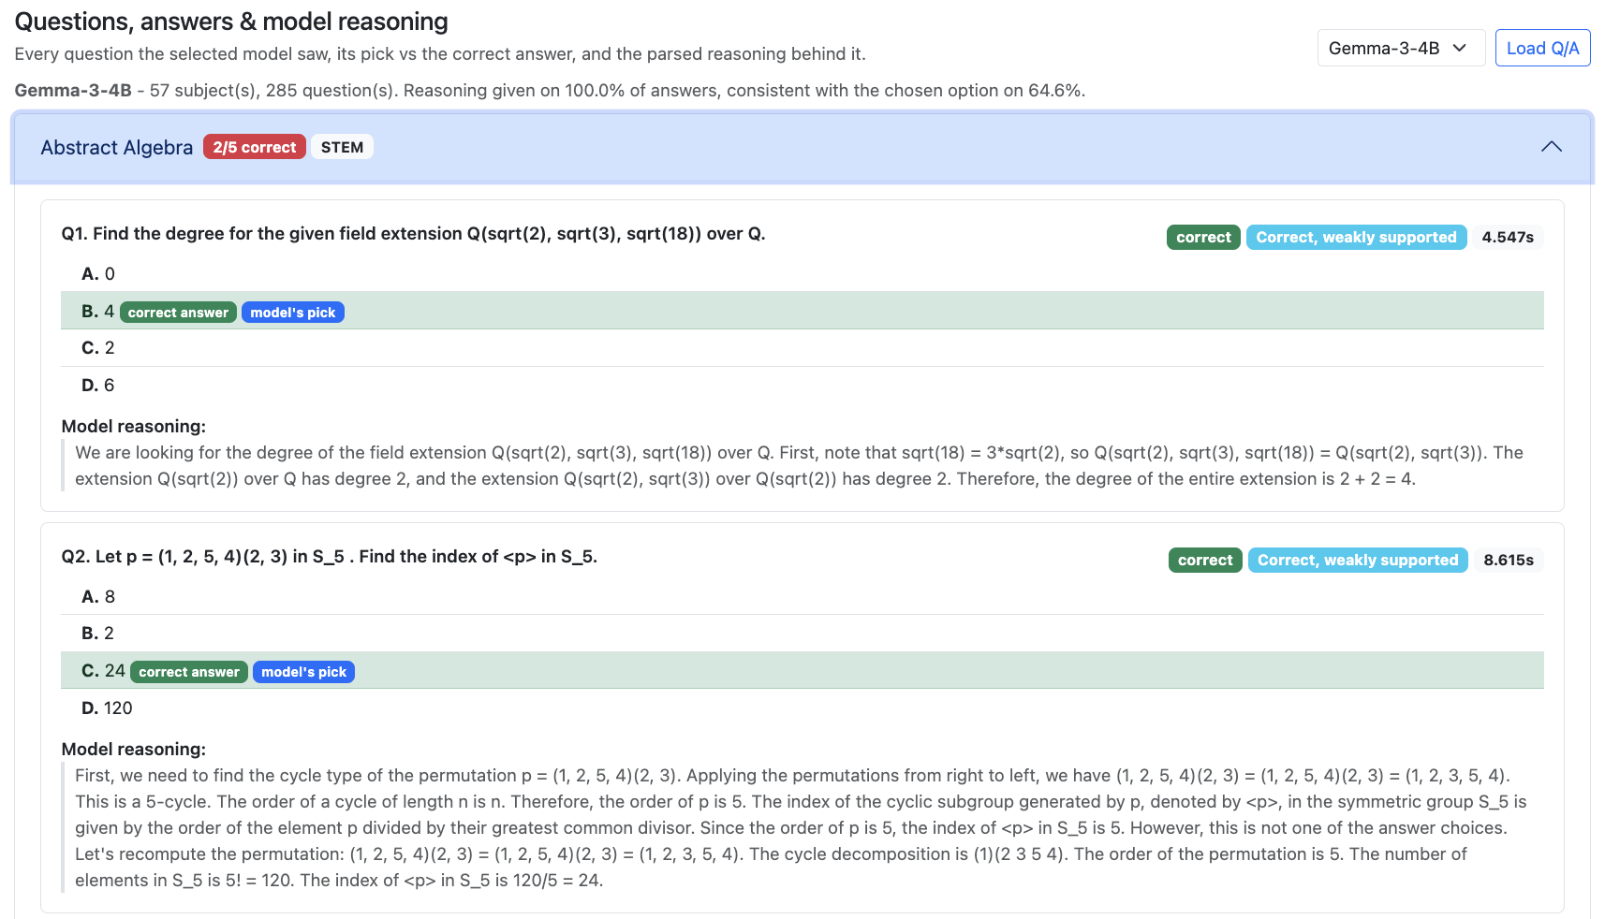
RESULTS
MMLU — web app
Subject picker with category presets, live terminal, per-question Q/A + reasoning viewer with the model's pick vs. the correct answer and reasoning verdict.
LAMBADA & MMLU Benchmark Evaluation
33

Slide 34
DISCUSSION OF THE RESULTS
Why these LAMBADA results?
— Accuracy gap (38.1% Ministral vs. 20.8–21.9% for the other two) matches the compression story: Ministral is the only model not distilled or pruned from a larger checkpoint. LAMBADA specifically punishes compression, because the correct word is very often a rare proper noun or specific detail that a distilled/pruned model is more likely to have smoothed over.
— LAMBADA gives no multiple-choice options — the model must generate the exact right token from the full vocabulary with nothing to recognize from, stressing raw language-modeling precision more than instruction-following, which is exactly where heavy pruning tends to cost the most.
— Gemma-3-4B's latency (1.198s, more than double Llama's 0.577s) is not primarily an architecture story here: this evaluation's own retry log shows Gemma's run hit a sustained string of HTTP 429 rate-limit responses from its OpenRouter-hosted provider, each costing up to ~60s in retries before succeeding — inflating its measured average well above its likely ‘clean’ speed (~0.58s, based on an earlier 50-sample dry run before that congestion).
— All three models finished at 0 recorded errors — the retry-with-backoff logic added after that congestion was diagnosed always eventually succeeded rather than giving up.
LAMBADA & MMLU Benchmark Evaluation
34

Slide 35
DISCUSSION OF THE RESULTS
Why these MMLU results?
— Ministral-8B's win here is even larger than on LAMBADA (78.9% vs. runner-up 63.9%): MMLU tests knowledge breadth across 57 subjects, and raw parameter count (8B vs. 3–4B) tracks especially closely with how much factual knowledge a model can store — more so than with pure language-modeling fluency.
— Category accuracy reveals unevenness the headline number hides: Llama-3.2-3B swings from 43.3% (STEM) to 63.3% (Social Sciences) — a 20-point gap between its weakest and strongest domains. Ministral-8B's own spread is much tighter (73.9%–83.3%, a 9.4-point gap) — evidence of more consistent competence, not just a higher average.
— Reasoning length is not reasoning quality: Ministral writes the shortest average explanation (54.1 words) yet the most consistent one (69.1%); Llama writes the longest (61.8 words) yet the least consistent (59.7%) — verbosity doesn't buy correctness.
— The composite ranking keeps Llama-3.2-3B ahead of Gemma-3-4B (0.630 vs. 0.590) despite Gemma's higher raw accuracy (63.9% vs. 55.8%) — because Gemma's 2.502s average latency is more than 3× Llama's, and speed carries 15% of the score. This is the clearest illustration in this study of how weighting can reorder a leaderboard relative to accuracy alone.
LAMBADA & MMLU Benchmark Evaluation
35

Slide 36
DISCUSSION OF THE RESULTS
Comments and discussions
ACCURACY & KNOWLEDGE DEPTH
SPEED & LATENCY
— Ministral-8B leads both benchmarks (38.1% LAMBADA, 78.9% MMLU) — the only model not distilled or pruned from a larger checkpoint, so it keeps more raw capacity for precise recall.
— Gemma-3-4B and Llama-3.2-3B are both compressed from bigger teacher/checkpoint models — a cost that shows up most on exact recall of rare words or facts.
— Llama-3.2-3B is fastest on both benchmarks (0.577s LAMBADA, 0.768s MMLU) — the smallest, most compressed model.
— Gemma-3-4B is the slowest despite being smaller than Ministral-8B — interleaved global-attention layers, fewer OpenRouter hosting providers, and (on its LAMBADA run specifically) transient provider rate-limit congestion all inflate its latency.
REASONING QUALITY (MMLU)
USE-CASE PERSPECTIVE
— Ministral-8B has the highest reasoning consistency (69.1%); Gemma-3-4B is close behind (64.6%) despite its latency cost; Llama-3.2-3B is lowest (59.7%) despite being fastest.
— Speed, accuracy, and reasoning quality don't move together — the composite score (70/15/15) exists precisely to weigh that trade-off.
— Ministral-8B: best when accuracy and reasoning quality matter most and an 8B footprint is affordable.
— Llama-3.2-3B: best for latency-sensitive or edge deployment.
— Gemma-3-4B: strong quality-per-parameter on paper, but the weakest speed/cost trade-off in this specific hosted (OpenRouter) setup.
LAMBADA & MMLU Benchmark Evaluation
36

Slide 37
Conclusions
Does a larger, non-distilled model beat smaller, compressed ones across both benchmarks?
— Yes — in raw accuracy and knowledge depth: Ministral-8B wins LAMBADA (38.1%) and MMLU (78.9%).
— No — in latency and cost-efficiency: Llama-3.2-3B, the smallest and most compressed model, is consistently the fastest.
For this evaluation:
— Ministral-8B is the strongest choice when accuracy and reasoning quality matter most.
— Llama-3.2-3B is preferable for latency-sensitive or edge deployment.
— Gemma-3-4B sits in between — competitive in quality-per-parameter terms, but currently the weakest on measured speed via this hosted setup.
— LAMBADA rewards real use of context; MMLU rewards breadth of knowledge and reasoning that actually supports the answer — together they separate raw language modeling from broader competence.
LAMBADA & MMLU Benchmark Evaluation
37

Slide 38
REFERENCES
Sources
— Paperno, D. et al. (2016). The LAMBADA dataset. Proceedings of ACL 2016.
— Hendrycks, D. et al. (2021). Measuring Massive Multitask Language Understanding. Proceedings of ICLR 2021.
— Google (2025). Gemma 3 technical report.
— Meta (2024). Llama 3.2 model card.
— Mistral AI (2024). Ministral model family.
github.com/ronvoy/gen-ai · unina.cc/gen-ai
LAMBADA & MMLU Benchmark Evaluation
38

