Slide 1
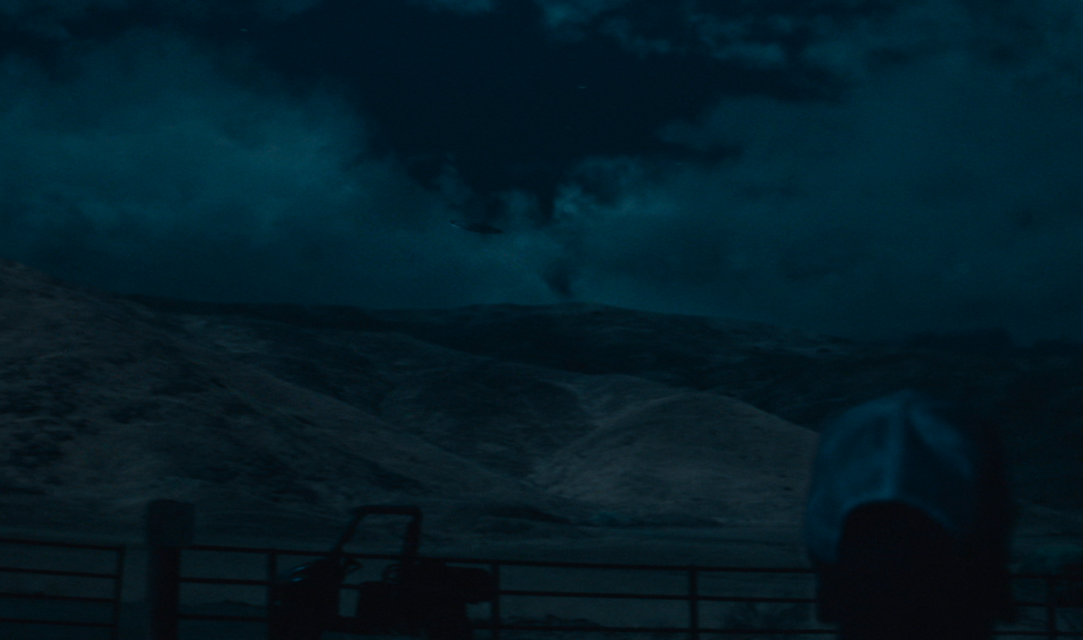
Do Records Show Proof of UFOs?
BY: RONY GUERRA

Slide 2
Questions
Which country has the most reported UFO Sightings?
In the United States, which state has the most UFO Sightings? How are they distributed across the US?
What are the most common UFO descriptions?
Is there a correlation between the time of day that people report these UFO Sightings?
Is there a correlation between the time of day that people report the shape of the UFO?
Are UFO Sightings seasonal? If so, which month has the most reported UFO sightings?
Why is July the best month to spot a UFO?
Has the frequency of UFO sightings increased throughout the years?

Slide 3
Appendix
The data was retrieved from the National UFO Reporting Center. The dataset includes over 80,000 reports of UFO sightings around the world. I downloaded the open-source from Kaggle.
I loaded the dataset into Excel and explored the data.
I prepared the dataset by removing the columns “duration (hours/min)” and “comments.” Also, I split the ‘datetime’ column to “Month,” “Day,” and “Year.”
I filled any missing values in the ‘Country’ column as ROW (Rest of the World).
After reprocessing the dataset, I continued with my analysis and proceeded to answer the questions.

Slide 4
UFO Sightings Around the World
As of 2014, the United States ranks number 1 in country for UFO sightings.
*The ‘Rest of the World’ label did not specify its country name. Therefore, I grouped all countries with no names and categorized it as ‘Rest of the World.’

Slide 5
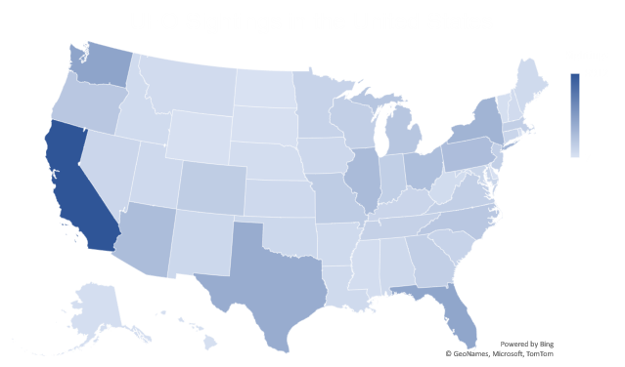
UFO Reports in the United States
Since 2014, California has the most UFO sightings in the United States.
It’s important to note that the top 10 states with the highest number of reports are from the United States.

Slide 6
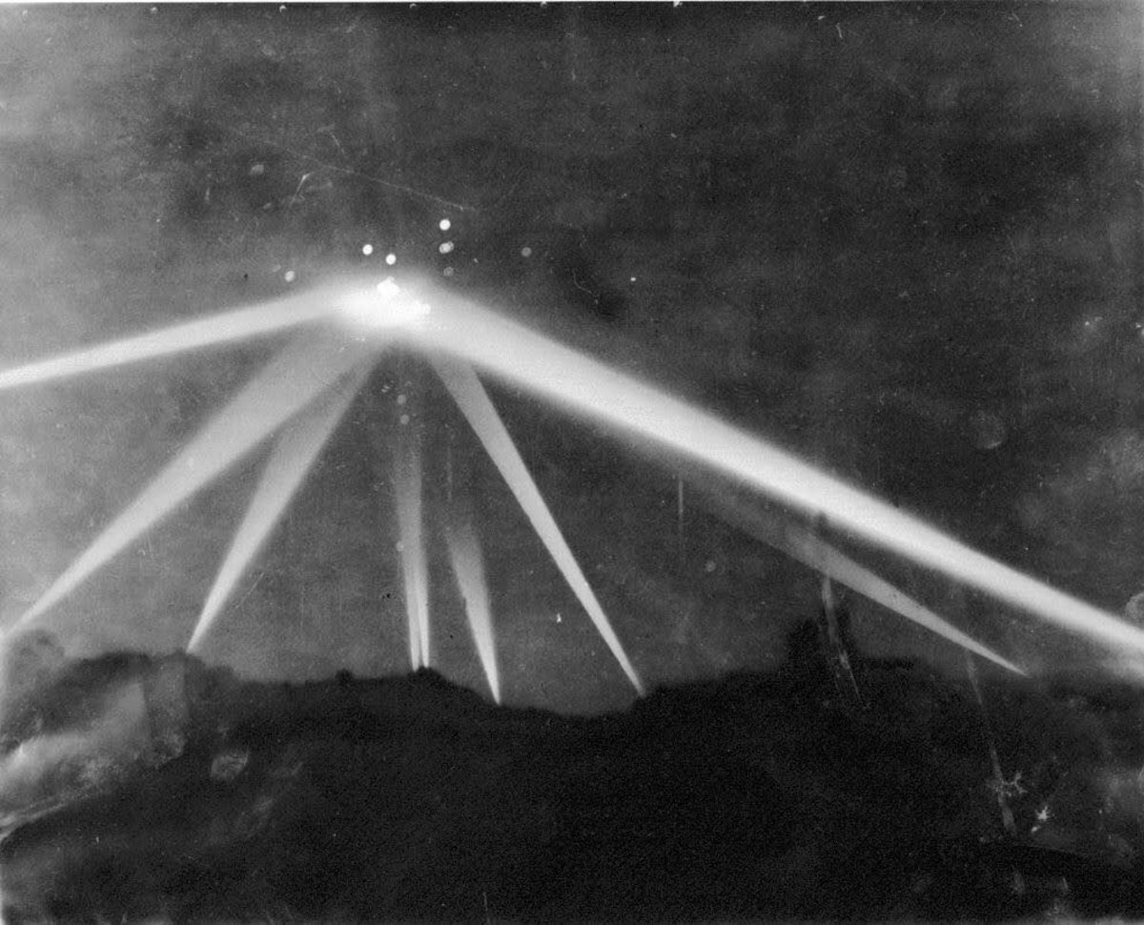
What are the most common UFO descriptions?
One of the most witnessed UFO Sightings that took place in the 1940s, known as the Battle of Los Angeles.
From the chart above, the top UFO description is reported seen as a light. This could suggest that people are witnessing these “light” objects during the night. On the other hand, there are many types of words that people use to describe UFOs. Many of them are very similar such as a circle and a sphere. Its possible that people are misidentifying these shapes based on UFO pop culture references.

Slide 7
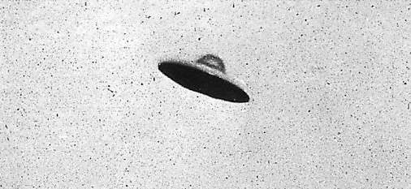
The Flying Saucer
One of the most recognizable UFO shapes is the flying saucer. In the history of popular culture, The flying saucer has been used as a stereotypical symbol as one of the most haunting UFO objects in science fiction, books, videogames, comics, films, and television. We can see that the top states with the most witnesses of a disk/saucer shaped body mostly consist of states in the United States. This begs the question whether pop culture has had an influenced over Americans being interested in extraterrestrial. Perhaps, this could be a reason why there has been an increase in flying saucer sightings throughout the years. Can it be an American cultural phenomenon?

Slide 8
Time of Day Witnesses Report UFOs
Overall, the NUFORC’s data shows reports of witnesses seeing UFOs mostly during nighttime hours between 7pm until midnight.
As previously mentioned, the top UFOs description is ‘light’ which is sighted mainly between 9-10pm.

Slide 9
UFO Sightings Rise During Summer
According to the analysis, it shows that more UFO sightings are reported in July than any other month.
Why is this the case? Were going to have to explore the data to further understand why July is the best month for UFOs sightings.

Slide 10
Why is July the best month to spot a UFO?
Based on the results, witnesses report UFOs sightings the most in 4th of July.
This explains why July has the most reported UFOs sightings.
It is likely that these witnesses misidentified a UFO for fireworks.
Another explanation can be that more people are looking up at the sky during Independence day than any other day.
However, we can’t rule out the possibility that it could be a non-terrestrial object in the sky.

Slide 11
UFO Sightings on the Rise
This data chart reports an increase in UFO sightings in the past 20 years. As time progresses, UFO reports will continue to increase based on the linear regression line. In addition, UFO reports will change with the technology of the times.

Slide 12
Conclusion
In Conclusion, we can not conclude the existence of extraterrestrial life based on this data. Nonetheless, we have uncovered many useful insightful information regarding UFO sightings. For instance, it appears that the highest number of UFO sightings are reported in the United States primarily in the state of California. In extend, one of the most common UFO description that individuals witness is an unusual light. There are a list of numerous objects that can be interpreted as light such as planes, lightning, fireworks, stars, comets, etc. As well, There are so many factors to consider whether these UFO reports were sighted under bad weather conditions or if the individual was intoxicated during that occurrence. Regardless, the fact the number of UFO reports have been increasing over time reveals an uncertainty towards UFOs. Only time will time as we gather more data to uncover this strange phenomenon.

