Slide 1
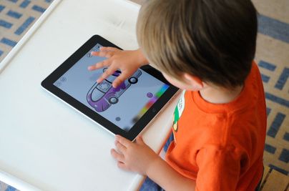
KidZone
Online Learning Platform for Kids
Presented By:
Name: Md. Rony Hossain
ID: 1910876102

Slide 2
What Inspired This Project?
1.Children today are highly responsive to scrollable content like YouTube and Facebook Reels.
2. We wanted to use that same concept to make learning fun, visual, and interactive.
3. Parents need a secure, controlled environment where they can manage what their kids learn and watch.
4. Inspired by the goal to blend education, safety, and entertainment in one platform.
Notes:
Today, most children spend a lot of time watching short videos on platforms like YouTube or Facebook Reels.
While these platforms are engaging, they aren’t designed for educational use or child safety.
That inspired the idea behind KidZone — to bring the same level of interactivity and fun into a safe, learning-focused environment.
Here, parents can manage what content their kids access, set controls, and switch to kid mode securely with a PIN.
The goal was to combine education, safety, and entertainment in one platform.

Slide 3
Limitations of YouTube Kids and Khan Academy
1. Lacks personalized parental control for each child.
2. No subscription mechanism for specific creators — kids may see random content.
3. Occasional irrelevant or inappropriate recommendations despite filters.
4. No social media–style news feed for kids.
5. Parents cannot control or customize what content their children access.
Takeaway:
Existing platforms either lack parental control or interactive, creator-driven features, inspiring the development of KidZone, which combines both.

Slide 4
Key Users and Roles
1. Creator
2. Admin
3. Parent
4. Kid
Notes:
Lets see the key users and their roles:
Creators will create their account and upload educational content.
An admin will review and process those content.
Parents will subscribe those content creators and will let their children to watch those contents.
Kids will then enjoy scrollabale , social- media like newsfeed.

Slide 5
SDLC Model: Agile Methodology
(Software Development Life Cycle)
Plan → Design → Develop → Test → Review → Repeat

Slide 6
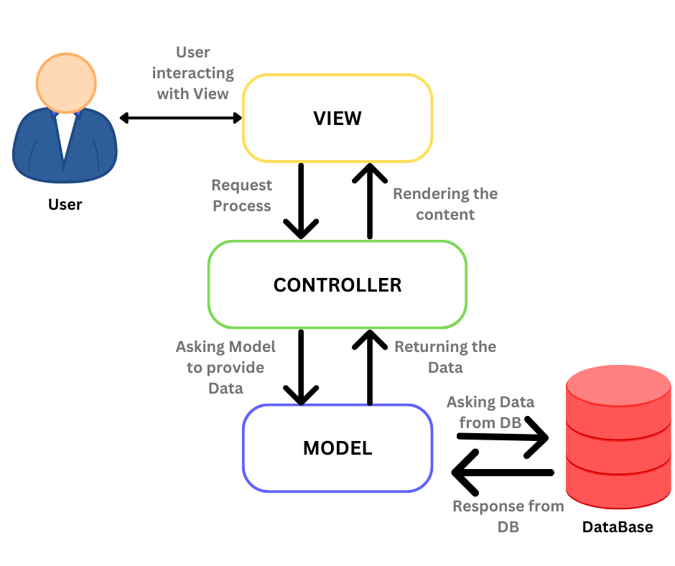
System Architecture
Notes:
The system architecture of KidZone follows the MERN stack, which includes MongoDB, Express.js, React, and Node.js.
The client side is built with React, which provides a dynamic and responsive user interface for different users — creators, parents, and kids.
The server side uses Express.js and Node.js, handling all API requests, authentication, content management, and communication between the frontend and the database.
The database is MongoDB, a NoSQL database that stores user profiles, educational content, subscriptions, and parental settings in a flexible JSON-like structure.
This three-tier structure ensures modularity, scalability, and efficient communication between the client, server, and database layers.

Slide 7
Technology Stack
Layer | Technology | Purpose
Frontend | React js | UI
Backend | Node js + Express | API & Server Logic
Database | MongoDB | Data Storage
Authentication | JWT | Secure login
Hosting | Vercel | Deployment

Slide 8
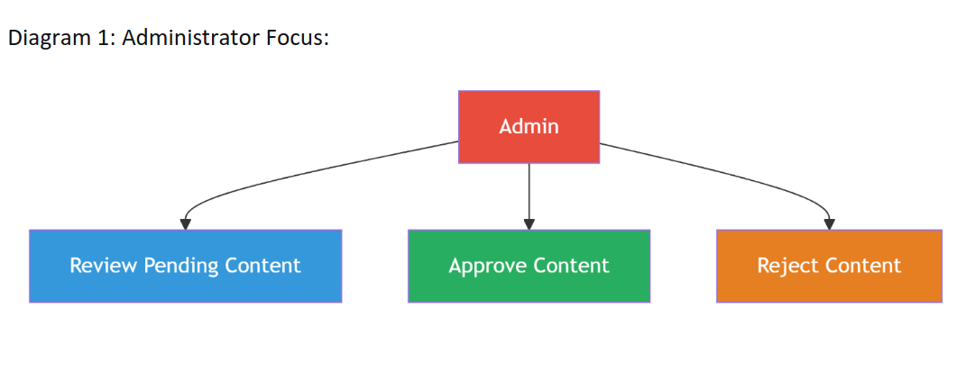
Functional Diagrams

Slide 9
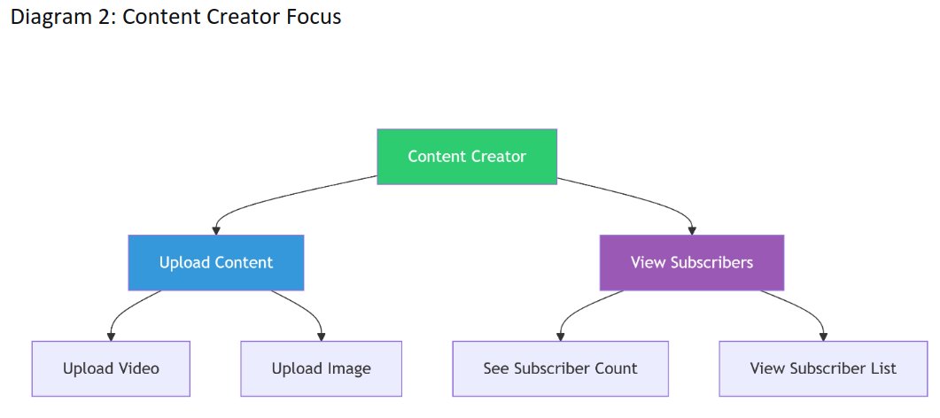

Slide 10
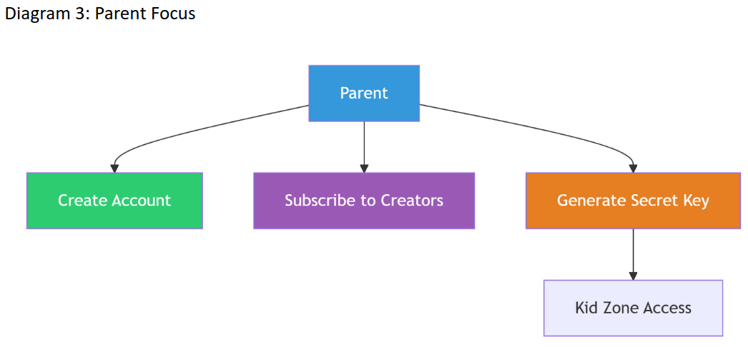

Slide 11
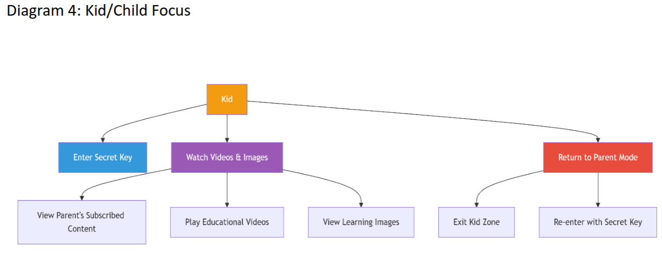

Slide 12
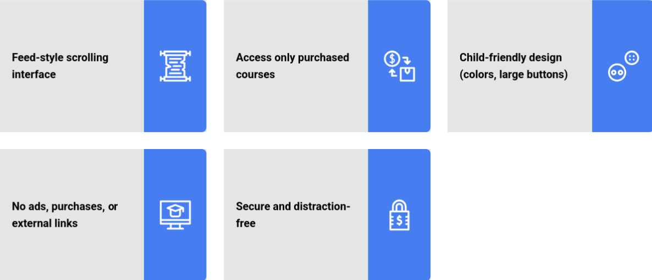
Kid Mode Features

Slide 13
Screenshots of The Project

Slide 14
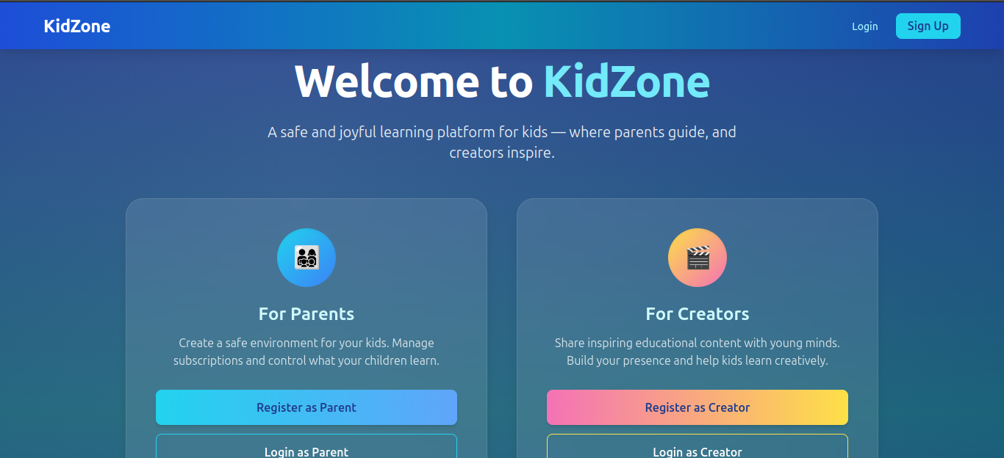
Fig: Homepage

Slide 15
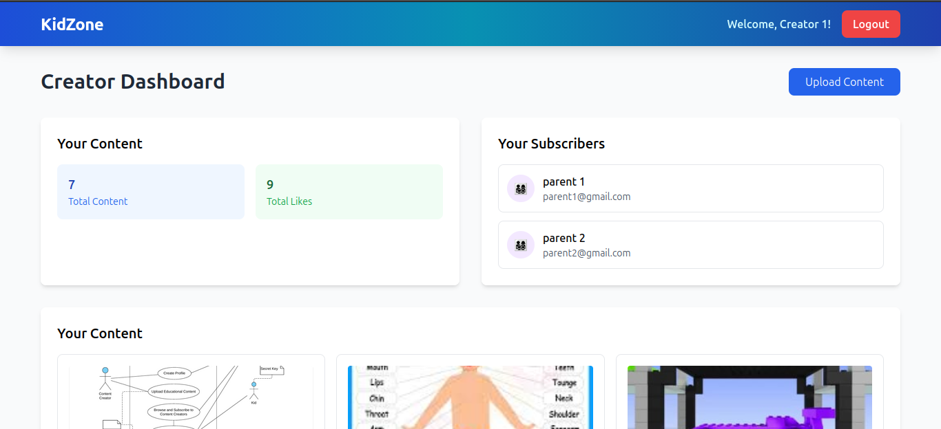
Fig: Creator’s Dashboard After Signing In

Slide 16
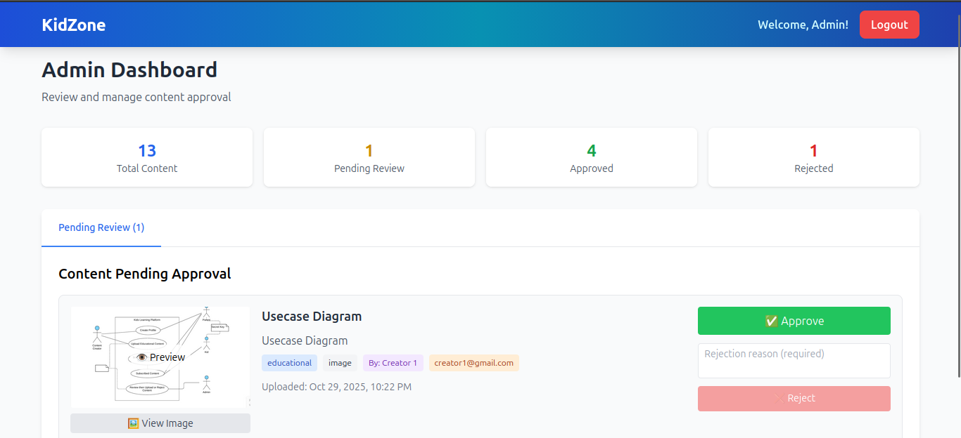
Fig: Admin Dashboard

Slide 17
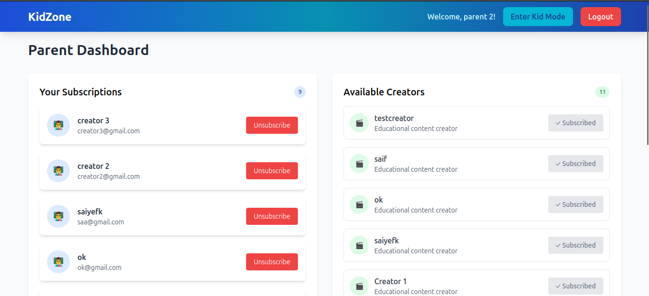
Fig: Parents’ Dashboard After Signing In

Slide 18
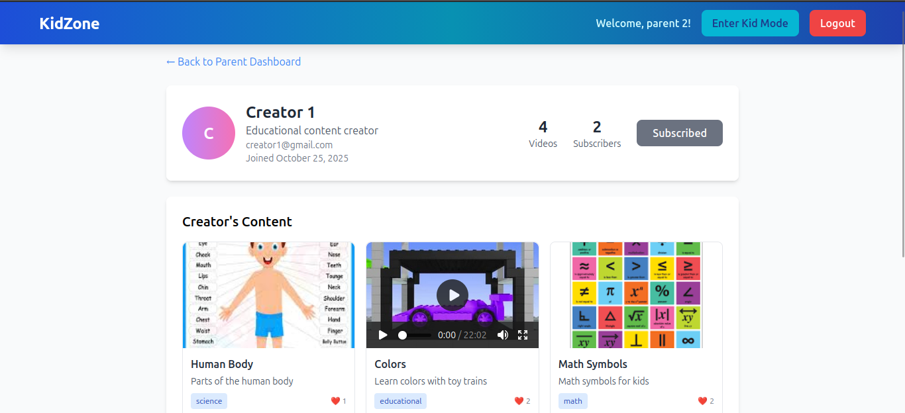
Fig: Parent Viewing Creator Profile

Slide 19
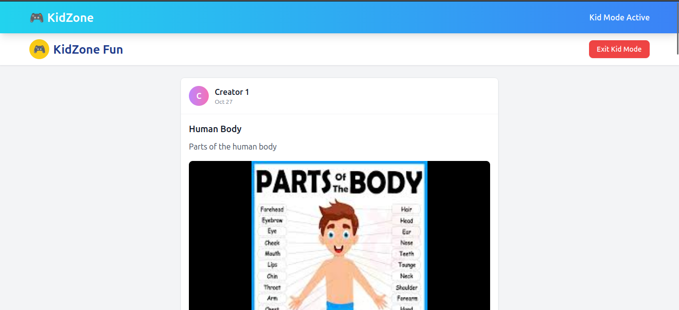
Fig: Kid’s Newsfeed

Slide 20
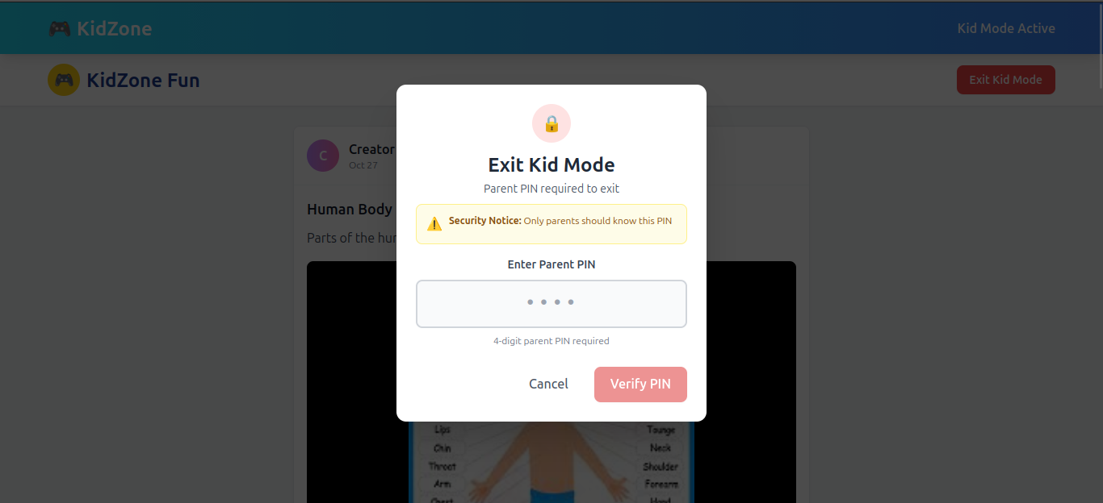
Fig: PIN Verification When Exiting Kid Mode

Slide 21
Limitations
1. Requires stable internet.
2. Web-based only (no mobile app yet).
3. Manual admin approval may take time.

Slide 22
Future Scope
1. Mobile apps for Android and iOS.
2. AI-assisted content moderation.
3. Quizzes, live classes, and interactive learning features.

Slide 23
Project Link:
https://github.com/rony191002/KidZone

Slide 24
Thank You

