Slide 1
Analysis
Of
Bangladeshi Students Performance

Slide 2
GROUP INFORMATION
GROUP NO
16

Slide 3
INTRODUCTION
This project analyzes the factors influencing Bangladeshi students' academic performance, including demographics, internet access, and extracurricular activities, using Python and data analysis tools. It gives ideas to improve education.

Slide 4
OUR MOTIVATION
To discover insights that enhance academic success and improve the quality of education.

Slide 5





PROJECT PIPELINE
Data Collection
Data Analyze
1
2
3
4
5
Problem Definition
Data Preprocessing
Data Visualizations

Slide 6
05
Data Visualizations
Create visual representations.
04
Data Analyze
Explore patterns and insights.
03
Data Preprocessing
Clean and structure the data.
02
Data Collection
Gather relevant student data.
01
Problem Finding
Identify the problem and objectives.

Slide 7
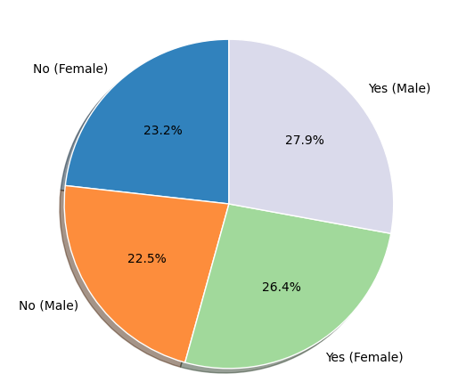

STUDENT WITH INTERNET ACCESS
This pie chart shows students in city, urban and rural who have internet access or not.
In this chart 54.3% students have internet access and 45.7% students do not have internet access
In this chart 50.4% male and 49.6% female students.

Slide 8
STUDENTS WITH INTERNET BY LOCATION
Students are used internet and who lives in city, rural and urban

Slide 9
INTERNET ACCESS VS ACADEMIC PERFORMENCE
Average score of all students in each subject who have internet access or not.

Slide 10
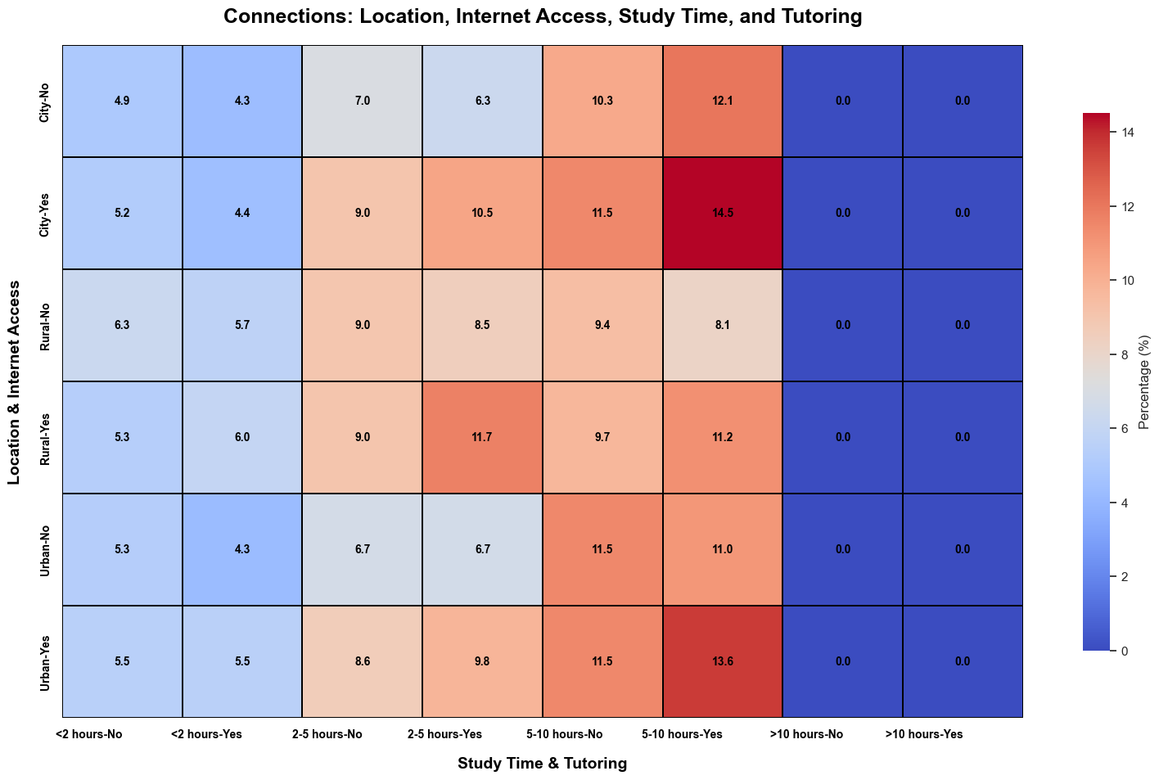
STUDY TIME VS INTERNET ACCESS
This heatmap shows how internet access affects students study time in different locations.

Slide 11
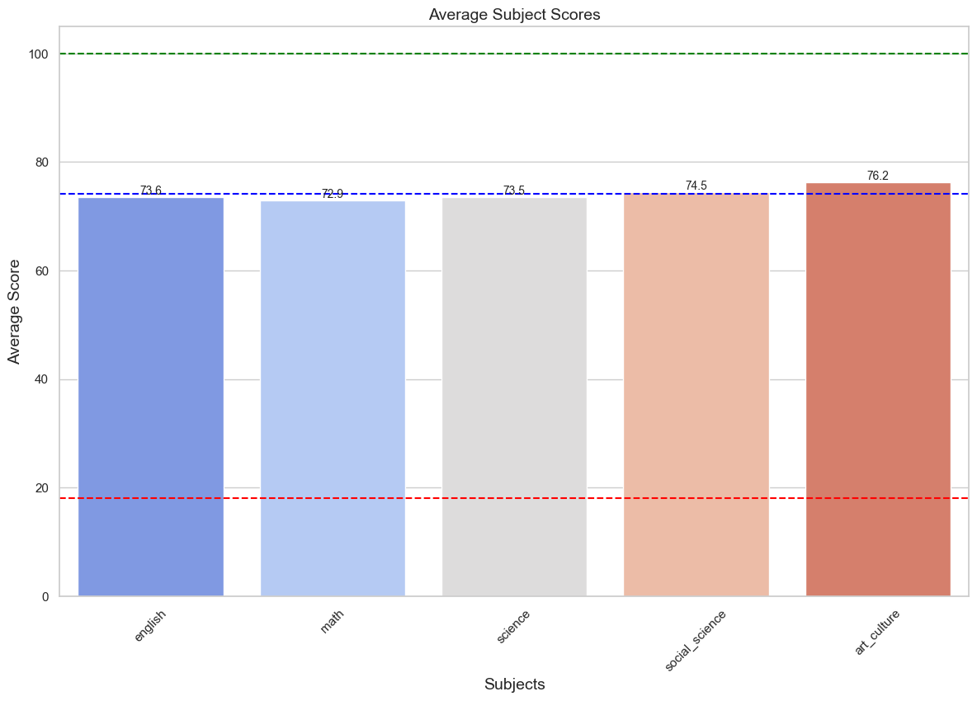
Average Academic Scores Across Subjects
Highest: Art & Culture (76.2)
Lowest: English (72.9)
Math (73.5) and Science (73.6) show similar scores.
Overall scores range from 70 to 76.2.

Slide 12
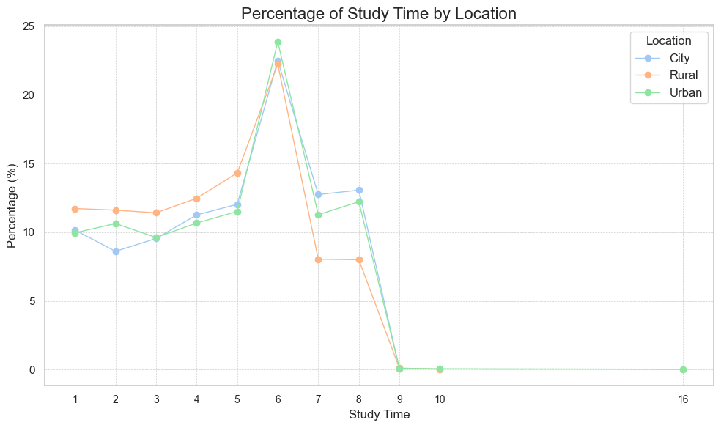

STUDY TIME IN DIFFERENT LOCATION
City students predominantly study for 6 hours, indicating a focused routine.
Rural students have diverse study hours (1-8 hours), reflecting varied habits.
Urban students commonly study for 5 hours, with a few dedicating longer hours.

Slide 13
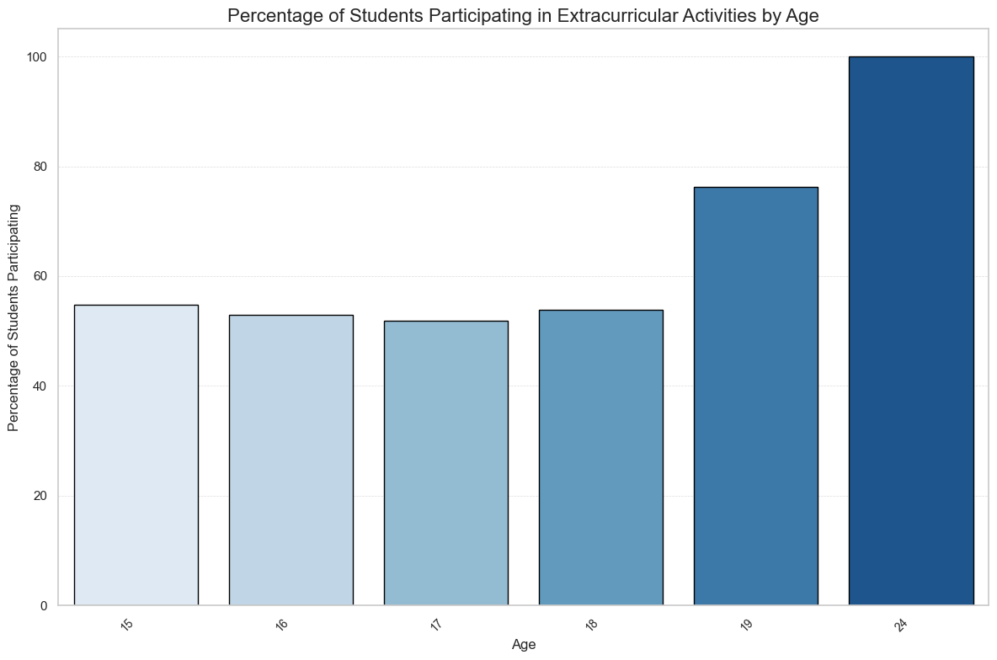
Participation in Extracurricular Activities by Age
Age 17: Lowest participation (just under 50%).
Age 16: Slight increase (just above 50%).
Age 18: Further rise to ~55%.
Age 19: Significant jump to ~80%.
Age 21+: Highest participation (nearly 100%).

Slide 14
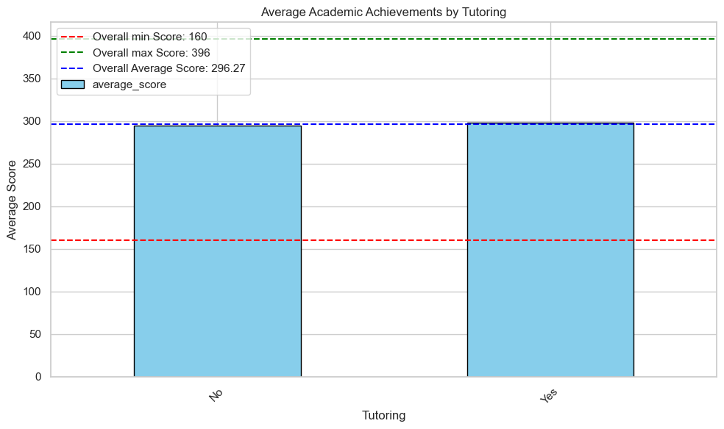
ACADEMIC ACHIVEMENT BY TUTORING
Scores range from 160 to 396, with an average of 296.27.
Students with tutoring achieve higher average scores.
Both groups’ scores are close to the overall average.

Slide 15
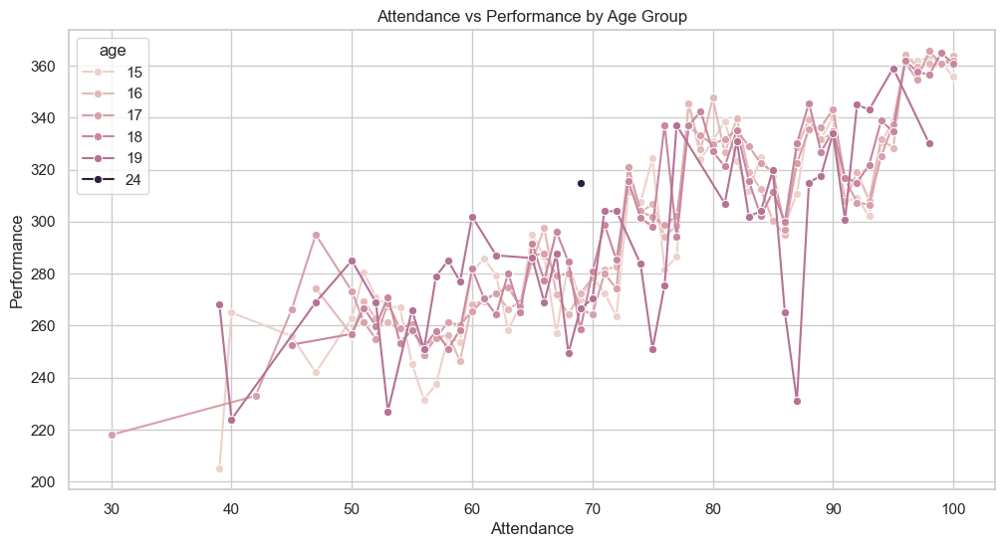

Relationship Between Attendance and Performance by Age
Positive correlation observed: Higher attendance leads to better performance.
Exceptions at ages 15-16 with varied results.
Strong correlation at ages 17-19.
Age 24 shows consistently high performance regardless of attendance.

Slide 16
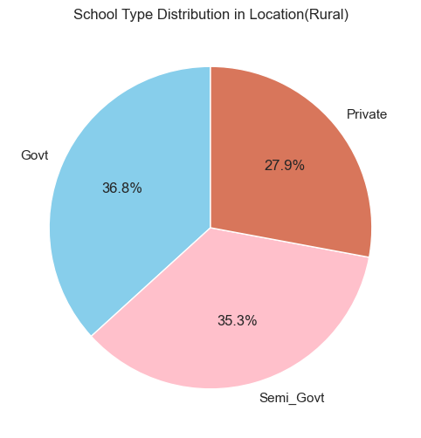
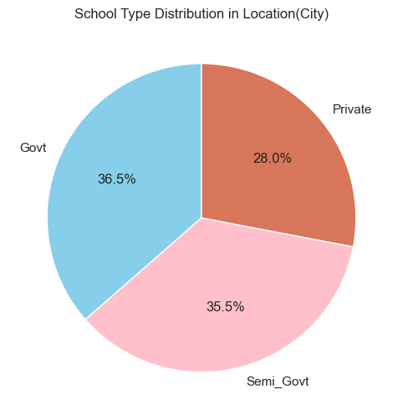
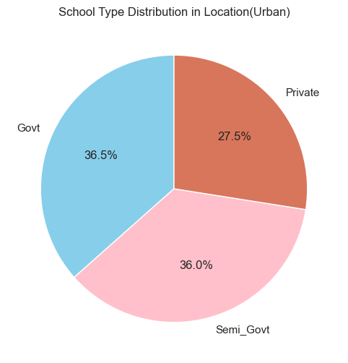
INISTITUTE TYPE IN DIFFERENT LOCATION
Government and Semi-Government schools dominate across regions.
Private schools have the smallest share.
Rural areas have a higher proportion of Government schools.

Slide 17
Actionable Insights and Key Challenges
Improve English Performance: Focus on targeted strategies to boost English scores, as they are the lowest among subjects.
Support for Rural Students: Address diverse study habits in rural areas with flexible programs and resources.
Encourage Extracurricular Participation: Foster participation in younger students to align with the upward trend observed in older age groups.
Promote Tutoring: Highlight the benefits of tutoring to enhance academic performance for all students.
Enhance Attendance: Reinforce the link between attendance and performance, especially for ages 17-19.

Slide 18
Conclusion
Students perform best in Art & Culture, showing the importance of creativity in education. Tutoring and regular attendance help improve academic performance, especially for students aged 17 to 19. Participation in extracurricular activities increases with age, showing the value of overall development. These ideas can help create better strategies to improve education and solve key problems.

Slide 19
THANK YOU

