Slide 1

OPERATIONS RESEARCH
Faroque Ahmed
Research Associate
Bangladesh Institute of Governance and Management (BIGM)

Slide 2
Contents
Introduction to Operations Research(OR)
Applications in various areas
The OR Process
Techniques used
Linear Programming Problems(LPP)
Applications of LPP in various functional domains
Hands on Exercises

Slide 3
Introduction
Operations Research is a systematic and analytical approach to decision-making and problem-solving
It is used in a variety of organizations to solve many different types of problems.
It is widely used in different functional areas like Marketing Production, Manpower Planning, Supply Chain Optimization etc.
Notes:
How it is different from industrial engineering
https://mie.umass.edu/undergraduate-students/ieor-program
Operational research (OR) encompasses a wide range of problem-solving techniques and methods applied in the pursuit of improved decision-making and efficiency, such as simulation, mathematical optimization, queueing theory and other stochastic-process models, Markov decision processes, econometric methods, data ...
Federal Express..it promises the overnight delivery of their packages. The started with Hub and Spoke Network in which there are few Hubs as at major cities and from their packages are distributed to various destinations. It has been statrdet with
DHL minimizes its inventory and applied JIT Techniques with OR techniques and made an effective and efficient supply chain

Slide 4
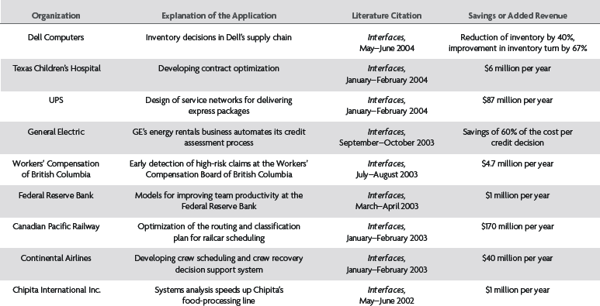
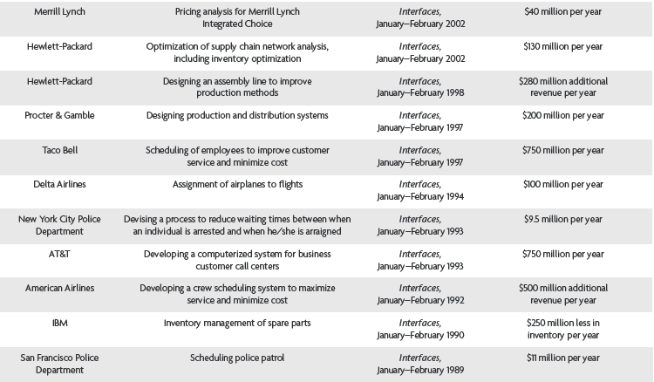
Successful Applications of OR

Slide 5
Applications of OR
Finance
Portfolio Management
Capital Budgeting
Productivity enhancement of banks
Operations
Capacity planning,
Sequencing of Jobs
Inventory Management
Location Planning
Marketing
Advertising and sales
Media Selection
Forecasting
Travelling Salesman
Human Resource
Manpower Planning
Roaster Making
Engineering
Fleet Assignment at Airlines
Gasoline blending at
petroleum refineries
.
Notes:
Capital budgeting is the process in which a business determines and evaluates potential expenses or investments that are large in nature. These expenditures and investments include projects such as building a new plant or investing in a long-term venture
Capital budgeting, or investment appraisal, is the planning process used to determine whether an organization's long term investments such as new machinery, replacement of machinery, new plants, new products, and research development projects are worth the funding of cash through the firm's capitalization structure
.Commerce: An analysis of elements of a company's product mix to determine the optimum allocation of its resources. Two most common measures used in a portfolio analysis are market growth rate and relative market share.
https://www.pitt.edu/~jrclass/or/or-intro.html

Slide 6
OR Models
The goal of operations research is to provide a framework for constructing models of decision-making problems, finding the best solutions with respect to a given parameters, and implementing the solutions in an attempt to solve the problems
Examples : an equation, an outline of process, a diagram, and a map, a blueprint
We talk about ‘mathematical models’
.
Notes:
Deterministic models
Used for problems in which information is known with a high degree of certainty.
Used to determine an optimal solution to the problem.
Probabilistic models
Used when it cannot be determined precisely what values (requiring probabilities) will occur (usually in the future).

Slide 7
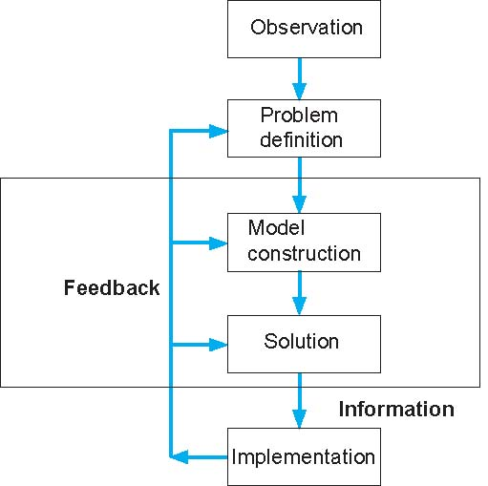
The OR Process
The problem is recognized
Formulation: Description
Of processes, assumptions and
Describing the objective
Develop Mathematical Model
Applying powerful
solution method
Establish the procedure
Notes:
Observation: Decision making begins with a situation in which a problem is recognized. The problem may be actual or abstract, it may involve current operations or proposed expansions or contractions due to expected market shifts, it may become apparent through consumer complaints or through employee suggestions, it may be a conscious effort to improve efficiency or a response to an unexpected crisis. It is impossible to circumscribe the breadth of circumstances that might be appropriate for this discussion, for indeed problem situations that are amenable to objective analysis arise in every area of human activity.
The figure shows the situation with vague outlines because most problems are poorly defined in their original conception. Historical data describing organizational operations and performance may be present in various forms. The data may be immediately relevant to the situation or investigations may reveal the need for additional data collection

Slide 8
Operations Research Tools & Techniques
Linear Programming Problems
Transportation Problems
Assignment Problems
Travelling Salesman Problems etc.
Decision Theory
Inventory Management
Game Theory
Waiting Line Management

Slide 9
What is Linear Programming Problem (LPP)
Linear programming is a simple technique where we depict complex relationships through linear functions and then find the optimum points.
Here, the linear objective function is maximized or minimized (optimized) when subjected to various constraints.
Constraints can be limitations on resources or expenditure or labour hours etc.

Slide 10
Model Components
Decision variables - Decision variables describe the quantities that the decision makers would like to determine. Represented by x₁, x₂, x_{3 ……} or x, y, z….. How many products to be produced?
Objective function - a linear mathematical relationship describing an objective of the firm, in terms of decision variables - this function is to be maximized or minimized(Cost/Profit/Return).
Constraints – requirements or restrictions placed on the firm by the operating environment, stated in linear relationships of the decision variables.(labour hrs/raw materials)
Parameters - numerical coefficients and constants used in the objective function and constraints. (Per unit cost/raw material used to produce 1 product)

Slide 11
Summary of Model Formulation Steps
Step 1 : Clearly define the decision variables
Step 2 : Construct the objective function
Step 3 : Formulate the constraints
Step 4 : Add non-negative restrictions
Step 5: Solution to problem by applying appropriate technique

Slide 12
Example of Model Construction (1 of 3)
Information and Data:
Business firm makes and sells a steel product
Product costs Tk.5 to produce
Product sells for Tk.20
Product requires 4 kgs of steel to make
Firm has 100 kgs of steel
Business Problem:
Determine the number of units to produce to make the most profit, given the limited amount of steel available.

Slide 13
Example of Model Construction
Variables: x = # units to produce (decision variable)
Z = total profit (in Tk.)
Model: Z = Tk.20x - Tk.5x (objective function)
4x = 100 kg of steel (resource constraint)
Parameters: Tk.20, Tk.5, 4 kgs, 100 kgs (known values)
Formal Specification of Model:
maximize Z = Tk.20x - Tk.5x
subject to 4x = 100

Slide 14
Example of Model Construction
Model Solution:
Solve the constraint equation:
4x = 100
(4x)/4 = (100)/4
x = 25 units
Substitute this value into the profit function:
Z = Tk.20x - Tk.5x
= (20)(25) – (5)(25)
= Tk.375
(Produce 25 units, to yield a profit of Tk. 375)

Slide 15
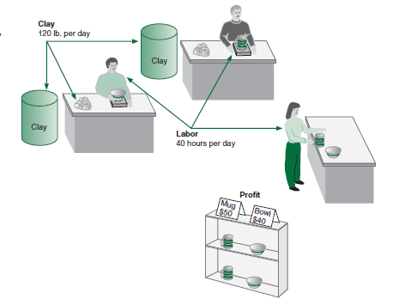
Model Construction: Product Mix Problem
 | Resource Requirements
Product | Labor (Hr./Unit) | Clay(in 00’) (gm/Unit) | Profit (Tk./Unit)
Bowl | 1 | 4 | 40
Mug | 2 | 3 | 50
Product mix problem - Pottery Company
The maximum availability ‘Labour hours per day’ are 40 hrs
The maximum availability ‘Clay’ per day are 120 gms(in 00s’)
How many bowls and mugs should be produced to maximize profits given labor and materials constraints?

Slide 16
LP Model Formulation
A Maximization Example (2 of 3)
Decision x₁ = number of bowls to produce per day
Variables: x₂ = number of mugs to produce per day
Objective Maximize Z = Tk.40x₁ + Tk.50x₂
Function: Where Z = profit per day
Resource 40 hrs of labor per day
Availability: 120 gms of clay (in 00’s)
Resource 1x₁ + 2x₂ ≤ 40 hours of labor
Constraints: 4x₁ + 3x₂ ≤ 120 grams of clay
Non-Negativity x₁ ≥ 0; x₂ ≥ 0
Constraints:

Slide 17
LP Model Formulation
A Maximization Example (3 of 3)
Complete Linear Programming Model:
Maximize Z = Tk.40x₁ + Tk.50x₂
subject to: 1x₁ + 2x₂ ≤ 40
4x₁ + 3x₂ ≤ 120
x₁, x₂ ≥ 0
(0,0) , (5,10),
(10,20)
Are these possible solution??

Slide 18
Feasible Solutions
A feasible solution does not violate any of the constraints:
Example: x₁ = 5 bowls
x₂ = 10 mugs
Z = Tk.40x₁ + Tk.50x₂ = Tk.700
Labor constraint check: 1(5) + 2(10) = 25 ≤ 40 hours
Clay constraint check: 4(5) + 3(10) = 70 ≤ 120 grams

Slide 19
Infeasible Solutions
An infeasible solution violates at least one of the constraints:
Example: x₁ = 10 bowls
x₂ = 20 mugs
Z = Tk.40x₁ + Tk.50x₂ = Tk.1400
Labor constraint check: 1(10) + 2(20) = 50 > 40 hours

Slide 20
The Manufacturing Problem

Slide 21
A Furniture Company
The XYZ Furniture Manufacturing Company wishes to determine its production schedule for the next quarter for variants of Kids Chairs.
The company produces four variants of Kids Chairs, including Sofa Chair, Portable Chair, Rocking Chair, and Study Chair
The profit contribution from selling one Sofa Chair is Rs.120, one Portable is Rs.80, one Rocking Chair is Rs.150, and one Study Chair is Rs.40.
The quarterly production budget is atmost Rs.1,80,000. Each unit of a sofa, portable, rocking, and study chair costs Rs.400, Rs.300, Rs.500, and Rs.150, respectively.
The sales forecasts indicate that the potential sales volume is limited to 250 units of sofas, 300 units of portable, 200 units of rocking, and 600 units of study chairs.

Slide 22
A Furniture Company
There is maximum of 800 machine hours available and
1,200 labor hours available. Table below summarizes the number of machine hours and the number of labor hours required per unit of each product.
Variants | Machine Hours/Unit | Labour Hours/Unit
Sofa Chairs | 2 | 2.5
Portable Chairs | 1 | 2
Rocking Chairs | 2.5 | 3
Study Chairs | 0.75 | 1
Formulate and solve the LPP

Slide 23
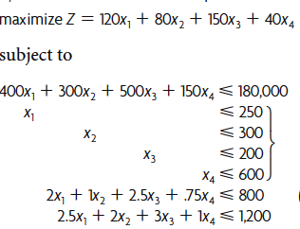
Formulation: A Furniture Company
X₁ = number of sofa chairs to produce
X₂ = number of portable chairs to produce
X₃ = number of rocking chairs to produce
X₄ = number of study chairs to produce
x₁, x₂ x₃, x₄ ≥ 0

Slide 24
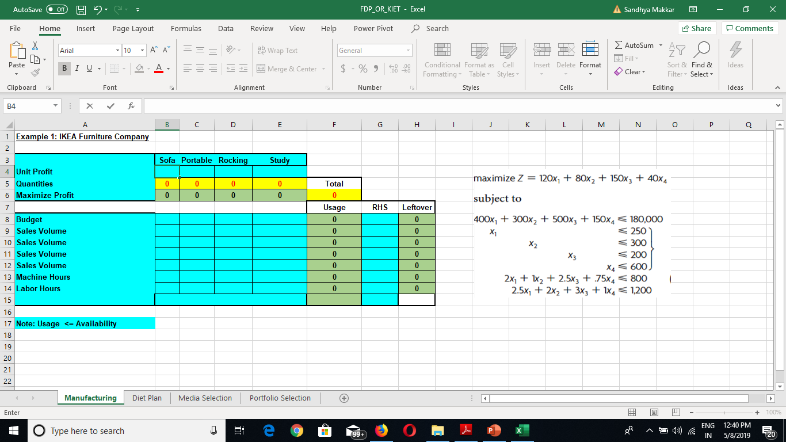
Practical Excel Template

Slide 25
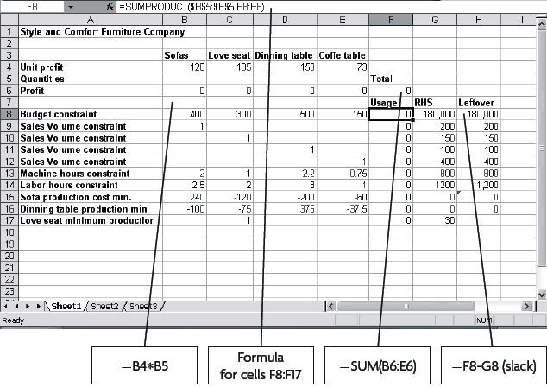
Understanding Formulas/Functions

Slide 26
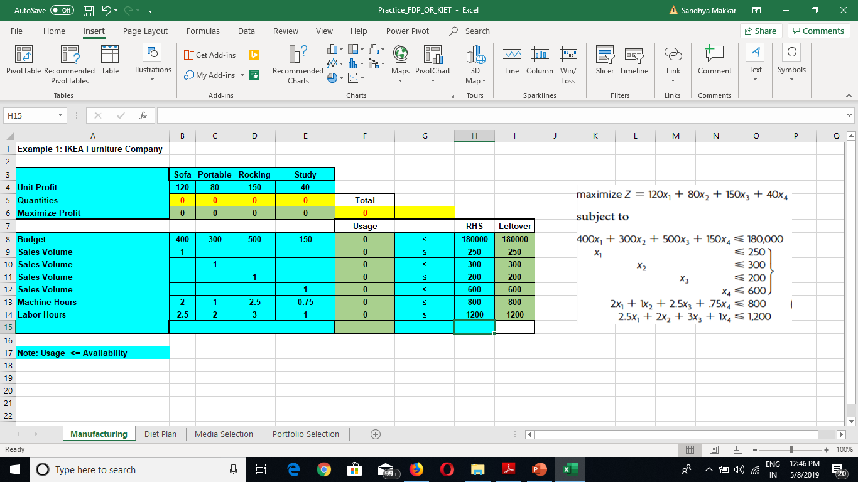
Setting up table

Slide 27
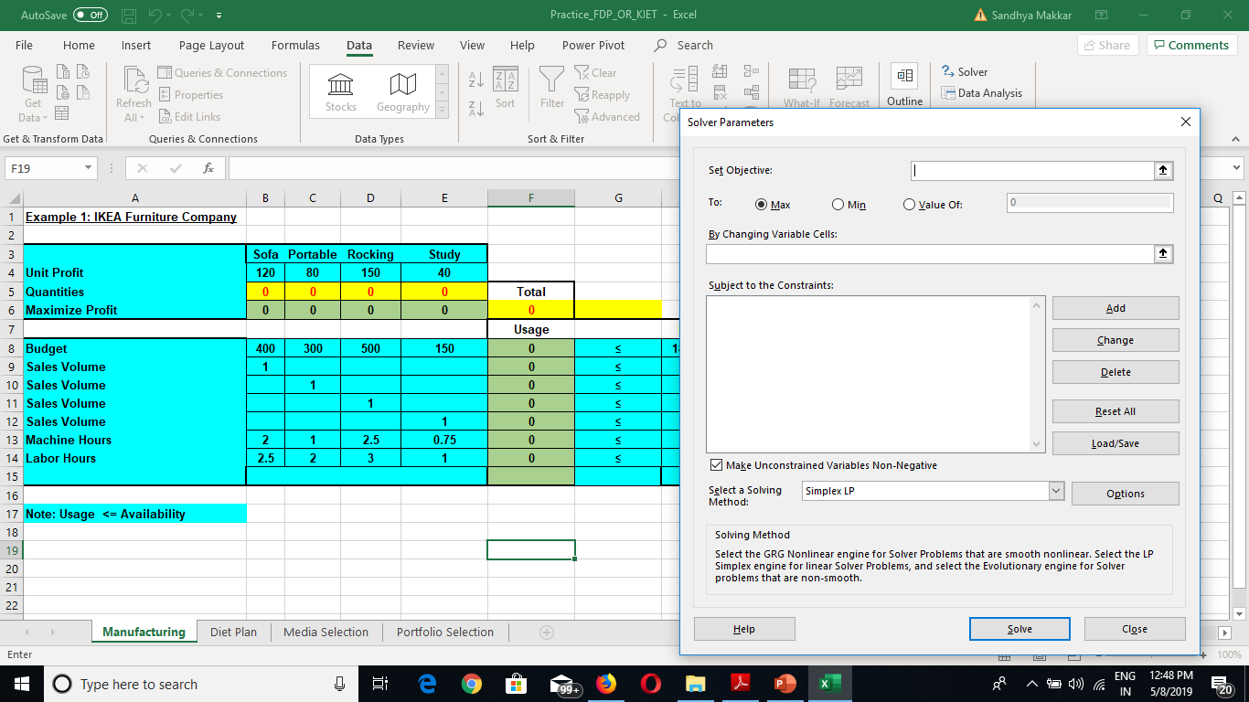
Data Tab => Solver

Slide 28
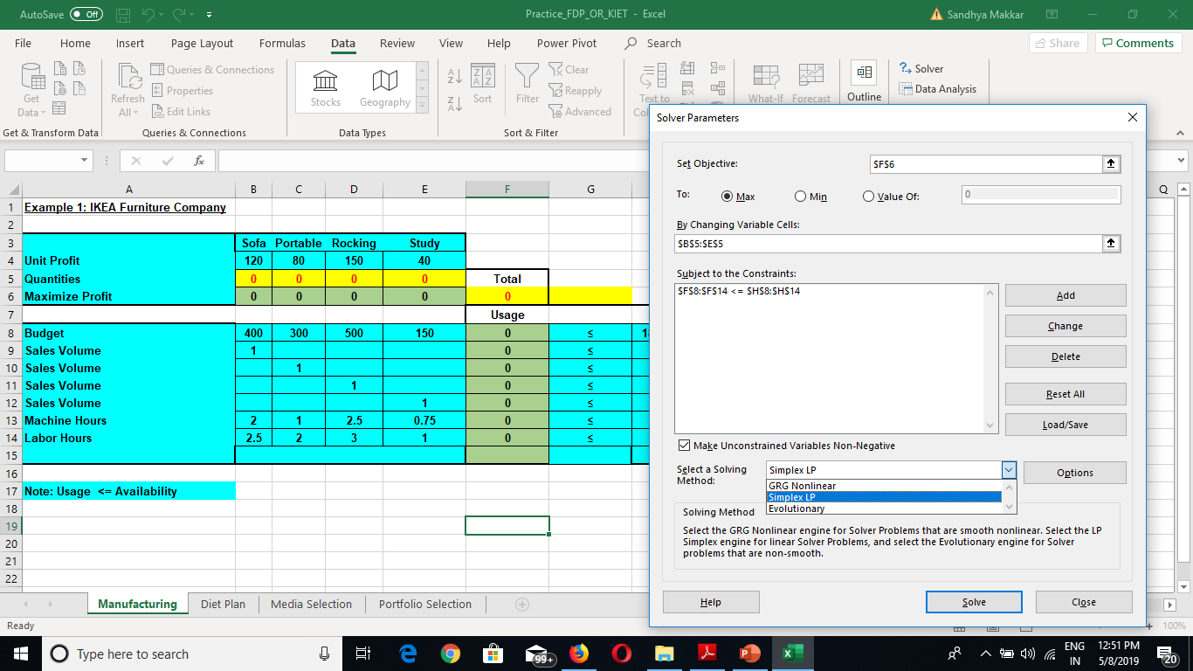
Fill the necessary Heads

Slide 29
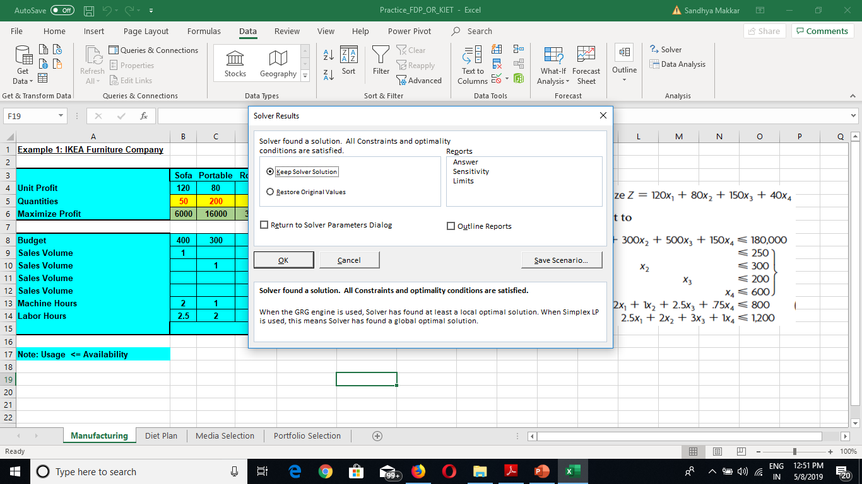
Click ‘Solve’ => keep the solver sol => ok

Slide 30
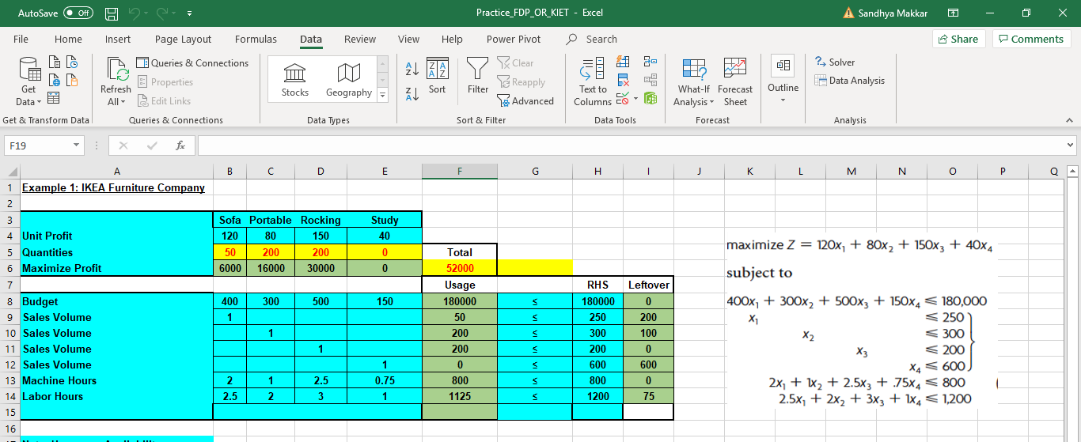
Optimal Solution
Produce 50 units of sofa, 200 units of portable chairs , 200 units of rocking chair
In order to get max profit of Rs. 52,000

Slide 31
The Diet Problem

Slide 32
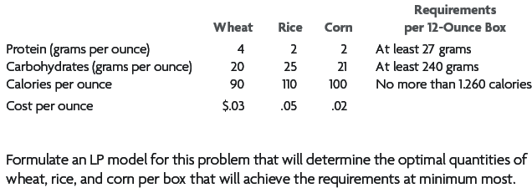
The Diet Problem
A cereal manufacturer is investigating a possibility of introducing a new cereal box of 12 ounces. It would be composed of wheat, rice and corn flakes. The flakes are targeted to provide essential nutrients like proteins, carbs and calories.
The cost per ounce and dietary requirement are shown in the table below
cost

Slide 33
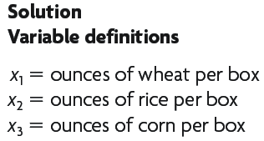
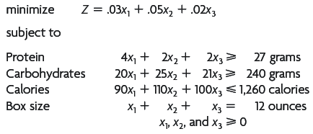
The Diet Problem Contns..

Slide 34
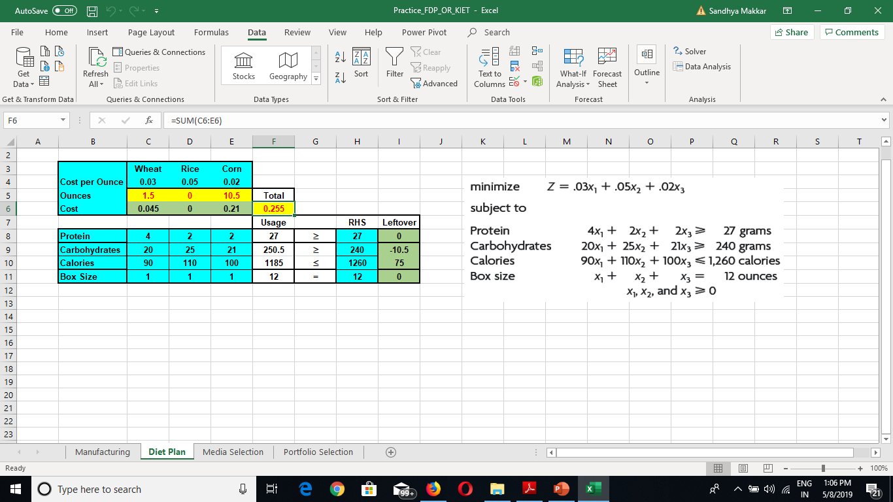
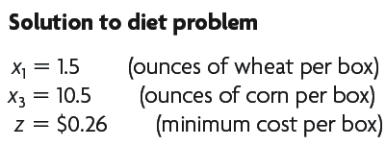
Solution: The Diet Problem

Slide 35
Thank You

