Slide 1


OnTheFly

Slide 2

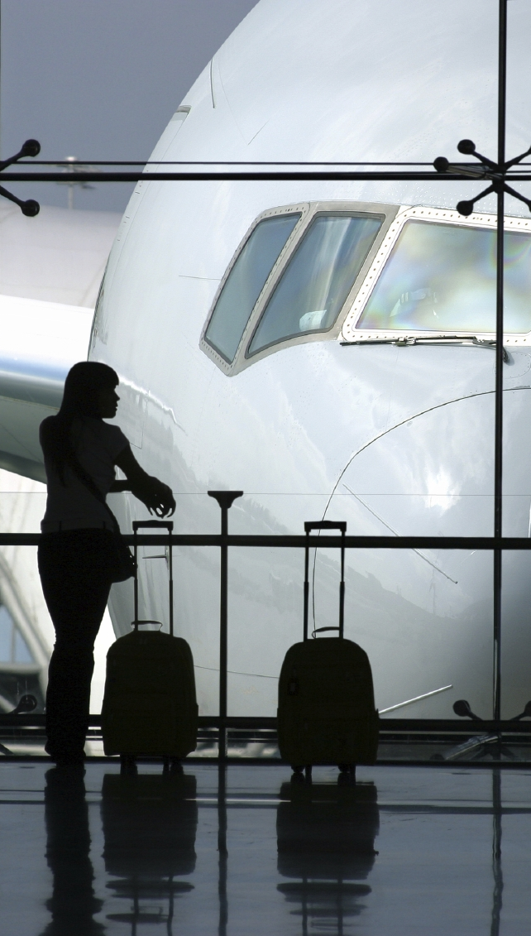
OnTheFly

Slide 3


OnTheFly
FROM
TO
WHEN
Go

Slide 4




OnTheFly
Skip
Connect

Slide 5












OnTheFly
Chat | People | Feed
Kevin
is looking to pass time
Hey! How wants to hang out?? I’m in terminal 5 right next to starbucks…
3 comments
Tomer
wants to eat something
Who’s hungry…? In the mood for Chinese!
1 comments
You should meet!
Starbuck café at terminal 3
OnTheFly users enjoy a free cup of coffee with a purchase of a regular sized coffee. Visit us at terminal 3.
Catherine
wants to share a cab
Going to the town’s central area, anyone up for sharing a taxi?
2 comments
Ofer
is looking to explore the city
Long wait and thought of exploring the city. Who wants to come?
4 comments
This sounds fun!

Slide 6


OnTheFly
Chat | People | Feed
Starbuck café at terminal 3
OnTheFly users enjoy a free cup of coffee with a purchase of a regular sized coffee. Visit us at terminal 3.
Catherine
wants to share a cab
Going to the town’s central area, anyone up for sharing a taxi?
2 comments
Ofer
is looking to explore the city
Long wait and thought of exploring the city. Who wants to come?
4 comments
This sounds fun!
10% of all gadgets
Beats by Dr. Dre® Solo 2 Headphones for just 199.99$. Only for OnTheFly users! Visit us a terminal 2.
Gal
is looking to pass time
10 hours to burn. Though of watching a long movie. Any LOTR fans?
1 comments

Slide 7

OnTheFly
Chat | People | Feed
Starbuck café at terminal 3
OnTheFly users enjoy a free cup of coffee with a purchase of a regular sized coffee. Visit us at terminal 3.
Catherine
wants to share a cab
Going to the town’s central area, anyone up for sharing a taxi?
2 comments
Ofer
is looking to explore the city
Long wait and thought of exploring the city. Who wants to come?
4 comments
This sounds fun!
10% of all gadgets
Beats by Dr. Dre® Solo 2 Headphones for just 199.99$. Only for OnTheFly users. Visit us a terminal 2.
Gal
is looking to pass time
10 hours to burn. Though of watching a long movie. Any LOTR fans?
1 comments

Slide 8

OnTheFly
Chat | People | Feed
Kevin
is looking to pass time
Hey! How wants to hang out?? I’m in terminal 5 right next to starbucks…
3 comments
Tomer
wants to eat something
Who’s hungry…? In the mood for Chinese!
1 comments
You should meet!
Catherine
wants to share a cab
Going to the town’s central area, anyone up for sharing a taxi?
2 comments
Ofer
is looking to explore the city
Long wait and thought of exploring the city. Who wants to come?
4 comments
This sounds fun!
Gal
is looking to pass time
10 hours to burn. Though of watching a long movie. Any LOTR fans?
1 comments

Slide 9













OnTheFly
Chat | People | Feed
8 hours wait!
Matan, 26
Flying your way!
Same age as you!
From your home, Israel!
6 hours wait!
Kevin, 28
Flying your way!
Also studies Computer Science!
5 hours wait!
Aviya, 26
From your home, Israel!
Same age as you!
Also loves dogs!
3 hours wait!
Gal, 25
Here for a long time.
From your home, Israel!
Donnie, 56
3 hours wait!
Here for business.
Works in RedHat.
Visited Israel once.

Slide 10

OnTheFly
Chat | People | Feed
8 hours wait!
Matan, 26
Flying your way!
Same age as you!
From your home, Israel!
6 hours until flight!
Kevin, 28
Flying your way!
Also studies Computer Science!
5 hours wait!
Aviya, 26
From your home, Israel!
Same age as you!
Also loves dogs!
3 hours wait!
Gal, 25
Here for a long time.
From your home, Israel!
Donnie, 56
3 hours wait!
Here for business.
Works in RedHat.
Visited Israel once.

Slide 11
OnTheFly
Chat | People | Feed
8 hours wait!
Matan, 26
Flying your way!
Same age as you!
From your home, Israel!
6 hours wait!
Kevin, 28
Flying your way!
Also studies Computer Science!
5 hours wait!
Aviya, 26
From your home, Israel!
Same age as you!
Also loves dogs!
3 hours wait!
Gal, 25
Here for a long time.
From your home, Israel!
Donnie, 56
3 hours wait!
Here for business.
Works in RedHat.
Visited Israel once.

Slide 12



OnTheFly
Chat | People | Feed
Tomer
Great! :) See you there!
seen 10 minutes ago
Matan
Hey dude!
seen 1 hour ago
Emily
I’ll will be at FCO at 11am.
seen 1 hour and 20 minuts ago

Slide 13
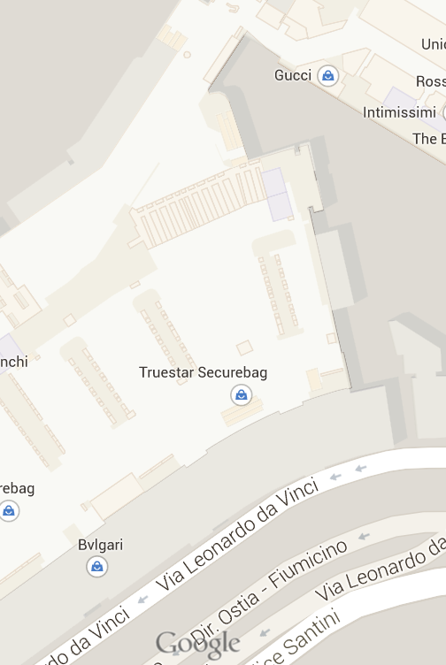
OnTheFly
Chat | People | Feed

Slide 14

OnTheFly
Chat | People | Feed
Hurry up!
Your flight leaves in
1 hour!

