Slide 1
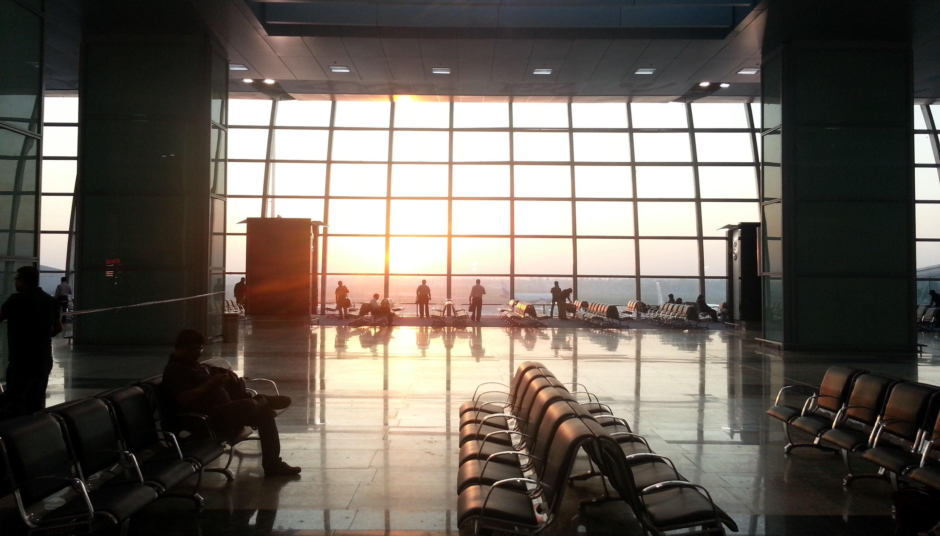

OnTheFly

Slide 2
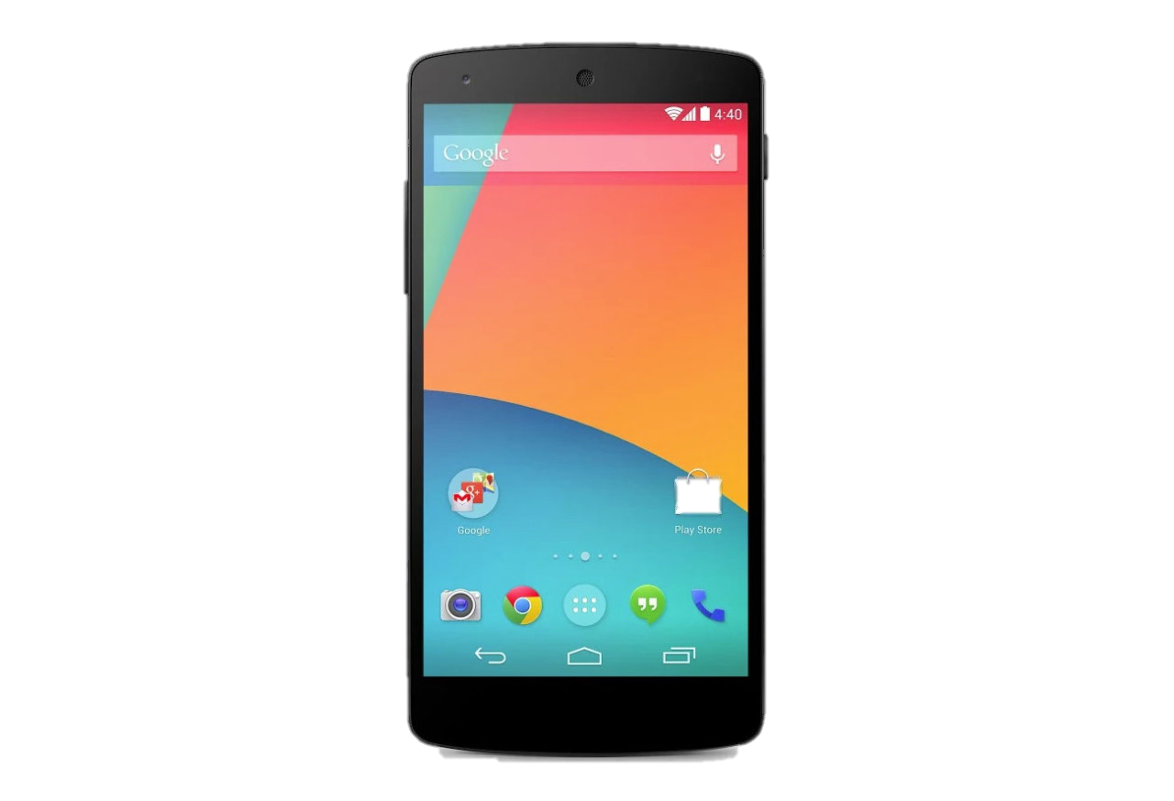

OnTheFly

Slide 3




OnTheFly
Skip for now

Slide 4



OnTheFly
Chat | People | Feed

