Slide 1


OnTheFly

Slide 2
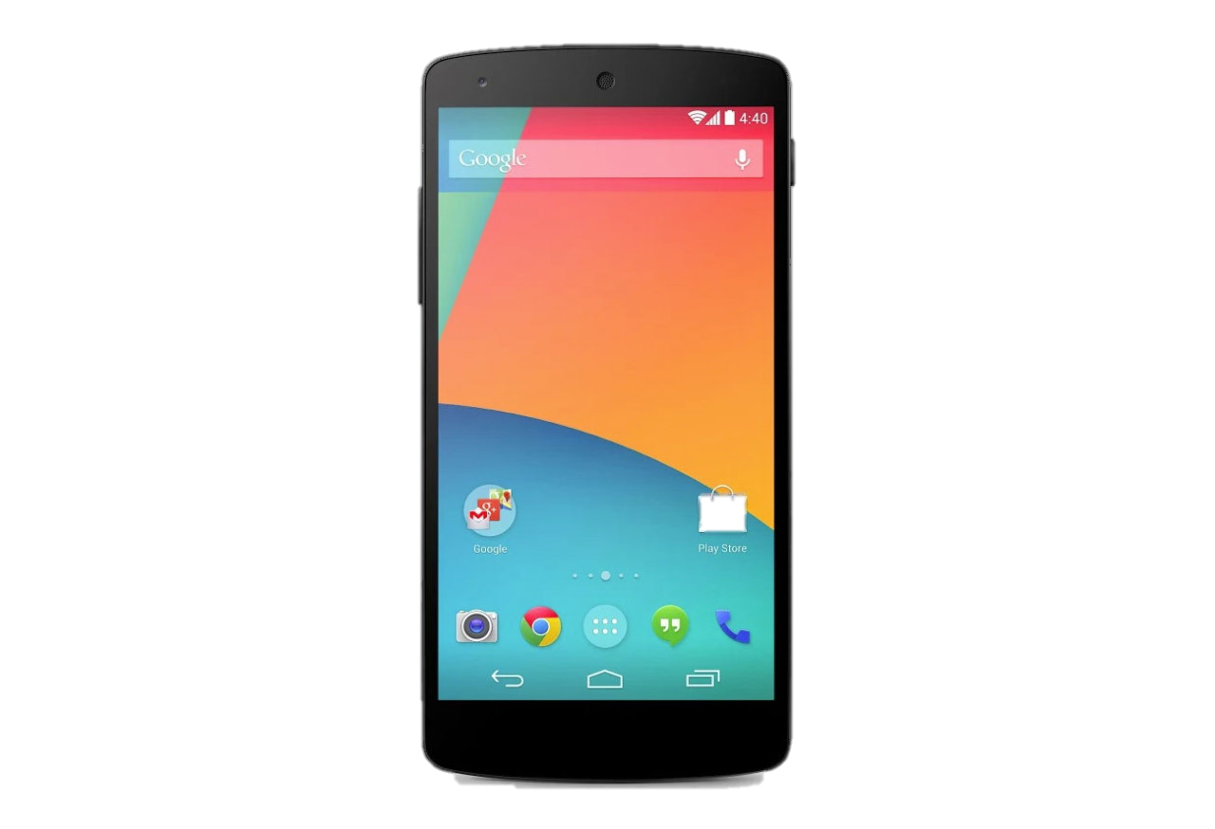

OnTheFly

Slide 3




OnTheFly
Skip for now

Slide 4








OnTheFly
Chat | People | Feed
Kevin
Tomer
Cahterine
Ofer
Gal

