Slide 1


OnTheFly
Alon Grinshpoon (TAU) Rony Jacobson (TAU) Idan Tsitiat (OpenU) Aviad Levy (TAU)

Slide 2

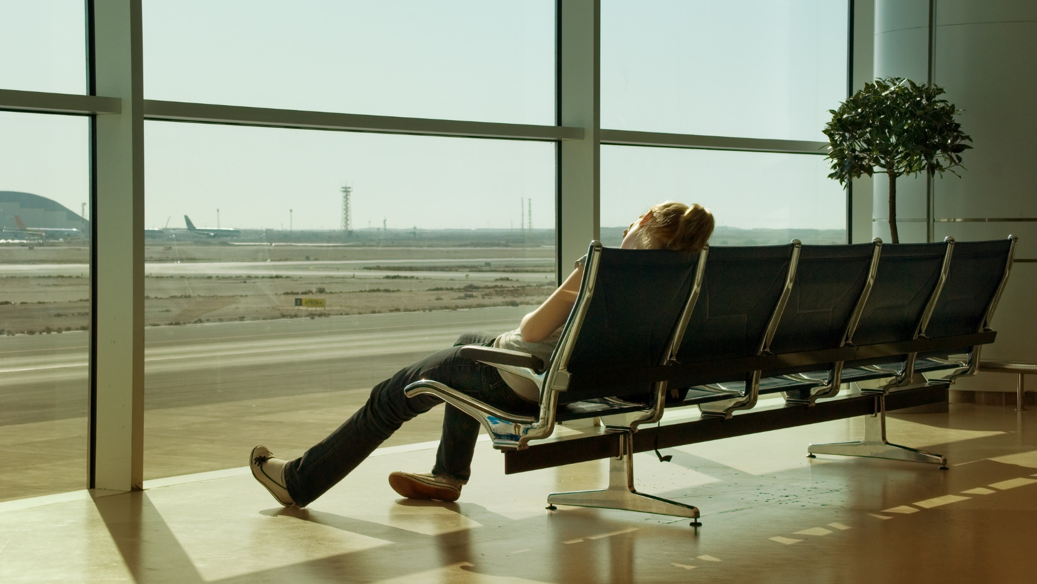
OnTheFly
Networking framework that helps people who have a long connecting flight layover at the airport to connect, hangout and pass time together.

Slide 3
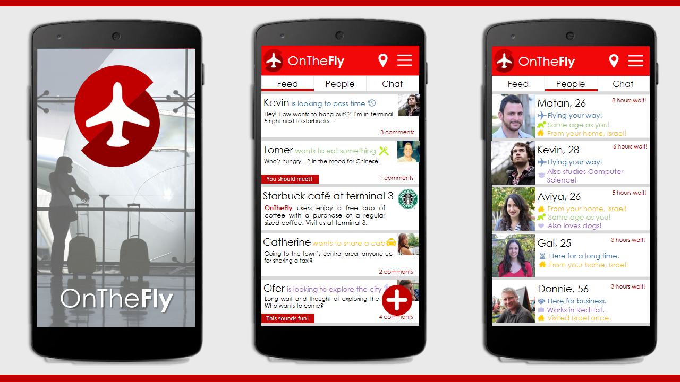

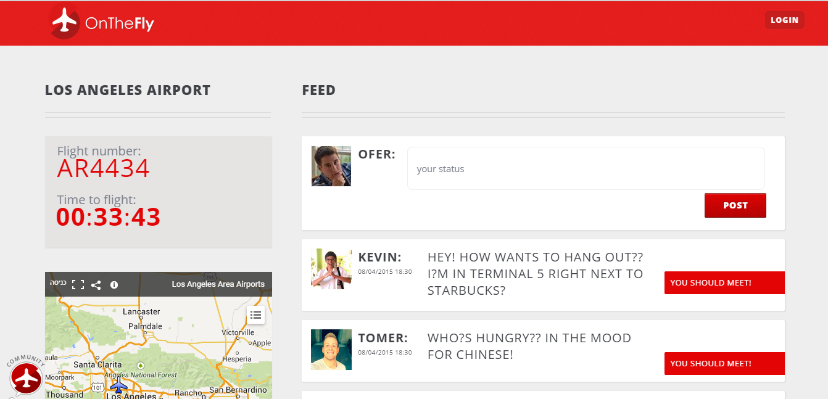
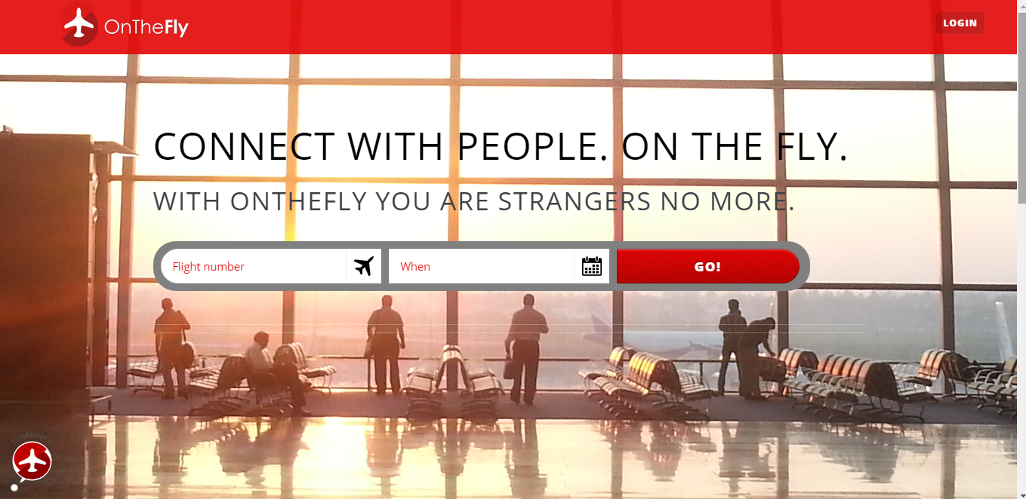
OnTheFly

