Slide 1


Telecom Churn Pattern Mining and Analysis
Course – INFO 523 Data Mining and Discovery
Term – Fall 2024
Instructor – Prof. Yan Han
Team Members – Rony, Ralph, Nitya

Slide 2
Content
Dataset Introduction
Schema Design
Data Integration
Association Rules
Clusters
Visualizations
Classification using ML Models

Slide 3
Dataset Introduction
Dataset is taken from IBM Community Blogs
We have also created our own dataset for the transactions of these customers

Slide 4
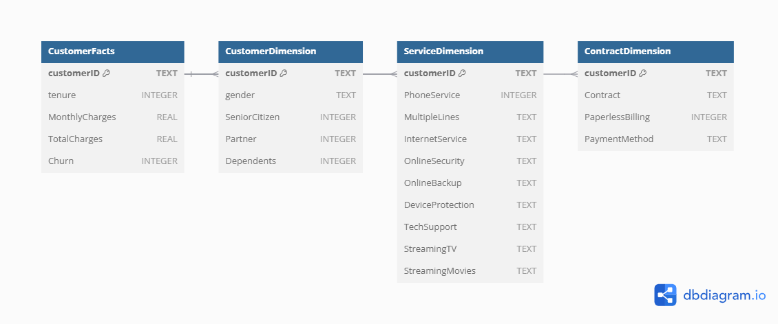
Schema Design for Customer Database

Slide 5
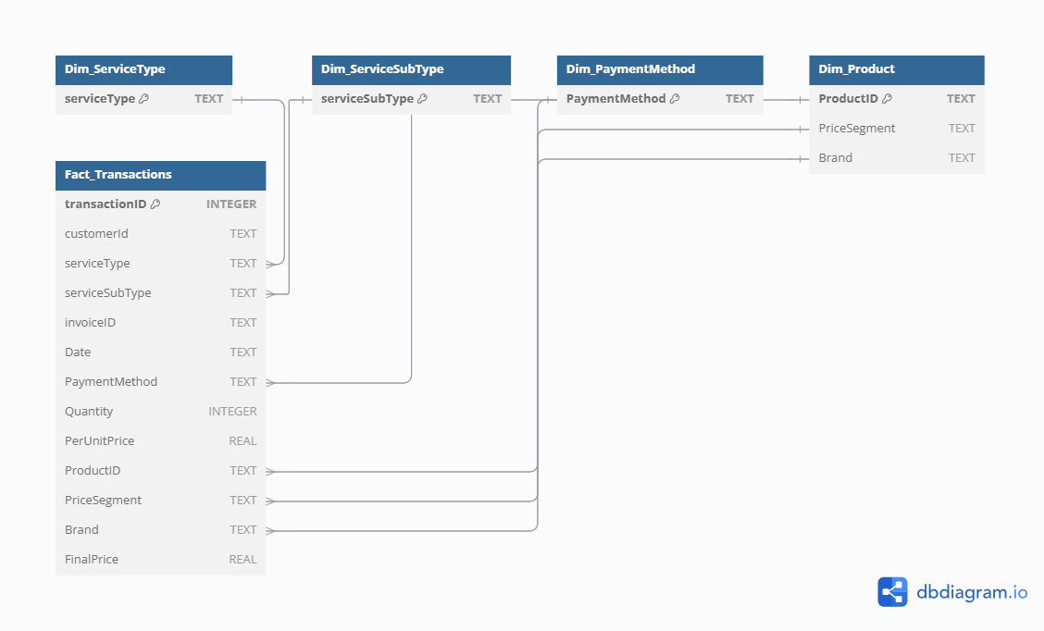
Schema Design for Transactions Database

Slide 6


Database Creation and Data Integration
Libraries used: sqlite3 and pandas
sqlite3 provides support for executing SQL queries directly from Python.
pandas simplifies row-wise operations for data transformation before database insertion.
Fact Table: CustomerFacts holds metrics like tenure, MonthlyCharges, TotalCharges, and Churn.
Dimension Tables:
CustomerDimension for demographics (e.g., gender, senior citizen, dependents).
ServiceDimension for subscription details (e.g., PhoneService, InternetService).
ContractDimension for contract details (e.g., Contract type, Payment method).
Primary Key Consistency:
customerID serves as the primary key across all tables for referential integrity.
SQL Features Used:
Conditional creation of tables with IF NOT EXISTS for idempotency.
Use of FOREIGN KEY constraints to maintain data relationships.
Sequential insertion into four tables: CustomerFacts, CustomerDimension, ServiceDimension, and ContractDimension.
Commit changes after each row to prevent excessive memory usage.
Reuse of customerID across tables ensures data linkage and supports dimensional modeling.

Slide 7
Database Creation and Data Integration
Fact Table: Fact_Transactions
Stores transactional metrics such as transactionID, Date, Quantity, PerUnitPrice, and FinalPrice.
Maintains relationships with all dimension tables via foreign keys.
Dimension Tables:
Dim_ServiceType: Stores unique service types offered.
Dim_ServiceSubType: Captures subtypes of services for detailed categorization.
Dim_PaymentMethod: Lists distinct payment methods for transactions.
Dim_Product: Describes product details, including ProductID, PriceSegment, and Brand.

Slide 8
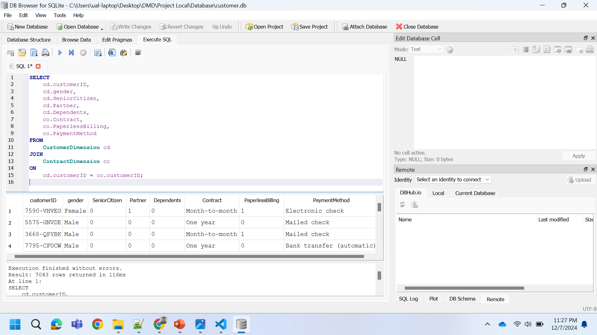
Querying the customer database

Slide 9
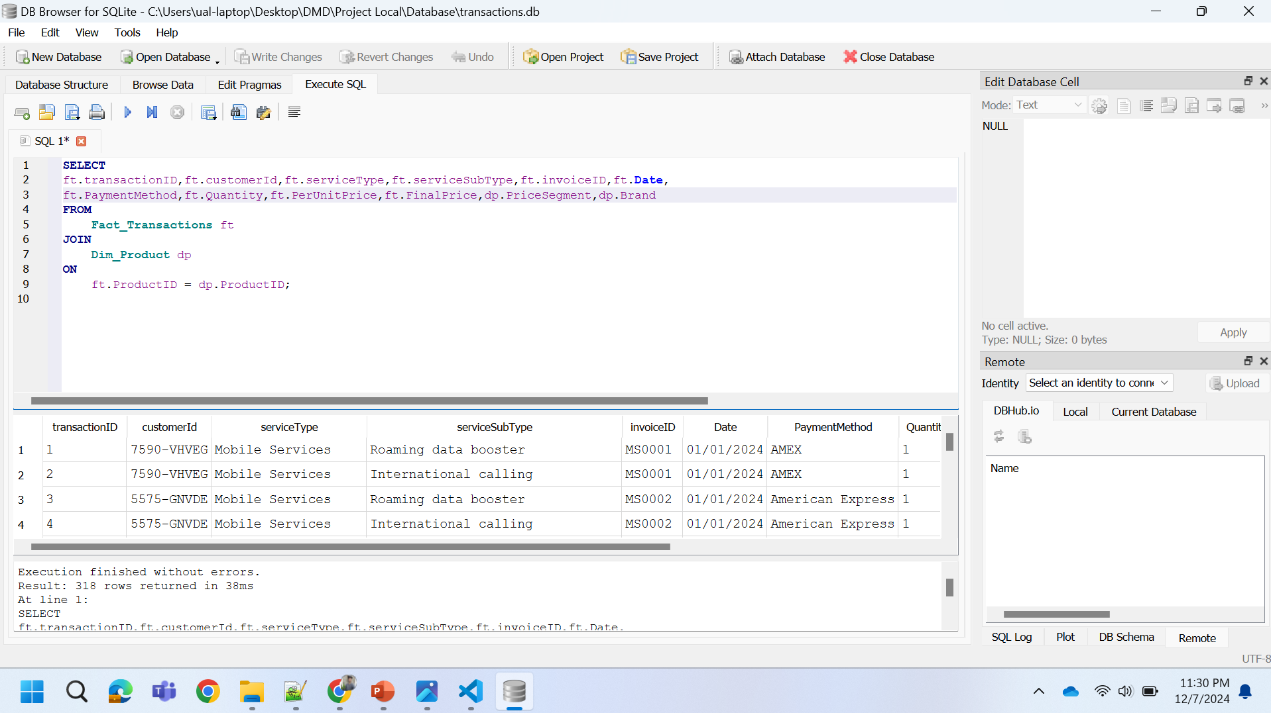
Querying the transactions database

Slide 10
Selecting visual aids
Enhancing your presentation

Slide 11
Effective delivery techniques
This is a powerful tool in public speaking. It involves varying pitch, tone, and volume to convey emotion, emphasize points, and maintain interest:
Pitch variation
Tone inflection
Volume control
Effective body language enhances your message, making it more impactful and memorable:
Meaningful eye contact
Purposeful gestures
Maintain good posture
Control your expressions

Slide 12
Navigating Q&A sessions
Know your material in advance
Anticipate common questions
Rehearse your responses
Maintaining composure during the Q&A session is essential for projecting confidence and authority. Consider the following tips for staying composed:
Stay calm
Actively listen
Pause and reflect
Maintain eye contact

Slide 13

Speaking impact
Your ability to communicate effectively will leave a lasting impact on your audience
Effectively communicating involves not only delivering a message but also resonating with the experiences, values, and emotions of those listening

Slide 14
Dynamic delivery
Learn to infuse energy into your delivery to leave a lasting impression.
One of the goals of effective communication is to motivate your audience.
Metric | Measurement | Target | Actual
Audience attendance | # of attendees | 150 | 120
Engagement duration | Minutes | 60 | 75
Q&A interaction | # of questions | 10 | 15
Positive feedback | Percentage (%) | 90 | 95
Rate of information retention | Percentage (%) | 80 | 85

Slide 15
Final tips & takeaways
Consistent rehearsal
Strengthen your familiarity
Refine delivery style
Pacing, tone, and emphasis
Timing and transitions
Aim for seamless, professional delivery
Practice audience
Enlist colleagues to listen & provide feedback
Seek feedback
Reflect on performance
Explore new techniques
Set personal goals
Iterate and adapt

Slide 16
Speaking engagement metrics
Impact factor | Measurement | Target | Achieved
Audience interaction | Percentage (%) | 85 | 88
Knowledge retention | Percentage (%) | 75 | 80
Post-presentation surveys | Average rating | 4.2 | 4.5
Referral rate | Percentage (%) | 10 | 12
Collaboration opportunities | # of opportunities | 8 | 10

Slide 17
Thank you
Brita Tamm
502-555-0152
brita@firstupconsultants.com
www.firstupconsultants.com

