Slide 1
Introduction and Basic Laws
of
Electrical Engineering
Presented by
Md. Feroz Ali
Assistant Professor
Dept. of Electrical and Electronic Engineering (EEE)
Pabna University of Science and Technology (PUST)

Slide 2
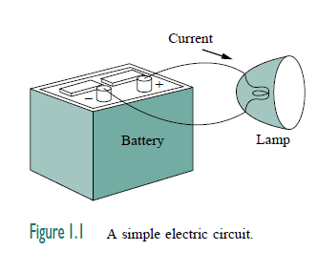
Introduction
An electric circuit is an interconnection of electrical elements that make a close path.

Slide 3

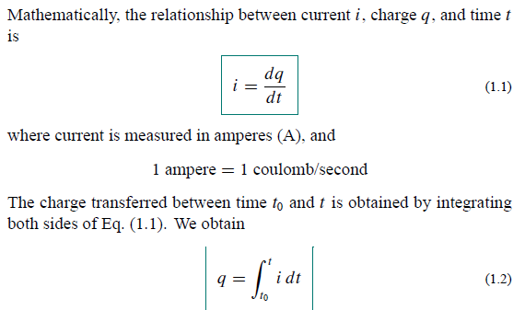

Charge and current

Slide 4
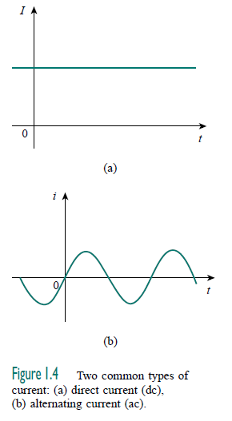


DC and AC

Slide 5

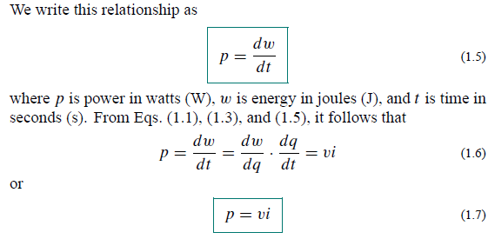



Voltage, Power and Energy

Slide 6

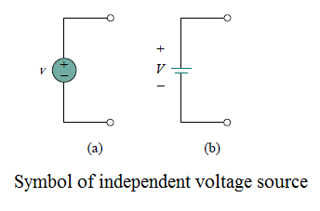
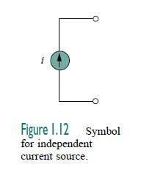
Independent Source

Slide 7

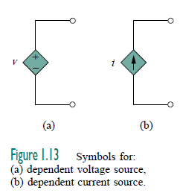

Dependent Source

Slide 8



OHM’S LAW

Slide 9
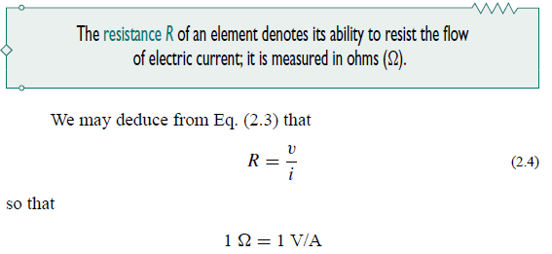
Resistance

Slide 10


Short circuit and Open circuit

Slide 11
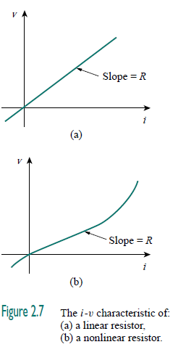
i-v characteristic of Ohm’s law

Slide 12

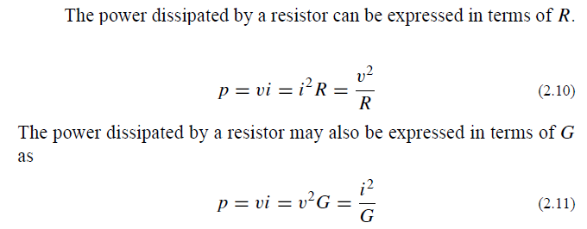

Conductance and power dissipated by a resistor

Slide 13

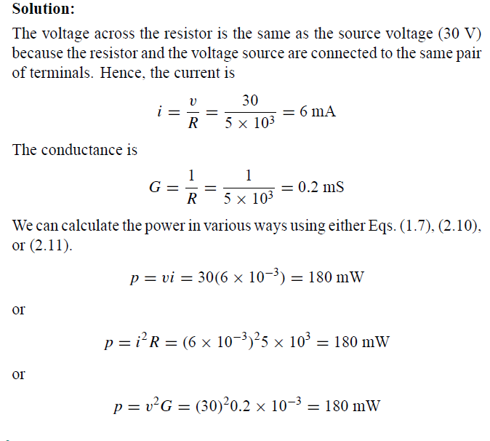

Slide 14

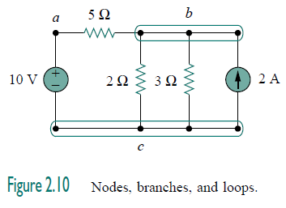


NODES, BRANCHES, AND LOOPS

Slide 15

Series and Parallel connection

Slide 16

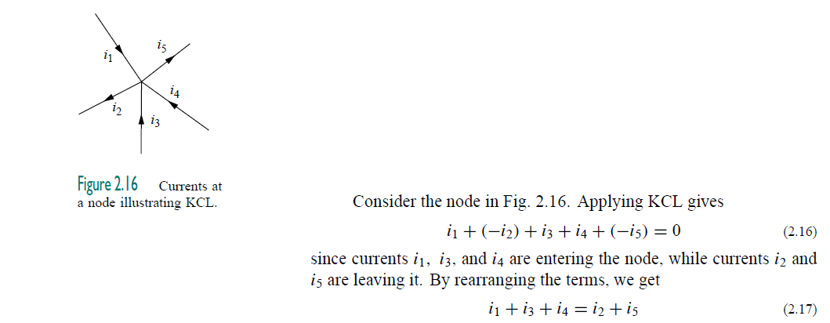


KIRCHHOFF’S CURRENT LAWS (KCL)

Slide 17



KIRCHHOFF’S VOLTAGE LAWS (KVL)

Slide 18
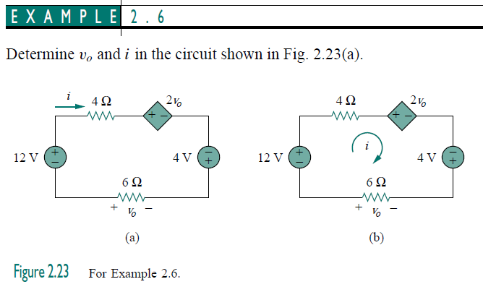
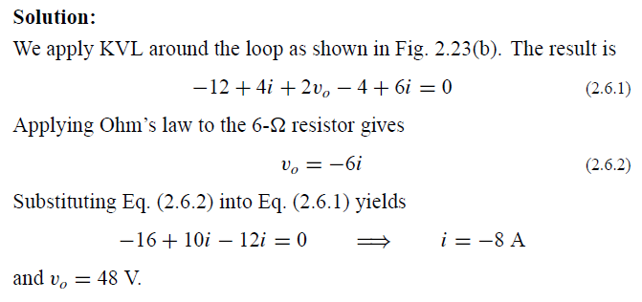

Slide 19
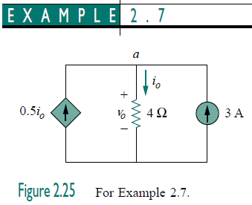
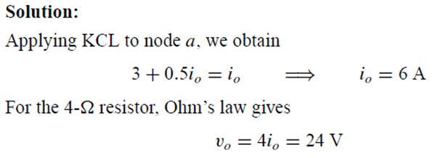

Slide 20
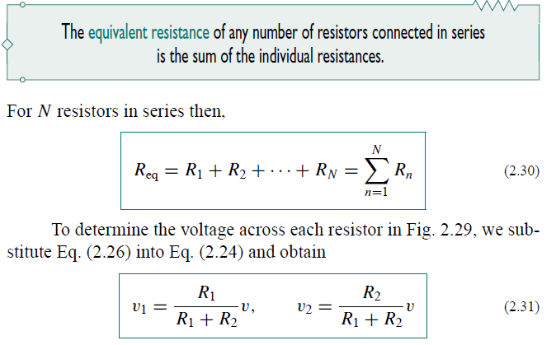
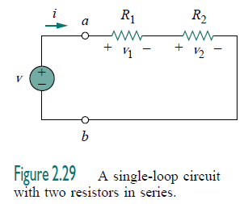





SERIES RESISTORS AND VOLTAGE DIVISION
Voltage divider rules

Slide 21

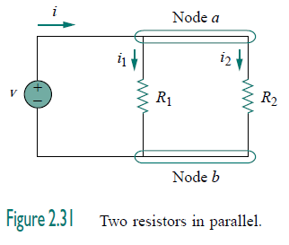
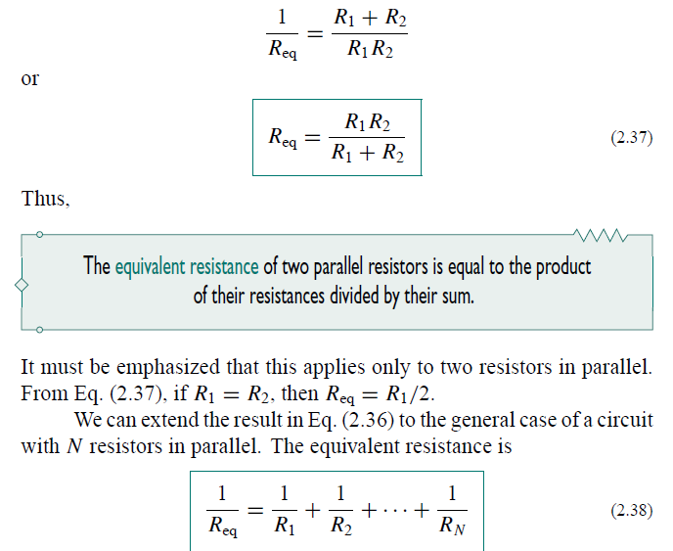


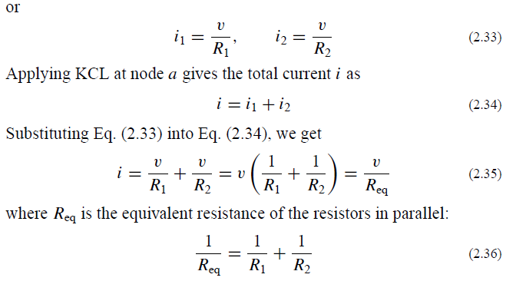

PARALLEL RESISTORS AND CURRENT DIVISION
Current divider rule

Slide 22

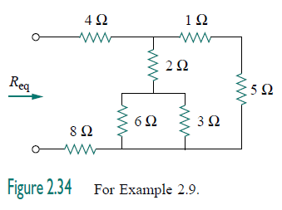
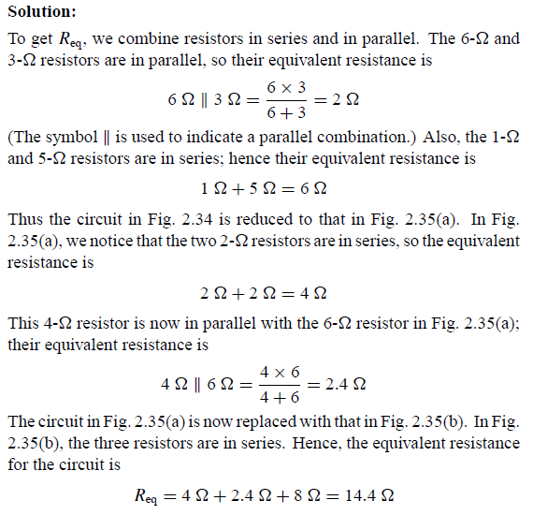
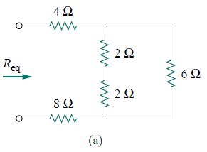
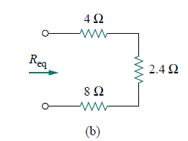

Slide 23
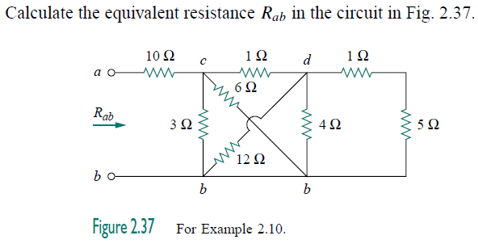
Rab= 11.2 Ω

Slide 24
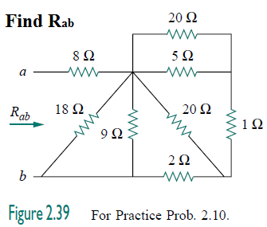
Rab= 11 Ω

Slide 25
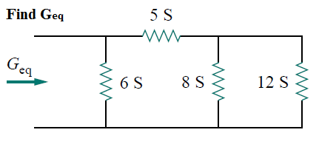
Geq= 10 S

Slide 26
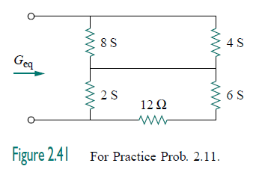


Slide 27
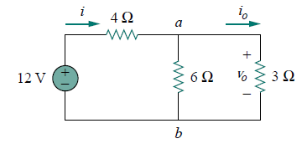
io=1.33 Amp; Vo=4 V P0=5.33 W

Slide 28
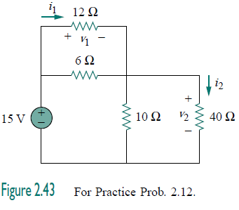


Slide 29
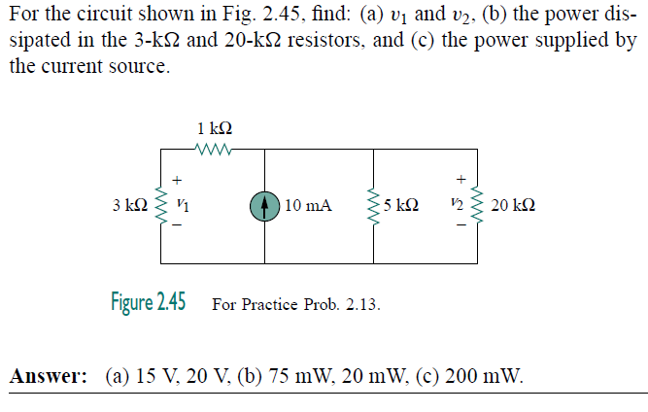

Slide 30
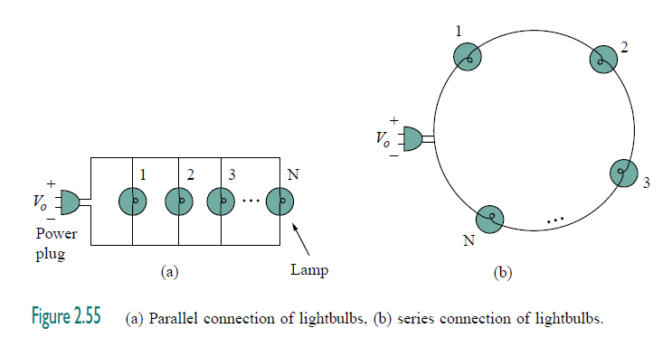
Applications

Slide 31
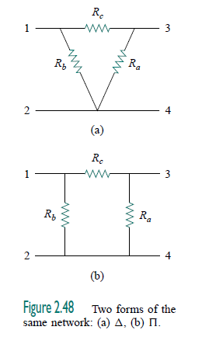
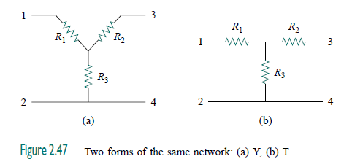
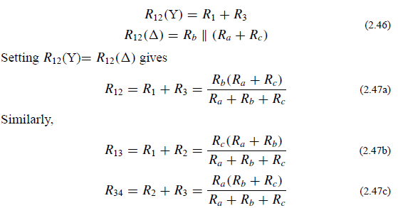
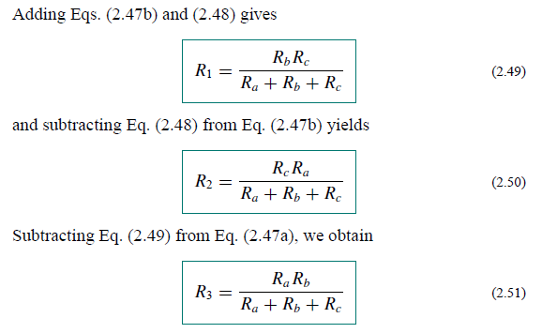
WYE-DELTA TRANSFORMATIONS
Delta to Wye Conversion:

Slide 32
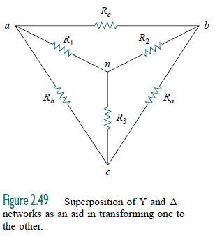
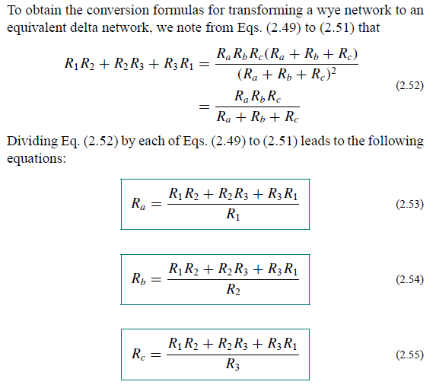
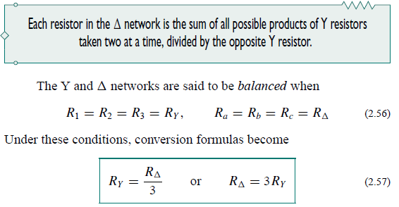
WYE-DELTA TRANSFORMATIONS
Wye to Delta Conversion:

Slide 33

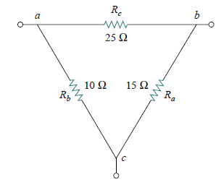
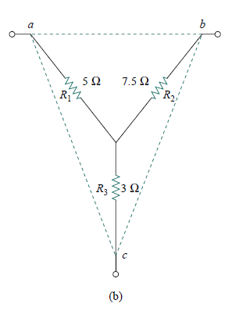
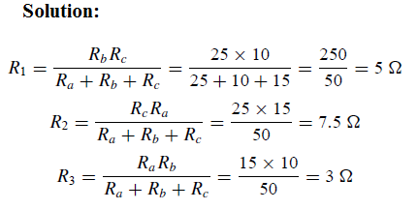

Slide 34
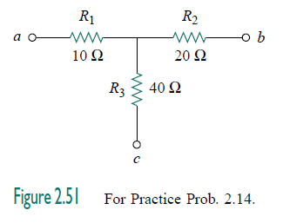


Slide 35
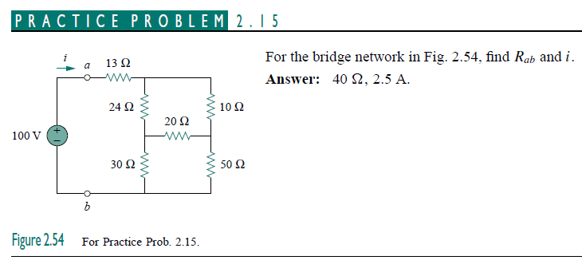

Slide 36
Thanks to all

