Slide 1
From Prompt to Product
Spec-Driven Development with GitHub Spec Kit
A real example on the Heltec WiFi Kit V3
Notes:
Open with a show of hands: who has ever asked an AI coding assistant to 'just build X' from a single sentence? Almost everyone has. This talk is about what happens next -- and about a specific, real embedded-systems example (a temperature monitor on a Heltec ESP32 board) that we'll follow from a vague prompt all the way to tested, working, physically-verified firmware. No prior Spec Kit, embedded, or even AI-agent experience is assumed.

Slide 2
The Vague Prompt
Build an application for a Heltec WiFi Kit V3 that reads a sensor,
shows the value on the display, and shows a warning when the value is too high.
❓ Is this enough information to build the correct product?
Notes:
Read the prompt out loud, slowly. It sounds complete -- it has a sensor, a display, a warning. That's the trap: it reads like a spec but it isn't one. Give the audience a real moment of silence here before moving to slide 3, where we'll pull apart everything this single sentence quietly left undecided.

Slide 3
Everything the Prompt Never Answered
A coding agent still has to answer every one of these -- it just answers them silently, by guessing:
Which sensor is actually connected? (temperature-only? temperature + humidity? which chip?)
How often should the value be sampled -- once a second, once a minute?
What exactly counts as "too high" -- what is the numeric threshold?
What happens right at the threshold -- does it flicker on and off as the value hovers there?
Once the warning is showing, at what point does it clear again?
What should happen if the sensor stops responding or returns garbage?
What should the display show while that error is happening?
What, if anything, gets written to the Serial console for debugging?
Notes:
Each bullet is a real decision, and an unspecified prompt does not remove the decision -- it just moves it into the model's head, where you can't see it, review it, or agree with it. Optionally show examples/prompt-only/naive_monitor.ino here to prove these aren't hypothetical: point out which lines in the real generated code quietly picked an answer to each question above.

Slide 4
The problem is usually not that the AI cannot write the code.
The problem is that the product behavior was not sufficiently defined.
Notes:
This is the one sentence the audience should remember from the whole workshop -- pause for a beat after reading it aloud. Modern AI models are already good enough at writing code; that is not the bottleneck anymore. The bottleneck moved upstream, to deciding *what* the code should do. Spec Kit, which we introduce shortly, is a tool for making that decision-making step explicit and structured instead of implicit and skipped.

Slide 5
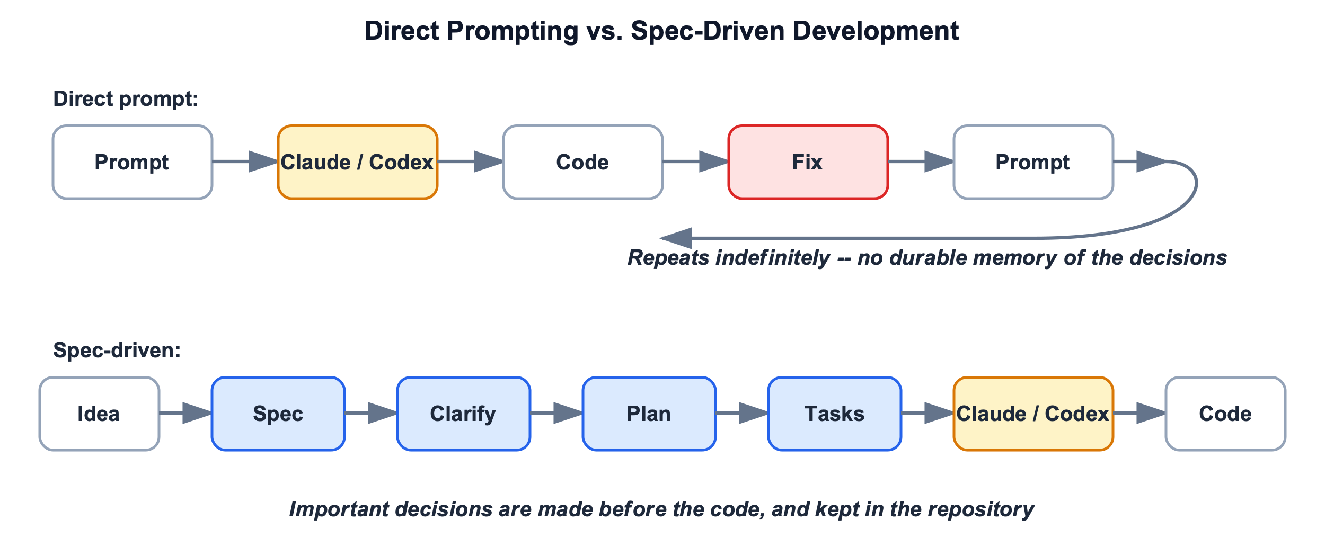
From Prompt to an Infinite Loop
Notes:
Focus only on the TOP half of this diagram for now (we'll come back to the bottom half on the next slide). This is the ordinary loop when you skip specification: prompt -> code -> you notice something is wrong -> you send a follow-up prompt to fix it -> that fix reveals or breaks something else -> repeat. Every 'Fix' box is a product decision that got made *after* code already existed and contradicted it -- which is the most expensive possible time to make that decision, because now there's already code and possibly a user depending on the wrong behavior.

Slide 6
The Alternative: A Spec-Driven Process
Notes:
Now point at the BOTTOM half of the same diagram. The difference is not 'more paperwork' -- it's the same decisions (which sensor, what threshold, what happens on error) being made once, on purpose, in a short clarification step, before any code exists -- instead of one at a time, by accident, after code already exists and needs to be un-written. Same total number of decisions either way; the only thing that changes is *when* they get made, and that timing is the entire value proposition of this workshop.

Slide 7
What Each Stage Catches
Every stage exists to catch one specific kind of mistake -- before it becomes code:
constitution → A rule gets silently broken because nobody wrote it down
specify → We never agreed what this does
clarify → We agreed on the happy path, not the edges
plan → We agreed on what, not how -- and how has real constraints
tasks → We know the plan, not the order or the dependencies
analyze → Two of our own documents quietly contradict each other
implement → (this is the only step prompt-only starts from)
Notes:
Walk through all seven stages briefly here; the deep dive on each one comes later in the Heltec walkthrough section.

Slide 8
What Is GitHub Spec Kit -- and Why Does It Exist?
It's an open-source toolkit published by GitHub (github.com/github/spec-kit) -- free, not a product you buy.
Concretely, it is two things: a small command-line tool called specify, plus a set of Skills/Commands (the /speckit-... commands we've been showing) that it installs into your AI coding agent -- Claude Code, Codex, or others.
Spec Kit does not write your application code itself, and it is not an AI model. It structures the *process* a human and an AI agent go through together before and while code gets written: agree on rules, write down requirements, resolve ambiguity, plan the technical approach, break work into tasks, cross-check everything for contradictions, then implement.
Why GitHub built it: as AI coding agents got fast enough to generate whole features in seconds, teams found the code was rarely the bottleneck anymore -- unclear or unstated requirements were. This pattern is called "spec-driven development," and Spec Kit is GitHub's tooling for it: a practical way to keep the speed of an AI agent without giving up the discipline of knowing what you're actually building.
📷 Spec Kit website + GitHub repo
(real screenshot missing -- see screenshot-checklist.md)
Notes:
This slide is the anchor for the whole talk -- take your time. Key points to say out loud: (1) it's from GitHub, it's free and open-source, this is not a pitch for a paid product; (2) it doesn't replace Claude Code or Codex -- those are the agents that actually write code, Spec Kit is the structured process layer on top of them (this gets its own diagram two slides from now); (3) the motivating problem is exactly what slides 2-4 just showed: fast code generation exposed how much of the real work is actually deciding what to build. If time allows, briefly show the real Spec Kit GitHub repo and its README (screenshots #1-2 on the checklist) so the audience sees this is a real, actively maintained project, not a one-off script.

Slide 9
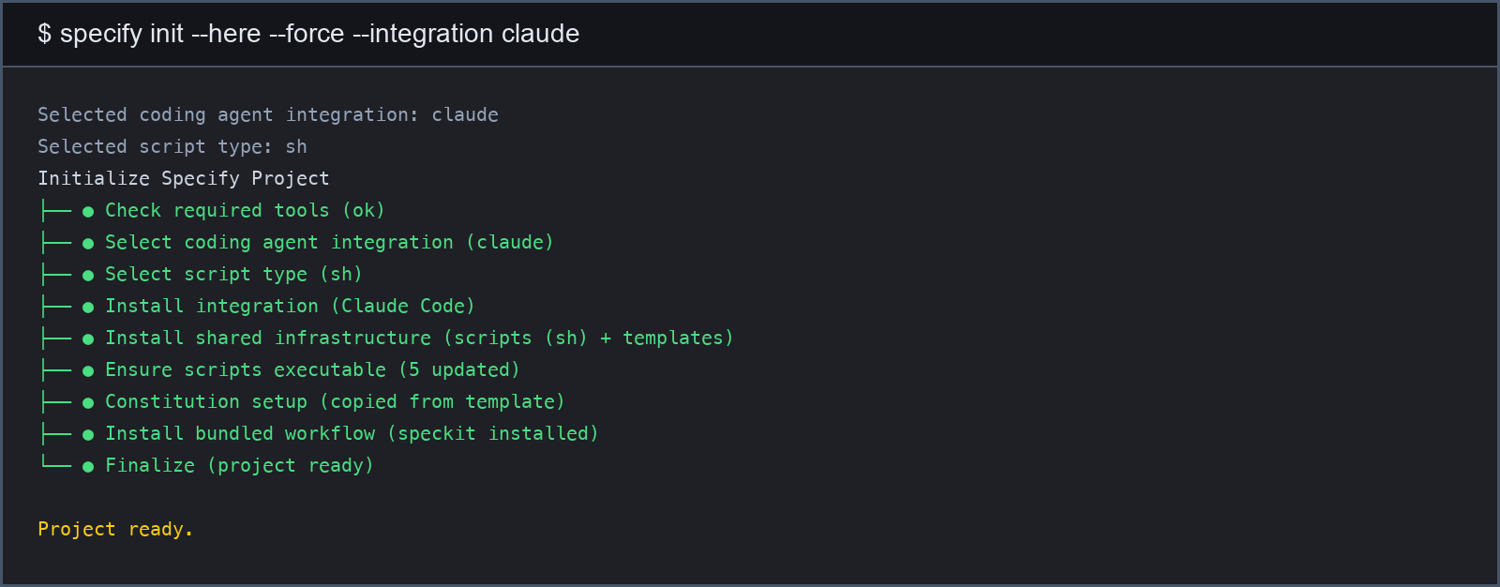
Installation
uv tool install specify-cli
specify init --here --integration claude
Notes:
The first line installs the specify CLI itself (a one-time setup, via the uv Python tool). The second line runs it inside an existing project folder and tells it which agent to wire up -- here, Claude Code. This creates a .specify/ folder (templates, scripts, the project constitution) and a .claude/skills/ folder with the /speckit-... commands. The terminal output below is the real, unedited output captured from this repository's own initialization -- nothing here is staged or simulated.

Slide 10
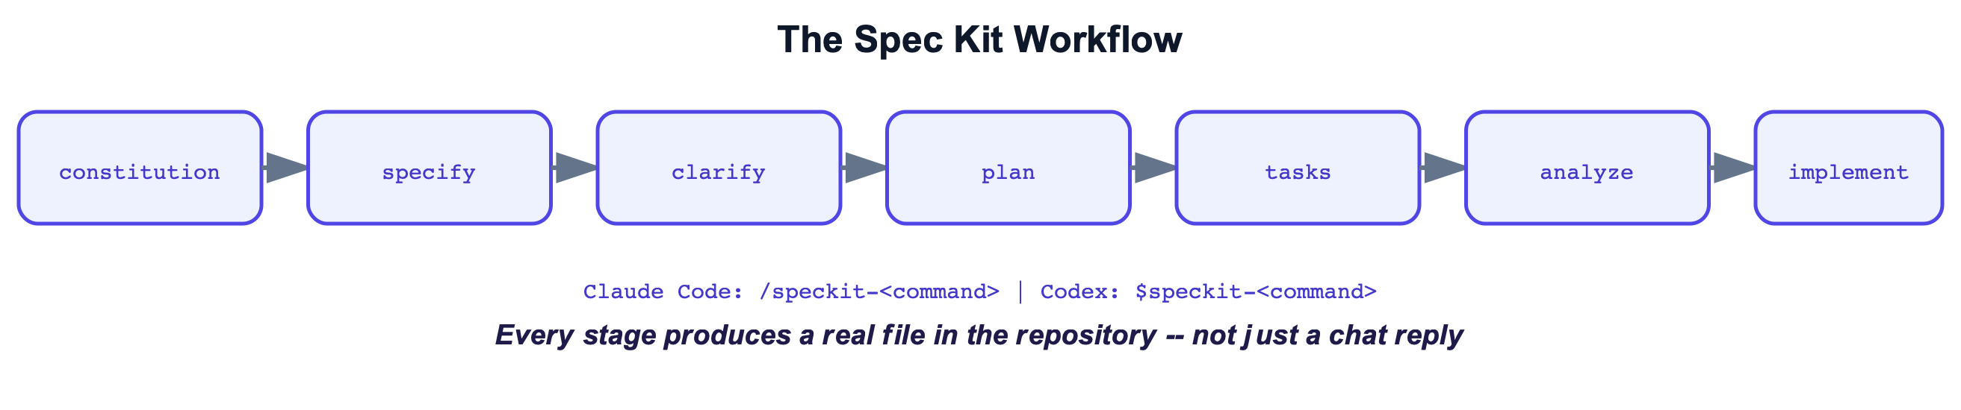
The Workflow in Seven Stages
Notes:
Don't dive into command syntax yet -- the goal here is just the mental model of the pipeline: constitution (project-wide rules, written once) -> specify (what are we building) -> clarify (resolve the ambiguous parts) -> plan (technical approach) -> tasks (break the plan into ordered, checkable steps) -> analyze (automatically cross-check spec/plan/tasks for contradictions) -> implement (the agent writes the code). Each stage produces a real file in the repo, which is the subject of the next slide. We already previewed *why* each stage exists on slide 7 -- this slide is the order they run in.

Slide 11
The Output: Real Files in the Repository
specs/001-heltec-monitor/{spec,plan,tasks}.md
Every stage writes plain Markdown files into the repository -- they are committed to git like any other source file.
That's the opposite of a chat conversation, which lives in one tool, is easy to lose, and is hard for a second person (or a second AI agent) to pick up later.
Practical payoff: you can close the chat, switch from Claude Code to Codex, or come back to the project a month later, open spec.md, and see exactly what was decided and why -- without reconstructing it from memory.
Notes:
This is a good moment to actually open specs/001-heltec-monitor/spec.md in the editor if you have it up, even just to scroll through it -- seeing a real, readable Markdown file (not code, not JSON) tends to de-mystify the whole idea for a novice audience.

Slide 12
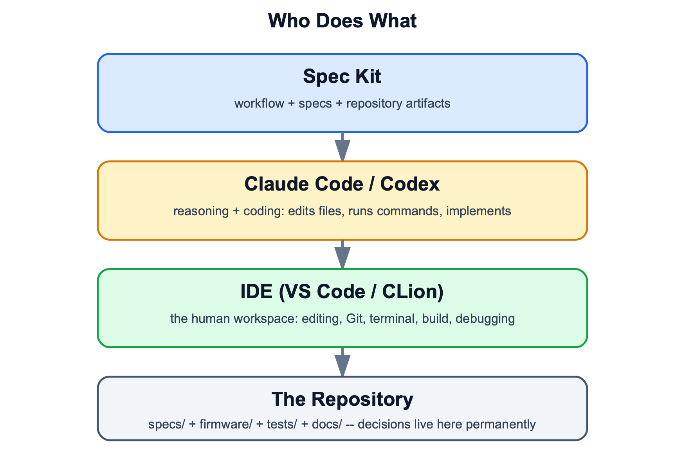
Who Does What
Notes:
Say this explicitly, it's the most common point of confusion for newcomers: Spec Kit is not a coding agent and does not write code. Claude Code or Codex are the agents that actually read the spec/plan/tasks files and write the firmware. The IDE (VS Code, CLion/JetBrains) is just the human's workspace for reading and editing files alongside the agent. So the stack is: IDE (human) + coding agent (does the work) + Spec Kit (the structured process the agent follows) -- three separate, replaceable layers, not one product.

Slide 13
Same Repo, Two Agents
Claude Code → /speckit-specify (.claude/skills/)
Codex → $speckit-specify (.agents/skills/)
Same command, same underlying files, same result -- only the invocation syntax differs because each agent has its own convention for triggering a custom command.
This isn't a theoretical claim -- this exact repository has both integrations installed side by side, and either agent can pick up the work where the other left off.
📷 Claude Code + Codex session (same repo)
(real screenshot missing -- see screenshot-checklist.md)
Notes:
Live screenshots #6-7 on the checklist would go here. If you have a live terminal available, it's worth actually running /speckit-specify in one agent and $speckit-specify in the other against this repo to show it's the same underlying skill, just a different trigger syntax per agent.

Slide 14
VS Code, Briefly
Two VS Code extensions do all the real work here: PlatformIO IDE (builds and flashes the firmware, manages the ESP32 toolchain) and C/C++ (syntax highlighting and navigation for the firmware source).
Everything else in this workshop -- Spec Kit's commands, Claude Code, Codex -- works the same way regardless of editor.
If you use JetBrains/CLion instead: same repository, same files, same Spec Kit commands, just a different terminal and a different set of keyboard shortcuts.
Notes:
Keep this brief -- the point is that the editor is the least important choice in this whole workflow. Don't get pulled into an extensions debate; two extensions is the whole list.

Slide 15
Direct Prompting vs. Spec Kit
Same underlying agent, same target hardware -- what changes is where each of these things lives:
Requirements — Live in chat history → Live as repository files
Clarifications — Agent assumes on its own → Explicit clarification stage
Traceability — Low → High
Repeatability — Low-to-medium → High
Notes:
Traceability here means: can you point to the exact moment and reason a requirement was decided? Repeatability means: if you handed this same spec to a different agent, or ran the process again, would you land on roughly the same result? Both are naturally low with a single ad-hoc prompt because nothing was written down -- and naturally higher with Spec Kit because the requirements are files, not memory.

Slide 16
And Why Not Just "Another Framework"?
Spec Kit is not the only tool in this space -- it's worth knowing it's a design point on a spectrum, not the only option.
OpenSpec
covers similar territory -- write specs before code -- with its own template and command conventions.
BMAD (Breakthrough Method for Agile AI-Driven Development)
goes further: multiple defined AI roles (analyst, architect, developer, QA) handing work off to each other, which adds real structure but also real overhead for a small project.
Spec Kit deliberately sits in the middle: more structure than a bare prompt, far less ceremony than a multi-role framework -- which is why it fits a small embedded-firmware example like this one.
Notes:
Not a framework survey -- don't spend more than a minute here, this isn't the point of the workshop. The only message worth landing: this is a spectrum (no process -> Spec Kit -> heavier multi-agent frameworks), and the right amount of process depends on project size and team size.

Slide 17
The Hardware, Verified
The board we're actually building for: a Heltec WiFi Kit V3, which is an ESP32-S3 microcontroller with a built-in small OLED display, plus an external BME280 sensor (temperature/humidity/pressure) wired to it over I2C.
The board has no built-in environmental sensor -- so "which sensor" from slide 3 was never a technical detail, it was a real product decision someone had to make before any code could be correct.
One surprising, easy-to-get-wrong technical detail: on this specific board, the built-in display's I2C pins are GPIO 17/18, not the ESP32's usual default I2C pins (21/22) -- get this wrong and the display simply stays blank with no error message.
Notes:
This slide exists to establish real hardware credibility before we compare the two build approaches -- everything from here on is grounded in an actual physical board, not a toy example.

Slide 18
Stage A: Prompt Only
The point of this comparison: implicit assumption vs. explicit decision -- not "bad code vs. good code."
To keep the comparison fair, the hardware wiring (I2C pins, the Vext power-enable sequence) is correct in both the prompt-only version and the spec-driven version -- wiring mistakes are not the story here.
What genuinely differs is everything the original prompt never specified: exactly which sensor to use, the precise numeric threshold, and whether the warning needs any tolerance band (hysteresis) around that threshold.
The clearest example: the prompt-only version has no hysteresis at all. That is not a coding bug -- the code does exactly what a reasonable reading of the prompt implies. It's the direct result of a requirement that was simply never stated.
Notes:
Visual: examples/prompt-only/naive_monitor.ino. If you have it open, scroll to the threshold check and point out there is exactly one comparison (value > 30) with no second condition for clearing the warning -- that single missing 'else' branch is the whole hysteresis story, and it's coming up in detail on slide 20.

Slide 19
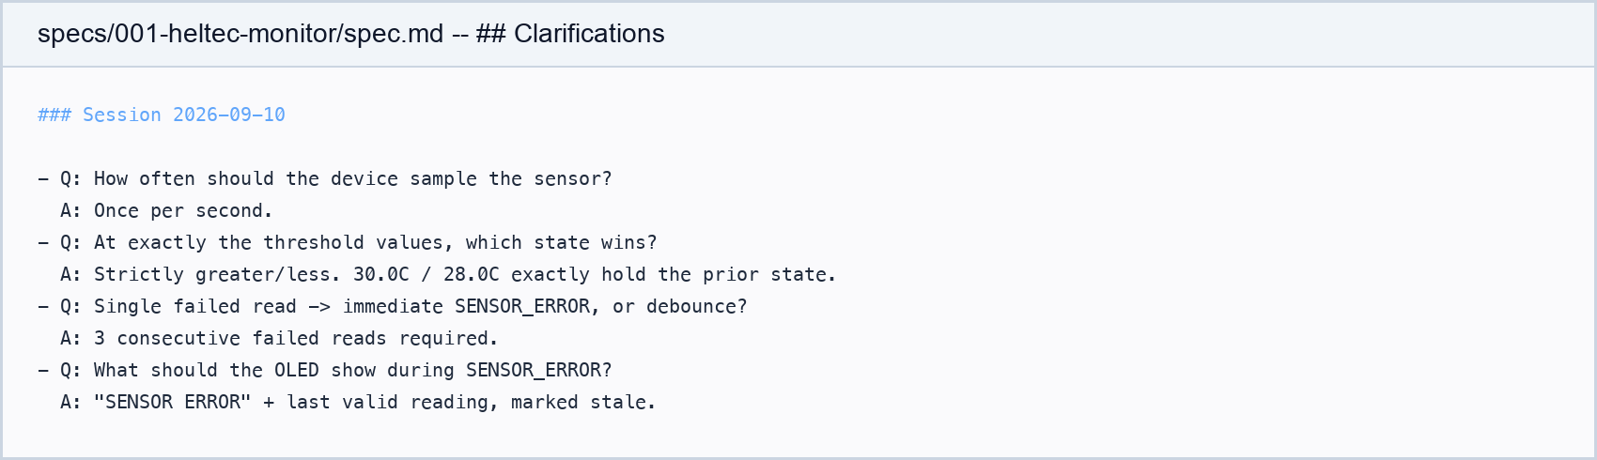
Stage B-C: Specify + Clarify
specify writes down what the product should do, in plain language, without touching code yet -- essentially a first draft of spec.md.
clarify then asks the human targeted questions about exactly the gaps from slide 3, recording each answer directly into the spec. Below is the real transcript:
Notes:
This is the real clarify transcript from this project, not a mockup. Point out that these are exactly the kind of questions a careful human reviewer would ask -- the agent is just asking them earlier, before writing any code, and recording the answers so they're never lost.

Slide 20
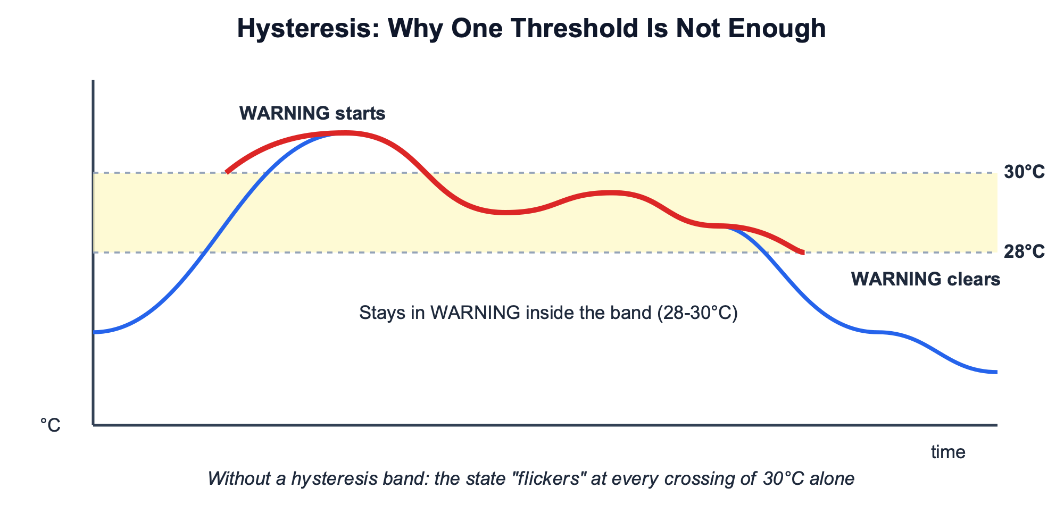
Hysteresis: The Clearest Example
Notes:
Walk through the diagram left to right: temperature crosses 30°C, WARNING turns on. Without a tolerance band, the moment temperature drops back to 29.9°C the display would flip straight back to OK, then back to WARNING at the next tiny fluctuation -- flickering on every crossing of a single number. The band (here, 28-30°C) means once WARNING is on, it *stays* on anywhere inside the band, and only clears once the temperature drops below the lower edge (28°C). This is not a programming problem to be debugged -- it is a product decision (how much tolerance is acceptable) that had to be made before a single line of the state machine was written, which is exactly the kind of decision the clarify stage exists to surface.

Slide 21
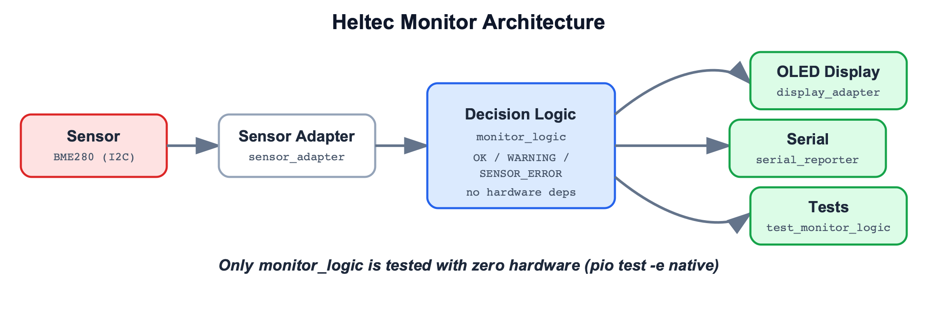
Stage D-E: Plan + Tasks
Notes:
plan turns the now-clarified requirements into a concrete technical approach: which board, which libraries, and critically, an architecture split into three separable pieces -- a sensor adapter, pure decision logic with zero hardware dependencies, and an OLED/Serial reporter. tasks then breaks that plan into small, ordered, checkable steps an agent (or a human) can execute one at a time. The architecture split shown here is what makes the next slide's automated testing possible: because the decision logic touches no hardware, it can be tested on a laptop with no Heltec board plugged in at all. If you want to also show the raw files, screenshots #10-11 on the checklist are plan.md and tasks.md themselves.

Slide 22
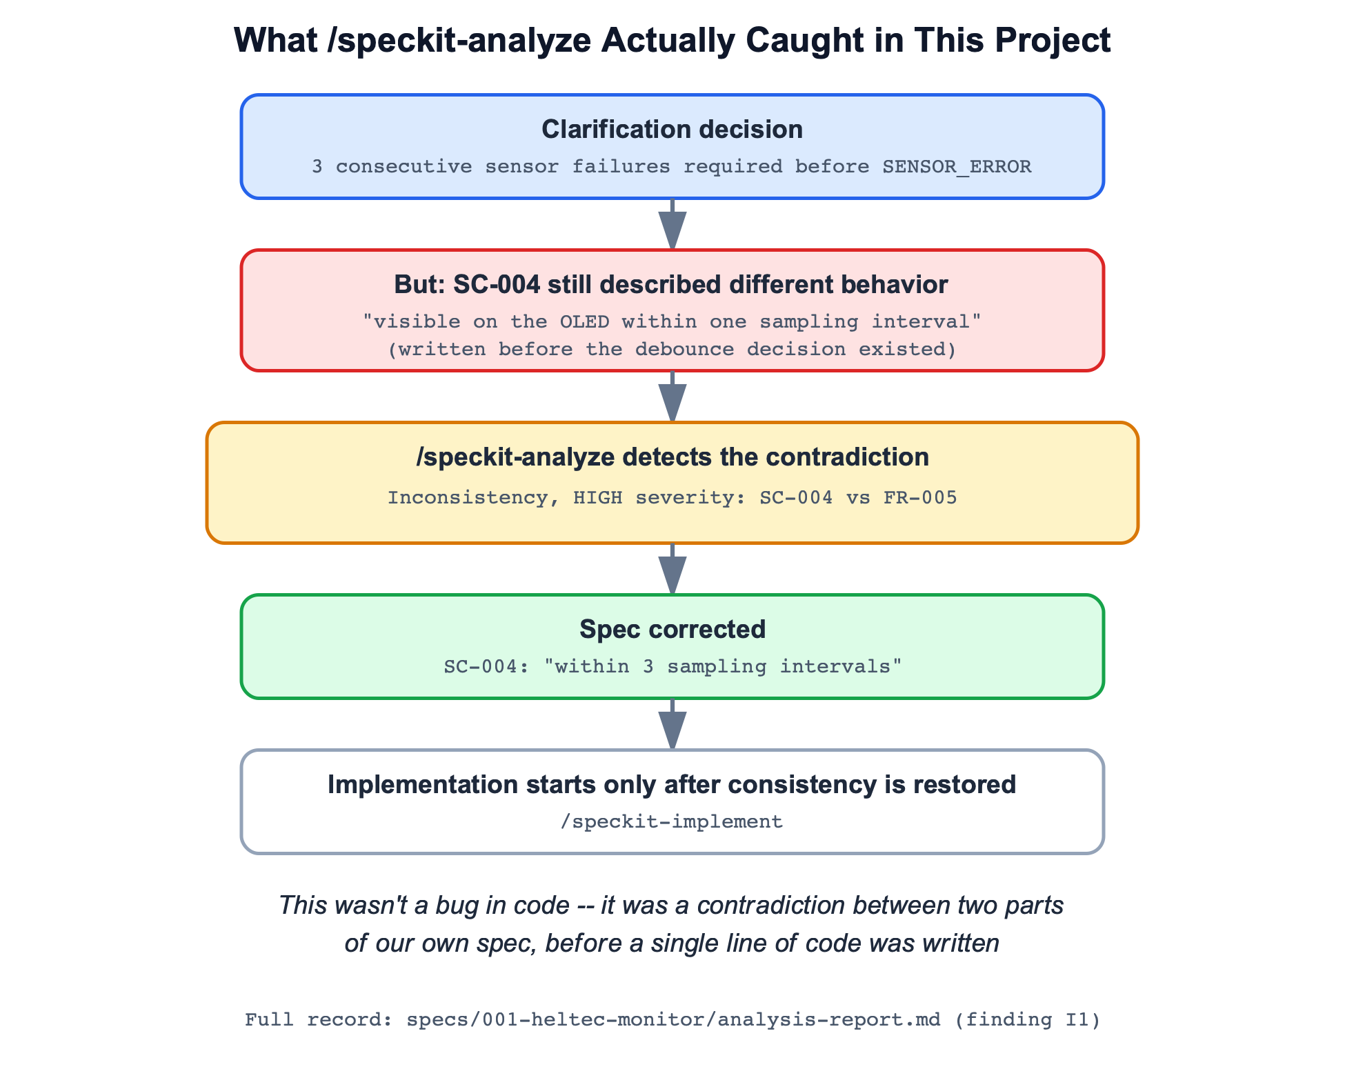
⭐ Stage F: Analyze Finds a Real Contradiction
Notes:
The most important slide in the whole talk -- do not rush through it. Walk through each of the five boxes: (1) during clarify, we decided the warning should stay on inside the hysteresis band; (2) but a separate success criterion (SC-004), written earlier, still described the old, simpler on/off behavior -- nobody noticed the two now disagreed; (3) /speckit-analyze, which cross-checks spec/plan/tasks against each other automatically, caught that contradiction; (4) the spec was corrected on the spot; (5) implementation only began after the documents agreed with each other. This is not a made-up example built for this talk -- it genuinely happened while building this exact project, and the full record is preserved in specs/001-heltec-monitor/analysis-report.md. If you have a terminal, show it live: git show b91cd94 -- specs/001-heltec-monitor/spec.md reproduces the exact diff.

Slide 23
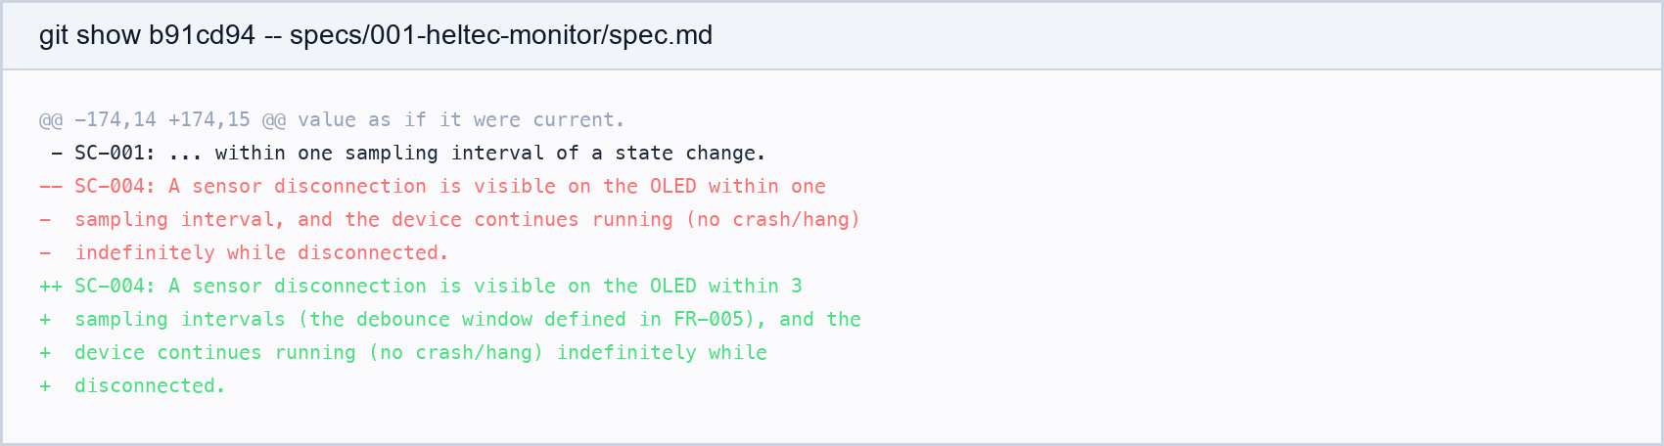
/speckit-analyze didn't find a syntax problem or a code bug.
It found that our own requirements contradicted each other -- before a single line of code was written.
Notes:
The strongest demonstration of Spec Kit's value in the entire talk -- if the audience remembers one concrete moment from this workshop, it should be this one. The image below is the real diff: the old wording of SC-004 on the left/red, the corrected wording on the right/green, showing the success criterion updated to match the hysteresis decision from clarify. Emphasize: no code had been written yet when this was caught -- fixing a contradiction between two Markdown documents costs a few seconds; fixing the same contradiction after it had already become two conflicting pieces of firmware behavior would have cost far more, and might not have been caught at all without a hardware test that exercises that exact edge case.

Slide 24
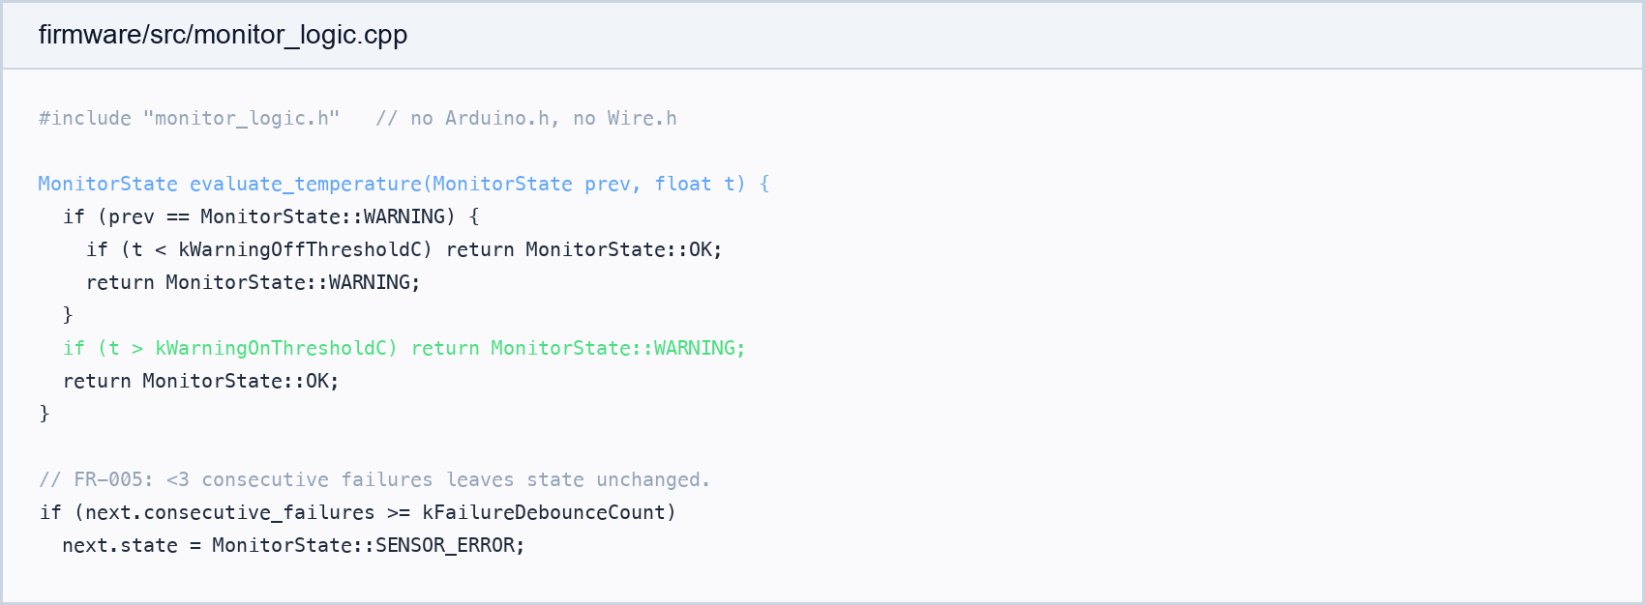
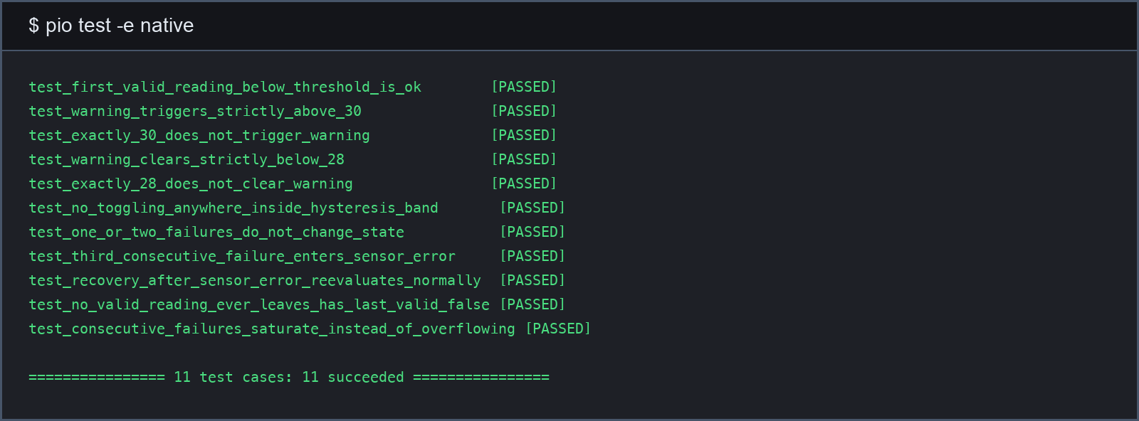
Stage G: Implement
monitor_logic is fully tested with zero hardware
(pio test -e native, 11/11 passed)
Notes:
implement is the stage that finally writes the actual firmware code, following plan.md and tasks.md in order. Because the decision logic (monitor_logic, shown above) was designed with zero hardware dependencies back in the plan stage, it can be exercised by an automated test suite running natively on a laptop -- no Heltec board, no serial cable, nothing physical required. The panel on the bottom-left is the real, unedited output of that test run: 11 out of 11 tests passing. This is why we can already have high confidence in the decision logic itself before ever touching real hardware -- what's still unverified is only the physical wiring, sensor, and display, which is exactly what the next two slides are about.

Slide 25
Live Demo
Normal temperature → OK
Warming above 30°C → WARNING
Partial cooling (28-30°C) → stays WARNING (the single most important point)
Cooling below 28°C → back to OK
If there's time: disconnect the sensor → SENSOR_ERROR
📷 Serial output + OLED photo
(real screenshot missing -- see screenshot-checklist.md)
⏳ Pending physical hardware verification (checkpoint 09-hardware-verified)
Notes:
Everything on this slide depends on the physical hardware test, which hasn't happened yet.

Slide 26
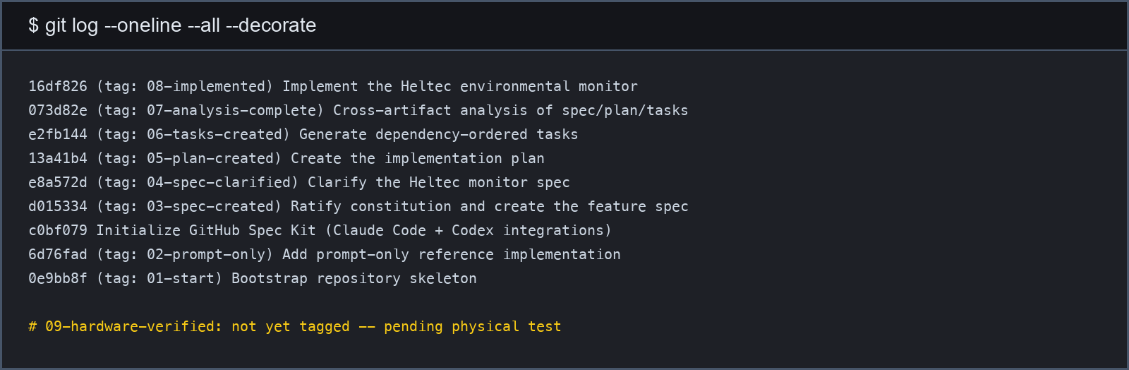
Git Checkpoints
⏳ Tag 09-hardware-verified does not exist yet -- pending physical test
Notes:
Every stage already exists as a tag in the repository -- the demo doesn't depend on a live AI run that could fail on stage.

Slide 27
Five Things to Remember
• AI coding speed does not remove the need for clear requirements
• Spec Kit gives a repeatable path from idea to implementation
• Claude Code and Codex are the agents; Spec Kit is the process and structure
• The spec, plan, and tasks live in the repository -- they don't disappear into a chat
• The best proof: not that it generates code, but that it forces answers to important questions before the wrong code gets written

Slide 28
Links and Credits
Spec Kit: github.com/github/spec-kit
Spec Kit docs: github.github.io/spec-kit
Claude Code docs: docs.claude.com/en/docs/claude-code
Codex docs: developers.openai.com/codex
PlatformIO: platformio.org
Heltec WiFi Kit 32 (V3): heltec.org/project/wifi-kit32-v3
Companion repository: (to be filled in after publishing)
Notes:
See presentation/slide-links.md for the full list.

