Slide 1
Machine Learning applied to Systems (294-162)
Joseph E. Gonzalez
jegonzal@Berkeley.edu

Slide 2
Why Apply Machine Learning to Systems Problems?
Optimal system policies or configuration may depend on input distribution or future state
System state can be difficult to model or partially observed
User’s objectives (utilities) may be unknown but indirectly observed

Slide 3
Early Success of “Machine Learning” in Systems
Expert systems for hardware configuration selection
XCON (late 1970s) – Rule based system to chose optimal DEC VAX configuration
Branch Prediction
In general a “learning based” technique
Perceptron branch prediction AMD Chips (2012)
Downsides/issues?
Learned cost models for query planning(early 2000s)
Packet Classification without deep inspection (early 2000s)
Notes:
Issue: computationally costly and learning algorithm stores information about workload
A survey of techniques for internet traffic classification using machine learning: https://ieeexplore.ieee.org/document/4738466

Slide 4
Early Issues Applying ML to Systems
Early ML techniques were brittle and difficult to tune
Still are?
Difficult to reason about “failure-modes”
Heavy computational costs associated with ML
Simple heuristics often “good enough”

Slide 5
Recent resurgence of interest in ML for Systems
Large-scale systems have elevated the need for learning based approaches
Recent progress in deep learning and its applications to ”hard problems” has generated renewed interests
Several recent efforts have demonstrated potential
From this week’s readings highlights 3 such papers

Slide 6
The Case for Learned Index Structures
Explores the idea of leveraging “over-fitting” to replace memory intensive data structures with compute intensive models.
Generated a lot of interests when first published
Hacker News, Stanford Response
Big issue -- updates -- is addressed in follow-up paper: ALEX: An Updatable Adaptive Learned Index

Slide 7
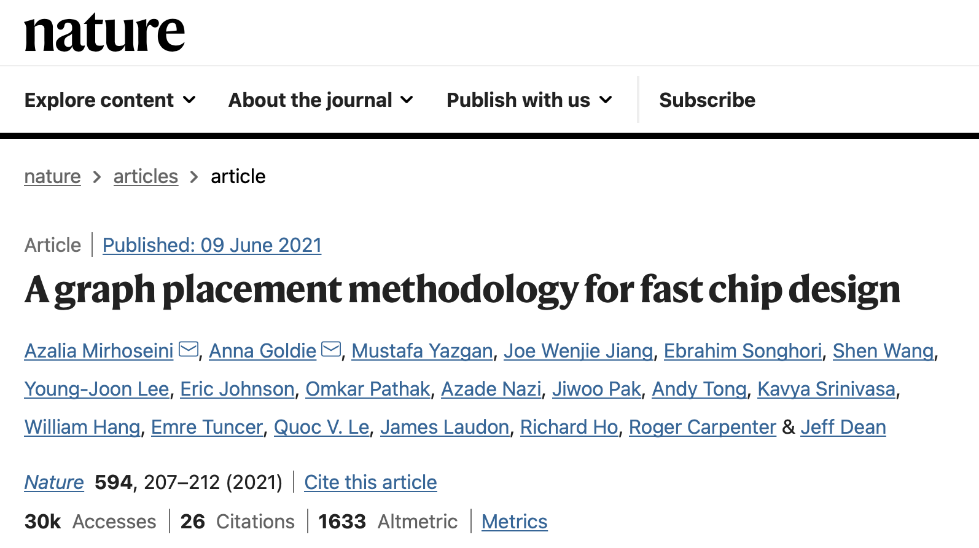

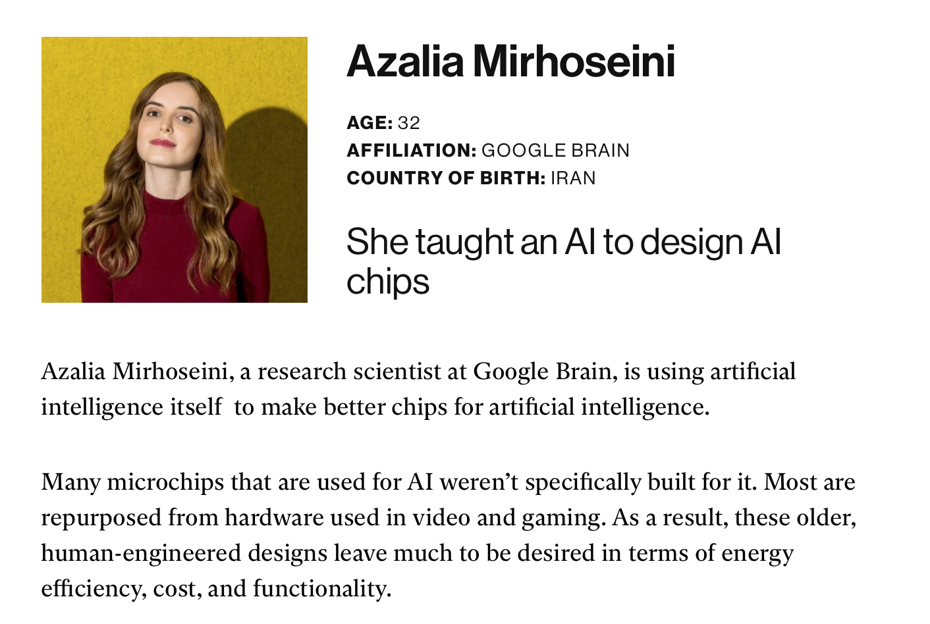
Device Placement Optimization with Reinforcement Learning
High profile project at Google that generated a lot of interest in RL applied to systems problems
Precursor to more recent high-profile chip design work by the same group

Slide 8
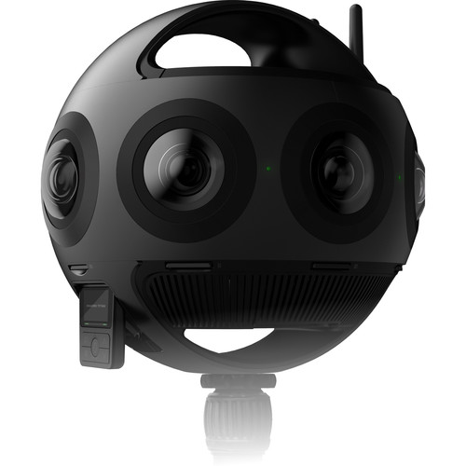
Neural Adaptive Video Streaming with Pensieve
Widely cited paper applying RL techniques to address adaptive quality selection of streaming video.
Addresses trends in earlier work that focused heavily on
Throughput modeling
Model predictive control
Future Opportunities: this addresses an area of likely increased interests
AR/VR Video Playback

Slide 9
Things to Ask when Applying ML to Systems
Before you start:
Is there “structure” in the problem being solved?
Can an “expert” given enough time and experience with the system “solve the problem”?
Is the problem input dependent?
Are there patterns in the input that can be modeled.
Once you succeed, you should ask:
What is being learned and in what way does your technique generalize?
Did you just run weeks of random search to find a model that finds a good solution to a single problem. (overfitting?)

Slide 10
Some of My Experience with ML Applied to Systems
Wireless Link Quality Estimation using GP Models: Failed
Hope: Learn how radio waves propagate through environment using only pair-wise observation
Problem: insufficient learnable structure
Baseline distance model reasonable strong
Deviation from baseline distance model is governed by complex interference that changes over cm distances.
VM Selection for Workloads: Success
Hope: Knowledge of the details of a workload and VM characteristics should determine performance
Idea: Similar workloads should perform similarly across different VM Types
Solutions: Collaborative filtering, modeling workload characteristics as a function of VM performance profiles.

