Slide 1
Synthesis Guide
SOC Design

Slide 2
Synthesis Guide
We synthesis under【 Vivado GUI 】
You need to select the FPGA for Synthesis
Follow up the SIM_Workflow to select FPGA Board
Edit FPGA Board in the project

Slide 3
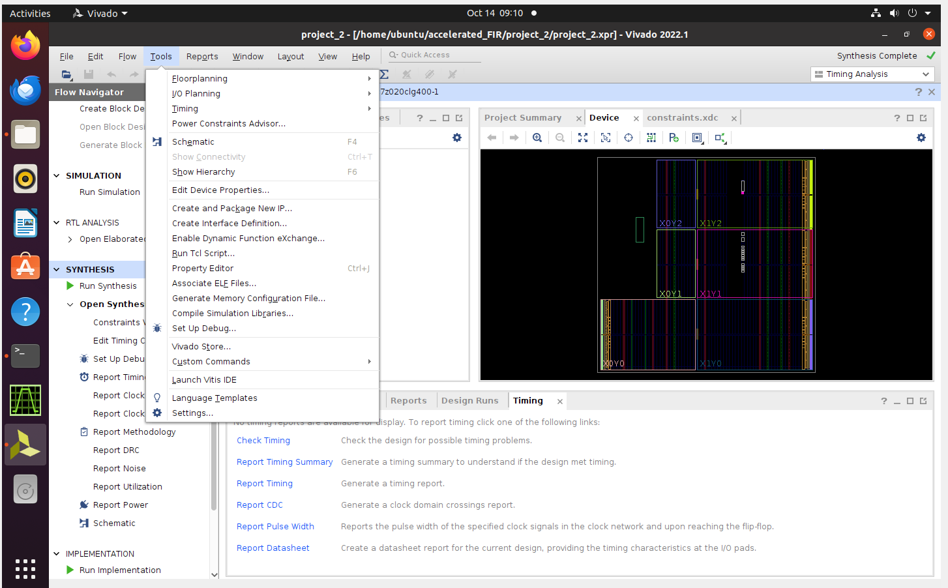
0. Select FPGA board
0.1. Left click Tools, and then click Settings

Slide 4
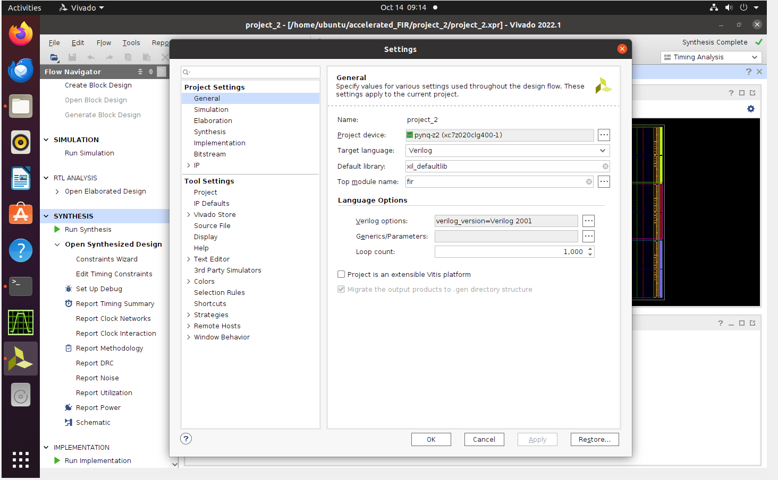
0.2. Modify Project Device
Select PYNQ-Z2 (xc7z020clg400-1)

Slide 5
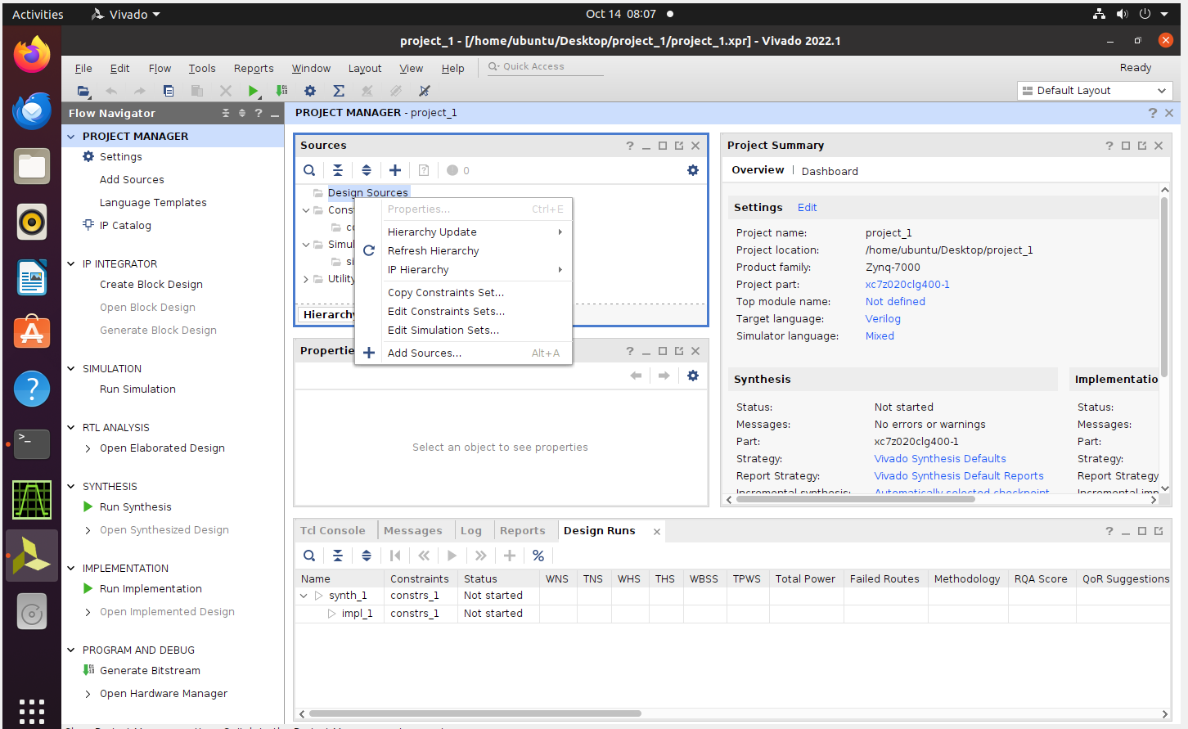
1.1 Add Constraints
1.1.1 Add Sources
【 Right click Design Sources, choose Add Sources 】

Slide 6
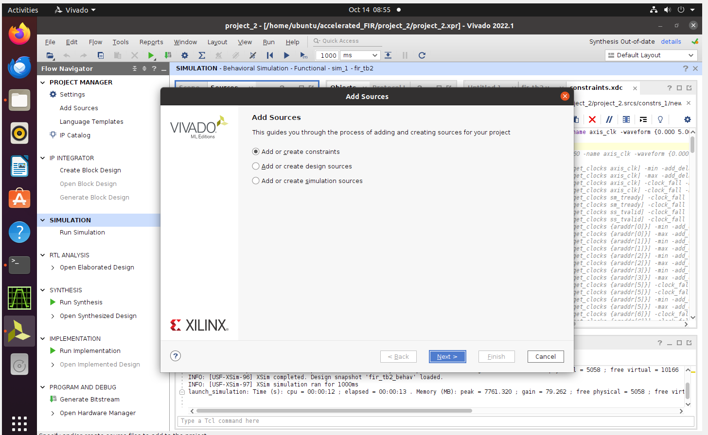
1.1.2 Add or Create constraints
【Select Add or Create constraints】

Slide 7
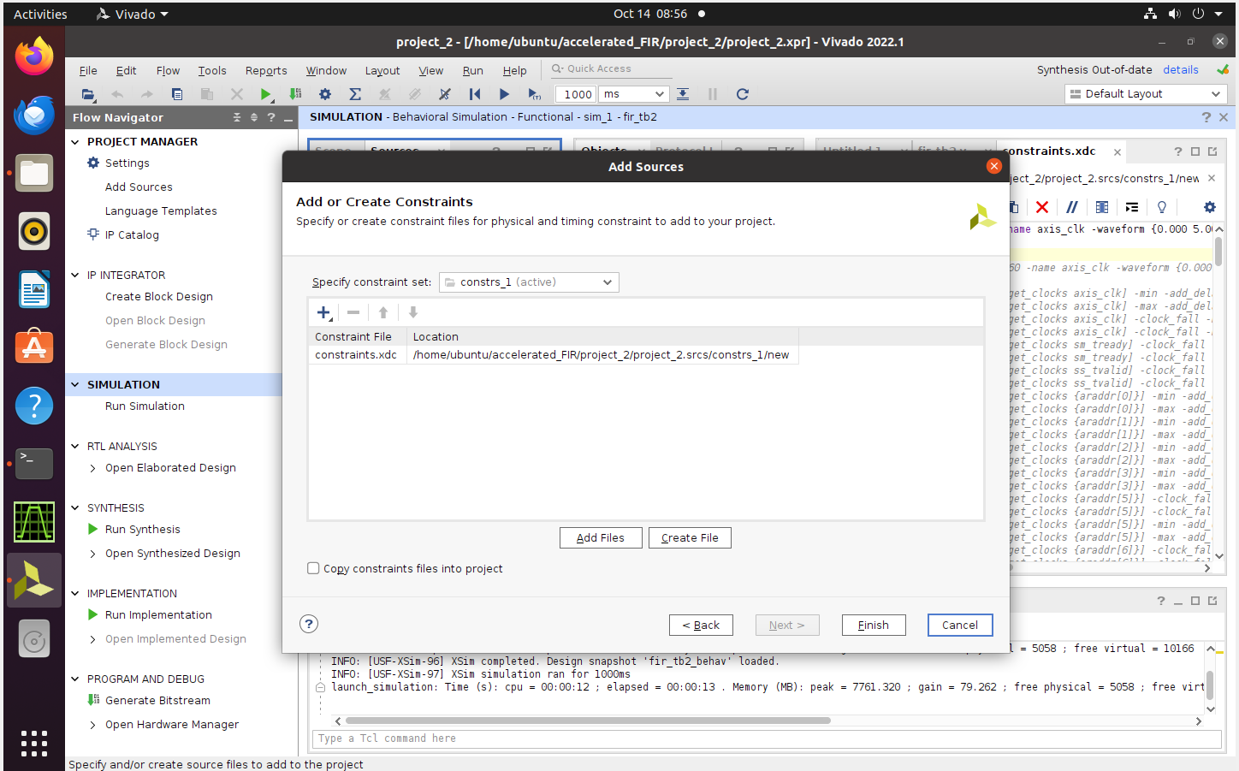
1.1.3 Add Files
【If there are Constraints, select Add files】
【If there are no Constraints , select Create file】

Slide 8
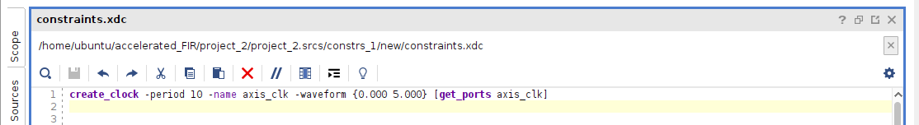
1.2 Modify Clock Constraints
1.2.1 Set Clock Constraints
create_clock –period period_time –name axis_clk –waveform {Rise_time Fall_time} [get_ports axis_clk]
1.2.2 Set Top Module before Synthesis
Set FIR file as top module.

Slide 9
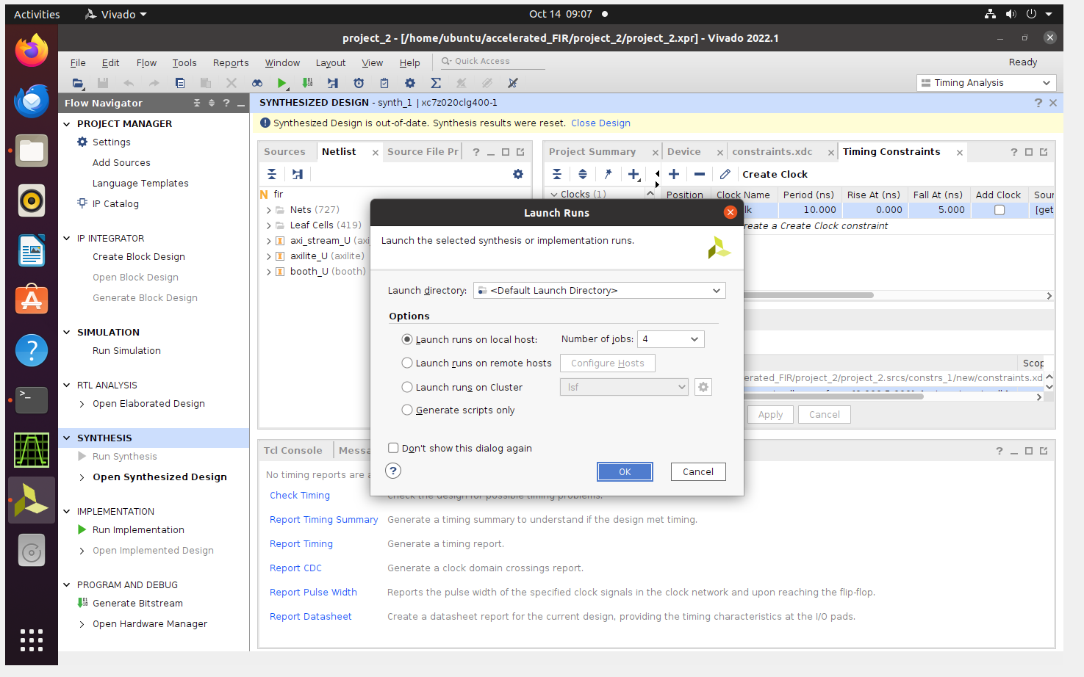
1.2.2 Run Synthesis

Slide 10
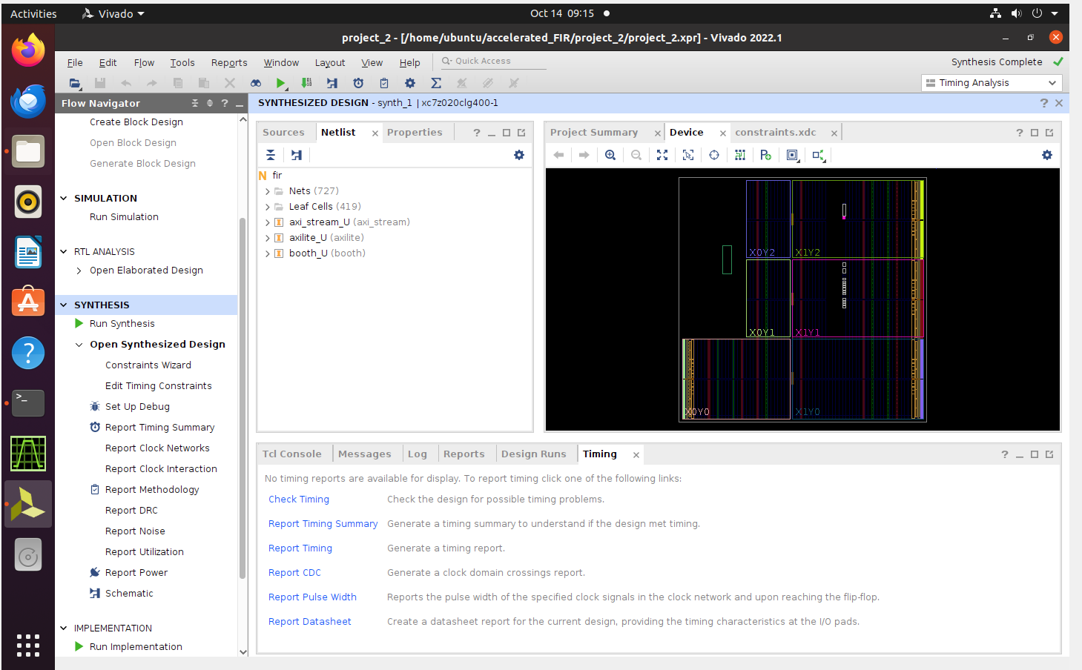
1.2.3 Report Timing Summary

Slide 11
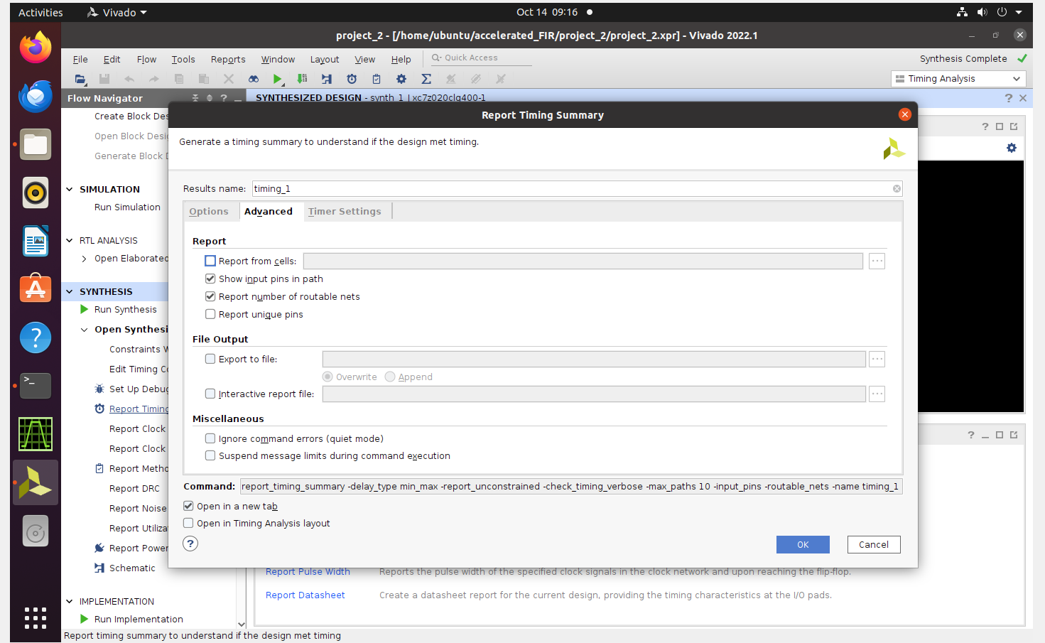
Export to timing summary file

Slide 12
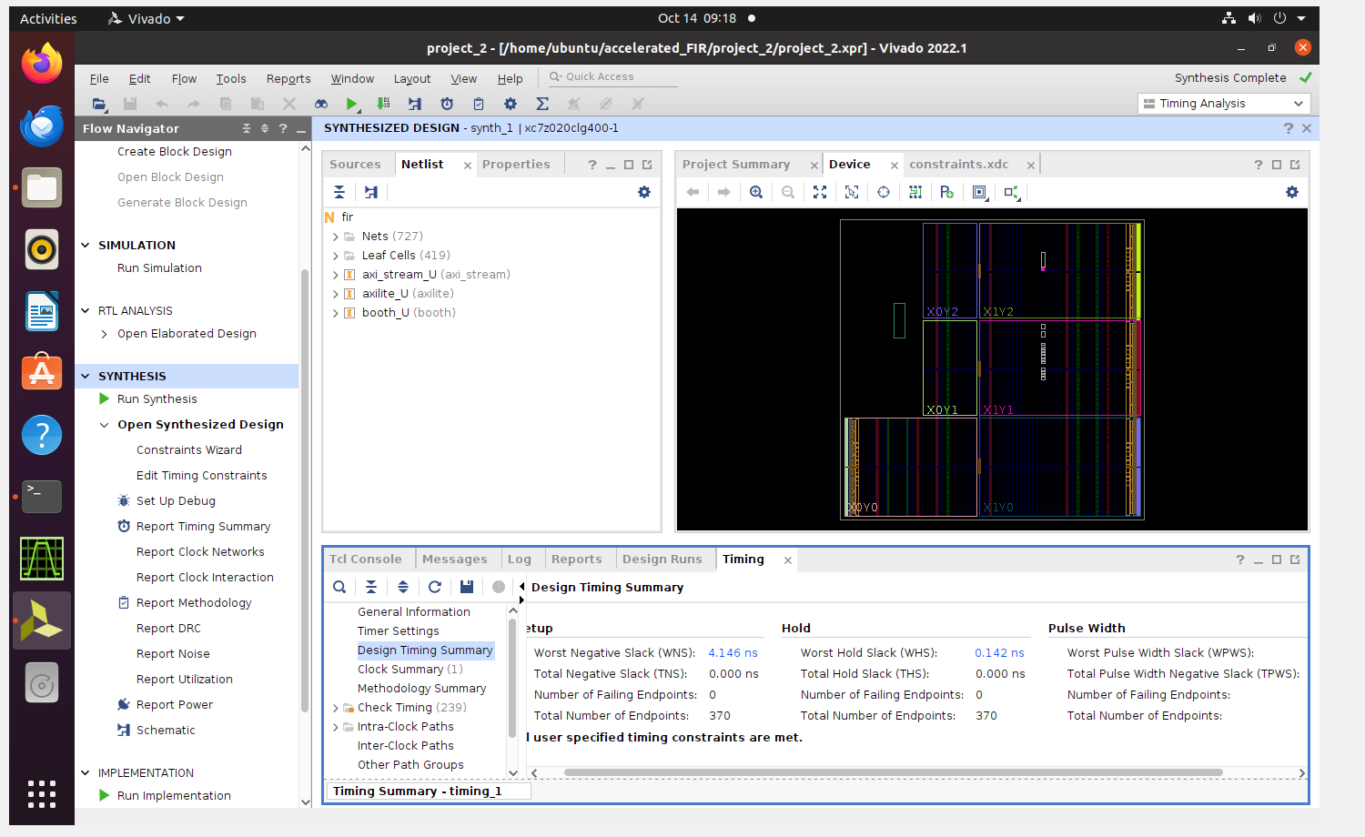
1.2.4 Check the Design Timing Summary
Slack time has to be positive integer

Slide 13
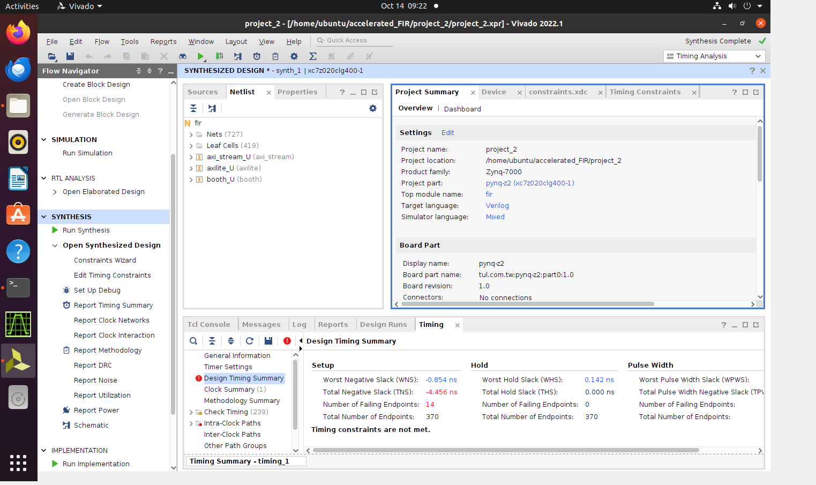
1.2.5 Edit Timing Constraints
If there is negative slack time, you need to increase timing constraints

Slide 14
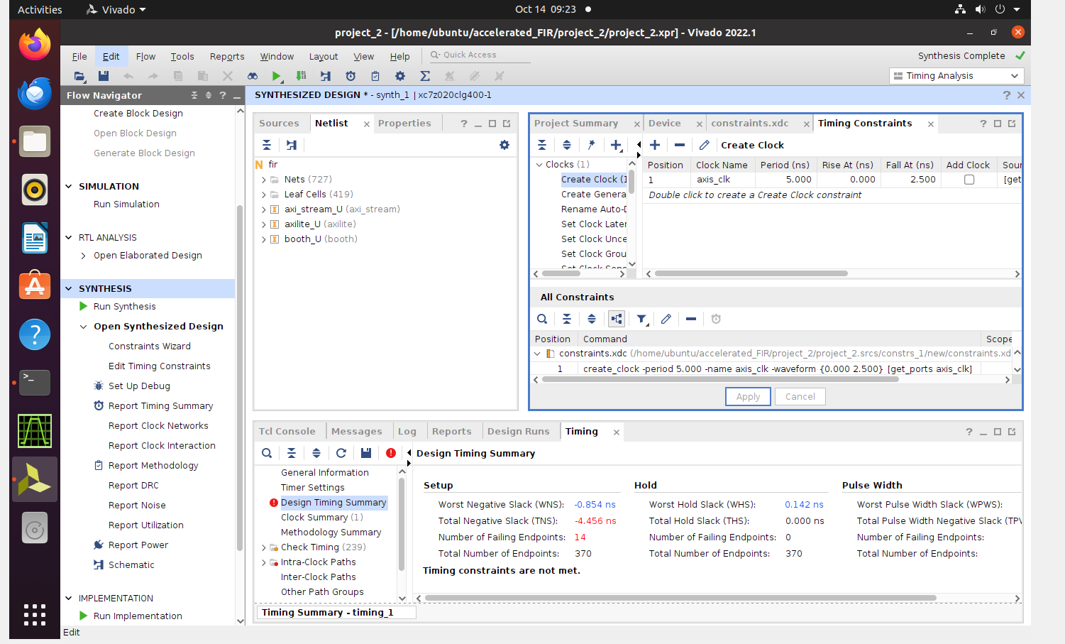
Edit the axis_clk constraints, then re-run the timing summary.

