Slide 1




AI Mouse
Team ID - 1508
Team Leader Jadish Odedara
Sharma Amit
Agrawal Dev
Patel Mayur
Solanki Tushar

Slide 2

Project Objectives
Problem Statement
Project Overview – Introduction
End Users
Wow Factor in Project
Modelling/Block Diagram/Flow of Project
Result/Outcomes
Conclusion
Future Perspective

Slide 3
Problem Statement
- Challenges:
1. Limited functions
2. Compatibility issues
3. Reduced accuracy
4. Adapting difficulties
- Solutions:
1. Improved camera-driven design
2. AI integration
- Importance in VR:
1. VR gaming growth demands better controllers.
2. AI mice offer simpler commands for immersive experiences.
- Environmental benefits:
1. Reduced material use
2. Decreased waste
3. Environmental preservation.

Slide 4
Project overview - Introduction
- Project Objective:
- Control cursor and perform clicking actions using AI and camera.
- Preset Gestures:
- Example: Index and first fingers close together for a single click.
- Gesture Display:
- Shown in a small window.
- Hand Movement Tracking:
- Captures hand movements.
- Additional Feature:
- Captures frames per second (fps) in the video.

Slide 5
End User
- Target Users:
- PC, laptop, or any device users requiring a mouse or controller.
- Potential Beneficiaries:
- Entire gaming community.
- Gamers.
- Game developers.
- Development companies.
- Software developers.
- VR developers.
- Testers.
- Potential Impact:
- Elevate user experience.
- Enhance gaming capabilities.
- Foster innovation and advancement.

Slide 6
Wow Factor in Solution
- Innovative Gesture Control: Replacing traditional mouse input with hand gestures using AI and camera technology.
- Seamless Interaction: Offering users a more intuitive and natural way to interact with their devices.
- Accessibility Enhancement: Providing a solution that caters to a broader range of users, including those with physical disabilities.
- Customizable Gestures: Allowing users to personalize their interaction experience by incorporating customizable gestures.
- Tailored Actions for Applications/Games: Implementing specific actions for certain applications or games, enhancing user immersion and engagement.
- Futuristic User Interface: Introducing a cutting-edge approach to human-computer interaction, paving the way for future advancements in technology.

Slide 7
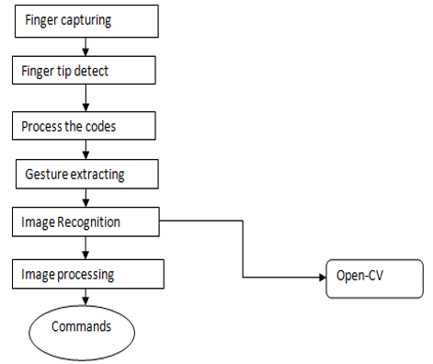
Modelling

Slide 8
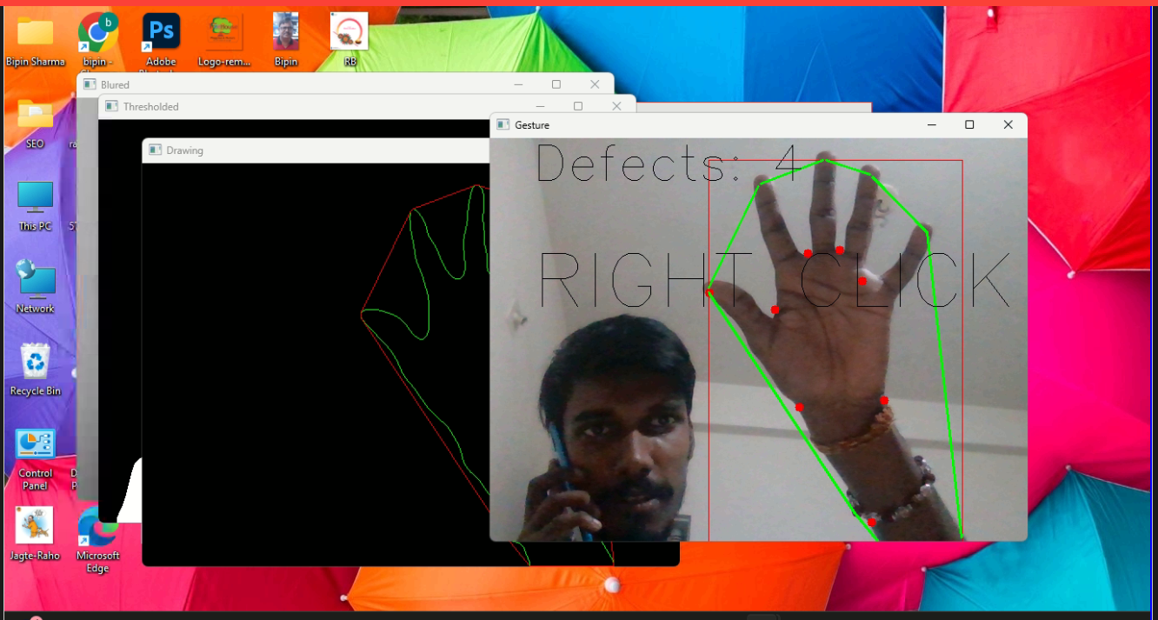

Result / Outcomes

Slide 9
Conclusion
- Primary Goal:
- Replace traditional physical mouse.
- Utilize hand gestures for cursor control.
- Key Objective:
- Transition from physical input to gesture-based control.
- Focus:
- Enhance user experience.
- Improve accessibility and interaction.

Slide 10
Future Perspective
- Future Plans:
- Improve and optimize AI virtual mouse system for low-end devices.
- Expand gesture options for users:
- Scrolling
- Dragging
- Selecting multiple files
- Performing actions like cut, copy, and paste
- Tailor Specific Actions for Games:
- Example: "Sky-Children of Life"
- Open glide
- Start story
- Run
- Drift
- Jump
- Skip dialogs
- And more tailored actions.

Slide 11
Thank you...!
Notes:
11

