Slide 1
DAMETIME MARKETING
Case Studies
Selected work, updated July 2026

Slide 2
KMM Property Maintenance
Website Rebuild
Web Design • Marketing Tooling • Brand Identity
Spec build, not yet a closed paid contract

Slide 3
The Problem
Existing site ran on a locked-down builder that didn’t allow any custom codeThat meant the marketing team couldn’t install tracking or analytics toolsNo way to measure what marketing spend was actually working

Slide 4
The Solution
A full rebuild using simple, standard web code, nothing that requires special software to edit laterOne single file now controls tracking and analytics for the entire siteReal brand colors and logo pulled directly from the client’s own business cardAdded a before/after project gallery and a customer review system, neither existed before

Slide 5
What Shipped
5 pages: home, services, portfolio, reviews, contactAll 3 forms (estimate, contact, reviews) fully working and ready for real submissionsA distinctive seasonal decorative touch that changes with a single settingContent updated and cleaned up based on real feedback after the first review

Slide 6
Design & Feature Breakdown
The design choices behind the build, and why each one was made

Slide 7
Simple, Standard Web Code: Nothing Exotic
No complicated tools or setup required to make changes laterChosen specifically so a non-technical team can edit it safelyDirectly solves the one problem this project exists to fix

Slide 8
Tracking Setup: The Actual Fix
One file controls tracking for the whole site, no page-by-page setupComes with plain-English instructions already written inThe direct answer to “our old site wouldn’t let us track anything”

Slide 9
Real Brand Identity, Not a Stock Look
Logo and colors traced back to the client’s own business card, not a stock lookDocumented clearly so it stays consistent if someone else edits it laterThe difference between “a site that happens to be for KMM” and “KMM’s site”

Slide 10
Portfolio and Reviews: Two New Features
Before/after photo gallery: 2 real completed jobs shown so farCustomer reviews go through a simple approval step before they’re postedBoth are brand-new features, neither existed on the old site

Slide 11
Contact Forms: Already Working, Not Just a Mockup
All 3 forms are ready to receive real submissions the moment the site is liveA hidden spam filter blocks bots automatically, invisible to real visitorsForms already feel finished when tested, not like a placeholder

Slide 12
A Distinctive Seasonal Touch, With a Real Design Process Behind It
One single setting switches which season is showing, across the whole siteAutomatically turns off on phones and for visitors who prefer less motionRefined through several real rounds of feedback, not a first draft left as-is

Slide 13
Content Improvements Based on Real Feedback
A redundant service was removed everywhere it appeared, not just the one spot flaggedA misplaced service (gutter cleaning) was moved to where it actually belongsFeedback to a fully updated, verified site: the same sitting

Slide 14
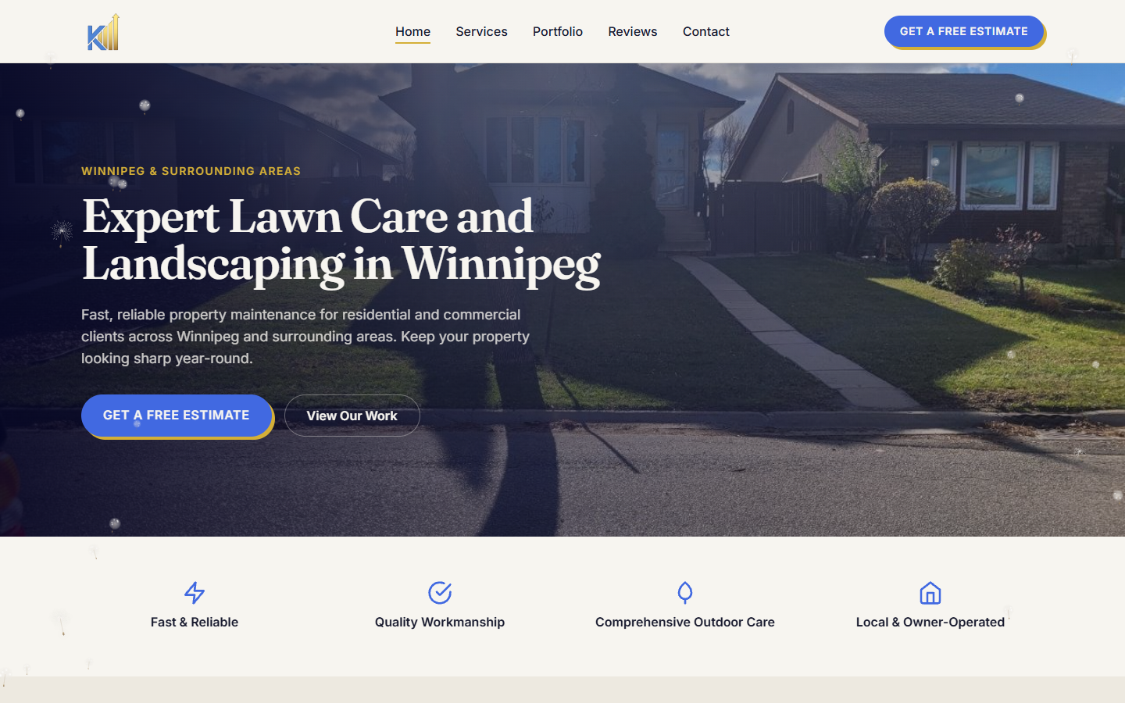
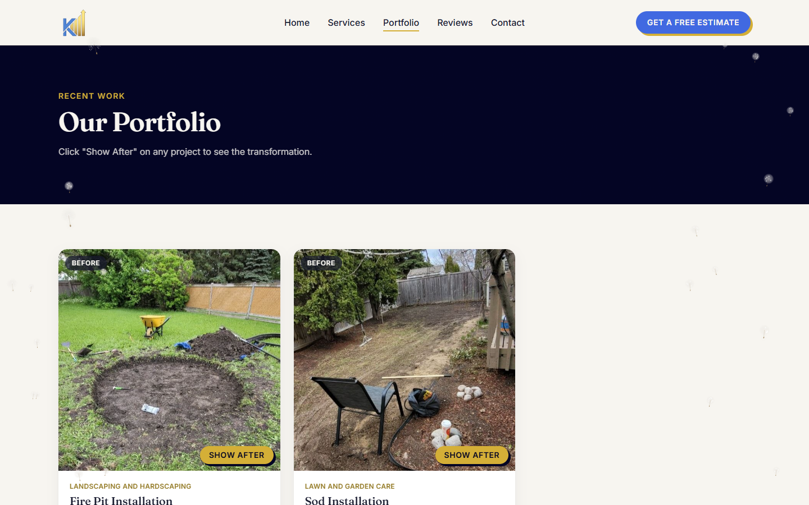
The Result
Homepage
Portfolio: before/after toggle

Slide 15
Why This Works
Solves one specific, provable problem, not a vague “make it look nicer” requestShows real range beyond a template: an identity built from the client’s own brandingProves fast, thorough follow-through on feedback, reassuring for a client sizing up the process

Slide 16
Let’s build yours.
Damien Dalupang, Dametime Marketing
damiendalupang@gmail.com

