Slide 1
Planetary Disassembler
Cyrus Sarkosh, Tyler Kowalczik

Slide 2
Overview
Disassemble a solar system as fast as you can
Launch disassembler beam into nodes of solar hierarchy
Interesting planet textures and illuminations
Main camera used to aim Planetary Disassembler
Second camera works as repositionable mini map
Disassembled planets turn into asteroids which can disassemble other nodes in the hierarchy
Has friendly UI that makes sense for non-direct manipulations

Slide 3
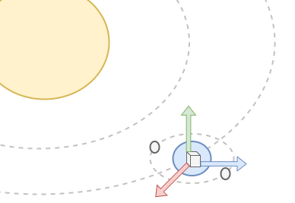
Phase I (Game Setup)
Scale planets and moons to desired size.
Final score depends upon size of planets and moons.

Slide 4
Phase II (Gameplay)
Begin disassembling planets!
Final score is a function of planet/moon sizes and time.
Disassemble planets with the Planetary Disassembler’s Laser Beam of Disassembly!

Slide 5
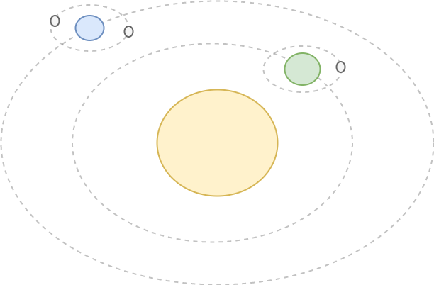
Hierarchy
Solar system hierarchy
Hierarchy composed multiple generations of orbiting objects.

Slide 6
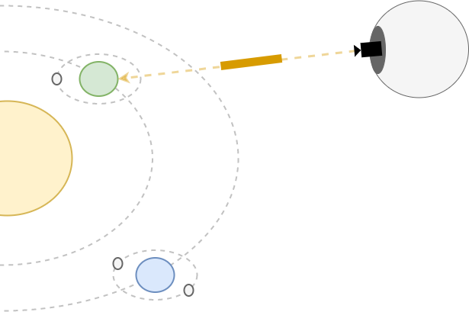
Planetary Disassembler & Main Camera
Send laser beam into solar hierarchy
Change laser beam path by manipulating main camera direction
Disassemble planets into asteroids

Slide 7
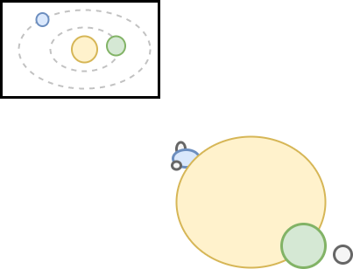
Second Camera
Mini map with top-down view of solar hierarchy
Reposition view inside mini map to solar hierarchy from various positions

Slide 8
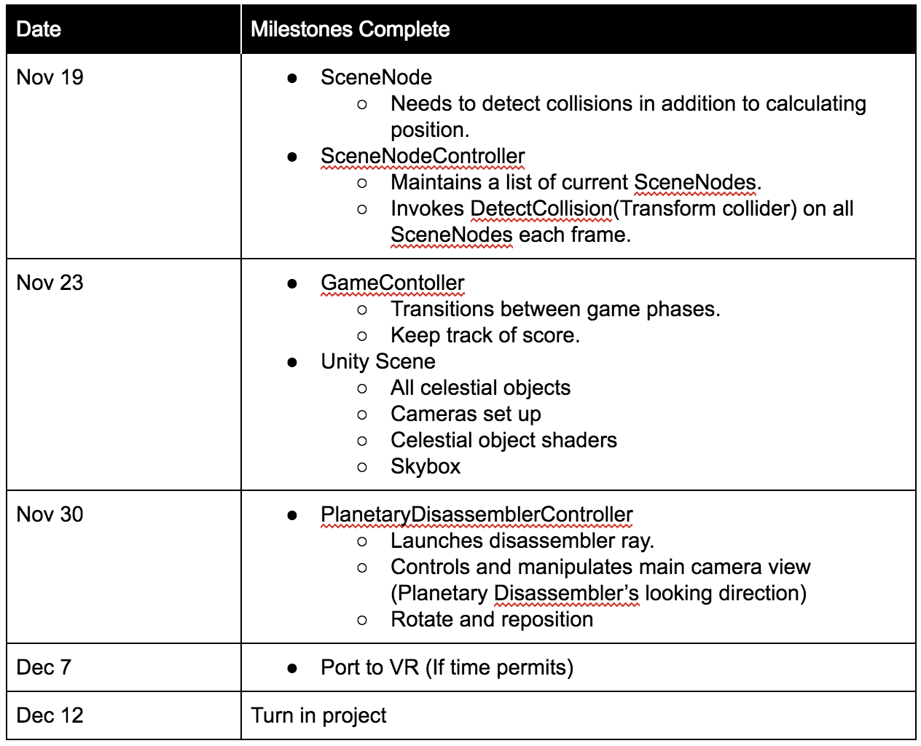
Timeline

