Slide 2
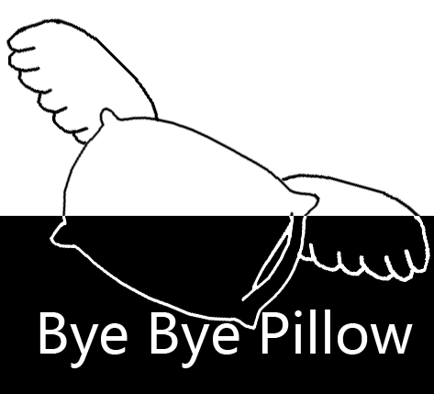
Click to Continue

Slide 3
Project Four Sticks
Bye Bye Pillow Games
Producer / Stacie Rajkovics
Lead Developer/ Sota Ogo
Developer and Assistant Designer / Joseph Lee
Lead Designer and UI Designer / Samuel Kim
Tester and Assistant Developer / Tae Chon

Slide 4
Agenda
Motivation of the Project
Game Components and Rules of “Yoot nori”
Limitation of the Original Game
Transformation of “Yoot nori” to “Four Sticks”
New Features in “Four Sticks”
Game UI
Technical Challenging
Identified Interesting Prototypes
Q & A

Slide 5
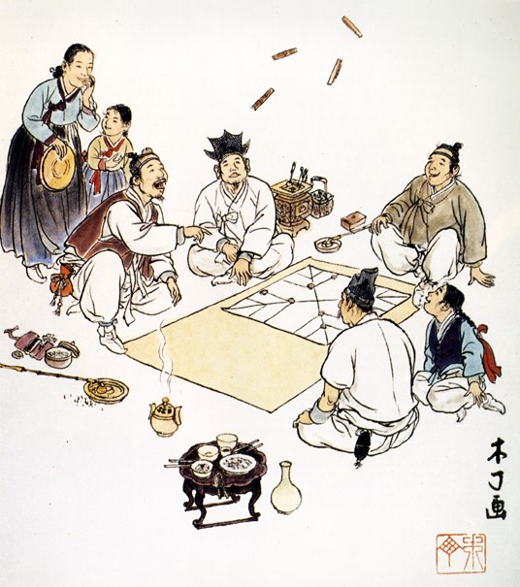
Motivation
Inspired by Korean traditional board game, “Yoot Nori”
Turn by Turn Strategy Game for 2 or more people
Played since A.D. 100 ~ Today
Koreans have been playing for 1910 years.
What made this game able to survive?
Family Entertainment
Highly Competitive
Simple rules
Requires good amount of Strategy
Game play depends on Randomness(Similar to Dice)
→ Provides variety of the game

Slide 6
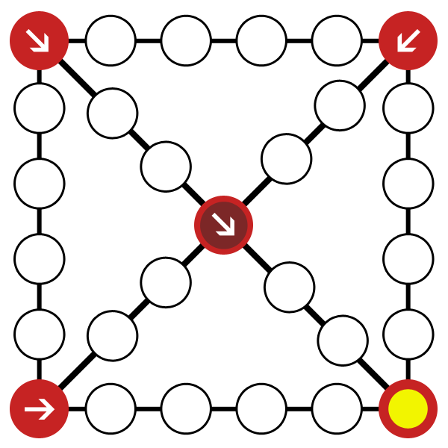


Game Components
Throwing Yoot (Sticks)
Game Board
Pieces

Slide 7
Throw Sticks
2. Move Pieces

Slide 8
Movement Cases
Do +1
4/16
25%
Ge +2
6/16
37.5%
Ger +3
4/16
25%
Yoot +4
1/16
6.25%
Throw +1
Mo +5
1/16
6.25%
Throw+1

Slide 9
Example Cases
Choose which piece to move

Slide 10
Go through the board to remove pieces
Player who removes all 4 pieces first Wins

Slide 11
Special Movement
Shortcuts
If you land on
a top corner or the center,
You can take a Shortcut

Slide 12
Catching Enemy
If you land on an
Enemy,
You can return
The Enemy
And Throw sticks 1 more

Slide 13
Stacking Units
If you land on
your own unit,
You can move them together
You can stack as many as you want
But they will be returned together

Slide 14
Changing order of Bonus Throws
You’ve got Mo (+5 +1 throw)
Don’t use it yet!
Throw one more time.
You’ve got Ge (+2)
Use it to catch enemy
You earned bonus throw.
Don’t use Mo yet!
Throw again
You’ve got Ge (+2) again
Use it to stack units
Now it’s time to use Mo.
If you earned bonus throw
(Yoot +4, Mo +5, Catch enemy)
You can change the order of movement

Slide 15
Limitation: Cultural game
Vocabulary and appearance are hard to be accepted by foreigners or modern culture.
Lack of story
Not engaging enough with only “Win” someone
How about blending with modern culture?

Slide 16
Transformation
Simple
Game board
Fantasy dungeon
With Magic circles
Four Sticks
Simply Repeating
game play
Change 4 units into
1 Champion and
3 minions
No
Story
Win race in the dungeon to earn Manastones
No
Rewards
Unlock champions and maps with Manastones
Yoot No-ri

Slide 17
Translate into Fantasy?

Slide 18
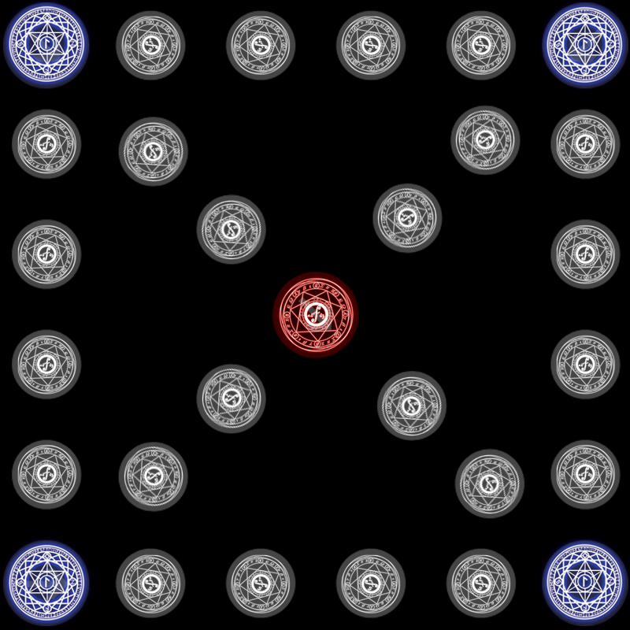


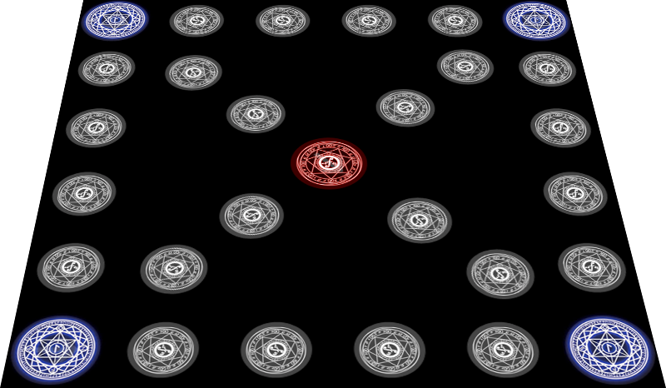
Translated into Fantasy!
2.5D ~ 3D Sticks
Perspective Stage

Slide 19
Champion w/ Minions
1 Champion who can use special Skills + 3 Minions
Plain 4 Units

Slide 20
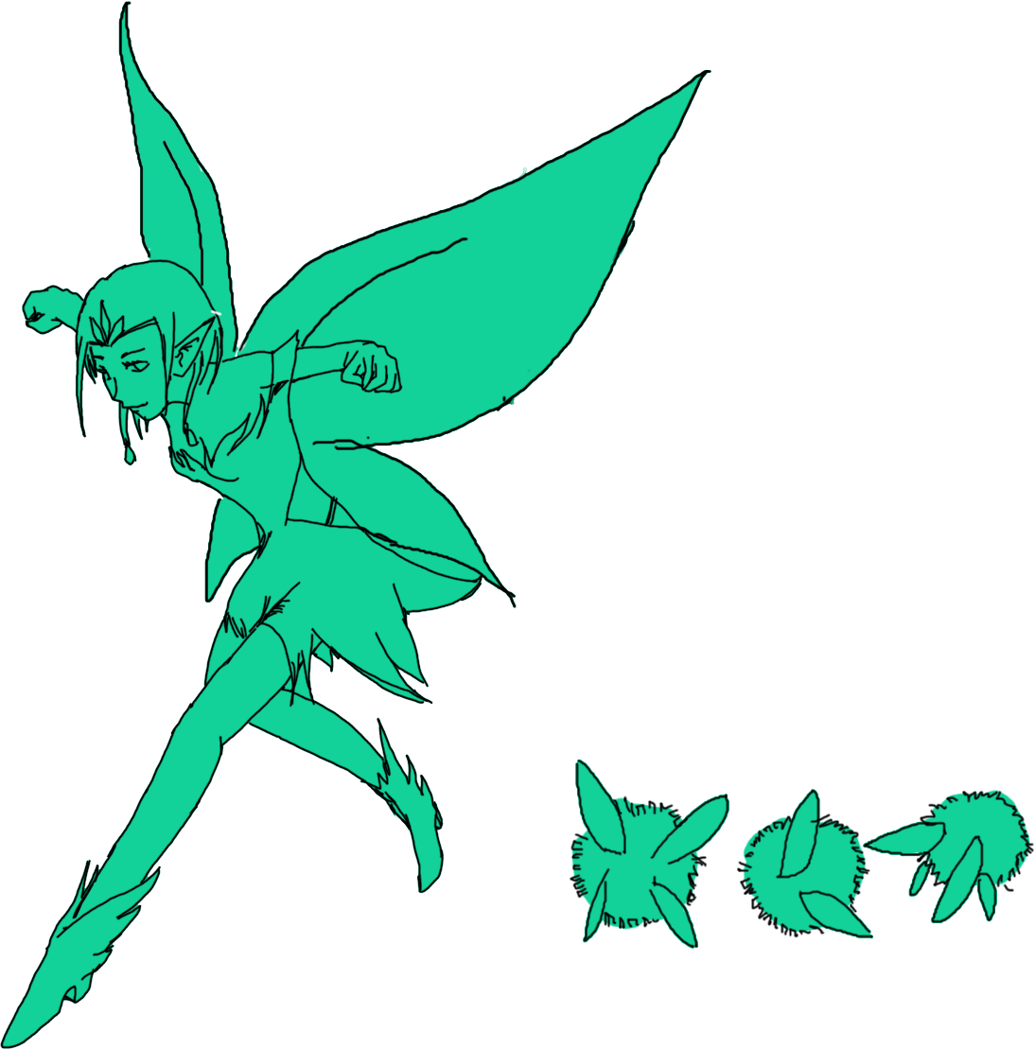
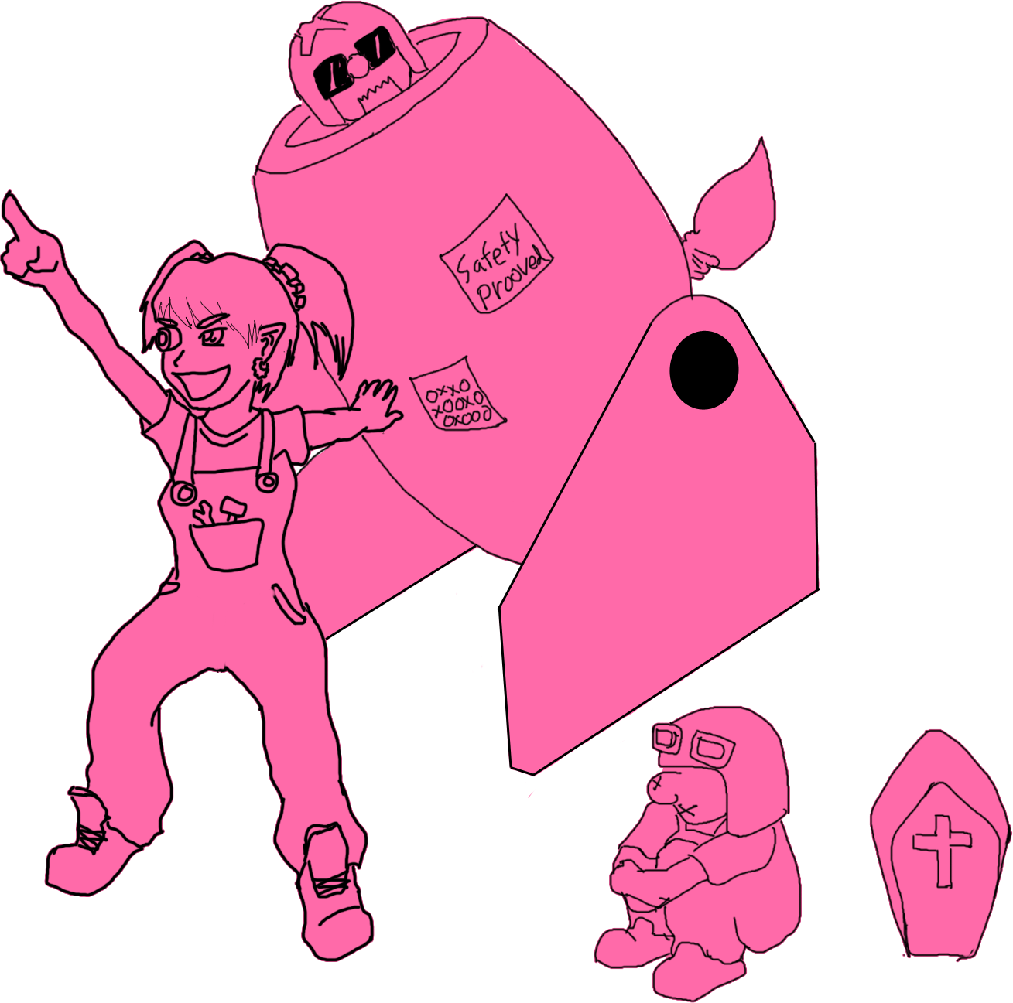
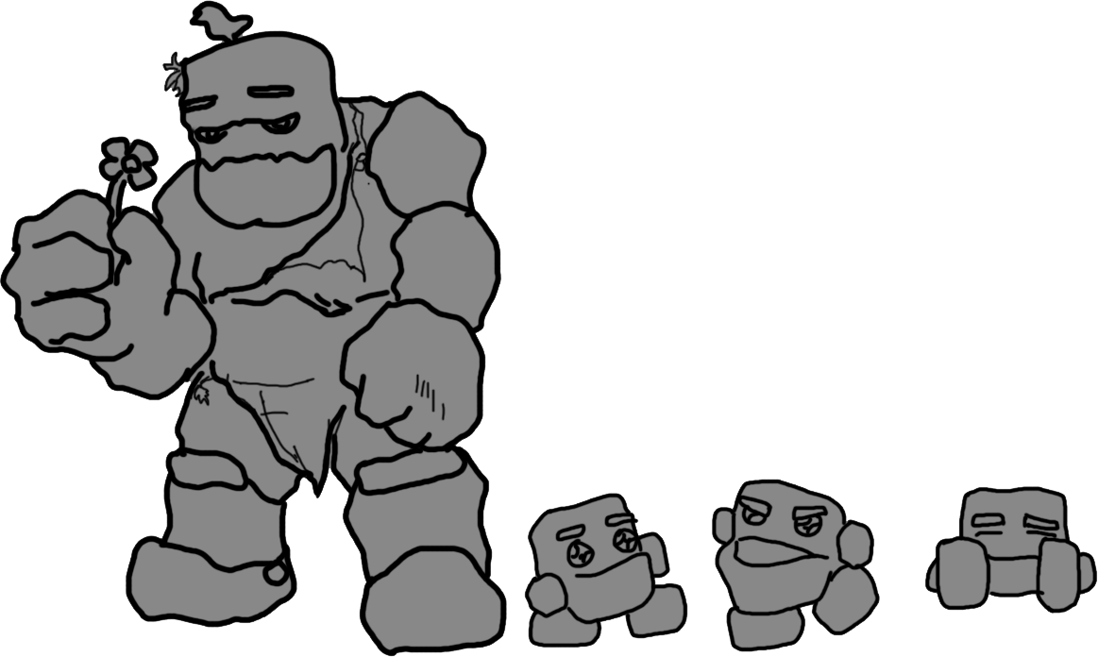
Player can choose one champion before you start the game by selecting a card.
Each champion has unique skills that can be used only limited times in one game.
Basic champion will be given, and player can unlock(buy) more champions with collected Manastones by winning games.

Slide 21
Berry
The Mad Gnome Mechanic
Skill
When a minion is stacked with Berry, she can send him forward with her crazy rocket. (Safety not guaranteed)

Slide 22
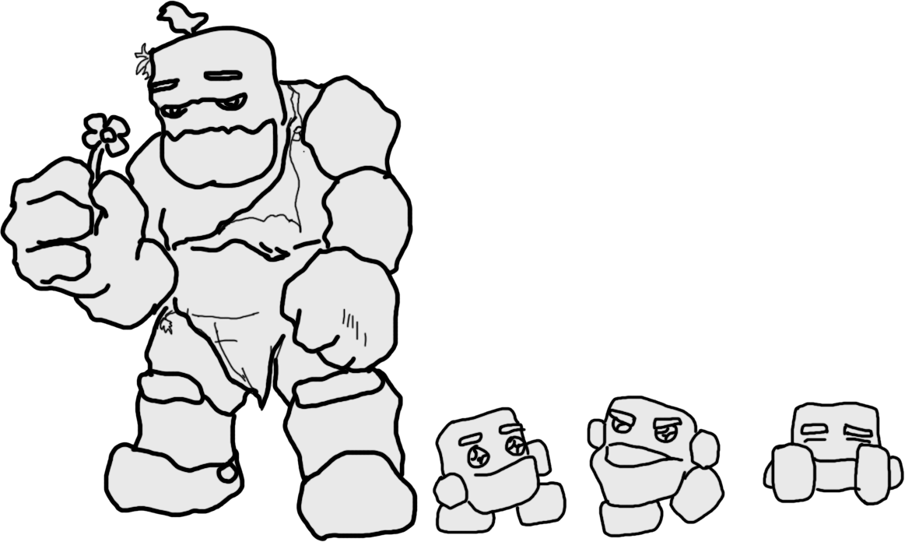
BoldStone
The Brother Stone
Skill
Roll Himself or minion,
Catch every enemies in their way

Slide 23
Sylpheel
The Queen of Wind
Skill
Regardless of landing on the edges, make herself or minion take shortcut

Slide 24
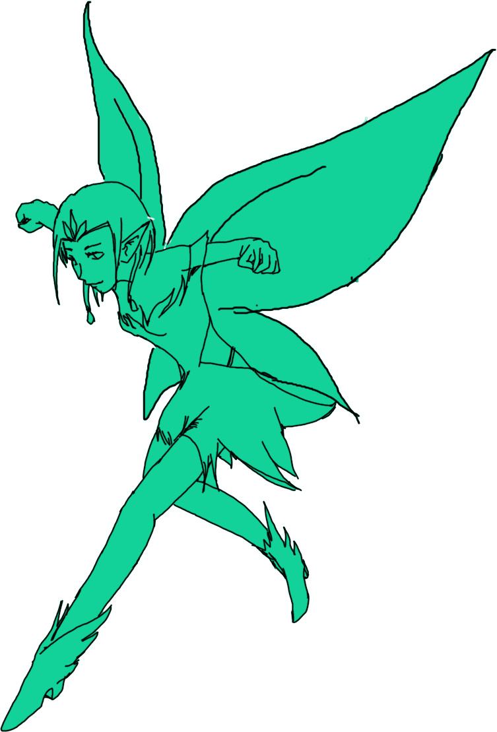
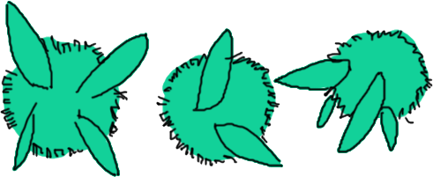
Game UI
Main Game Camera
(Movable, Zoomable)
Stick Throwing Window
Push or Drag to throw the sticks
Minimap
Current Status of Players

Slide 25
Technical Challenge
Complexity
Significant amount of art work
At least 15 art assets, sound effects
Each champion has unique skills
Numerous test cases for interactive
Computer AI should be created based on the each of the different cases
Each skill has to have unique effect and functions
Difficulty
Making AI calculate intelligent decision
Setting conditions to all user movement

Slide 26
Interesting prototypes
The 1st Prototype
Converting simplified game map into adjacency matrix.
If you click a certain node, Blue hero will move to the node jumping node by node between current position and the destination.
The 2nd Prototype
Random number N in between 1 and 5 will be generated each click. The blue hero can move only N number of nodes.
The 3rd Prototype
When Blue and Red hero meet each other on the same node, simple event message will appear
3
EVENT!

Slide 27
The 4th Prototype
There is a split path with blue hero.
When you press the buttons with numbers, the hero will move the numbers of cells.
If the hero reach the end, the hero will come back to the starting point.
If the hero land on the corner, the hero will take the branch.
1
2
3
4
5
2
3
4
5

Slide 28
Q&A

