Slide 1
TIME UPRISING
Chad Hickenbottom, Rodelle Ladia Jr., Angela Liu, James Murphree

Slide 2
Presentation agenda
Game Overview – Angela
Narrative & Game World – James
Game Purpose & Objectives – Chad
Level Progression – Chad
Tower Types – Rodelle
Upgrades & Achievements – Rodelle
Technical Considerations & Prototypes– James

Slide 3
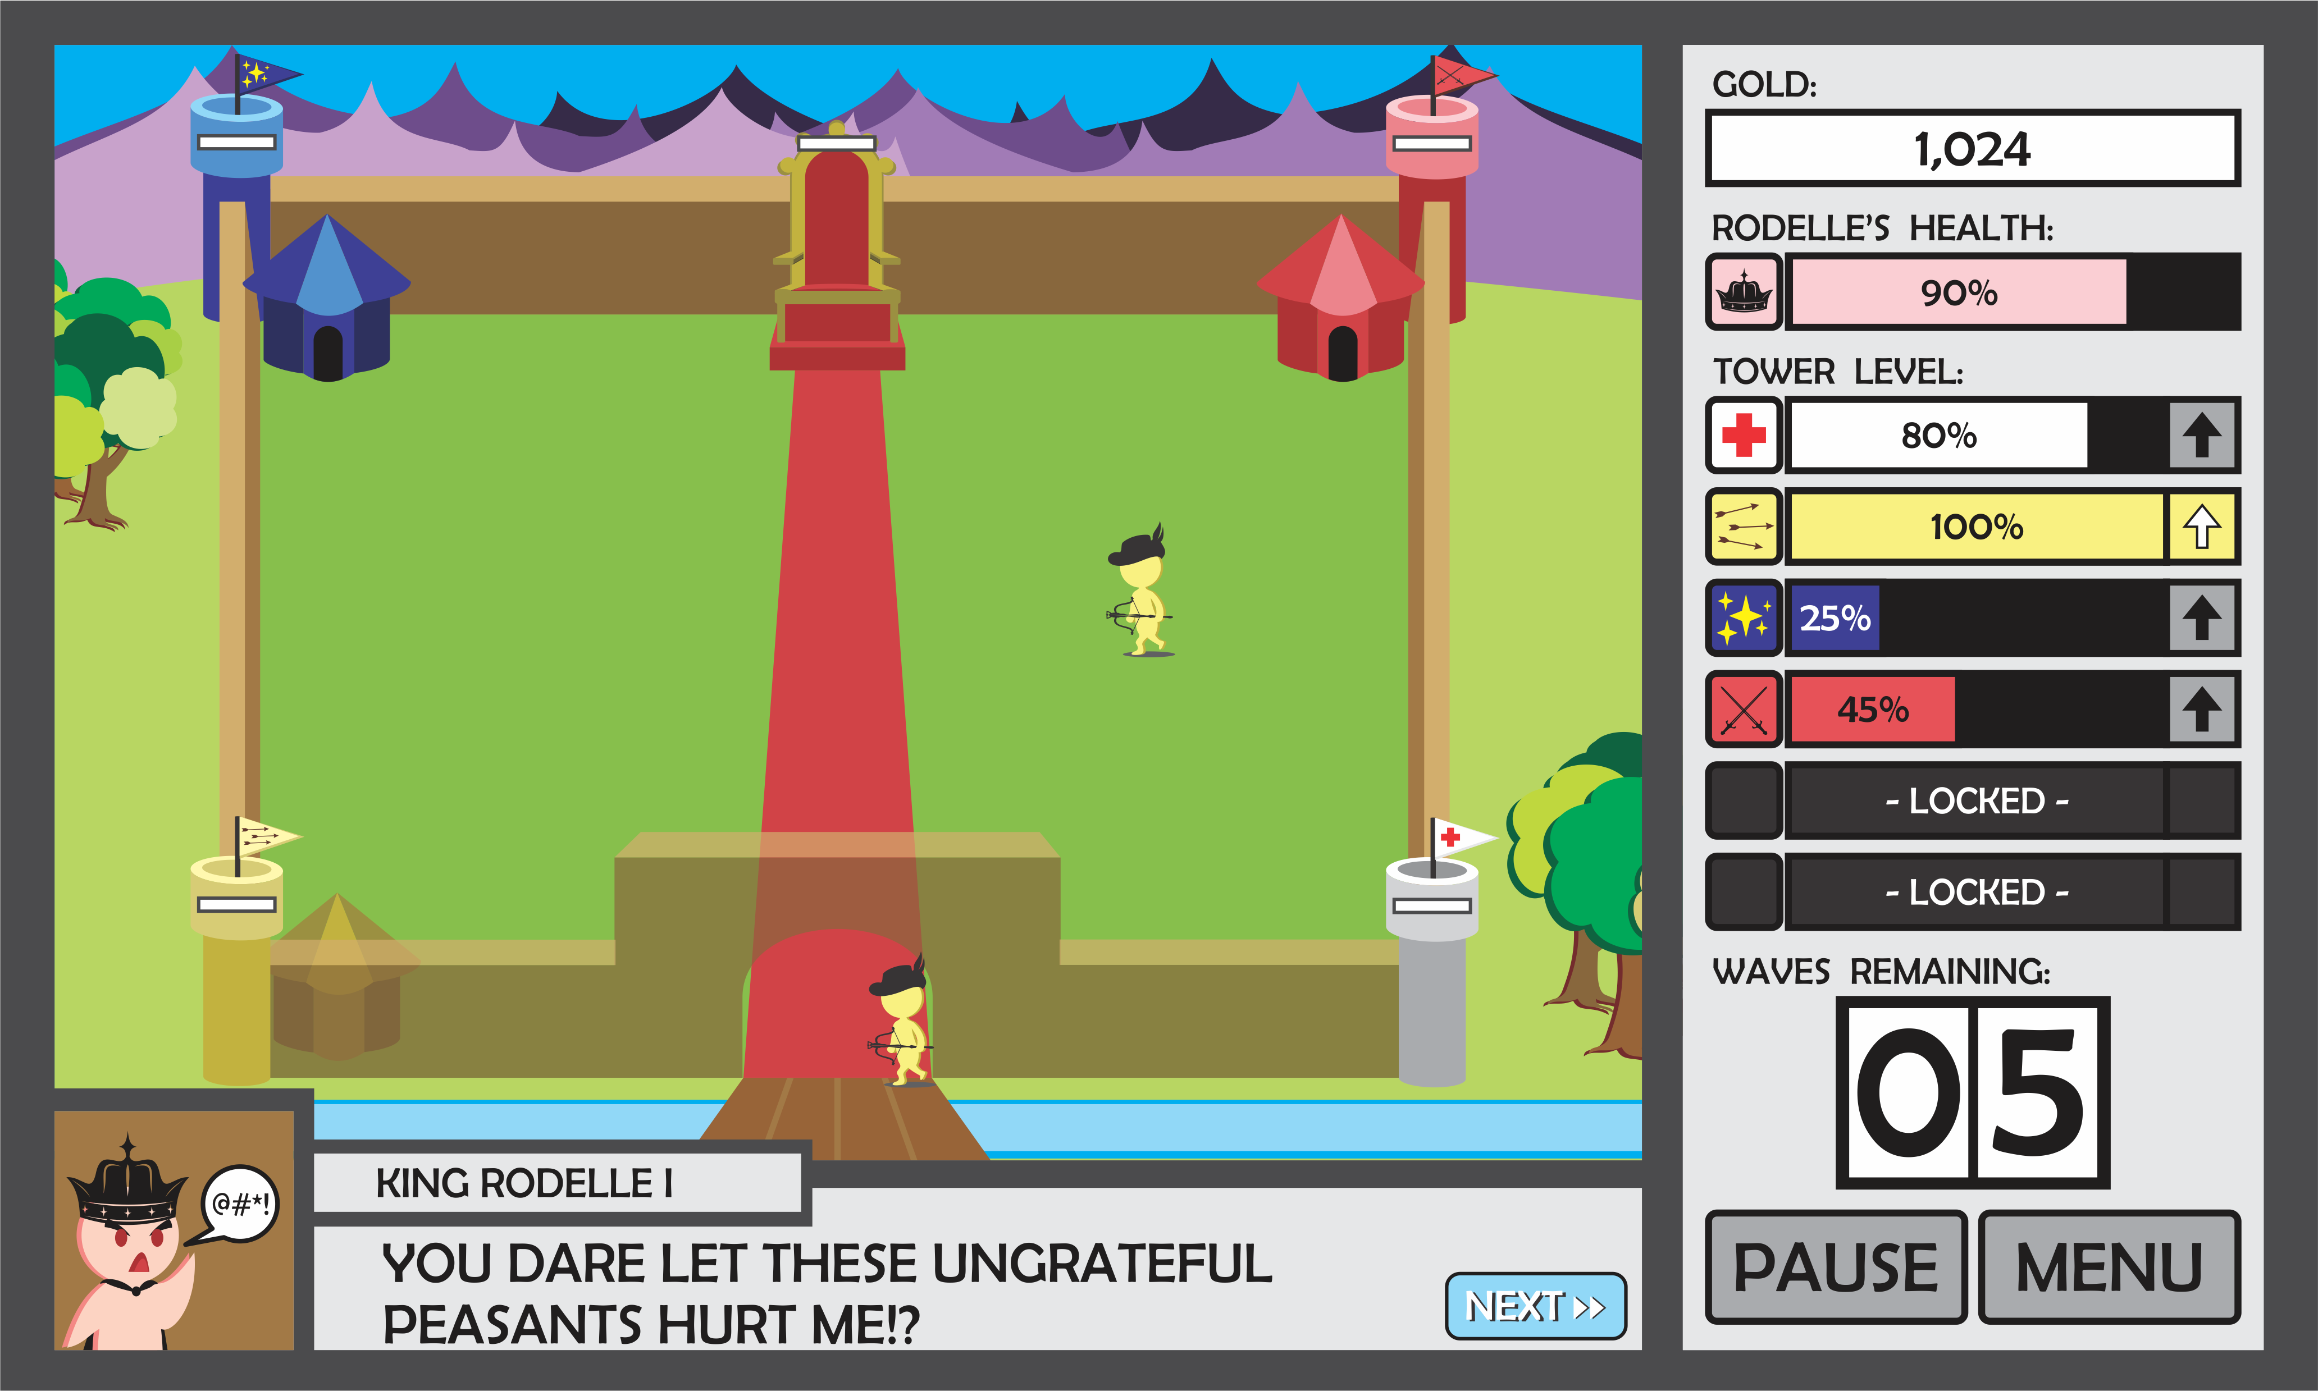
Game Overview: Single-Player, Tower Defense game that transcends time and space with capture-able towers and an engaging storyline!
Notes:
Target Audience: Tower-defense & RPG enthusiasts
Unique: capture-able towers & strong narrative
Platform: Computer (potentially mobile)
Game Logline: Single-Player, Tactical Tower Defense game that transcends time & space with capture-able towers and an engaging storyline!
Visual Look & Feel:
2.5D Simple Cartoon

Slide 4
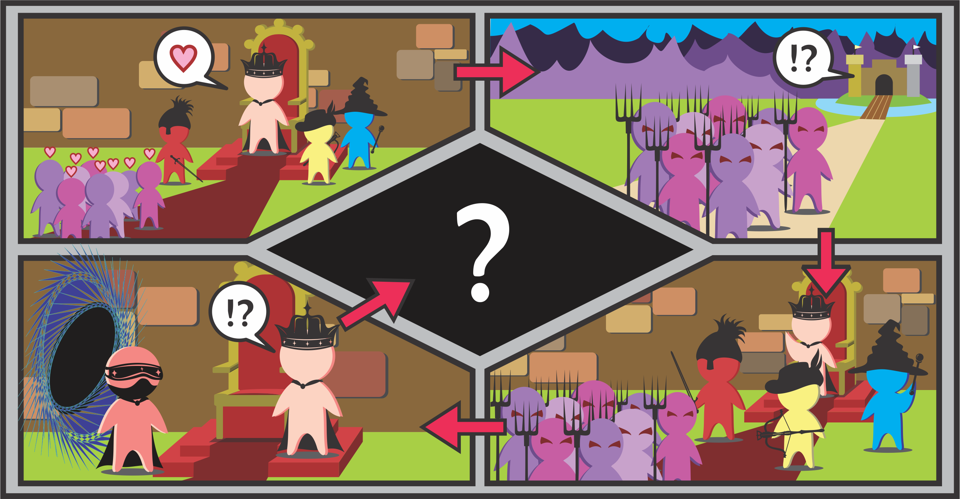
Narrative
Notes:
EXPOSITION: King Rodelle I is a very nice guy.
CONFLICT: Peasants are rebelling for an unknown reason. Protect King Rodelle I!
RISING ACTION: Galactic Overlord Rodelle XVI requests aid from King Rodelle I to help protect the Rodelle legacy with his strategic prowess.
CLIMAX & RESOLUTION: Mysterious Plot Twist

Slide 5
Game Purpose & objectives
Game Purpose: Complete the game to solve the mystery of the peoples’ unrest.
Winning Condition:
Level: Defeat all enemies for all waves
Game: Progress through all eras (levels)
Losing Condition:
Health of Rodelle of the level becomes zero

Slide 6
Level Progression
Prehistoric Era (Wish-listed)
Level 1
Medieval Kingdom
Level 2
Japanese Empire
Tutorial
Level 3
Level 4
Modern America (Wish-listed)
Year 2555 (Wish-listed)
3 Waves
1 Tower
4 Towers
7 Waves
4 Towers
8 Waves
5 Towers
10 Waves
6 Towers
5 Waves
Notes:
[Tutorial] Prehistoric Era: Caveman Rodelle
3 waves, 1 tower
Medieval Kingdom: King Rodelle I
5 waves, 4 towers
Japanese Empire: Emperor Rodelle
7 waves, 4 towers
(Modern America: President Rodelle)
8 waves, 5 towers
(Year 2555: Galactic Overlord Rodelle XVI)
10 waves, 6 towers

Slide 7
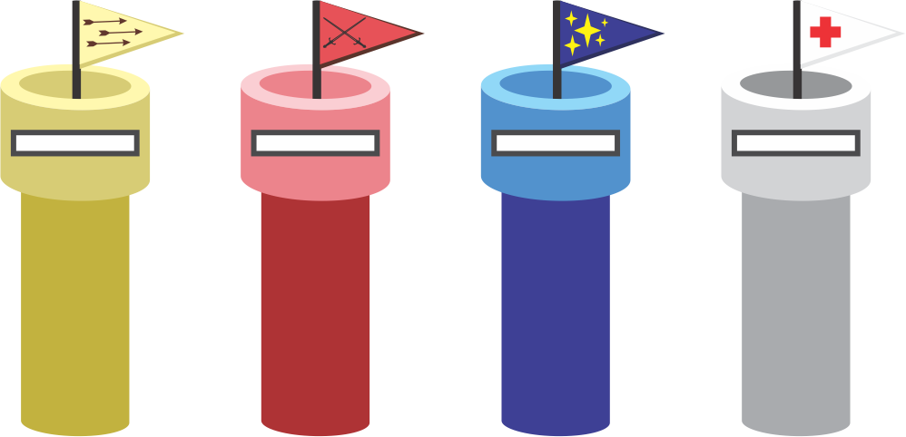
tower types
Capture-able Towers
Spawn
Ranged
Melee
Special Attacks
Ability
Heal
Multiplier (Wish-listed)
Bomb (Wish-listed)

Slide 8
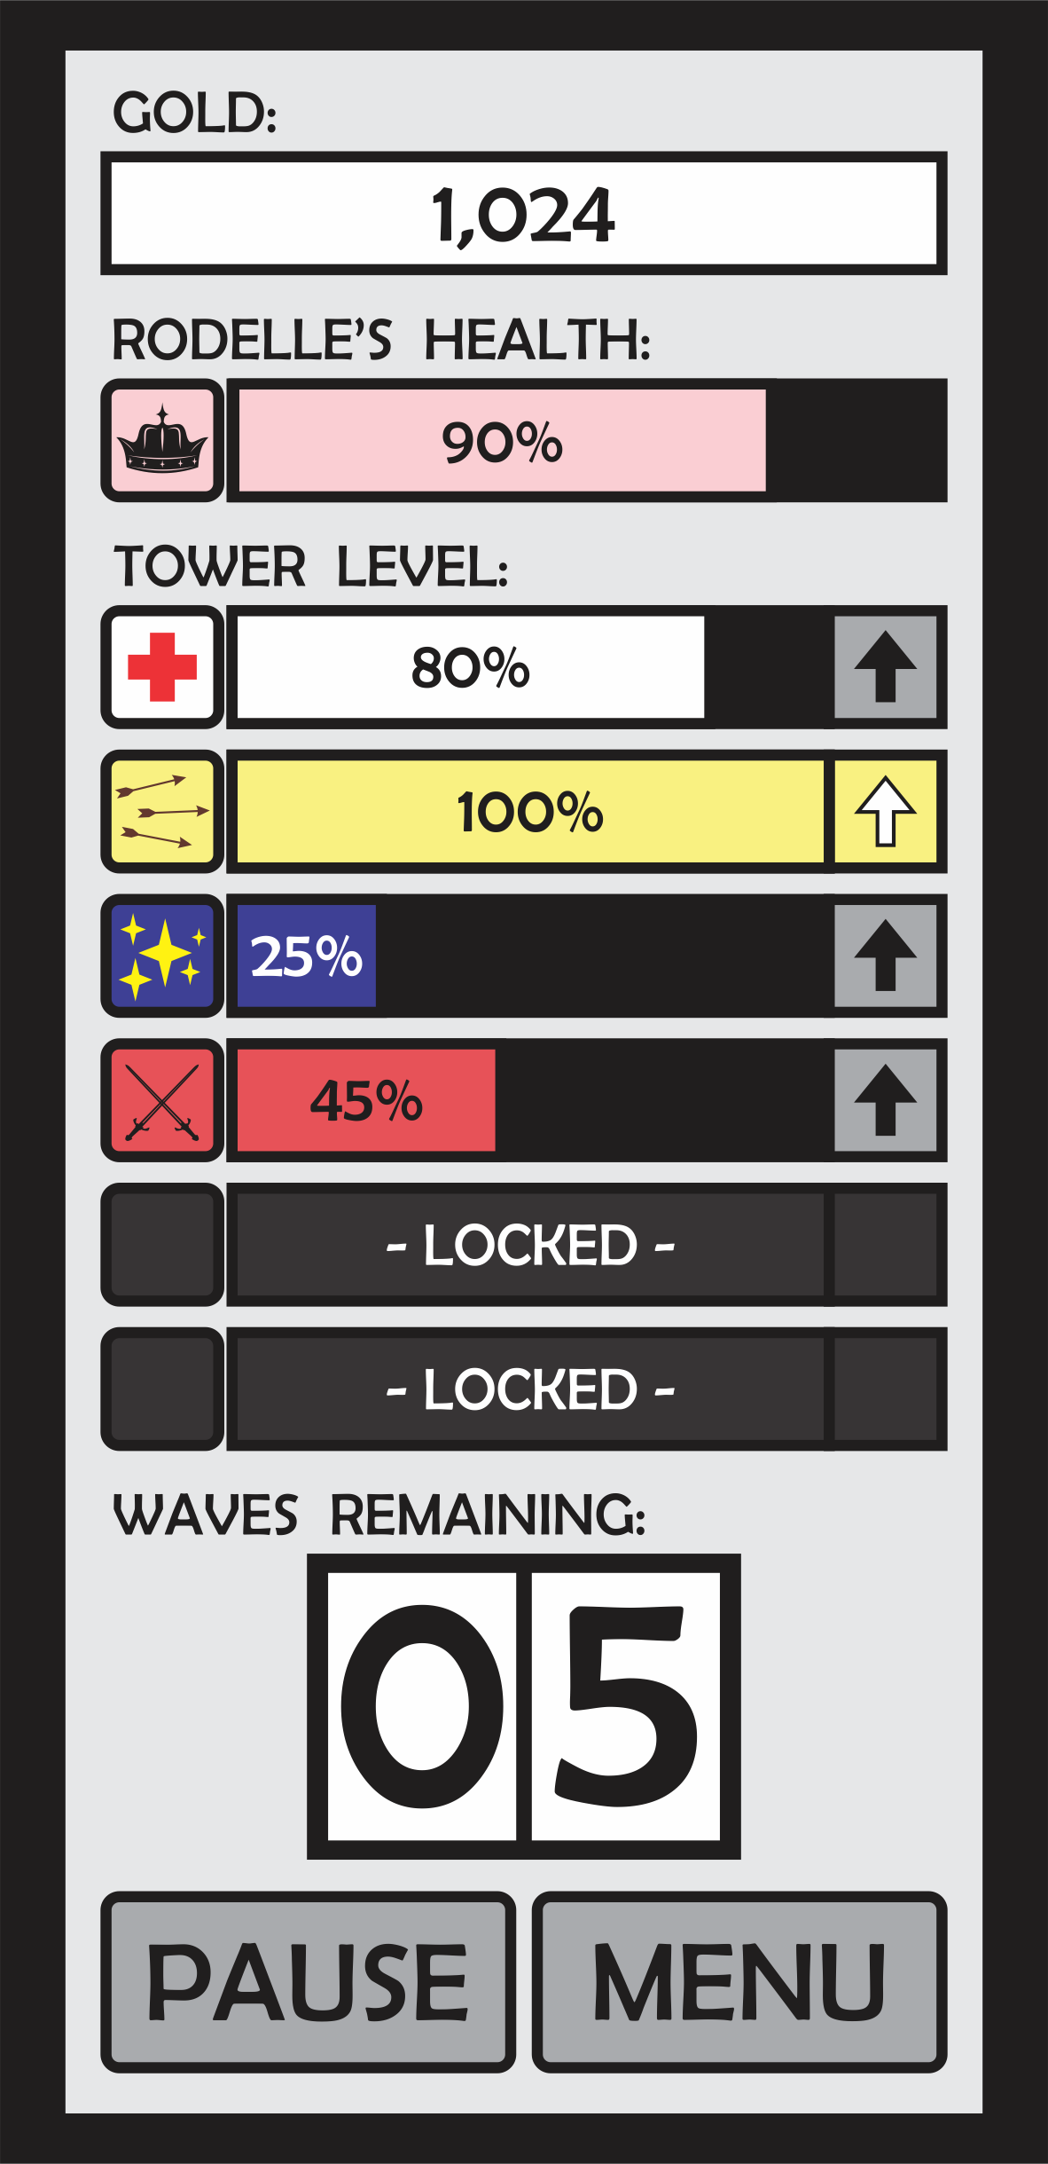
Upgrades & Achievements
Tower Levels:
During Levels
Control Panel & Experience
Soldier & Rodelle Boosts (Wish-listed):
Between Levels
Galactic Tower Store & Gold
(Badges)
Notes:
Insert Control Panel Diagram

Slide 9
Technical considerations (Prototypes)
Tower spawning units to user selected locations
Rendering units so they overlap correctly in 2.5D (top units have lower y-values)
Units clumping/arching around enemies nicely
Save/Load games
Tower control transition from user to enemy

Slide 10
#MATH (Questions)

