Slide 1
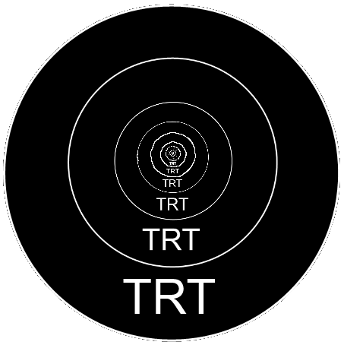
cRafTS
(name wip)
Jason Dailey, Melissa Kjelgaard,
Joseph Hoff, Brandon Roth

Slide 2
cRafTS?!
2D top-down - Multiplayer RTS
Set in a futuristic robotic dystopia
Players gather resources, build, make choices
Battle in the world of networked computers

Slide 3
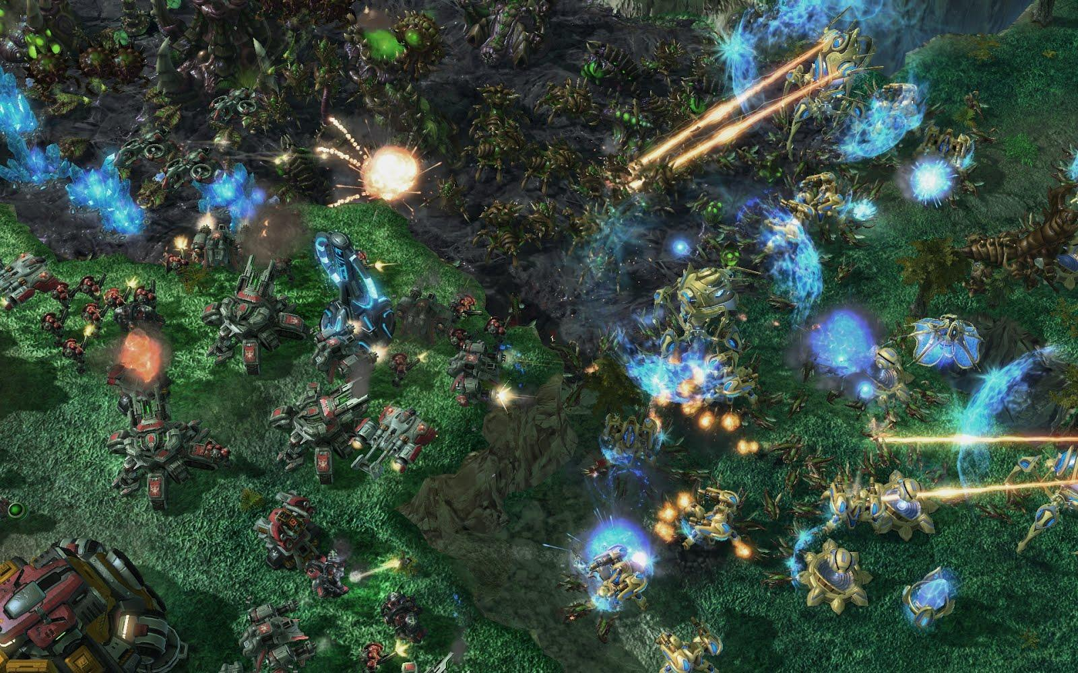
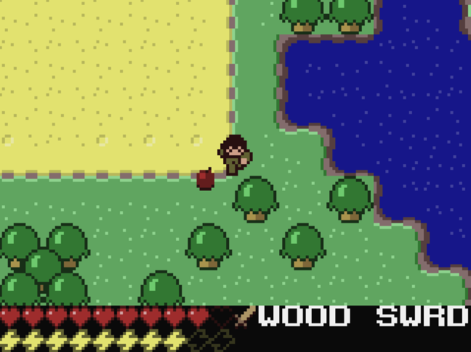
Synopsis
Notes:
Talk about having a RTS where you play as a leader and commander.
Combine perspective and resource gathering/crafting of minicraft with standard army and RTS elements from starcraft.

Slide 4

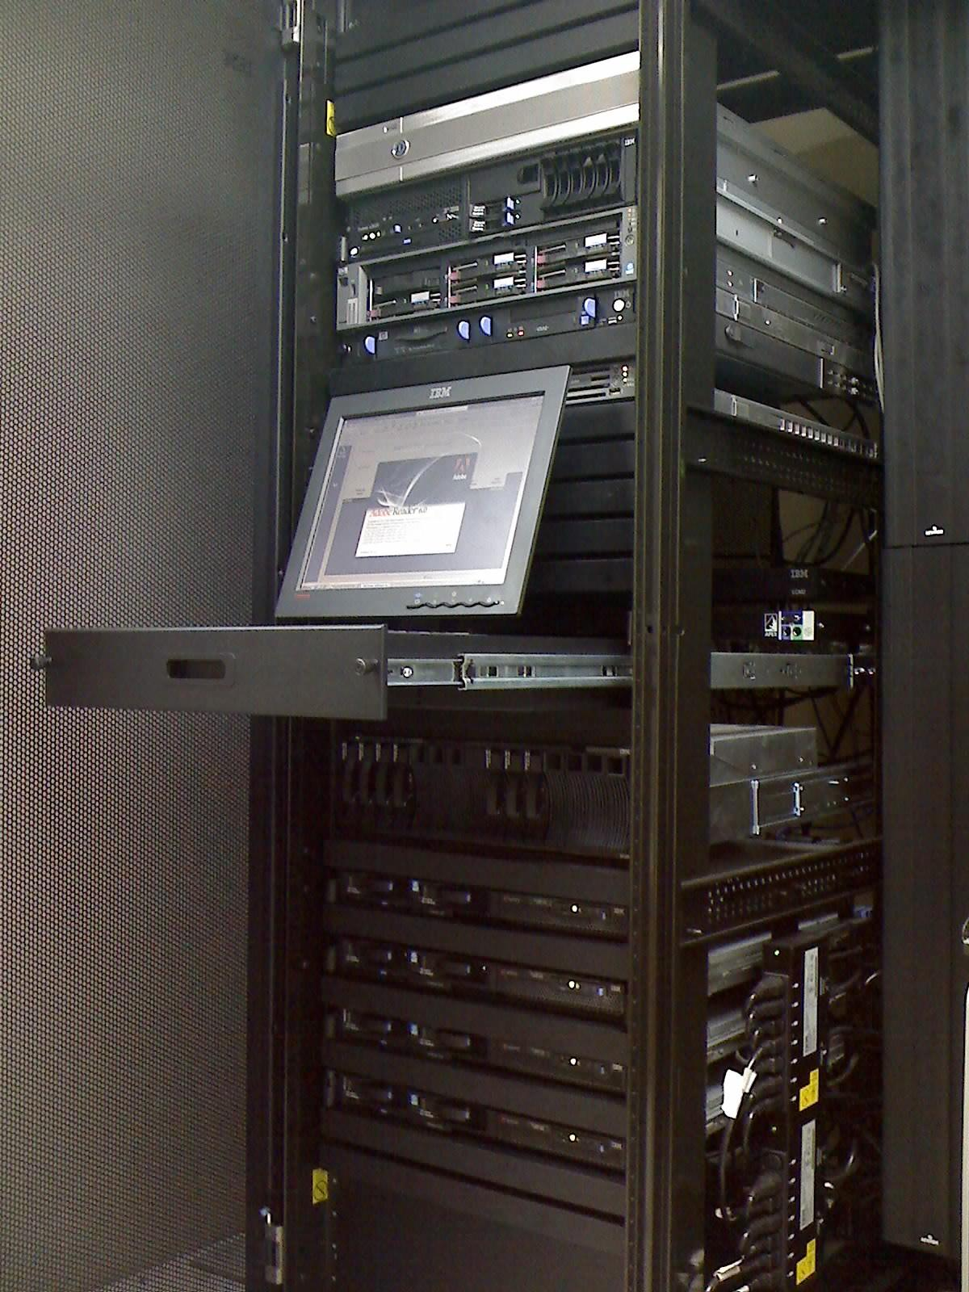
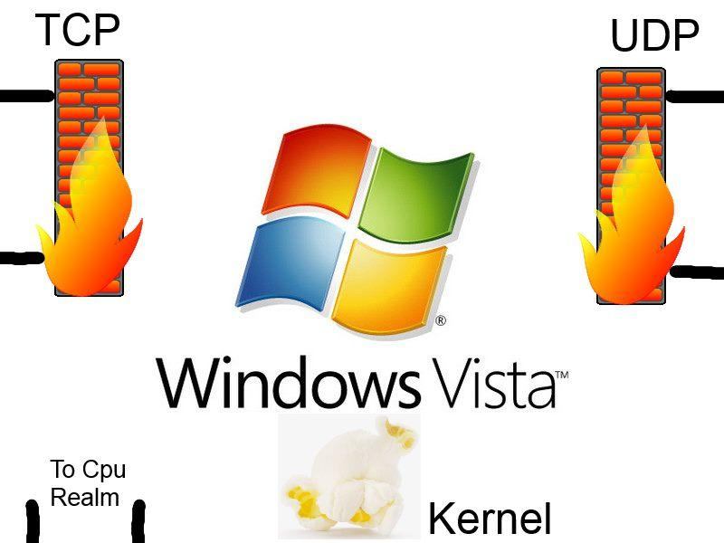

Two worlds
Physical World
Virtual World

Slide 5
Gameplay
Two Phases:
The Physical World - Resource Gathering, Upgrades, Strategy
The Virtual World - Combat, Direct Control of Units

Slide 6
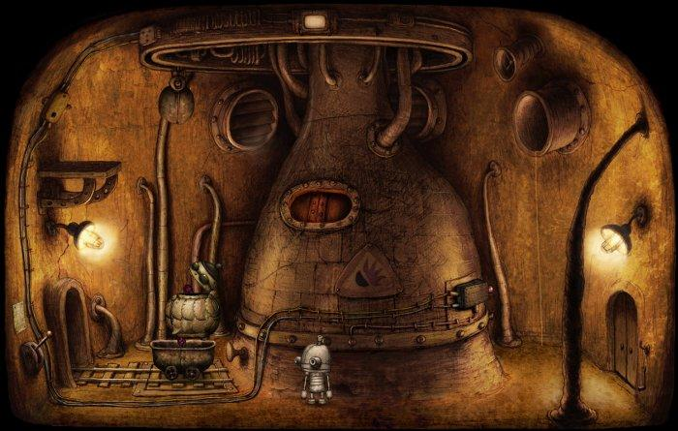
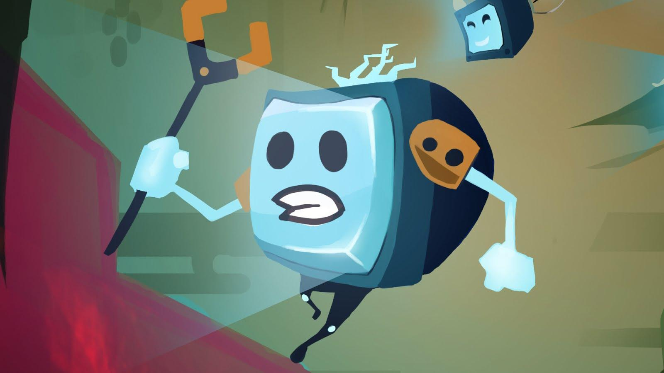
Art Themes
Physical Realm: Cartoony robot world (post-apocalyptic style)
Machinarium: example of a
near monochrome pallet
Mechanic Escape: example of desired character style
Notes:
Machinarium: example of a
near monochrome pallet

Slide 7
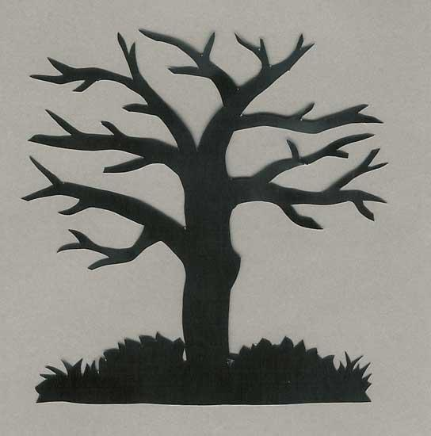

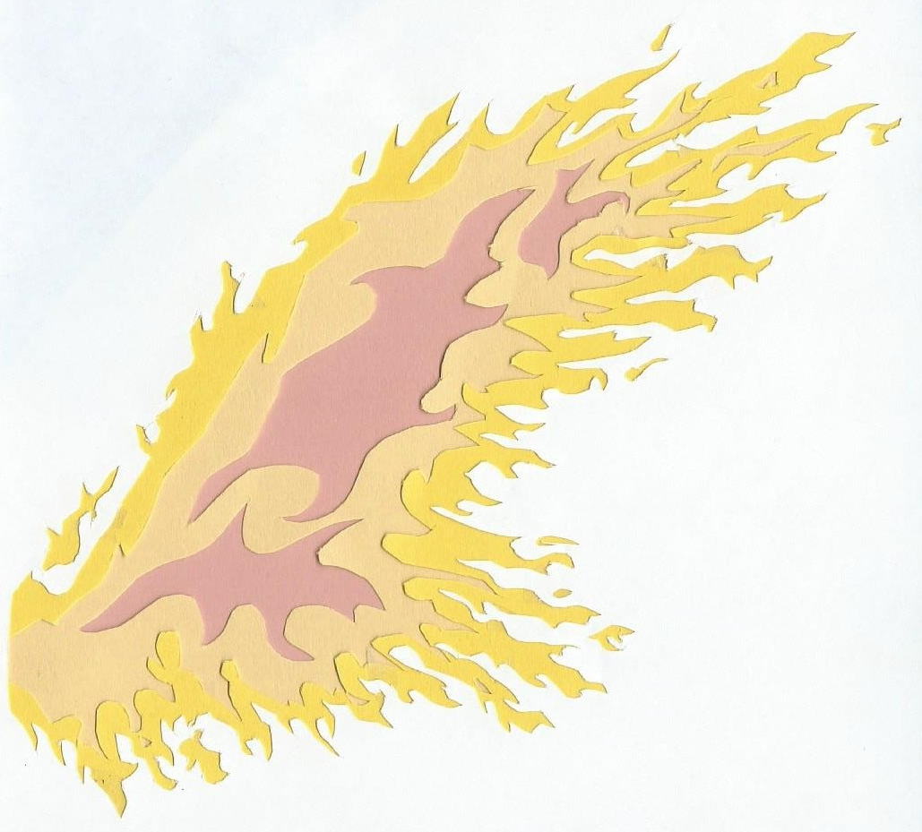
Art Themes
Virtual Realm: Scherenschnitte/kirigami style world with lots of color

Slide 8

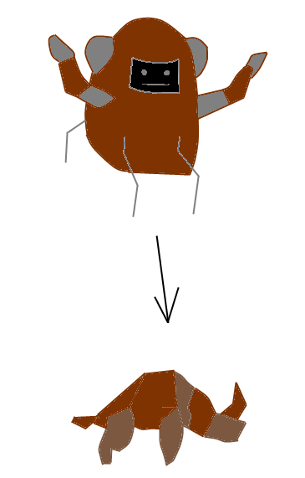
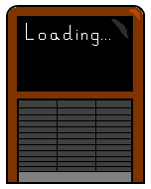
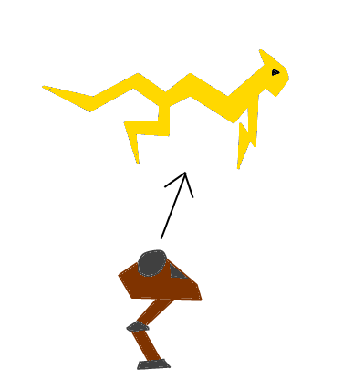

Preliminary Images

Slide 9
Sound Effects
Electronic steady sound with poppy distinctive sound effects
Background music will gradually change as you traverse the realms of the computer
Each character will have a distinct sound personality

Slide 10
Pitfalls/Challenges
Finding a good balance of fun and flow
Dropping features that are too expensive
Reaching consensus, eliminating ambiguity

Slide 11
Design Challenges
Successfully combine crafting and RTS
Create fluid transitions between realities
Make the code work in harmony with design!

Slide 12
Technical Challenges
Networking
Commanding units
Pathfinding
Crafting components together
Minimap or split screen
Dynamic world
Synchronization (maybe)
Hacking simulation (maybe)

Slide 13
Prototypes
0. Already working on networking prototype
0. Started on basic unit command prototype
1. Pathfinding is next prototype
2. Crafting units and collecting resources
3. Minimap prototype and combat AI
4. Dynamic World

Slide 14



Questions?

