Slide 1
Sprout
Arsany Azmy | Connor McGwire | Michael Ritchie | Spencer Milner

Slide 2
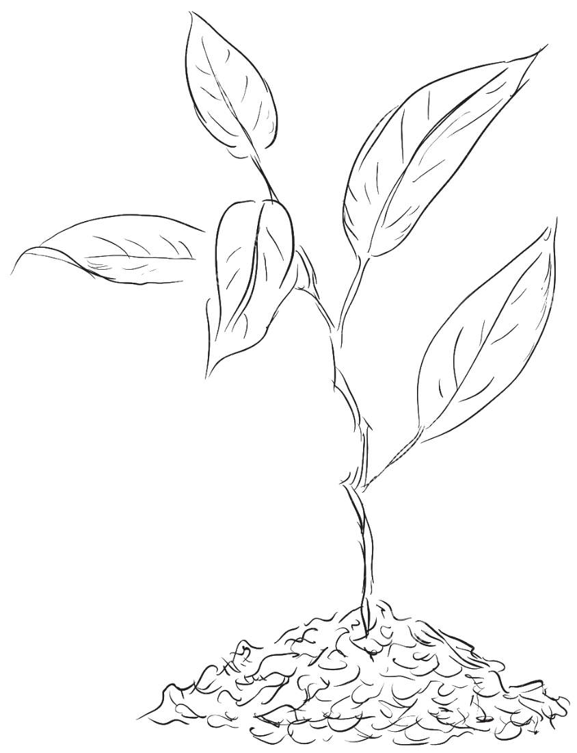
Outline
Overview
Setting and Narrative
Art
Objectives and Progression
Gameplay
Technical Challenges

Slide 3
In a sentence…
“Explore a mysterious world;
Turn a wasteland into a paradise…”

Slide 4
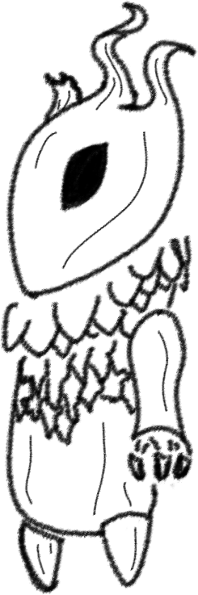
Setting & Narrative
Player controls a wooden sprite creature
Wakes up in a wasteland world
Immediate goal to return life to the land
Mystery of the world is unraveled as player progresses
Possible Player Character Design

Slide 5
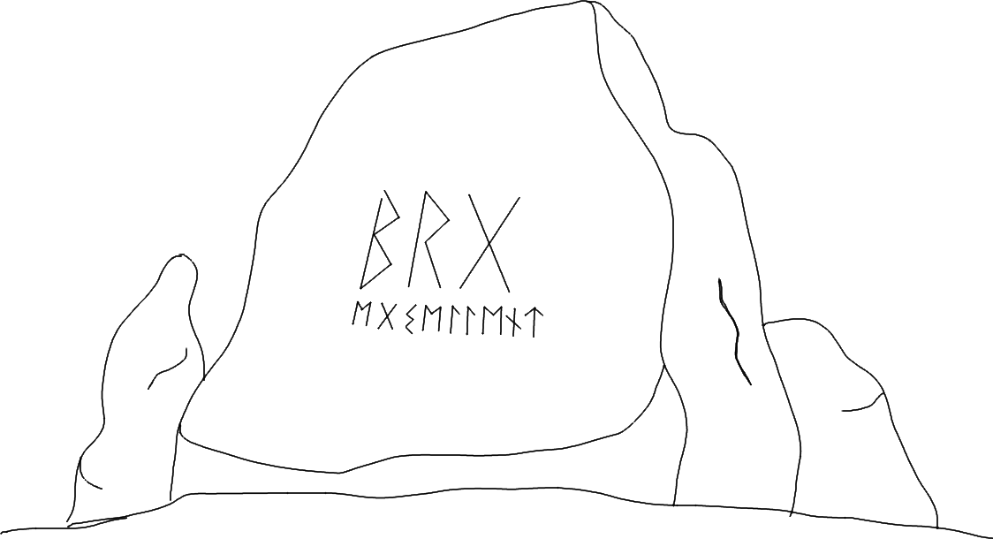
Setting & Narrative
We’re currently aiming for environmental storytelling
So minimal explicit narration

Slide 6
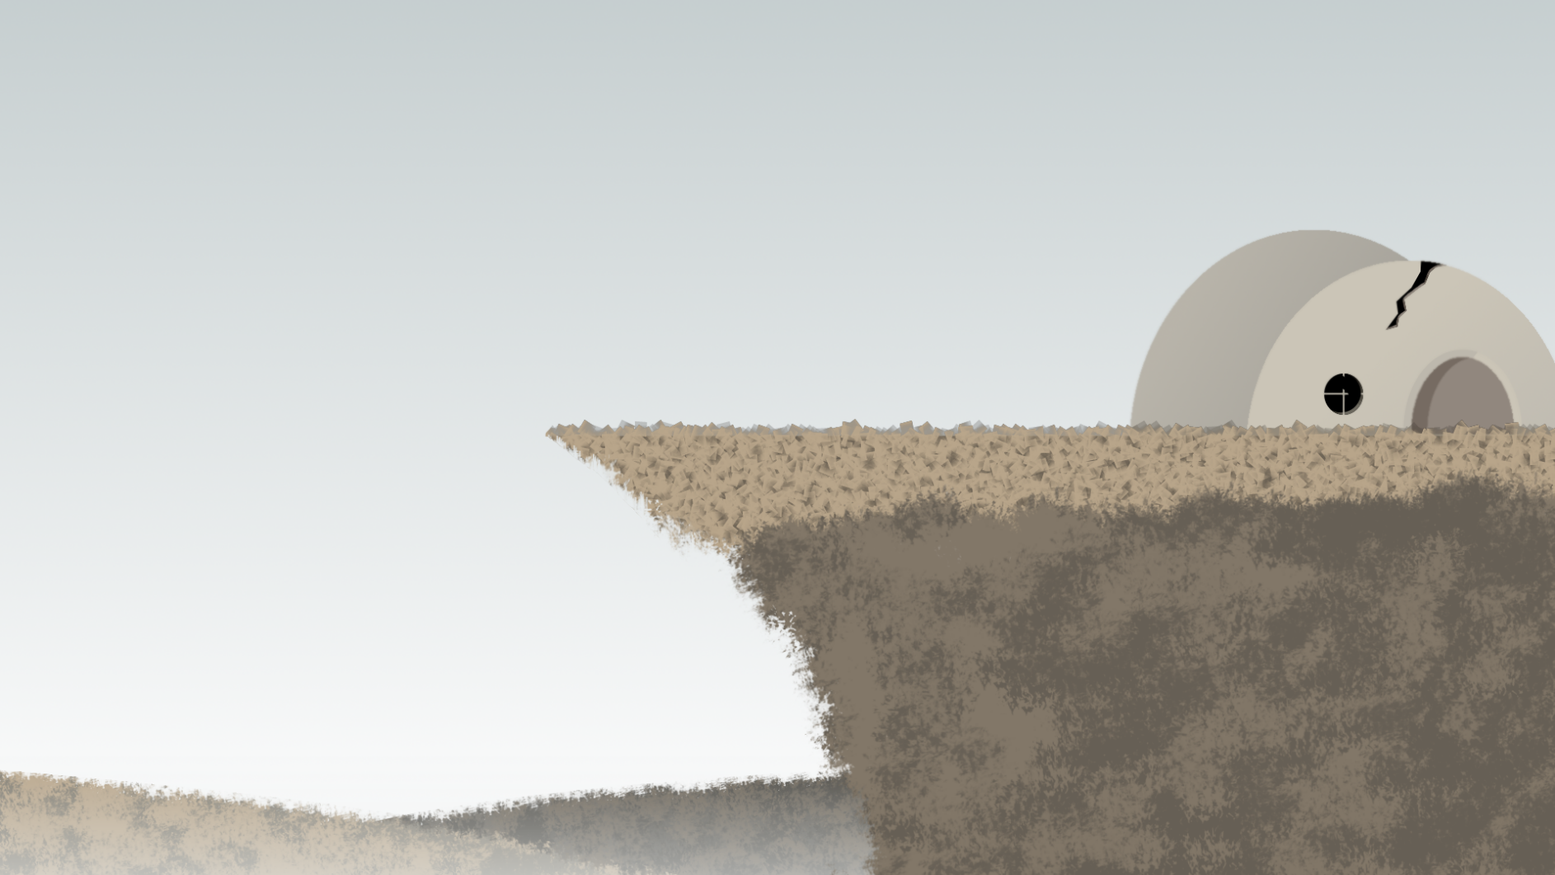
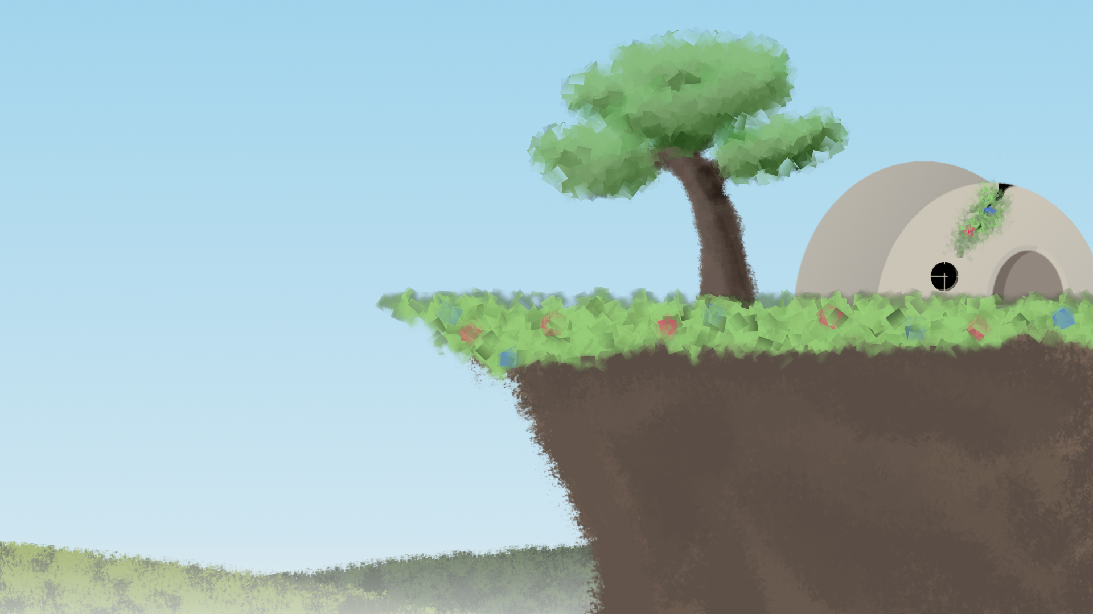
Art & Aesthetic

Slide 7
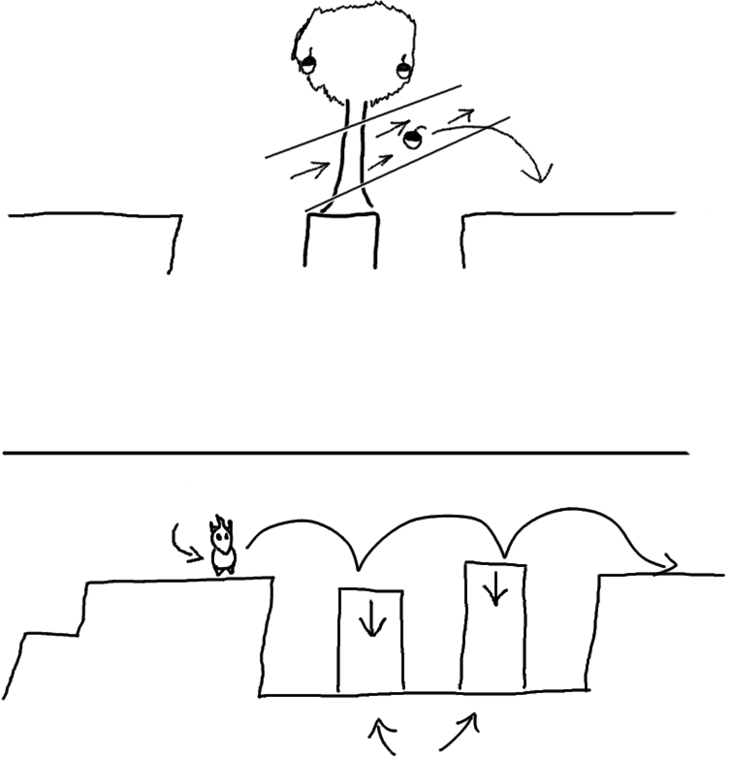
Gameplay & Puzzle Design
Seeds fall into pit
Player can manipulate:
Water
Air
Earth
To solve environment puzzles
Use wind to get to seeds
Player
Use earth powers to raise pillars

Slide 8
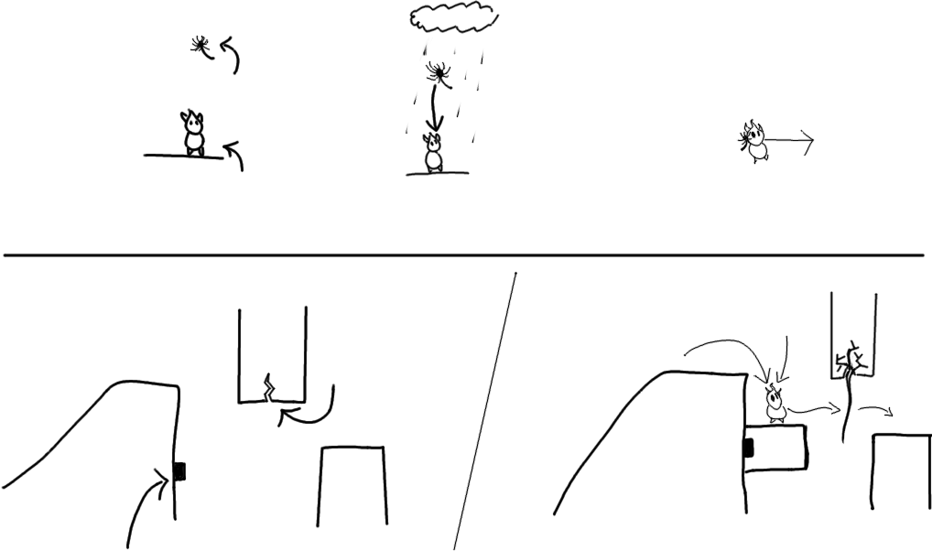
Gameplay & Puzzle Design
As player progresses, challenges become more complex…
Water brings the seeds down to stick onto you
Floating Seed
Hero carrying seed
Player
Player
Seed for vine here
Location to use earth power

Slide 9
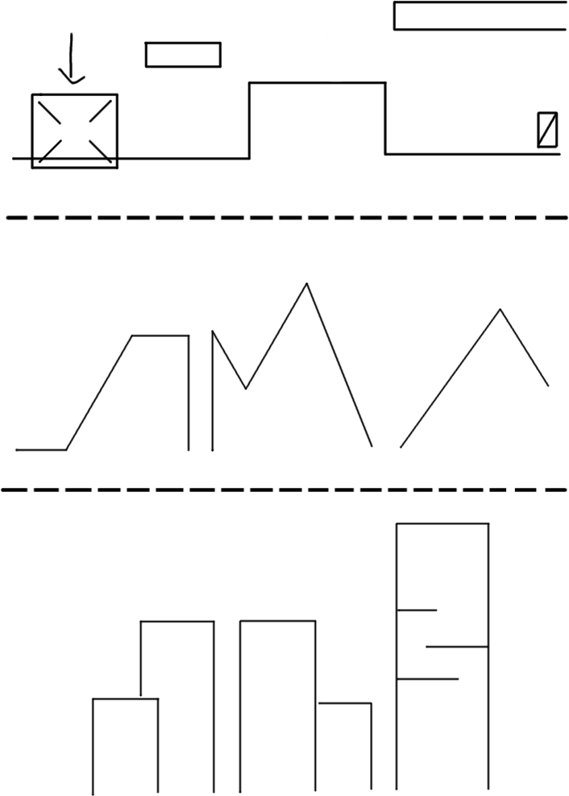
Level Design
Forest Area
Game Window
Levels are several spans larger than the game window
Each level has a distinct theme and series of puzzles
Mountain Area
City Area

Slide 10
Technical Challenges: Prototypes
Prototypes for:
Each player ability
Earth
Wind
Water
And each abilities interactions
Player Traversal
Seed Interactions

Slide 11
Technical Challenges: Other
Creating a compelling environment to explore in a short time frame
Creating a satisfying amount of content in a short time span

Slide 12
Thank you

