Slide 1

Meta Games
Putting the meta into games.

Slide 2
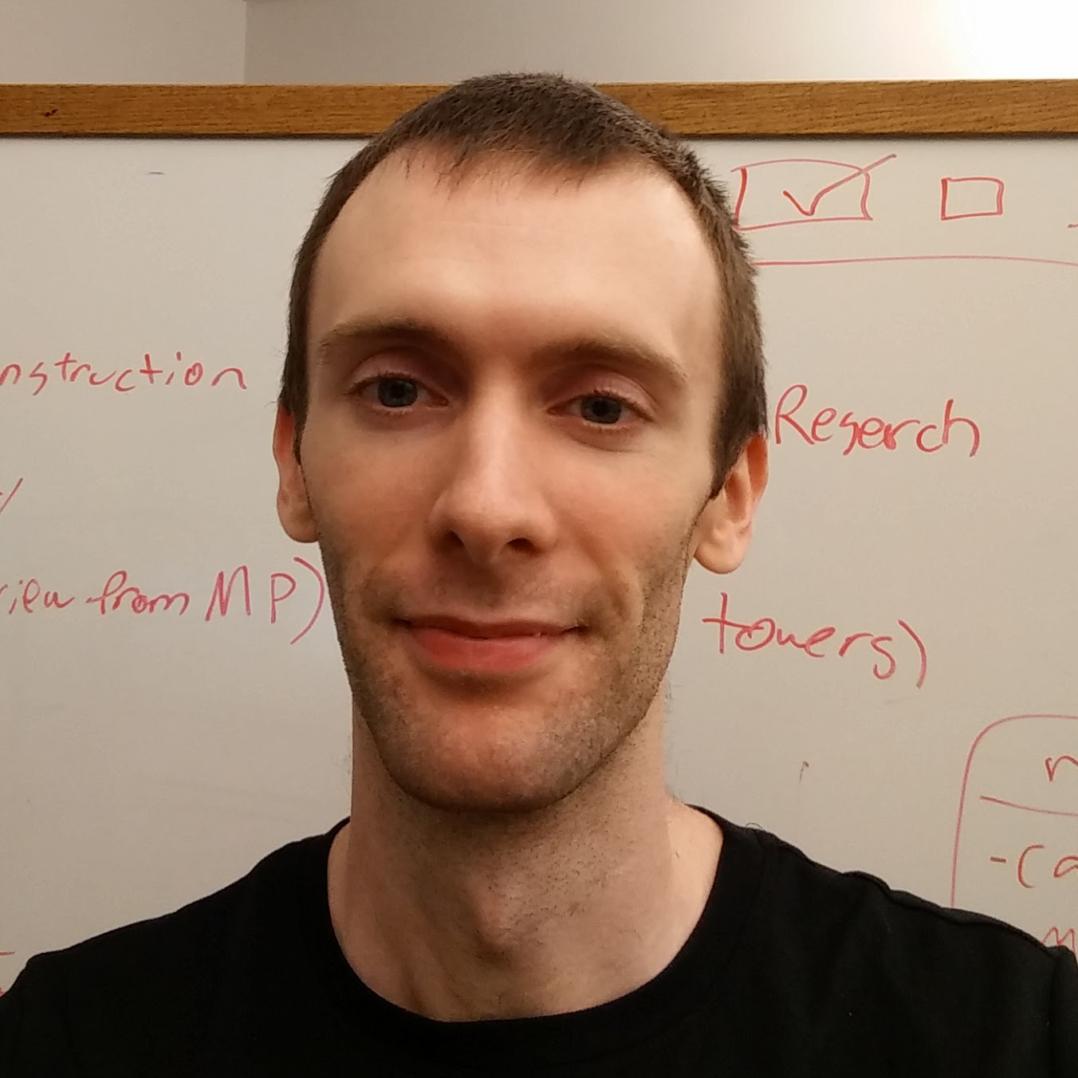

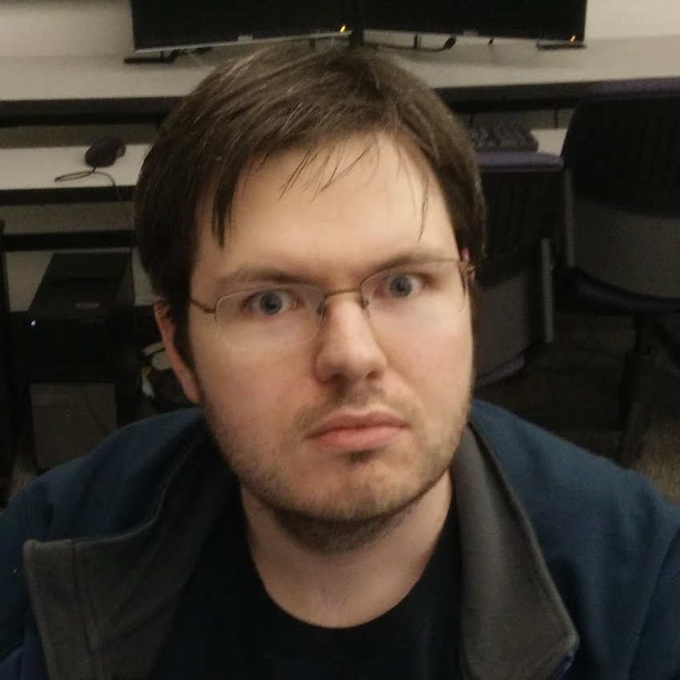
The team
Robert Griswold
Samuel Williams
Brent Eaves
Creative Lead
Lead Programmer
Lead Producer

Slide 3
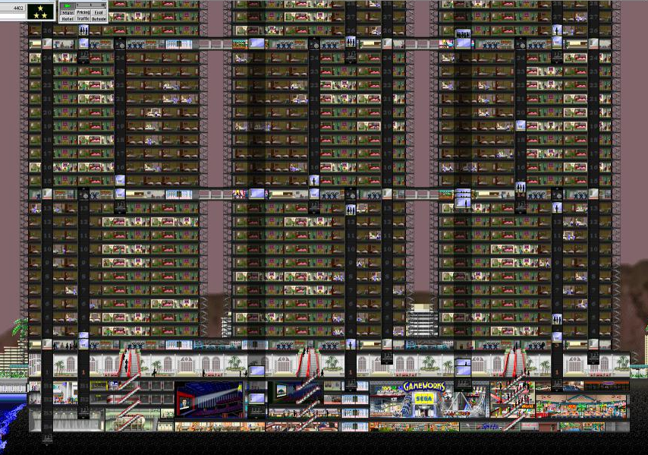
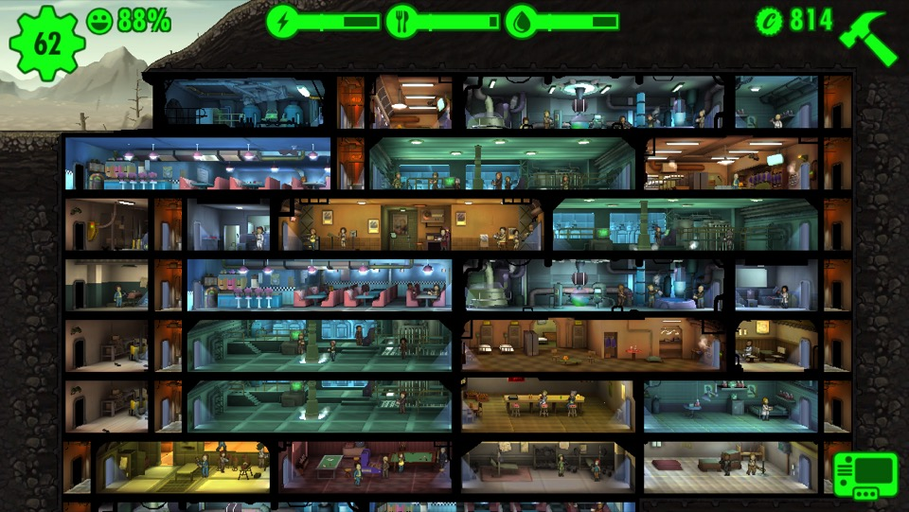
What does a tower management simulator game mean to you?
Bring your own dream building to life?
Strategically place rooms and stores to maximize profits?

Slide 4
Would you like to be an omniscient manager of a tower?
I know I would!

Slide 5

Seattle Towers

Slide 6
The Context
Seattle Towers is a tower construction and management simulator set in the heart of Seattle where the player is constructing a multi-purpose tower that hopes to overshadow the iconic space needle in both height and popularity.

Slide 7
Game Objectives
Design your multipurpose tower strategically to maximize profits.
Strategy?
Do you specialize, or do you diversify?
Do you build high, or do you spread out?
Do you keep like things together, or do you distribute?
Create the happiest virtual patrons.
Simulate a self-contained multi-purpose tower, and follow it through its economic hardships.

Slide 8
Open Ended Gameplay
Start building a tower from scratch using investment funds.
Plan out the construction floors while the game is paused.
Connect the floors using transportation methods like elevators.
Play out the day and watch patrons rush in to your tower to spend their money or live out their lives in your tower.
Spend your money on new construction and research.
Evaluate room interactions through happiness ratings given by the patrons.

Slide 9
Ways to spend money:
Construct new rooms.
Invest into research points.
(Pay maintenance costs).
Ways to spend research points:
Passives to increase room revenue.
Passives to increase room desirability (rented) or capacity (retail).
“Buff” rooms to augment nearby room types by increasing revenue and desirability.
Tutorial through population milestones:
Additional tower requirements introduced as the player reaches a population milestone.

Slide 10
Player Progression
Ways to spend money: Construct new rooms. Invest into research points. (Pay maintenance costs).
Ways to spend research points: Passives to increase room revenue. Passives to increase room desirability (rented) or capacity (retail). “Buff” rooms to augment nearby room types by increasing revenue and desirability.
Tutorial through population milestones: Additional tower requirements introduced as the player reaches a population milestone.

Slide 11
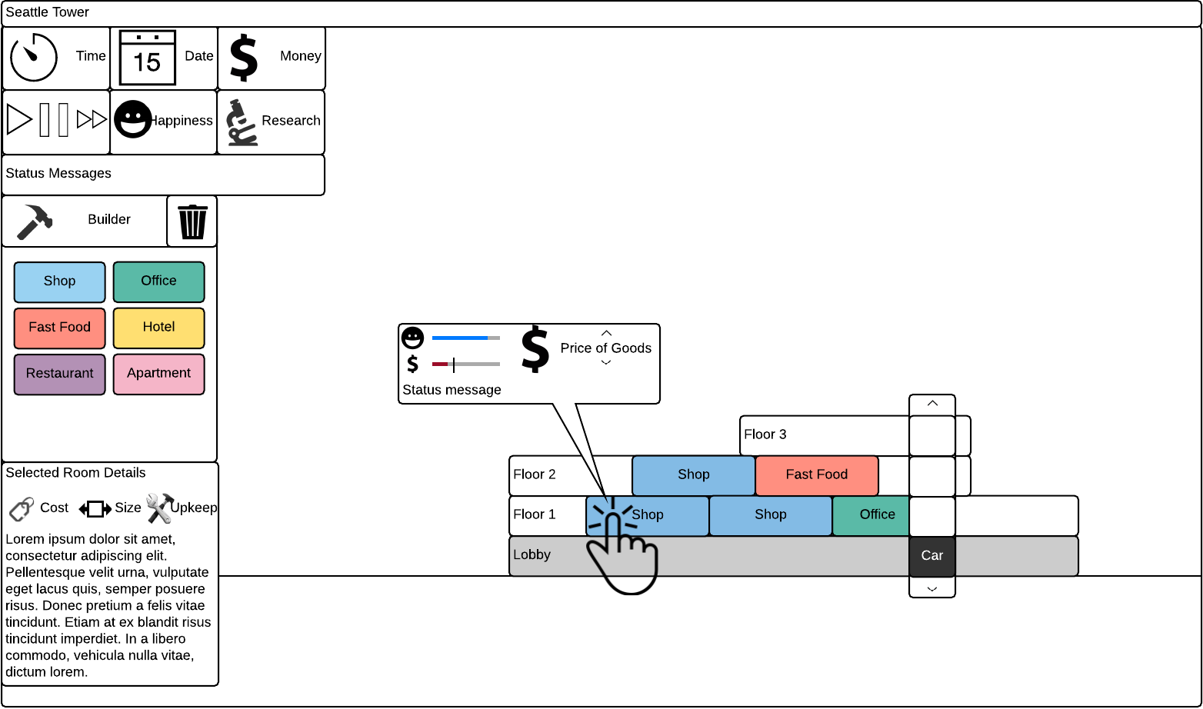
UI Mockup
Think big, but start small!
Keep everything close together.
Be unobtrusive.
Towers expand primarily up, so the UI should utilize horizontal space.
Only show builder and room details when needed.
No separate windows, only popups for configuration and status.
UI is just a step towards teaching the player what keyboard controls to use instead.

Slide 12
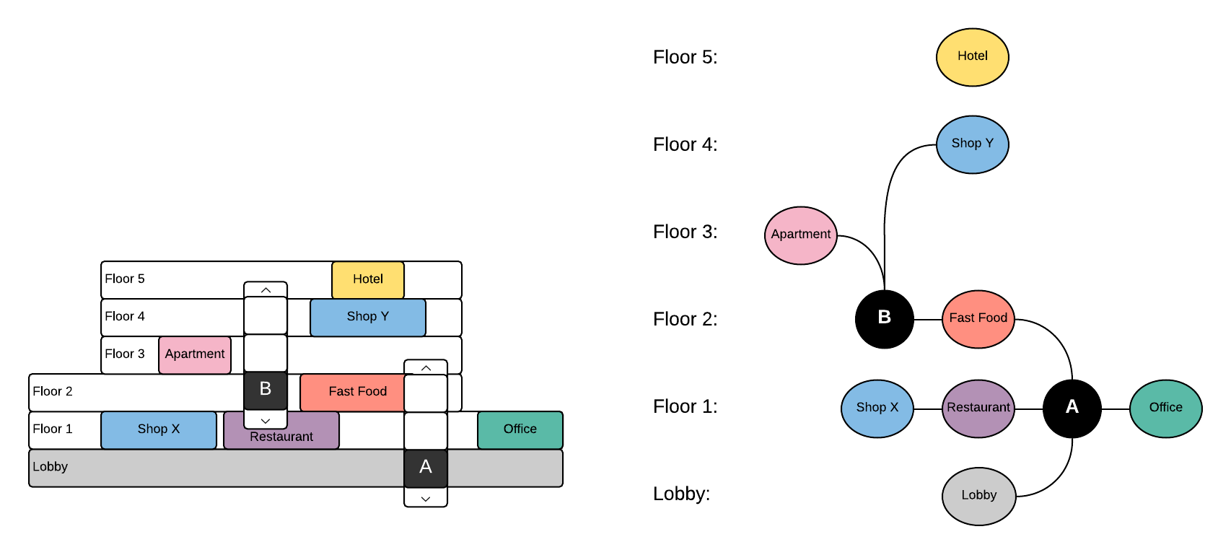
Prototyping Challenges
Room construction via mouse (click and drag that snaps to floors).
Save session and restore session.
Patron creation with randomized interests.
Elevator behavior.
Pathfinding to a destination through elevators.

Slide 13
Future Development
More room types and research tree expansion:
Room variety within a category.
More “buff” room variety.
Various maintenance rooms (e.g. trash, power, security, parking, etc.)
More dynamic room interactions:
Events (e.g. hotel conventions, holiday sales, etc.)
Multiplayer capabilities:
Visit other towers and rate them for research points.

