Slide 1
MOONSCAPE
Bobby Damore, Hiro Yuan, Tung Le, Shijie Xiong

Slide 2
Storyline
A full moon is coming out tonight, and the hero must race to shelter before being exposed.
Once fully exposed, the hero will transform into a strong and fast werewolf, which will be uncontrollable in a few secs.
The shelter at the end of each level will protect the hero from being exposed and prevent him from being uncontrollable.

Slide 3

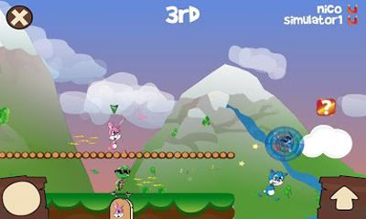
Game Info
Horizontally scrolling view that follows the hero as he progresses past obstacles.
The hero will accelerate to a max speed as long as nothing gets in the way.
There will be power ups, such as speed boost and jump boost, as well as power downs that may slow down the hero or prevent acceleration.
Obstacles will be walls to jump over or slide underneath. Some obstacles may slow the hero down or send him back to a checkpoint. There will also be traps to avoid.

Slide 4
Character
Hero’s movement ability:
Horizontal Movement (Walk, Run, or Slide)
Vertical Movement (Jump or Double Jump)
Hero’s attributes:
Different Texture in different forms of hero
Rigid body
Velocity
Acceleration
Coin Collection System
Life time

Slide 5
Levels
Difficulty select UI
Tutorial
Normal
Challenge
Bonus Stage
Player can get extra coin
Player should be careful for missing stage
Shop Scene
Between each stage

Slide 6
Prototyping
Player’s speed is increasing gradually by user input reducing speed with neutral control
Player is able to interact with bonus stage object and change scene after interacting
Player can enhance his speed after interacting with speed up panel
Player can earn coin when he collides with coin
Player lose coins when he falls down

Slide 7
Wishlist
The feature of changing forms of hero by the player
The feature of randomly combining different stages into a challenge stage
The feature of changing to 3D version
The feature of being applicable to iOS or Android System

Slide 8
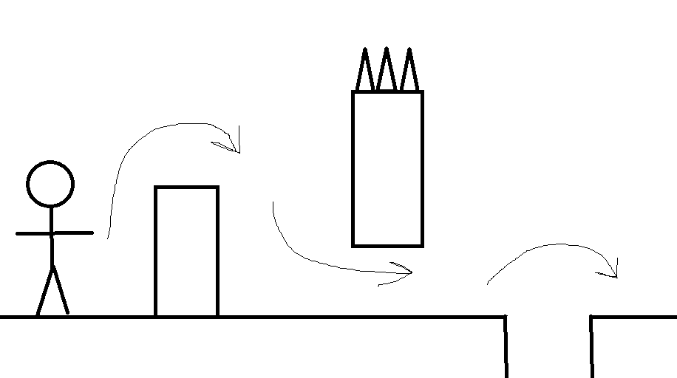
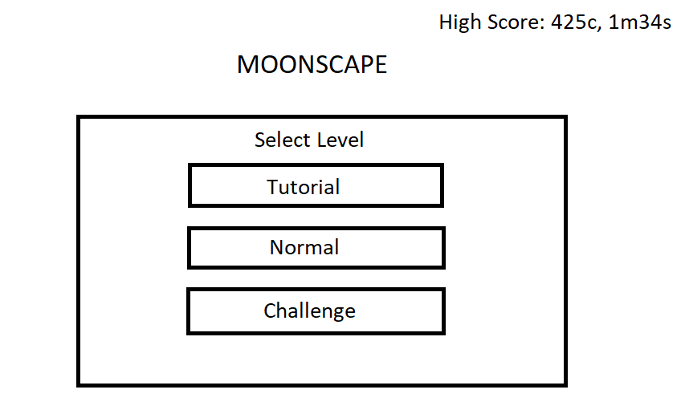
Visuals

