Slide 1
Dynamic Trees & Foliage
Cody Thayer and Ihsan Halimun
CSS 451

Slide 2
Overview
A tool for creating 3-dimensional tree and foliage objects within Unity
The program will allow:
Tree generation based on parameters (number of branches, size, etc)
Modification by the user in real time
Reactions to simplified physical forces, such as wind.

Slide 3
Core Requirements
Graphical Objects
A SceneNode hierarchy will be used as the basis for the underlying structure of the tree/foliage that is created. This will be used to hold the geometry of the tree, apply transformations and textures, and support user manipulation of the object.
Our hierarchy will also support the simplified wind physics simulation that is detailed below. This will mainly require a leaf-to-root traversal for each branch that is used to apply the forces prior to rendering each frame.

Slide 4
Core Requirements (cont.)
Illumination and Textures
At the minimum, we will support simple phong-illumination of the tree’s branches and structure. In this case we will define simple lit shaders that indicate the basic purpose of each part of the structure (i.e. brown for branches and trunk, green for leaf primitives).
We would like to support shaders that give either a stylized or semi-realistic appearance to the tree if we have time. For instance, we would like to implement a way to use a twig/leaf texture on quads that would be attached to the outermost branches (leaf nodes).

Slide 5
Core Requirements (cont.)
Object Interaction
We will support direct manipulation of the location and orientation of the tree branches by the user. This will rely on a mouse-selection interface that allows the user to reposition and orient “control points” that run along the length of the branch and control it’s positioning. This will allow the user to craft a customized look for each tree.
Additionally, there will be a 3D arrow-shaped object that will serve as a controller for the wind vector (as detailed in the Simplified Wind Physics section).

Slide 6
Core Requirements (cont.)
Multiple Camera Views
We will have a primary camera that is controlled by the user and supports tumble, track, and dolly. This will be the main viewport that they can use to edit and manipulate the tree.
A secondary camera and viewport will be used to provide another angle for the user to make manipulation of branches easier.
For instance, changing the positioning of one branch may look fine from a certain angle but may actually cause it end up inside another branch. The secondary camera will help to visualize this faster without having to constantly rotate the main view to check for issues. This camera will start at an angle orthogonal to the main view (e.g. top-down view).

Slide 7
Core Requirements (cont.)
Supporting Algorithms and Technology
Simplified Wind Physics:
We plan to implement a stripped-down version of wind simulation that will allow the trees to have a more dynamic quality to them.
We will provide an on-screen object that the user can use to control the wind vector that influences the tree. The direction vector represented/controlled by this object will then be used to cause the branches on the tree to move and sway.
The movement will be calculated by applying the wind vector “chain of control nodes” that make up each branch, starting at the end. The amount of flex and sway will also be influenced by the branch thickness at each node.
L-System
In order to generate trees and other foliage based on a set of parameters we will use an L-System (Lindenmayer system) that relies on a symbolic alphabet, a set of production rules that accept input parameters, and randomness for variation.

Slide 8
Visual
Wind Controls
W
Wind Speed:
Wind X-Direction:
Wind Y-Direction:
Wind Z-Direction:
Tree Parameters
W
Number of Branches:
Number of Leaves:
Branch Length:
Branch Angle:
Variation:
GENERATE
Trunk
Branch (1)
Branch (2)
Leaf

Slide 9
Visual (Tree Generation)
Tree Parameters
W
Number of Branches: 3
Number of Leaves: 3
Branch Length: 3.5000
Branch Angle: 45.0000
Variation: 0
GENERATE

Slide 10
Visual (Wind Control)
Wind Controls
W
Wind Speed:
10.0000
Wind X-Direction:
Wind Y-Direction:
Wind Z-Direction:
WIND

Slide 11
Visual (Tree Manipulation)
“Control Points” to manipulate branches

Slide 12
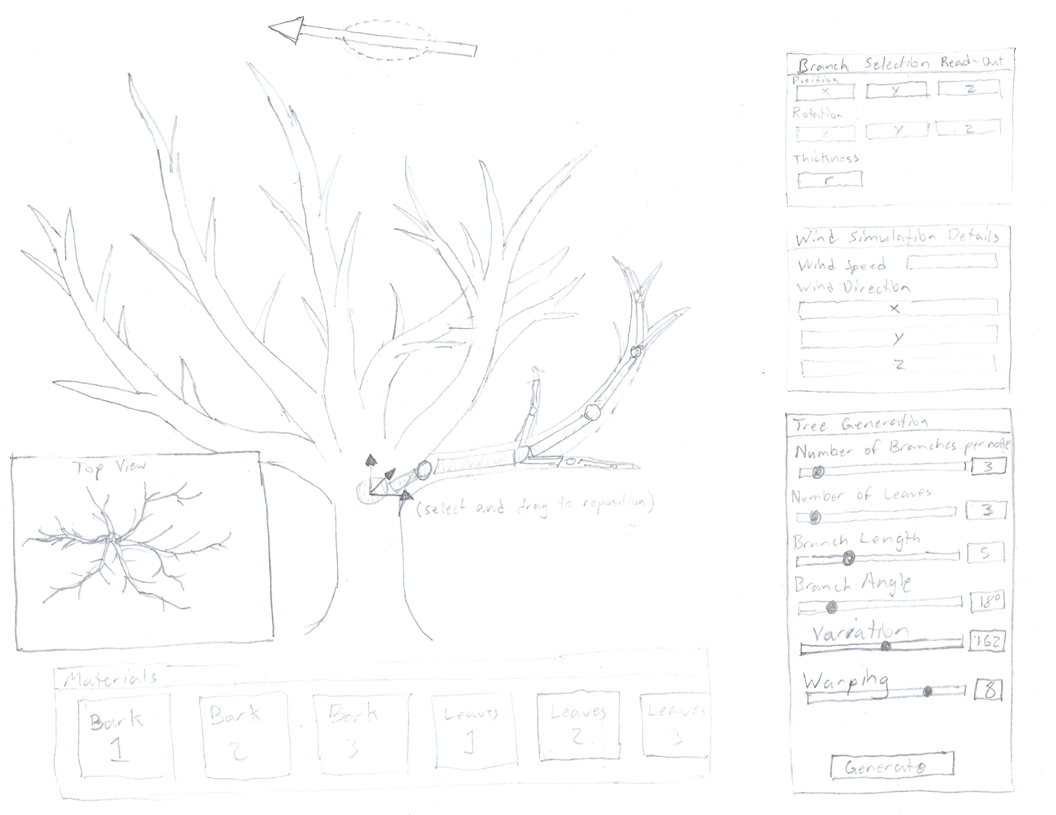
Initial Design

Slide 13
Proposed Milestone Schedule
11/13/19 - Proposal Presentation
11/17/19 - Core Interactions and Data Structures Implemented
Camera Controls
Scene Node Hierarchy
Basic UI
Node Controllers
Preliminary Shaders (functional, lit shaders)
11/20/19 - Wind Simulation Proof of Concept + System Improvements
Wind Vector Controller
Functioning application of wind forces to a branch
Improvements to L-System Interface
11/24/19 - Basic L-System Implementation
Core code for the symbolic alphabet
Core production rule code (can be very simple)
Parameterized input
Can generate very basic trees from code & parameters
11/25/19 - Progress Demo
Functional build for demo
Shows basic features, doesn’t need to be bug free

Slide 14
Proposed Milestone Schedule (cont.)
12/1/19 - Improved Shaders + L-System Refinement
Better shaders (possibly supporting higher quality textures)
L-System improvements including:
Improved output (better trees)
Expanded production rules
Randomization controls?
Bug Fixes
12/4/19 - L-System and Wind Simulation Refinement
Multi-branch wind simulation fully supported
Wind speed randomization (over time)
UI Improvements
Bug Fixes
Project should be nearly complete
12/8/19 - Final Build & Submission Materials
Final Build with all features
Video for demo rendered and complete
HTML table for submission
Signed Release Forms
12/9/19 - Final Presentation

