Slide 1
Type-O’s
Chad Dugie Michael Voght Ryu Muthui

Slide 2
Game Concept
Open world space shooter.
Gives the player a chance to explore the main game world, while attacking and defending from enemies.
Challenging and fun boss battle.

Slide 3
Scenes
Title/Splash Scene
Open World Scene
Boss Scene
Victory / Game Over Scene
Credit Scene

Slide 4
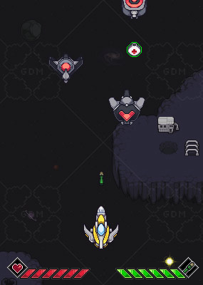
3 Different Game Objects
Player
Ship
Time Dimensional Lasers
Enemy
Ship
Time Dimensional Lasers
Space Station
Boss
Ship
Time Dimensional Lasers
Power-ups
Health
Shield

Slide 5
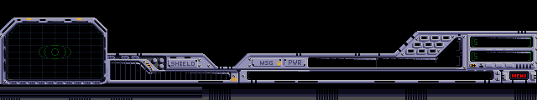
Camera(s)
Main view port as the main camera where all UI and game interaction takes place.
A mini-map view at bottom of the screen to indicate player/enemy positions shown in main view.

Slide 6
Behavior
We hope to incorporate: - Camera Shake when player is damaged. - Camera panning with clamping to open world map. - Enemies will chase and fire time dimensional lasers at the player.

Slide 7
Lighting
Point
Tip of Player’s ship lights up when firing time dimensional lasers.
Tip of Enemy ships light up when firing time dimensional lasers.
Directional
We will use the Sun as our directional light (maybe add a small rotation overtime).
Spotlight
The Boss will have three spotlights. One on each wing and one on the body of the ship.

Slide 8
Loose Ends
Normal Mapping
The enemy space station will rotate, allowing the sun’s directional light to reveal the detail of the space station.
Particle System
When a ship is hit by the time dimensional lasers and transported to a new dimension, a particle effect is left behind where the ship once was.

