Slide 1
TypOs
Chad Dugie Michael Voght Ryu Muthui

Slide 2
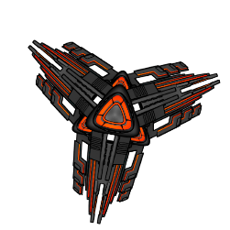
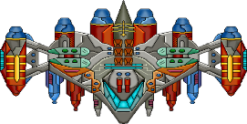





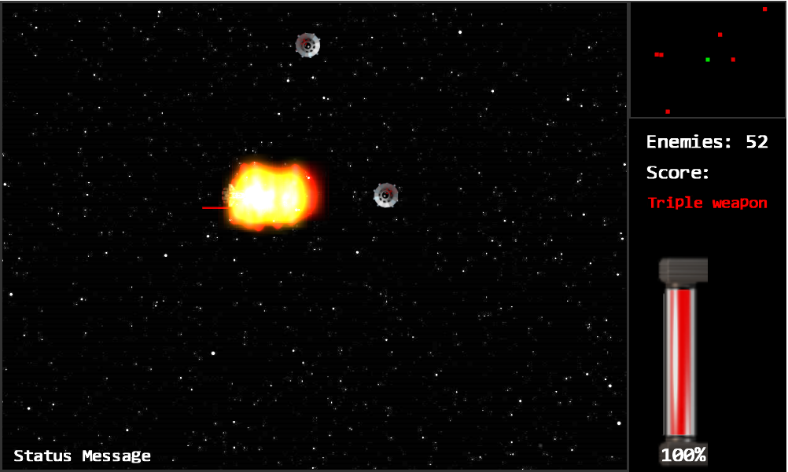
Scenes
Title/Splash Scene
Story/Controls Scene
Open World Scene
Boss Scene
Victory / Game Over Scene
Credit Scene
Complexity
7 Different Game Objects
Space Station
Turrets
2 Different Enemies
Saucers
Blades
Boss
Hero
Power Up
Camera Views
Main Camera
Mini Map Camera
UI Camera

Slide 3
Object Behavior
Interpolation
Camera Pan
Camera Shake
Autonomous Behavior
Saucer
Boss
Game World
Lights
Point Light
Hero Laser (when firing)
Directional Light
Main Scene
Boss Scene
Spotlight
2 Boss Spotlights (animate)
Meaningful Game
We feel that we have built a meaningful game given the time frame. It’s a simple idea that gives in depth gameplay and a chance for us to explore the thoughts and tasks in making a game.
Our gameplay mirrors other gameplay designs, seek and destroy an obstacle without dying and clear the area to advance to the next objective.

Slide 4
