Slide 1
Game Pitch
Jason Herold, Matt Lindquist, Matt Stewart

Slide 2
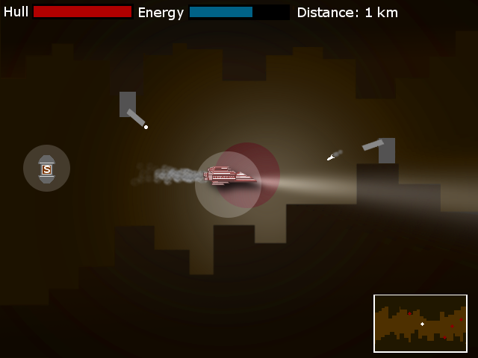

Slide 3
Basic Explanation
Side scrolling shooter type game where you are the ship
Ship has energy, which gets depleted as they take damage. As they take damage, the size of their light gets smaller
Randomly generated terrain
Turrets
Powerups

Slide 4
Technical requirements
Scene
Flesh scene/game level
Win/lose screens
Win screen may be dependent on reaching a certain distance
Title screen – similar to flesh screen, will have scrolling terrain as the backdrop

Slide 5
Technical requirements
Complexity
3 game objects: Hero, turret, bullet, terrain
10+ instances: Terrain will cover this at all times
Per pixel collision: Bullet to hero
2 camera views: Mini map
Behavior
Interpolation: Use for powerup “float”
Following behavior: Homing rocket

Slide 6
Technical requirements
Game world
5+ lights: Spotlights for powerups, spotlights for turrets, point light for lighting around the ship, directional light for light coming out of ship, spot/point light for bullets
Parameterized lights: Most lights will change position. Turret spotlights could change color when they see you
Normal map: Terrain texture will have a normal map so that the terrain gets darker as it gets further from the center

Slide 7
Technical requirements
Drop shadow on ship
Smoke trailing behind ship/rocket
Explosion on death

