Slide 1

Andromeda M31
By Adventurers Inc.
Group members:

Slide 2






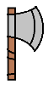
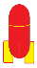

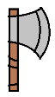
defense
Axe
Missle
defense
Axe
Missle
Q
W
E
R
U
I
O
P
A
S
D
J
K
L
SHIFT
SPACE
Shoot
Shoot

Slide 3
Our game happens in Andromeda M31 which is 220 light years from Earth

Slide 4


Characters
Two Character
Player takes control of one flying saucer
Blue one: More firepower; Moves slower
Yellow one: More Flexible; Lighter firepower

Slide 5


Game Property:
“Missile” : Tracking and attacking
“Shield” : Hack your opponent,
not able to defense

Slide 6


Game Property:
“Medikit” : Supply the HP
“Axe” : Spliting the stones forward

Slide 7
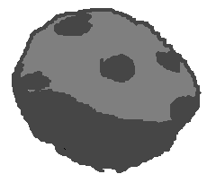
Barrier:
“Stones” : Flying towards you
Notice : Your HP decrease when crushing on stones

Slide 9
Game rules
Two players
Chose your character
Designed HP, for example, 5 HP
Evade the collision with stones
You can move in every direction
Props picked up have different function
The last survivor is the winner
0 HP means you GAME OVER !

