Slide 1

Group:Six God
Shadow or Life
PRESENTED BY group 6
Leng Wei,Gao Yu,Yang Hao

Slide 2
1 『Introduction』
目录
2 『Frame』
CONTENTS
3 『Challenge』
4 『Goal』

Slide 3
Part 1
Introduction

Slide 4

1
Hero
Name:
Nobody
Goal :
Take back of his Life

Slide 5





1
Story
Devil find him and take away all of him
Exiled into the abyss
Climb out of the abyss and find ‘SixGod’

Slide 6



1
Control
+A,D
Run
+W
Jump
+S
Slide
+W
Climb

Slide 7
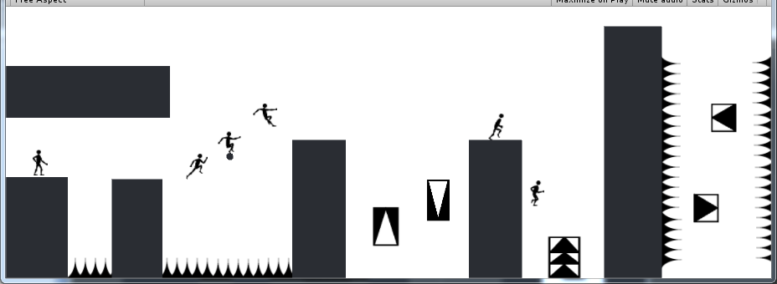
1
Imagine1

Slide 8
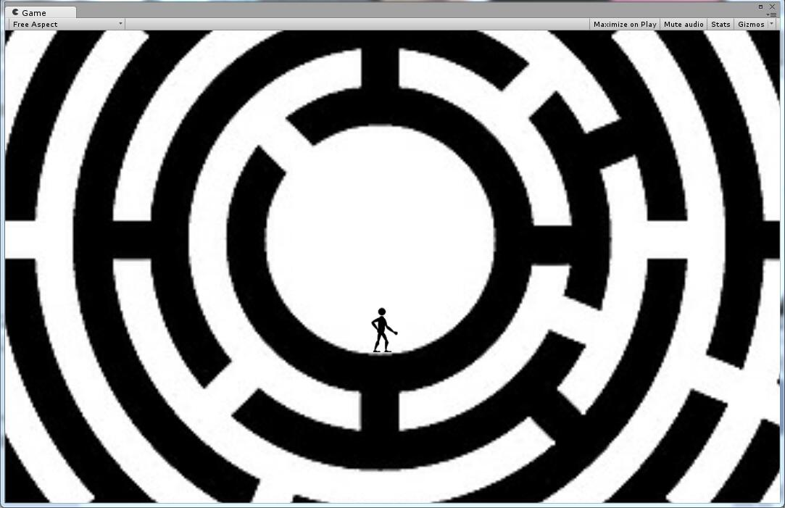
1
Imagine2

Slide 9
Part 2
Frame

Slide 10
3
Frame
Engine
Camera
Core
Light
Renderable
Physics
Shaders
GameObject
Hero
Wall
Obstacle
Platform
Simple FS,VS
Texture
Light
Shadow
GLSLShader
MyGame

Slide 11
2
Component
Scene
Object
Background
3 Scene,
3 Levels
One hero,
Many materials,
Maybe some enemy
Musics
Textures

Slide 12
Part 3
Challenge

Slide 13
3
Many Actions
Many Colliders
Physics
Challenges

Slide 14
Part 4
Goal

Slide 15
4
Goal
One mission,Different ways
Never know the next Level
Do our best

Slide 16
Group:Six God
Thank you ！
PRESENTED BY group 6
Leng Wei,Gao Yu,Yang Hao

