Slide 1
Kelvin 373
Stephen Barkas, Blase Johnson,
Chris Johnston, Pavel Samsonov,

Slide 2
Backstory
The year is 20XX. In the years following the Mole Sunk war against the robots, humanity has fallen and Earth was taken over by the robots from the planet Kelvin 373. After years of the robots draining Earth of its resources, you are humanity’s last hope to stop them. The odds are stacked against you, but you must succeed. Failure is not an option. Go out there and save humanity!

Slide 3
Game Description
Kelvin 373 will be a 2-D Action Platformer, which will work as a side scroller. Guide Hobbes through 4 levels armed with just a squirtgun and water balloons, and face up against General Kelvin’s robot army.

Slide 4
Splash Screen
Splash screen will have our game name and a placeholder image. If no action is taken by the player, after ~10 seconds we will display the backstory to the game. If any action is taken while the story is being displayed the splash screen will be brought back up. There will be buttons to start the game with each difficulty setting.

Slide 5
Game Objects
Hero Character
Boss Characters
Boss Minions
Projectiles (Squirt gun, water balloons, etc)
Squirt gun: Fires a projectile in a fast arc
Water balloon: Strong splash damage projectile which travels in a slow arc.
All water projectiles give off droplets as a particle effect when traveling and on hit

Slide 6
Behaviors
Interpolate
Camera Position
Whatever else comes up
Shake Position
Screen shake when boss is defeated
Small object shake on hero when taking damage

Slide 7
Behaviors
Chase
Minions will chase after the hero
One boss will have spotlight that follows the hero
Enemy projectiles follow hero
Collision
Per pixel collision occurs with projectiles and boss objects.
Object collision occurs with water balloons.

Slide 8
Behaviors
Game Over
When player health drops to zero, show screen to prompt user to press button to restart.
Player will resume gameplay back at the start of their current level

Slide 9
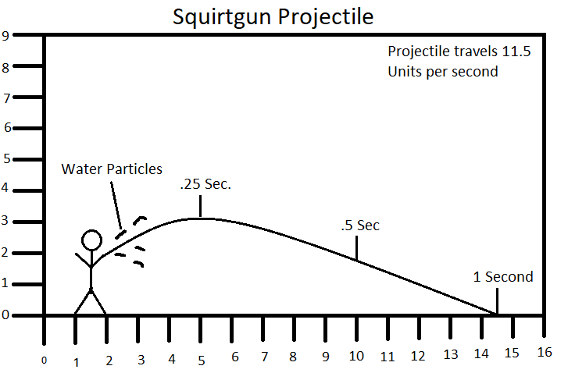
Example of Projectile Behavior

Slide 10
Camera
Final stage will be set in a room with TVs in the background that will be filming the epic battle.
As the battle goes on the TV start breaking down and displaying static
Dialog boxes will use secondary cameras to zoom in on Hero and Bosses’ faces.

Slide 11
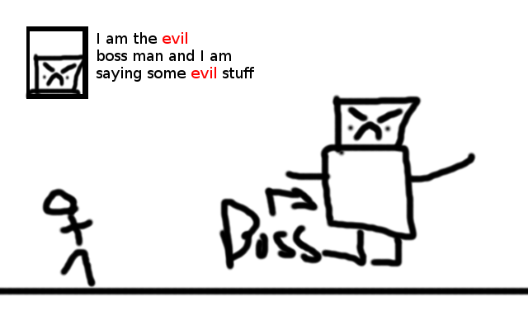
Camera

Slide 12
Physics
Platforming will be handled by rigidbody physics
Water particles & projectiles will be affected by gravity. Particles stop moving and shortly disappear when hitting a rigid body

Slide 13
Game World
Lights
Point lighting: Spotlight follows player around in a dark room for one of the bosses.
Directional lighting: Platforms block light
Spotlights: Boss rooms have spotlights.
Normal Map
Background for each level will implement a normal map made by an auto-generator.

Slide 14
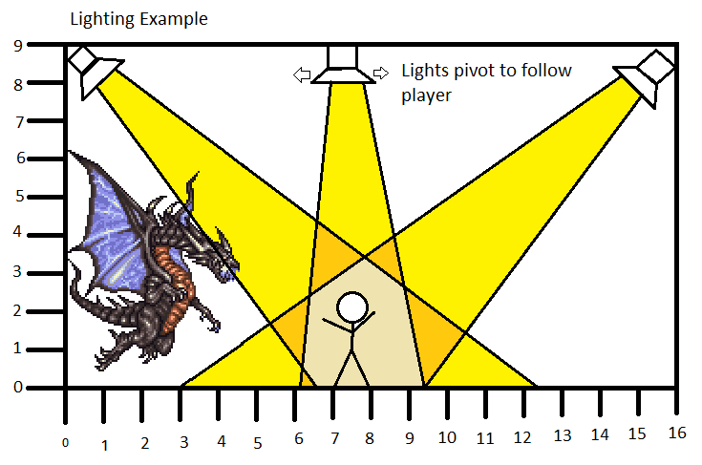
Lighting Example for Boss Room

Slide 15
Particle System
Squirtgun and water balloons produce water particles
Sparks from Robots

Slide 16
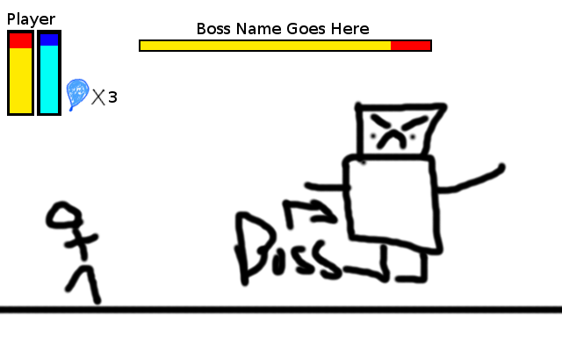
HUD Example

Slide 17
Game systems
Difficulty System
Health and damage multipliers
Scoring System
Combo based multiplier based
Powerup System
Speed Multipliers
Infinite Health, Infinite Water Balloons

Slide 18
How are we going to meet the deadline?
Week 1
Have platforming physics working
Have collision working
Finalize planning documents
Week 2
Implement lighting and particle system
Implement levels and bosses
Week 3
Minor tweaks and debugging
Playtesting

Slide 19
Season Pass!!!1!
Gamestop pre-order exclusive
1 additional level
Cheat codez
MTN DEW XP Boost
$24.99

