Slide 1
To The End
Team name: 404 NOT FOUND(Group 5) Team Members: 赵浩然 葛心泉
常文清 马一宁
电子科技大学 武汉大学 西安交通大学

Slide 2

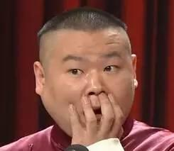
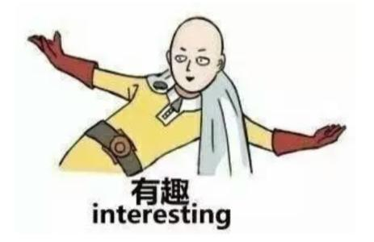
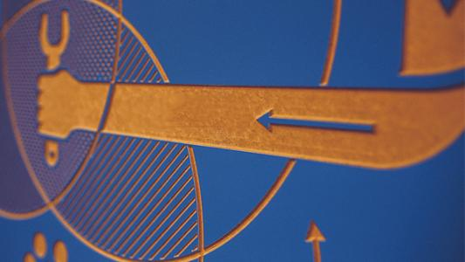
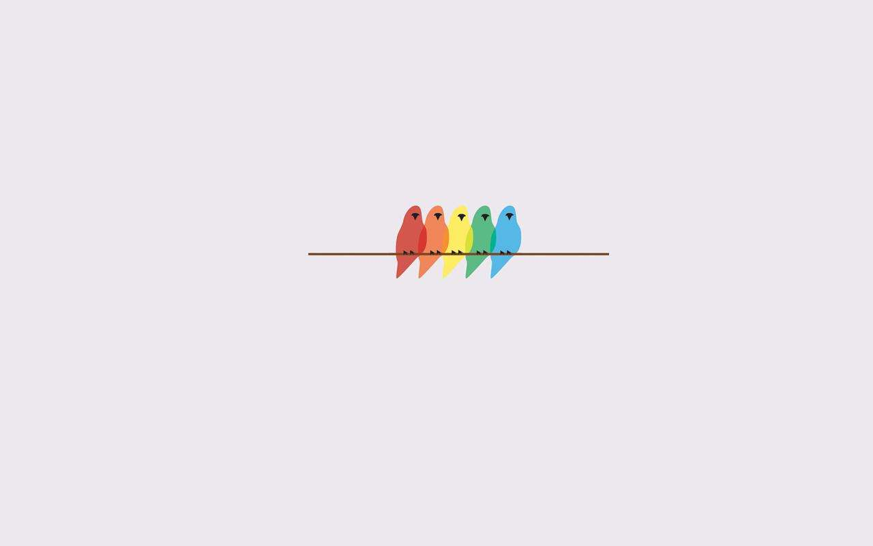
Goal
Interesting
story
Enlightening
process
You might never know the truth until to the end.
You will get the information which helps win from our tips and your experiences.
Simple Style
Unexpected
Adventure
We want to present simple interface to players, which will make them feel comfortable.
Every level has different danger.

Slide 3
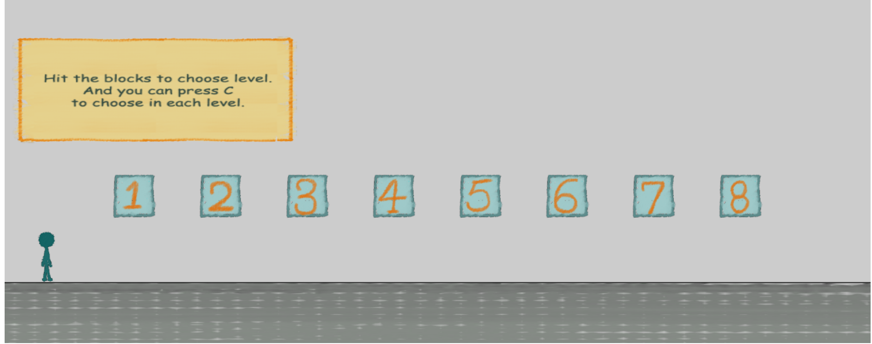
Spirit of the Game
Stay it Simple.
Make it fun.
Make you feel unexpected.

Slide 4
What you should pay attention to
1、关卡选择
2、改进关卡
3、彩蛋
4、新故事
https://solsticeg.github.io/2DGame/

Slide 5
Thanks for watching.
Presented by Group 5

