Slide 1
To The End
Team name: 404 NOT FOUND(Group 5) Team Members: 赵浩然 葛心泉
常文清 马一宁
电子科技大学 武汉大学 西安交通大学

Slide 2
01.
Introduction
02.
Frame
03.
Challenge
Contents
04.
Goal

Slide 3
01.Introduction

Slide 4
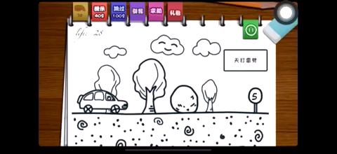
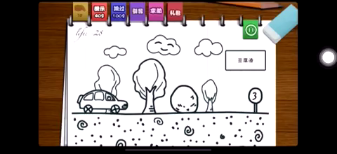
1.1 Spirit of the Game
Make it Simple.
Make it fun and unexpected.

Slide 5
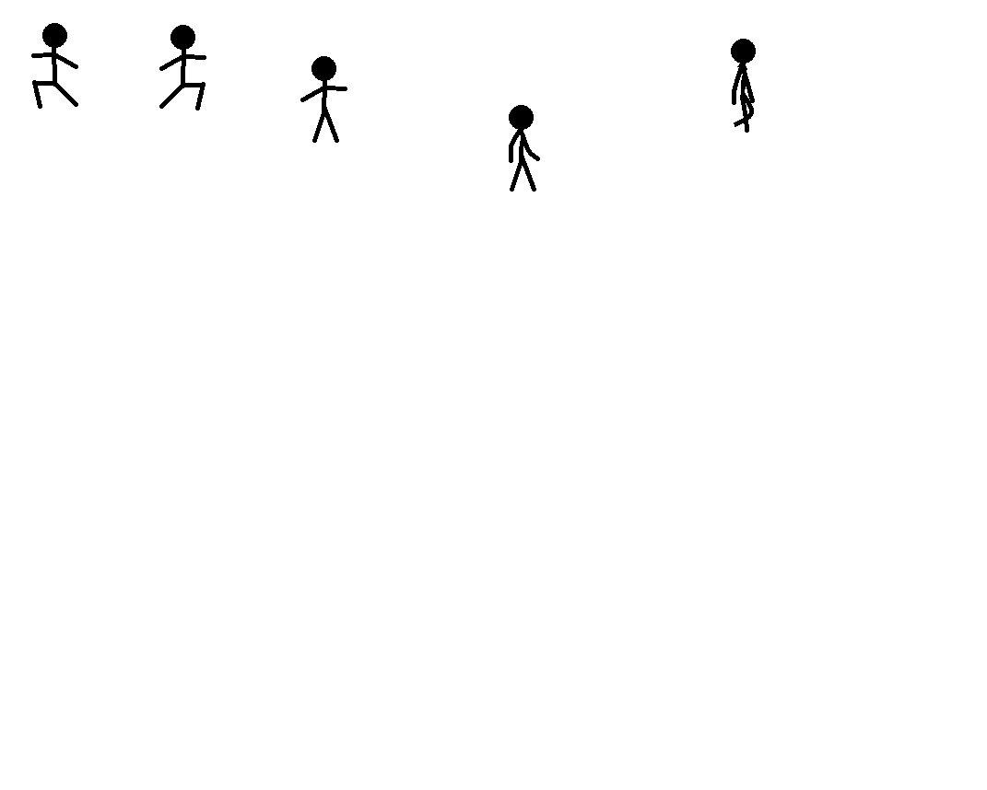
1.2 Character
You are a hero.
You are a hero heading towards the unknown treasure.

Slide 6

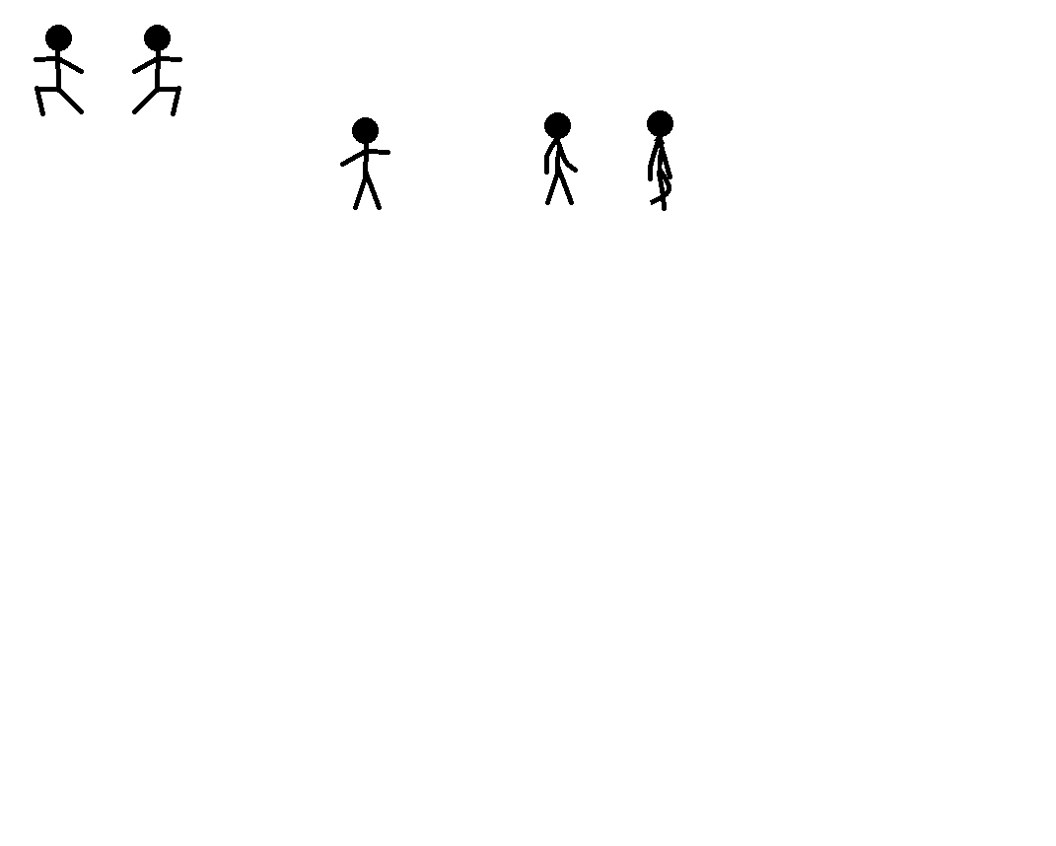
1.3 Control
Mouse
W
A
D
Do as you can
Jump
Go towards the left
Go towards the right

Slide 7

1.4 Logic
WIN
LOSE
When you arrive at the stair with your courage and wisdom, you will be the winner.
There might be traps and other kinds of danger on your way.

Slide 8
02.Frame

Slide 9



2 Components
BACK
GROUND
SCENE
OBJECT
5 LEVELS
SEVERAL SCENES
One Hero
Many Objects(Cloud,Stone,etc)
Enemy or Helper?
Music
Textures

Slide 10
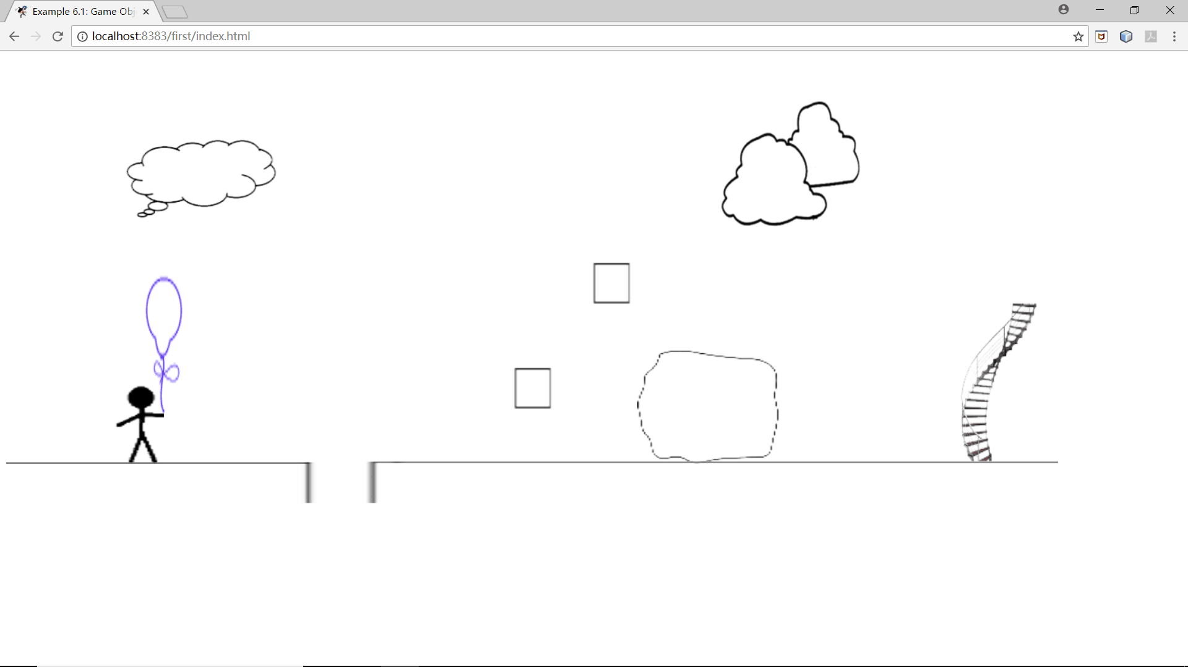

Slide 11
03.Challenge

Slide 12



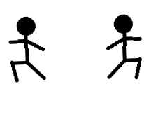
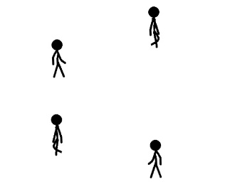

3 Challenges
Animation of Hero
Plot
Interaction
Physics

Slide 13
04.Team Goal

Slide 14

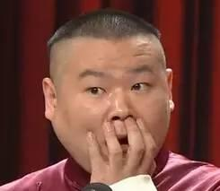
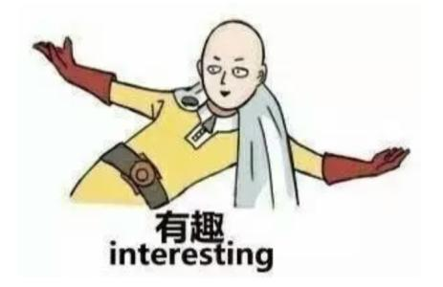


4 Goal
Interesting
story
Enlightening
process
You might never know the truth until to the end.
You will get the information which helps win from our tips and your experiences.
Simple Style
Unexpected
Adventure
We want to present simple interface to players, which will make them feel comfortable.
Every level has different danger.

Slide 15
Thanks for watching.
Presented by Group 5

