Slide 1




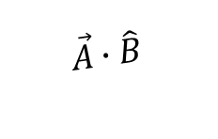

Dot Product: Three properties
$$\vec{A}$$
Projected Distant
$\vec{A}$ not normalized
$\hat{B}$ is normalized
Cosine-theta
Both normalized
Direction (normalization is not important)
$\vec{A}∙\hat{B}$> 0
$\vec{A}∙\hat{B}$< 0
$$\hat{B}$$
$$\vec{A}∙\hat{B}$$
$$\hat{A}$$
$$\hat{B}$$

Slide 2
Intersections With Vectors

Slide 3
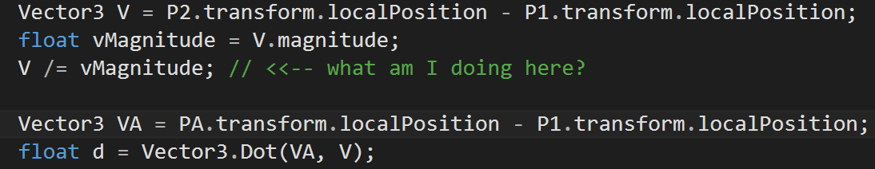
Pt to Line Distance
P2
vMagnitude
V = (P2 – P1).Normalize()
d
h = Closest distance
PA: when d > 0 && d < vMagnitude
P1
VA

Slide 4
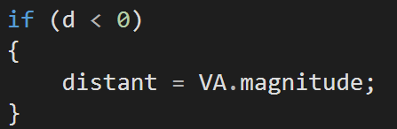
Pt to Line Distance
P2
vMagnitude
V = (P2 – P1).Normalize()
P1
d
Closest distance
VA
PA when d < 0

Slide 5
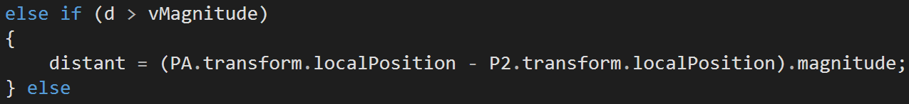
Pt to Line Distance
P2
PA when d > vMagnitude
vMagnitude
h = Closest distance
d
P1

Slide 6
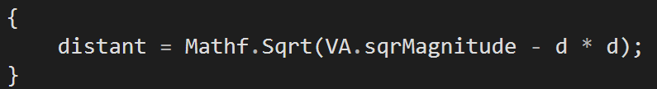
Pt to Line Distance
P2
Projected
Projected = P1 + d * V
d
V = (P2 – P1).Normalize()
PA
P1
VA

Slide 7
NEXT: Line Sphere Intersection

Slide 8
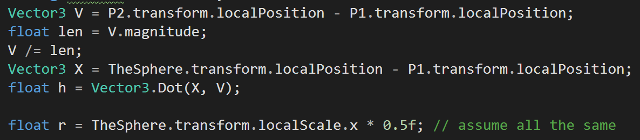
Line Sphere Intersection
P2
len
V = (P2 – P1).Normalize()
h
C: Center of Sphere = transform.localP
r: Radius of Sphere
P1
X

Slide 9
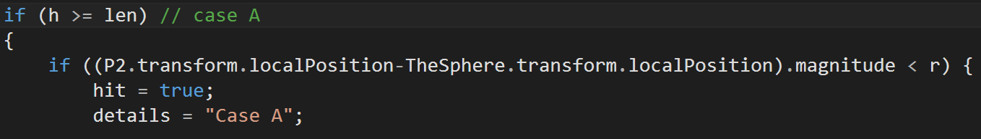
Line Sphere Intersection: Case A
h > len
Greater or less than r?
d
P2
h
len
C: Center of Sphere
r: Radius of Sphere
X
P1

Slide 10
Line Sphere Intersection: Case A
Greater or less than r?
h > len
d
P2
h
C: Center of Sphere
r: Radius of Sphere
len
X
P1

Slide 11
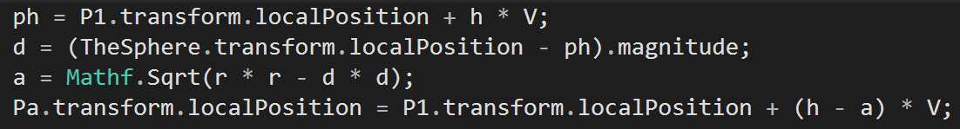
Line Sphere Intersection: Case A
ph = P1 + h * V
Greater or less than r?
h > len
d
P2
h
C: Center of Sphere
r: Radius of Sphere
len
X
P1

Slide 12
Line Sphere Intersection: Case A
ph
Greater or less than r?
h > len
d
P2
h
r
C: Center of Sphere
r: Radius of Sphere
len
X
P1

Slide 13
Line Sphere Intersection: Case A
a = sqrt (r*r – d *d)
ph
Greater or less than r?
h > len
d
P2
h
r
C: Center of Sphere
r: Radius of Sphere
len
X
P1

Slide 14
Line Sphere Intersection: Case A
ph
Greater or less than r?
h > len
a
d
Pa = P1 + (h – a) * V
V = (P2 – P1).Normalize()
P2
h
r
C: Center of Sphere
r: Radius of Sphere
len
X
P1

Slide 15
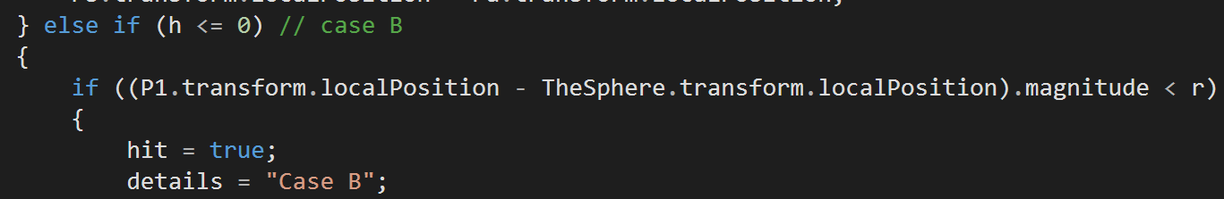
Line Sphere Intersection: Case B
P2
h < 0 (NOTE: h is negative!!)
len
V = (P2 – P1).Normalize()
ǁhǁ
P1
X
Greater or less than r?
d

Slide 16
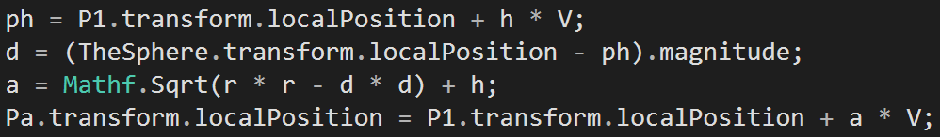
Line Sphere Intersection: Case B
P2
h < 0 (NOTE: h is negative!!)
len
V = (P2 – P1).Normalize()
ǁhǁ
Ph = P1 + h * V
P1
X
Greater or less than r?
d

Slide 17
Line Sphere Intersection: Case B
P2
h < 0 (NOTE: h is negative!!)
len
V = (P2 – P1).Normalize()
a
ǁhǁ
Ph = P1 + h * V
P1
r
X
Greater or less than r?
d

Slide 18
Line Sphere Intersection: Case B
P2
h < 0 (NOTE: h is negative!!)
len
V = (P2 – P1).Normalize()
a
r * r = d * d + (a-h) * (a-h) // h < 0
a - h = sqrt ( r * r – d * d)
a = sqrt ( r * r – d * d) + h
ǁhǁ
Ph = P1 + h * V
P1
r
X
Greater or less than r?
d

Slide 19
Line Sphere Intersection: Case B
P2
h < 0 (NOTE: h is negative!!)
len
V = (P2 – P1).Normalize()
a
ǁhǁ
Ph = P1 + h * V
P1
Pa = P1 + a * V
r
X
Greater or less than r?
d

Slide 20
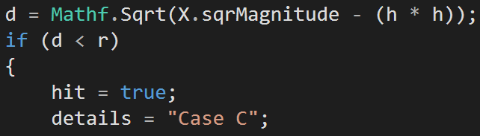
Line Sphere Intersection: Case C
h > 0 && h < len
P2
Greater or less than r?
len
d
h
X
P1

Slide 21
Line Sphere Intersection: Case C
h > 0 && h < len
P2
len
d = sqrt(X.mag * X.mag – h*h)
d
h
X
P1

Slide 22
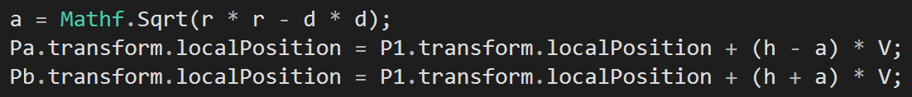
Line Sphere Intersection: Case C
h > 0 && h < len
P2
d = sqrt(X.mag * X.mag – h*h)
d
h
r
r
X
P1

Slide 23
Line Sphere Intersection: Case C
h > 0 && h < len
P2
a
d = sqrt(X.mag * X.mag – h*h)
a
d
h
r
r
X
P1

Slide 24
Line Sphere Intersection: Case C
h > 0 && h < len
a = sqrt(r * r – d * d)
P2
a
d = sqrt(X.mag * X.mag – h*h)
a
d
h
r
r
X
P1

Slide 25
Line Sphere Intersection: Case C
h > 0 && h < len
P2
Pa = P1 + (h + a) * V
a
d = sqrt(X.mag * X.mag – h*h)
a
d
Pa = P1 + (h – a) * V
h
r
r
X
P1

