Slide 1
Overview of Project Active Park Assist 2
Software Engineering CSE435
Michigan State University
Fall 2013
TEAM MEMBERS:
  Project Manager: Will McGee
  Facilitator: Emilio Castillo
  Customer Liason: Claury Mejia
  Configuration Manager: Cameron Rooks
  Security Manager: Yumo Wang
CUSTOMER: EILEEN DAVIDSON - FORD MOTOR COMPANY
INSTRUCTOR: DR. BETTY H.C. CHENG*
*PLEASE DIRECT ALL INQUIRIES TO THE INSTRUCTOR.

Slide 2
Project Overview
Main Functions:
  Remove the need for driver interaction in parking
  Increase safety for the vehicle and others around it
Motivation for project
  Remove human error in parking
  Reduce stress from parking for drivers
  Increase safety
  Integration of autonomous systems in cars

Slide 3
Overview of Features
Fully autonomous parking maneuver
  Perpendicular and Parallel
Automatic parking spot detection
Uses cameras and radar to detect objects
Manual override when needed

Slide 4
Overview of Features (cont.)
Security Features
  Verifies that a driver is present in seat
  Checks that sensor messages are “fresh”
  Validation from driver for selecting a parking spot

Slide 5
Domain Research
Investigated other automatic parking systems
Functional Constraints
  All subsystems must be functional to allow system use
  Driver must be aware of surroundings to effectively use system
  Communication through CAN bus

Slide 6
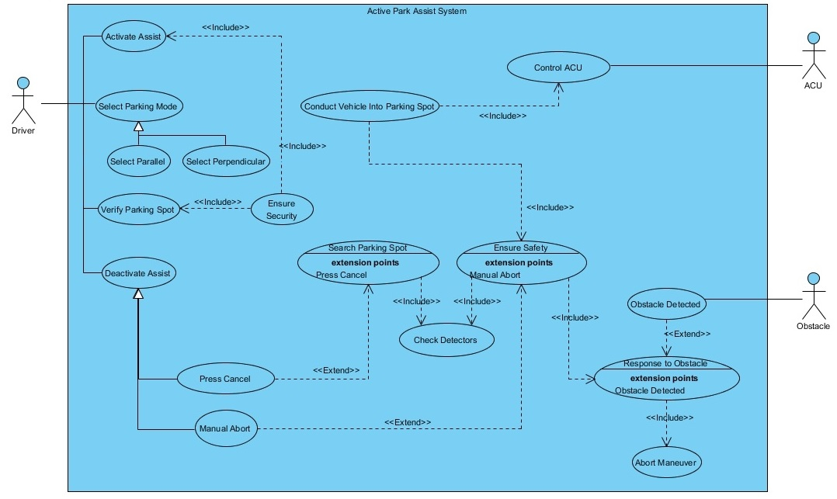
Part II: Use-Case view

Slide 7
Part III: SYNC Display Demo
Scenario 1:
Normal use of the system
Scenario 2:
  Cancel after searching for spots takes too long
Scenario 3:
  Manually aborting a parking maneuver

Slide 8
Acknowledgements
We gratefully acknowledge and appreciate the participation of our customer, Ms. Eileen Davidson from Ford Motor Company
We also would like to thank Dr. Cheng for all the work she did to allow us this opportunity

