Slide 1





Internet & World Wide Web How to Program, 5/e
Copyright © Pearson, Inc. 2013. All Rights Reserved.

Slide 2

Two aspects of any document are content and
style
Content: information to be presented
Style: how the information is presented
HTML's main role is to define content
Defining style: Cascading Style Sheets 3 (CSS3)
Used to specify the presentation of elements separately from the structure of the document.

Slide 3

Separation of content from presentation
Site-wide consistency
Reduce data transfer over a network
Easy to reformat pages for device portability
Better accessibility

Slide 4
CSS validator
jigsaw.w3.org/css-validator/
This tool can help you make sure that your code is correct and will work on CSS3-compliant browsers.

Slide 5

A style sheet is a set of rules.
selector
declaration
p {
background-color: #FFFFFF; width: 100%;
}
property
value

Slide 6

Style Classes
Style-class declarations are preceded by a period (.).
Use attribute class to define a class in HTML

Slide 7

A pseudo class give access to information not declared in the HTML document
Examples: hover, visited (visited links), link (unvisited links)
Complete list of pseudo classes can be found at
http://www.w3schools.com/css/css_pseudo_cl asses.asp

Slide 8






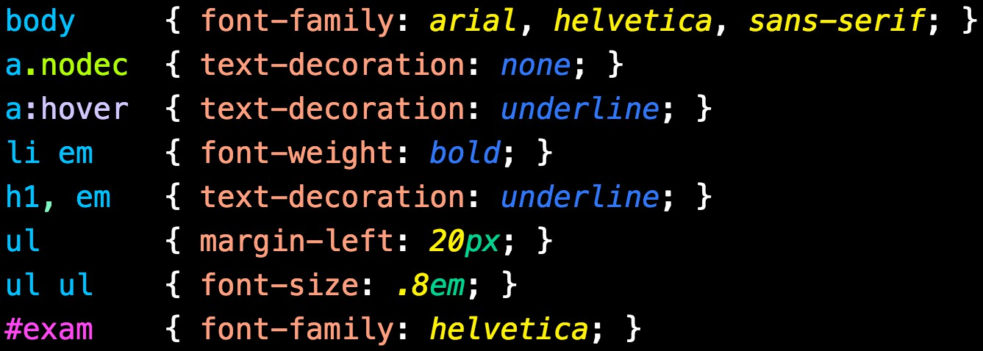

Any body element
Class nodesc under all <a> elements
Pseudo-class hover for all
<a> elements
Child element
<em> of all
<li> elements
All <h1> and
<em> elements
Use IDs for styling purposes? Think Again
Id exam
©1992-2013 by Pearson Education, Inc. All
Rights Reserved.

Slide 9

Most styles defined for parent elements are also
inherited by child (nested) elements.
Styles specified for child elements have higher specificity and take precedence over styles defined for their parent elements
Styles may be defined by an author (us!), a user, or a user agent (browser).
Styles cascade (and hence the term “Cascading Style Sheets”), or flow together, such that the ultimate appearance of elements on a page results from combining styles defined in several ways.
Styles defined by authors take precedence over styles defined by the user.
Styles defined by the user take precedence over styles defined by the user agent.

Slide 10
Inline styles
Styles declared in HTML elements
Only apply to the element where style is declared
Do not truly separate presentation from content
Embedded styles
Styles declared in an HTML document's head section
Apply to the entire HTML document
External styles (preferred)
Styles defined in external style sheets
Apply to all HTML documents on a site

Slide 11

<p style="font-size: 20pt; color:deepskyblue;" > This is an inline-style example.
</p>
Demo:

Slide 12
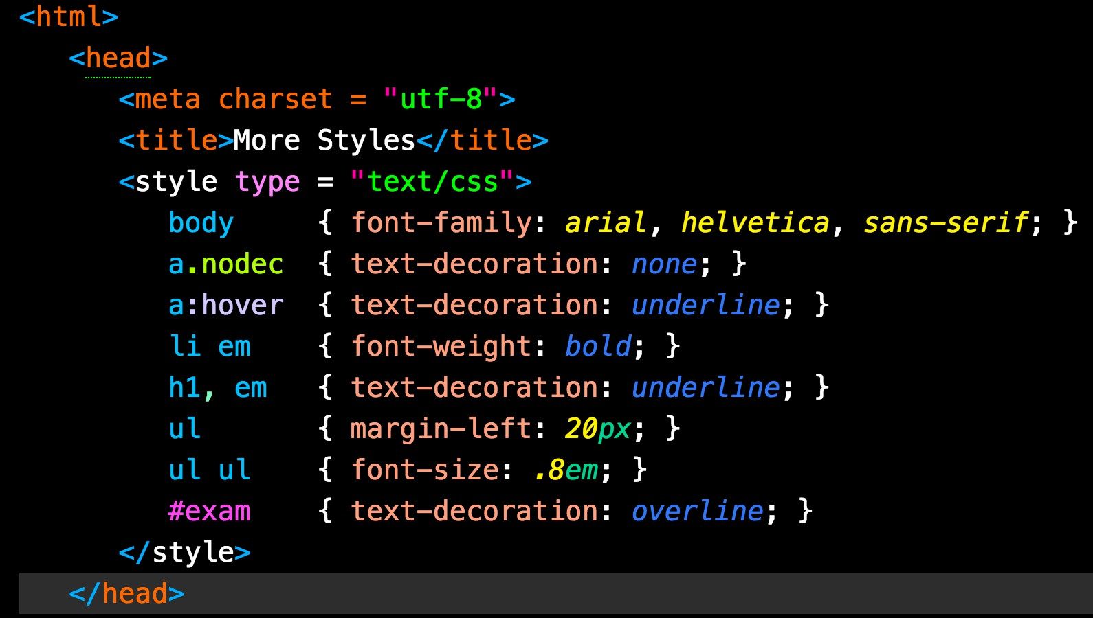
Demo:

Slide 13

<head>
<title>Linking External Style Sheets</title>
<link rel="stylesheets" type="text/css" href="styles.css"
</head>
Demo:

Slide 14

font-weight property specifies the “boldness” of text. Possible values are:
bold
normal (the default)
bolder (bolder than bold text)
lighter (lighter than normal text)
Boldness also can be specified with multiples of 100, from 100 to 900 (e.g., 100, 200, …, 900). Text
specified as normal is equivalent to 400, and bold text is equivalent to 700

Slide 15
font-family Property
font-family property specifies the name of the font to use.
Generic font families allow authors to specify a type of font instead of a specific font, in case a browser does not support a specific font.
Times New Roman is outdated
Use Arial, Helvetica, and Sans-serif

Slide 16
font-size Property
font-size property specifies the size used to render the font.
You can specify a point size or a relative value such as xx-small, x-small, small, smaller, medium, large, larger, x-large and xx-large.
Relative font-size values are preferred over points, because an author does not know the specific measurements of each client’s display.
Relative values permit more flexible viewing of web pages.
For example, users can change font sizes the browser displays for readability.

Slide 17
font-size Property
A point size value is formed by:
an optional + or – followed by a number
followed by a two-letter abbreviation
indicating the unit
(There are no spaces in the middle of thevalue)
Example: p {font-size: 0.4em}
Units include px(pixels), em(size of letter M), ex(size of letter x), in (inch), cm(centimeter)

Slide 18
font-style Property
Allows you to set text to none, italic or
oblique

Slide 19

text-decoration property applies decorations to text in an element
underline overline line-through
blink

Slide 20
color property specifies the color of text
{color:
keyword | #hex hex hex |
#hex hex hex hex hex hex | rgb(int int int) |
rgb(% % %)}
In CSS you can (see above) use three-hex values: "06f" is equal to "0066ff".

Slide 21


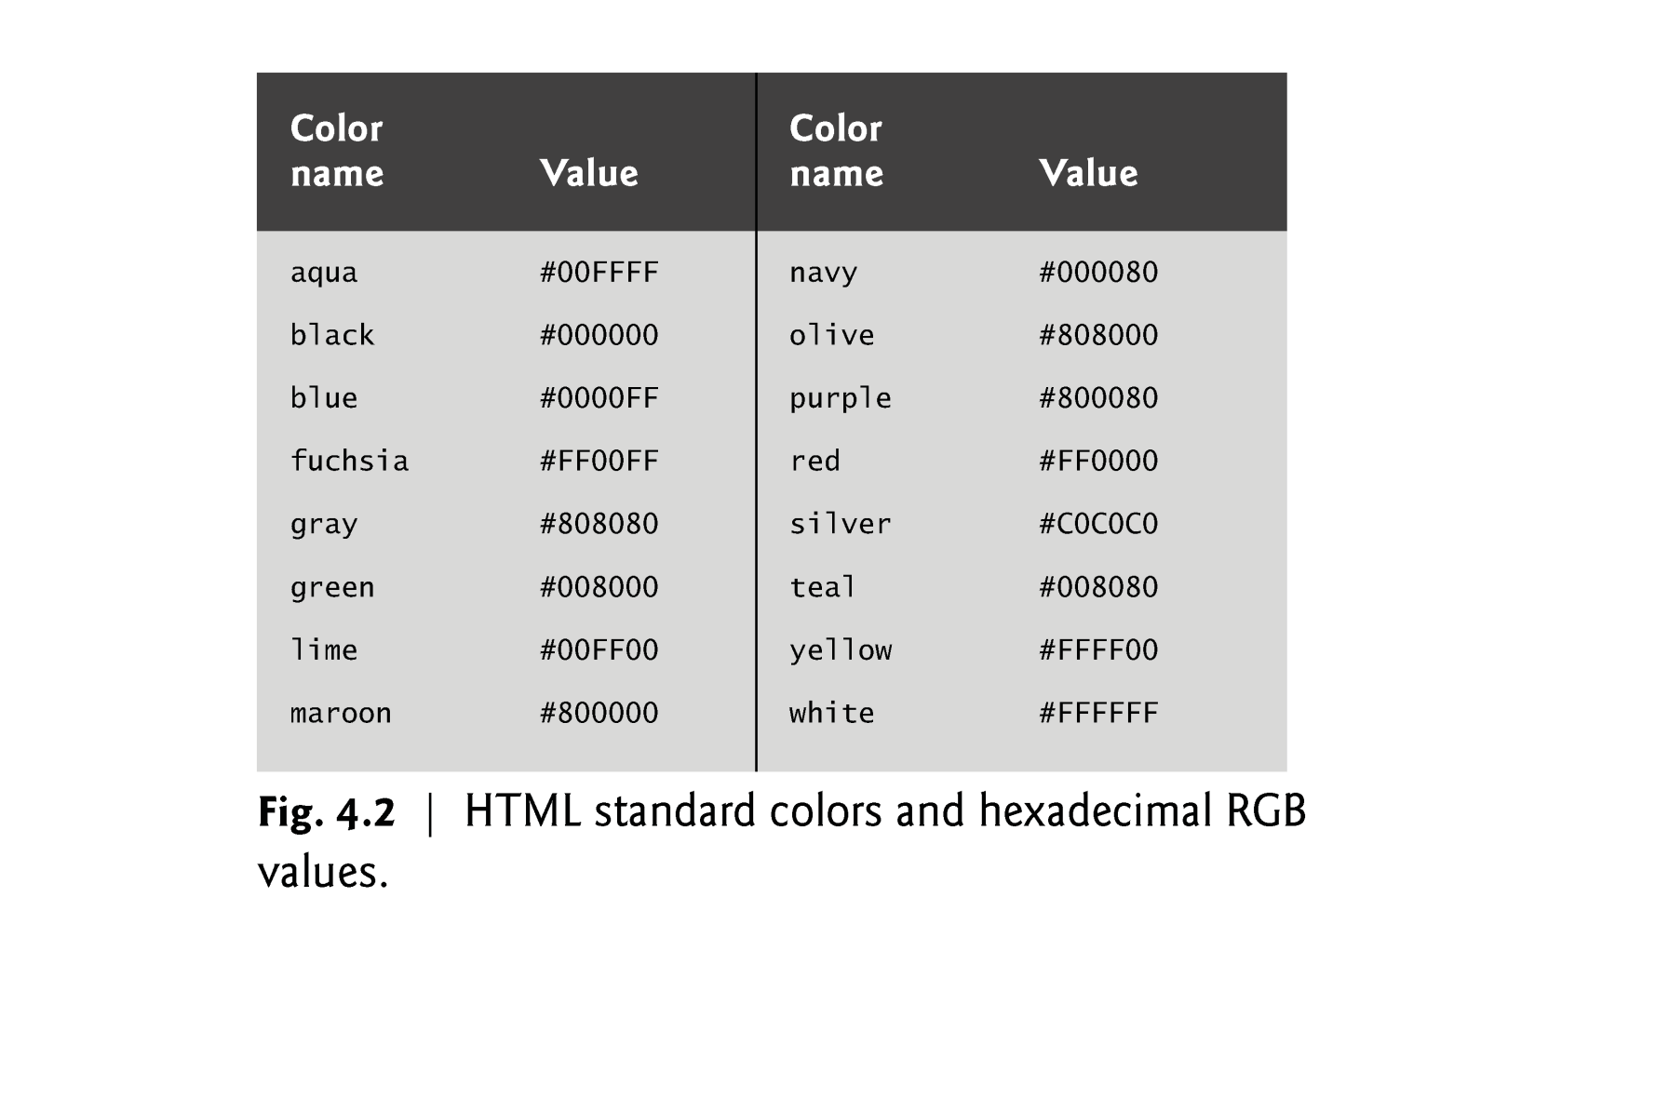



Slide 22
text-align Property
Text in an element can be centered using text-align: center; other values for the text-align property are left and right
text-indent Property
Indents the first line of text in the element by the specified amount

