Slide 1


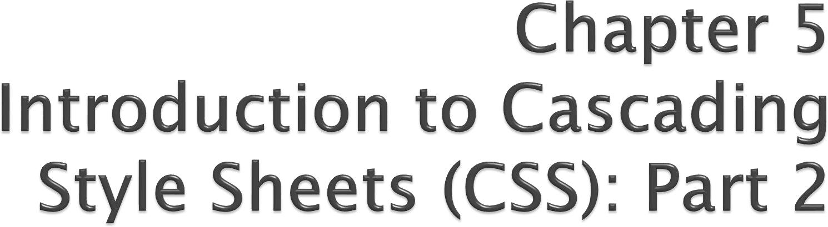

Internet & World Wide Web How to Program, 5/e
Copyright © Pearson, Inc. 2013. All Rights Reserved.

Slide 2

CSS position property
Allows absolute positioning, which provides greater control over where on a page elements reside
Normally, elements are positioned on the page in the order in which they appear in the HTML5 document
Specifying an element’s position as absolute removes it from the normal flow of elements on the page and positions it according to distance from the top, left, right or bottom margin of its parent element

Slide 3
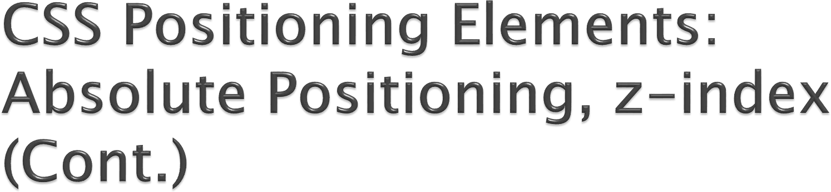
The z-index property allows a developer to layer overlapping elements
Elements that have higher z-index values are displayed in front of elements with lower z- index values

Slide 4

Inline and Block-Level Elements
Inline-level elements
Do not change the flow of the document
Examples:
img
a
em
strong
span
Grouping element
Does not apply any formatting to its contents
Creates a container for CSS rules or id attributes to be applied to a section

Slide 5

Block-level elements
Displayed on their own line
Have virtual boxes around them
Examples:
p
all headings (h1 through h6)
div
A grouping element like span, but
it's block-level

Slide 6

CSS can control the backgrounds of block- level elements by adding:
Background-color
Background-image

Slide 7
background-image Property
Specifies the URL of the image, in the format url(fileLocation)
background-position Property
Places the image on the page using the values top, bottom, center, left and right individually or in combination for vertical and horizontal positioning. You can also position by using lengths

Slide 8
background-repeat Property
background-repeat property controls the tiling of the background image
Setting the tiling to no-repeat displays one copy of
the background image on screen
Setting to repeat (the default) tiles the image vertically and horizontally
Setting to repeat-x tiles the image only horizontally
Setting to repeat-y tile the image only vertically

Slide 9


Slide 10
Block-level HTML5 elements have a virtual box drawn around them based on the box model
When the browser renders an element using the box model, the content is surrounded by padding, a margin and a border.
Padding
The padding property determines the distance between the
content inside an element and the edge of the element
Padding be set for each side of the box by using padding-top, padding-right, padding-left and padding-bottom
Margin
Determines the distance between the element’s edge and any
outside text
Margins for individual sides of an element can be specified by using margin-top, margin-right, margin-left and margin- bottom

Slide 11





Margin (transparent)
border
padding
content
content width

Slide 12

Border
The border is controlled using the properties:
border-width
May be set to any of the CSS lengths or to the predefined value of thin, medium or thick
border-color
Sets the color used for the border
border-style
Options are: none, hidden, dotted, dashed, solid, double, groove, ridge, inset and outset

Slide 13
Floating Elements
Floating allows you to move an element to one side of the screen; other content in the document then flows around the floated element.

Slide 14
margin and padding Properties
The margin property sets the space between the outside of an element’s border and all other content on the page.
The padding property determines the distance between the content inside an element and the inside of the element’s border.
Margins for individual sides of an element can be specified by using the properties margin-top, margin-right, margin-left and margin-bottom.
Padding can be specified in the same way, using padding-top, padding-right, padding-left and padding-bottom.

Slide 16
:hover pseudoclass
used to apply styles to an element when the mouse cursor is over it
display property
allows a programmer to decide if an element is displayed as a block element, inline element, or is not rendered at all (none)

Slide 17
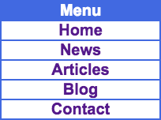

Slide 18

CSS text-shadow property
Adds a text shadow effect to any text
The property has 4 values: horizontal and vertical
offsets of the shadow, blur radius, and color
Example:
h1 {text-shadow: -4px 4px 6px dimgrey;}

Slide 19

CSS box-shadow property
Adds a shadow effect to any block-level element
The property has 4 values: horizontal and vertical
offsets of the shadow, blur radius, and color
Example:
h1 {box-shadow: 25px 25px 50px dimgrey;}

Slide 21

CSS animation property: allows animation of most HTML elements without using JavaScript or Flash
Syntax:
{animation: name timing-function duration delay iteration- count direction;}
name: name of the animation
timing-function: type of animation (linear, ease, ease-in, ease-out, ease-in-out, cubic-bezler, etc.)
duration: time for one iteration
delay: time after the page loads and before animation begins iteration-count: number of times animation runs (a number or infinite)
direction: animation direction (normal, alternate, etc.)

Slide 22


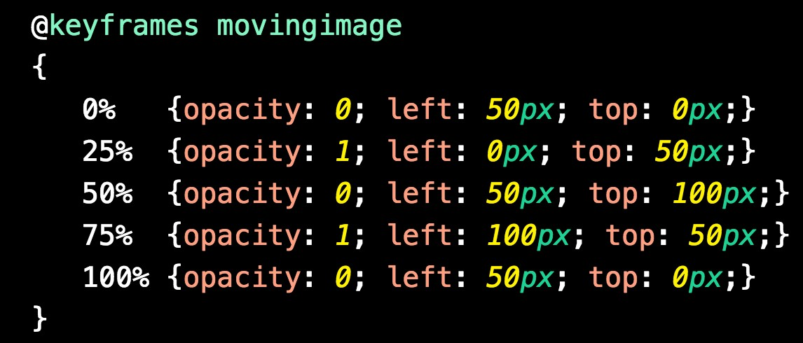
Also need to define a CSS @keyframe rule for
an animation
Example:
Animation name

Slide 23
Some CSS extensions only work with specific browsers
Extensions with prefix –webkit only work
with
webkit based browsers, such as Chrome, Safari, android and
IOS browsers
Extensions with prefix Mozilla Firefox | –moz | only | work | with
Extensions with prefex Microsoft browsers | –ms | only | work | with
Other extensions exist

Slide 24

