Slide 1




Internet & World Wide Web How to Program, 5/e

Slide 2

XML (eXtensible Markup Language) is a portable, widely supported, open (i.e., nonproprietary) technology for data storage and exchange
Extensible: XML permits document authors to create markup for virtually any type of information
Can create entirely new markup languages that describe specific types of data, including mathematical formulas, chemical molecular structures, music and recipes
©1992-2012 by Pearson Education, Inc.
All Rights Reserved.
2

Slide 3

XML describes data in a way that human beings can understand and computers can process.
An XML parser (e.g., a browser or your web application) is responsible for identifying components of XML documents and then storing those components in a data structure for manipulation
If an XML parser can process an XML document successfully, that XML document is well-formed
©1992-2012 by Pearson Education, Inc.
All Rights Reserved.
2

Slide 4

XML allows us to define our own nodes and tags for elements
Type of data
Data structure
Tools available to interchange data between databases and XML
XML provides ways to search and manipulate data
©1992-2012 by Pearson Education, Inc.
All Rights Reserved.
2

Slide 5

An XML document begins with an optional XML declaration, which identifies the document as an XML document and the version of XML syntax used in the document.
XML comments begin with <!-- and end with -->
An XML document contains text that represents its content (i.e., data) and elements that specify its structure. XML documents delimit an element with start and end tags (case sensitive!)
The root element of an XML document encompasses all its other elements
XML element names must begin with a letter, and they should not begin with “xml” in any combination of uppercase and lowercase letters, as this is reserved for use in the XML standards
©1992-2012 by Pearson Education, Inc.
All Rights Reserved.
2

Slide 6

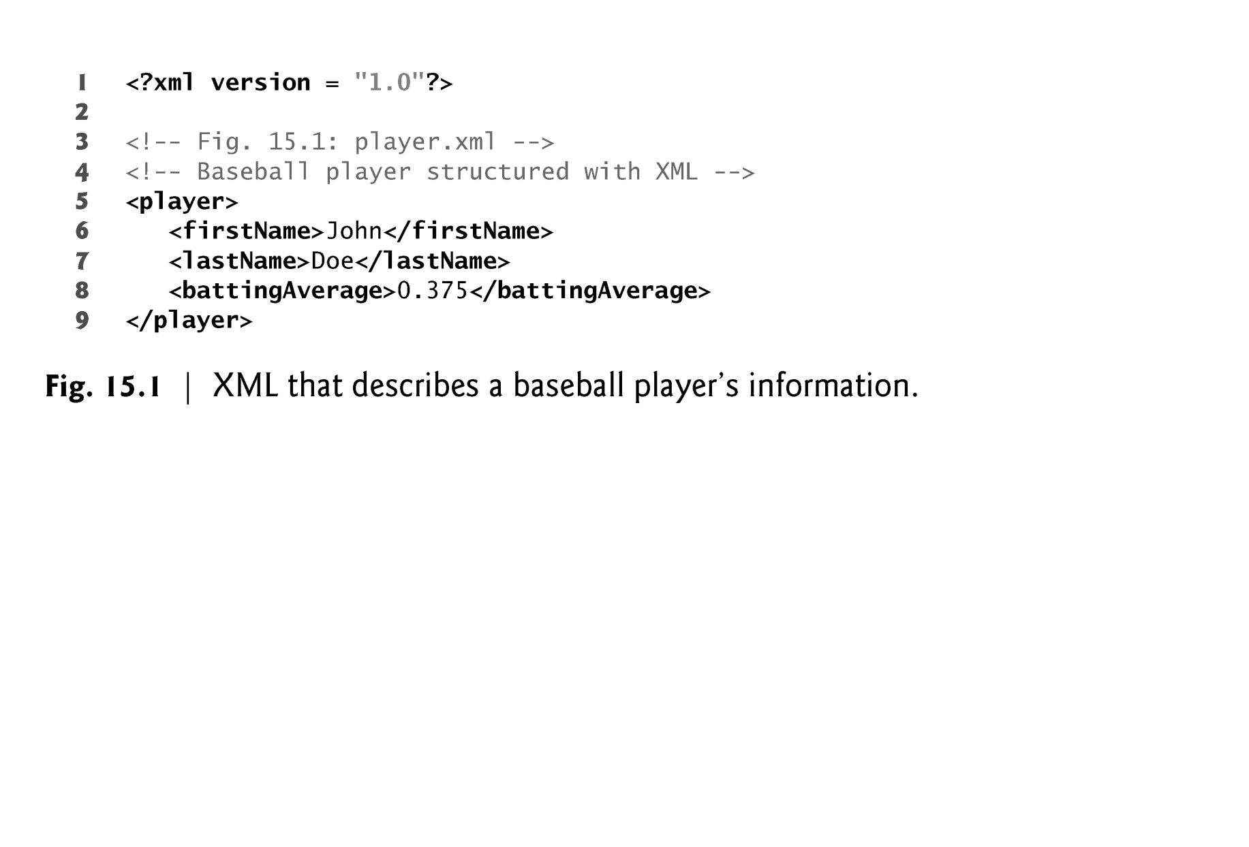


©1992-2012 by Pearson Education, Inc. All
Rights Reserved.
6

Slide 7
Both HTML and XML are specified in the Document Object Model (DOM)
DOM has a hierarchical tree structure
The top level is the document object
Each element name is represented by a node
A node that contains other nodes is called a parent node
A parent node can have many children, but a child node can have only one parent node
Nodes that are peers are called sibling nodes
A node’s descendant nodes include its children, its children’s children and so on
A node’s ancestor nodes include its parent, its parent’s parent and so on
©1992-2012 by Pearson Education, Inc.
All Rights Reserved.
7

Slide 8
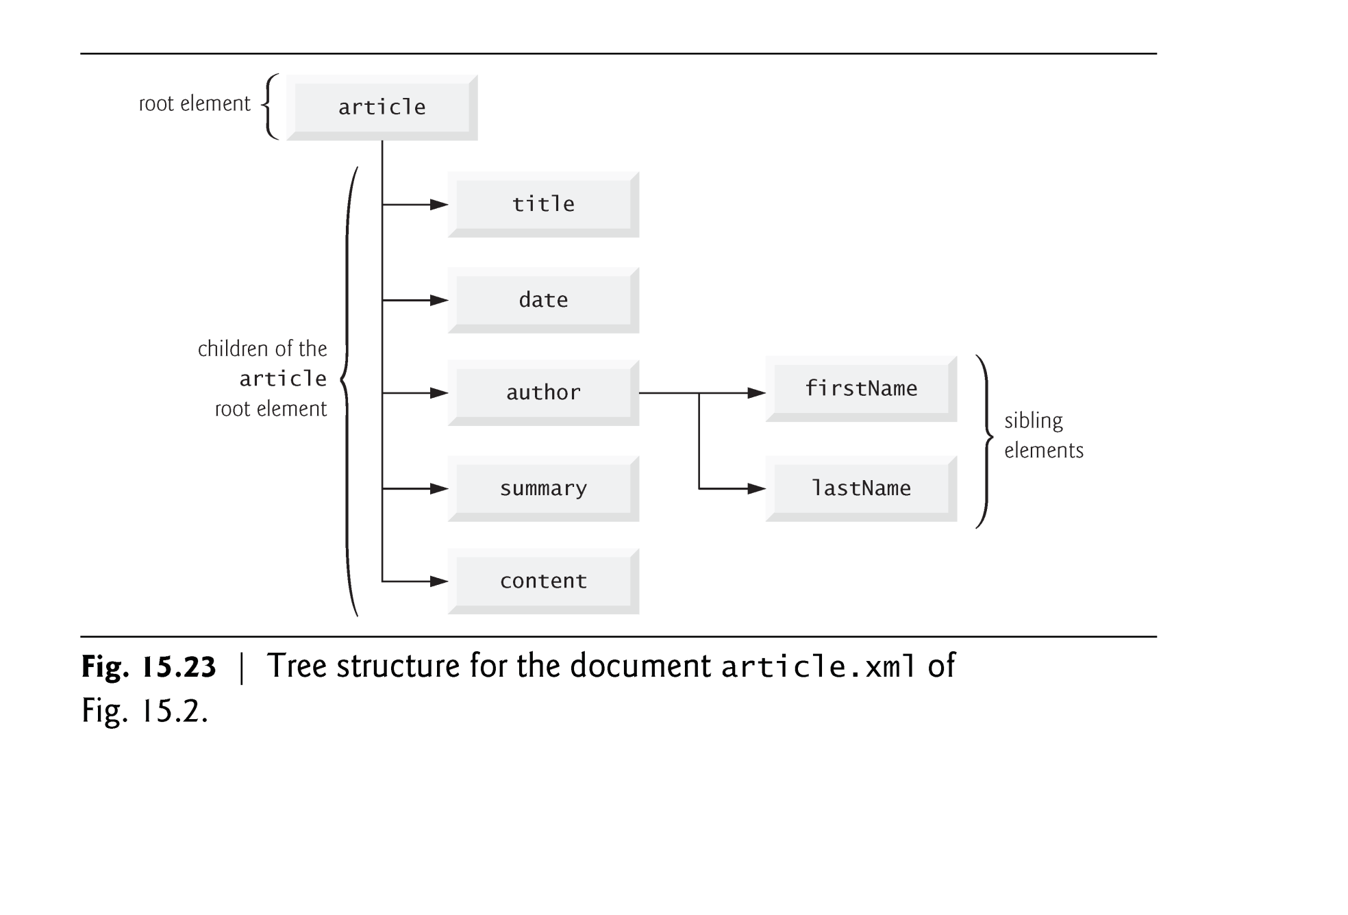
©1992-2012 by Pearson Education, Inc. All
Rights Reserved.
8

Slide 9

DOM is an internal map of the HTML/XML document
E.g., the root element of an HTML document object is <HTML>
It allows us to access or manipulate a document's elements when writing programs (e.g., Javascript)
©1992-2012 by Pearson Education, Inc.
All Rights Reserved.
9

Slide 10



Introduction to JavaScript

Slide 11
Why JavaScript?
Adds interactivity and visual enhancement
Mainly used for client-side execution
Processing client requests that do not require server processing
No Internet traffic
Cons
The client may not have enough processing resources
JavaScript can be turned off for security reasons

Slide 12
Origins…
Scripting language developed by Netscape – Mocha, LiveScript
Netscape and Sun collaborate –
JavaScript (1995)
Microsoft creates Jscript (1996)
ECMAScript is now the "standard"
European Computer Manufacturing Association

Slide 13
(JavaScript is not JAVA)
No graphical user interface
No read/write file access on clients
Not a class-based object model
No multithreading
Do not need the Java Virtual Machine (needs a browser)

Slide 14
What JavaScript can do
Client-side:
Control browser features
Modify document appearance
Modify document content
Store & use information about user
Manipulate images
React to state of browser and client system
More

Slide 15
When to Use JavaScript
CSS:
Hover and focus events
Image swaps
Basic animation
Drop-down menus
JavaScript
Visual enhancement that CSS can't do
Advanced animation

Slide 16
Where Does One’s JavaScript
Code Go?
Two general scenarios …

Slide 17
1. Embedding JavaScript in
HTML
<head>
<title>JavaScript template</title>
<script type=“text/javascript”>
// JavaScript code goes here
</script>
</head>
Actually,
JavaScript code can be inserted anywhere in the HTML, including in the body.
There are no limits on how many <script> tags can be embedded in the HTML code of a web page.
<body>
…

Slide 18
2. Putting the JavaScript in its
Own File
<head>
<title>Client-side input validation</title>
<script src="inputValidator.js" type="text/javascript"></script>
</head>
Attributes: src -
Specify URL of external code source.
type -
specifies scripting language ("text/javascript")
This is the best way for code reuse.

Slide 19
Development Environment
Text editor or HTML editor to do editing
Browser to run and debug code
Open the developer's tools under the browser's settings or preferences
Use the JavaScript console to test your code

Slide 20
Demo 1
As shown above:
Embedded (in <head>):
Separate (external) JavaScript file:
But, can have embedded elsewhere:
Embedded (in <body>):

Slide 21



The Language

Slide 22
Variables
Valid variable names
Consist of letters, digits, underscores, and dollar signs
Do not begin with a digit
Not a reserved JavaScript keyword
JavaScript is case sensitive
A var statement example: var varName=1;

Slide 23
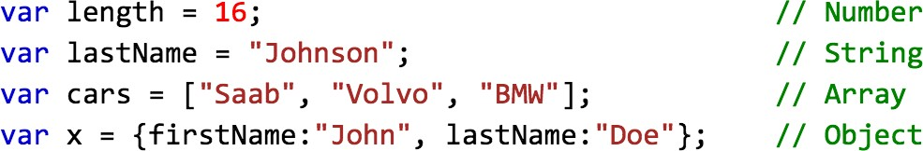
Dynamic Types
JavaScript variables have dynamic data types

Slide 24
Arithmetic Operators…
+
addition subtraction multiplication division
modulus (remainder)
increment decrement
-
*
/
%
++
--

Slide 25
Example:
var a=10; b = a++; b = ++a; b = a--;
b = --a;
(b=10, a=11) (b=11, a=11) (b=10, a=9) (b=9, a=9)

Slide 26
Comparison Operators…
Meaning | JavaScript | Example…
equal | == | (x==y)
strict equal | === | (x===y)
not equal | != | (x!=y)
strict not equal | !== | (x!==y)
greater than | > | (x>y)
(or equal) | >= | (x>=y)
less than | < | (x<y)
(or equal) | <= | (x<=y)

Slide 27
Example:
var a = 3; var b = "3";
var c = (a==b); var d = (a===b);
(c=true) (d=false)

Slide 28
Logical Operators…
Meaning | JavaScript | Example…
And | && | (A<B) && (C>D)
Or | || | (A<B) || (C>D)
Not | ! | !(E>F)

Slide 29
Assignment Operators…
JavaScript | Example | Same As
= | x=y | x=y
+= | x+=y | x=x+y
-= | x-=y | x=x-y
*= | x*=y | x=x*y
/= | x/=y | x=x/y

Slide 30
Comment Tags
// JavaScript comment
/*
Multiple line JavaScript comment
*/
<!-- HTML comment -->
<!--
Multiple line HTML comment
-->

Slide 31
String Operators
String concatenation (+) Ex.: x = "hello " + "world"
x = "hello" + 5 x = "5" + 5
x = Number("5") + 5
(x="hello world") (x="hello5")
(x="55") (x=10)

Slide 32
Work with Strings
var x="Virginia Tech" var y=x.length (y=13)
y=x.indexOf("i") (y=1) //counts from 0 y=x.lastIndexOf("i") (y=6)
var z=x.substring(9,13) (z="Tech") z=x.substr(9,4) (z="Tech")
z=x.toUpperCase() (z="VIRGINIA TECH") z=x.toLowerCase() (z="virginia tech") Link to other string methods

Slide 33
Date and Time
var a = new Date();
Date methods:
getHours
getDay
getDate
getMinutes
getMonth
getFullYear
//current date and time
//0-23
//0-6
//1-31
//0-59
//0-11
//yyyy

Slide 34
Control structures:
Conditions
if (condition) {
// area when condition is true
}
else {
// area when condition is false
};

Slide 35
Control structures:
Conditions
switch (expression) { case n;
// code when case is true break;
…
default:
// default code break;
};

Slide 36
Control structures:
Loop
while (condition)
{
// loop code goes here
};

Slide 37
Control structures:
Loop
do
{
// loop code goes here
} while (condition);

Slide 38
Control structures:
Loop
for(statement 1; condition; statement 2){
// loop code goes here
};
Example:
for (i=0; i<5; i++) {
…
};

Slide 39
Input/Output in JavaScript
(Limited because of security)
Output
window.alert() - popup message box
document.writeln() or document.write()
Input
window.prompt() - input box
confirm() - ok/cancel box
Debug
console.log()
Console.error()

Slide 40
Demo 2
Write JavaScript code to greet the user based on the current time

Slide 41
Demo 3
Write JavaScript code to calculate and print the sum of the integers from 1 to 10

Slide 42
Demo 4
Write JavaScript code to get student grades from the user, calculate the GPA for the class, and display the GPA

