Slide 1



JavaScript: Functions, Arrays,
Objects, and Events
1

Slide 2
JavaScript Functions
Built-in functions
JavaScript provides several objects that have a rich collection of methods for performing common math calculations, string manipulations, date and time manipulations, and manipulations of collections of data called arrays
Programmer defined functions
You can define programmer-defined functions that perform specific tasks
2

Slide 3
Programmer Defined Function
template
function name (parameters, if any) {
// function code goes here
}
3

Slide 4
Three ways to return control to the point at which a function was invoked
Reaching the function-ending right brace
Executing the statement return;
Executing the statement “return expression;” to return the value of expression to the caller
4

Slide 5
Functions are Objects
A function can be considered as an object and referenced by a variable
e.g., var obj = function(){
console.log("Hello");};
A function without a name is an anonymous function
A function can be used as an argument to another function
e.g., window.setTimeOut(obj, 5000);
5

Slide 6
Demo 1: Functions
Define a function that takes a person's height and weight and calculates the BMI.
6

Slide 7
Arrays
An array is a group of variables that have the same name and normally are of the same type
Each individual location is called an element
We may refer to any one of these elements by giving the array’s name followed by the position number of the element in square brackets ([])
7

Slide 8
Arrays (Cont.)
The first element in every array is the zeroth element.
The ith element of array c is referred to as
c[i-1].
Every array in JavaScript knows its own length, which it stores in its length attribute and can be found with the expression arrayname.length
8

Slide 9
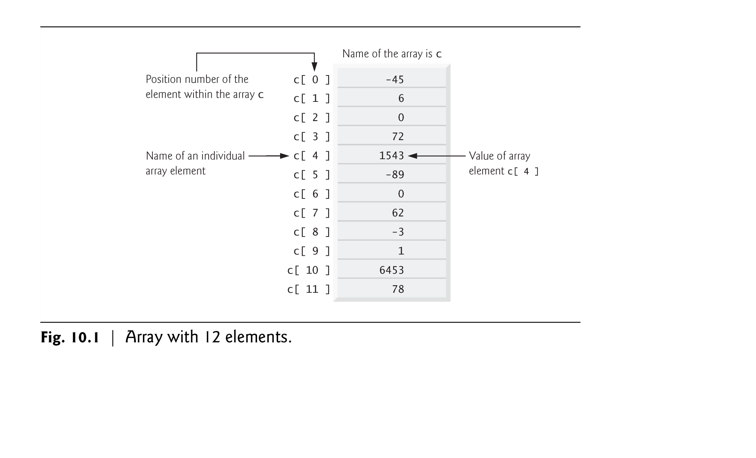
9

Slide 10
Declaring and Allocating
Arrays
JavaScript arrays are Array objects.
You use the new operator to create an array and to specify the number of elements in an array.
E.g., var n1= new Array(3); var n3 = new Array();
var n2 = ["Ford", "Toyota", "Honda"];
10

Slide 11
Array Methods
push(): adds new element to the end of array
pop(): removes last element in array and returns the removed element
shift(): removes first element in array and returns the removed element
concat(): concatenates two arrays into one
sort(): sorts an array
indexOf(): search array for an element and returns its position index
11

Slide 12
Examples:
var nums = [5, 3, 6, 2];
nums.push(1); console.log(nums); console.log(nums.pop()); console.log(nums); console.log(nums.shift());
//[5,3,6,2,1]
//1
//[5,3,6,2]
//5
console.log(nums); //[3,6,2] console.log(nums.concat([3,5])); //[3,6,2,3,5] console.log(nums.sort()); //[2,3,6] console.log(nums.indexOf(6)); //2

Slide 13
Events
JavaScript events
allow scripts to respond to user interactions and modify the page accordingly
Events and event handling
help make web applications more dynamic and interactive

Slide 14
The load Event
The window object’s load event fires when the window finishes loading successfully
i.e., all its children are loaded and all external files
referenced by the page are loaded
Different from the Form.Load event in VB.NET!
Every DOM element has a load event, but it’s most commonly used on the window object.

Slide 15
The load Event (Cont.)
An event handler is a function that responds to an event.
Assigning an event handler to an event on a DOM node is called registering an event handler
Method addEventListener can be called multiple times on a DOM node to register more than one event-handling method for an event.
If a script in the head attempts to get a DOM node for an HTML element in the body, getElementById returns null because the body has not yet loaded

Slide 16
The load Event (Cont.)
Two old models for registering event handlers
Inline model treats events as attributes of HTML elements
Traditional model assigns the name of the function to the event property of a DOM node
The inline model places calls to JavaScript functions directly in HTML code.
The following code indicates that JavaScript function start
should be called when the body element loads:
<body onload = "start()">
The traditional model uses a property of an object to specify an
event handler.
The following JavaScript code indicates that function start should be called when document loads:
document.onload = "start()";

Slide 17
Rollovers with mouseover and
mouseout
When the mouse cursor enters an element, an
mouseover event occurs for that element
When the mouse cursor leaves the element, a
mouseout event occurs for that element
Note: If CSS can do these, leave them to CSS

Slide 18
The Window Object
The window object represents an open window in a browser
If a document contains frames (<iframe> tag), there is a window object for the HTML document, and one additional window for each frame

Slide 19
Window Methods
alert(): display an alert message and an OK butotn
setTimeout(): call a function a specified number of miliseconds
setInterval(): call a function at the specified interval in miliseconds
Complete window properties and methods can be found here

Slide 20
Document Object
The root of an HTML document
Methods:
getElementById(): returns the value of the element at the specified id
writeln(): writes a line of output to the document (adds a new line at the end)
write(): writes output to the document
Will talk about more this object in DOM

Slide 21
Demo 2: load, mouseover,
mouseout, click

Slide 22
Demo 3: A running clock

